Slide 1
Spanish GCSE Therapy 2018
Foundation Writing

Slide 2
I can write sentences about a photograph.

Slide 3
“Marks in this question are for communication only […] The students who were most successful in this question were those who used simple language, usually with a verb like hay or veo, followed by something they could see in the photo.” AQA GCSE Spanish Report on the Examination. June 2018
Q1 Photo

Slide 4
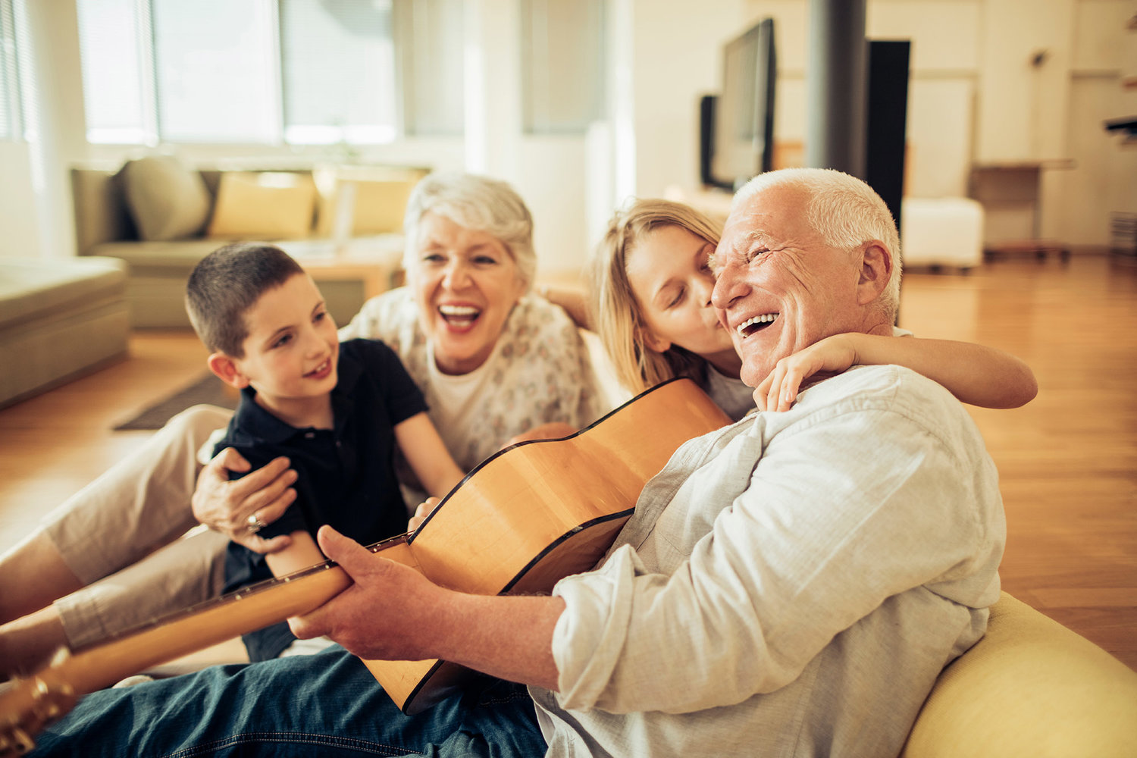
Select the four sentences that relate to something in the photo:
Your sentences must relate to something in the photo.
La foto es en color.
Hay una familia.
No veo un perro.
Veo un sofá.
Hay una guitarra.
Me gusta la foto.
Me gusta la guitarra.
Me gusta mi hermano.

Slide 5
Select the four sentences that relate to something in the photo:
Your sentences must relate to something in the photo.
La foto es en color.
Hay una familia.
No veo un perro.
Veo un sofá.
Hay una guitarra.
Me gusta la foto.
Me gusta la guitarra.
Me gusta mi hermano.

Slide 6
Add a verb to these sentences:
“Include a verb, but keep the sentences short.”
Una familia.
Un niño.
Una guitarra.
El abuelo.
Contento.
Un sofá.
Un salón.

Slide 7
Add a verb to these sentences:
“Include a verb, but keep the sentences short.”
Veo/Hay – una familia.
Veo/Hay – un niño.
Veo – una guitarra.
El abuelo – toca la guitarra.
El niño está – contento.
Veo/hay – un sofá.
Está en – un salón.

Slide 8
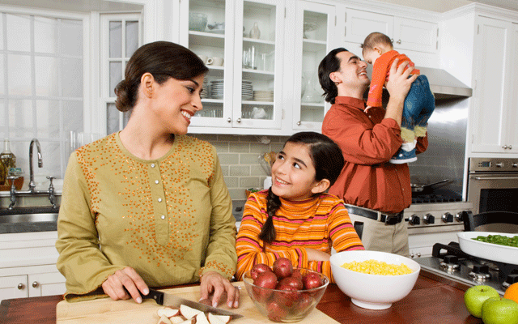
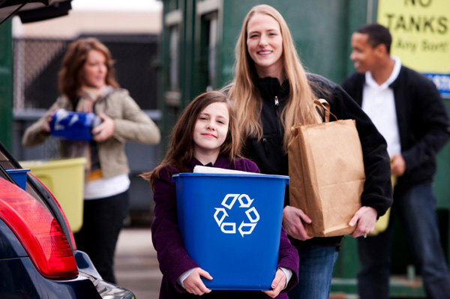
Write four sentences for each of these photos. Remember:
Your sentences must relate to something in the photo.
Include a verb, but keep the sentences short.

Slide 9
Mini-test
What type of sentence works best in the photo question?
What do all sentences need to have?
What is a good sentence starter for this question?

Slide 10
Commissioned by The PiXL Club Ltd.
This resource is strictly for the use of member schools for as long as they remain members of The PiXL Club. It may not be copied, sold, or transferred to a third party or used by the school after membership ceases. Until such time it may be freely used within the member school.
All opinions and contributions are those of the authors. The contents of this resource are not connected with, or endorsed by, any other company, organisation or institution. These papers were made by teachers in good faith based upon our understanding to date.
PiXL Club Ltd endeavour to trace and contact copyright owners. If there are any inadvertent omissions or errors in the acknowledgements or usage, this is unintended and PiXL will remedy these on written notification.

