Slide 1
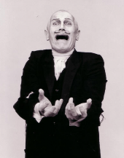
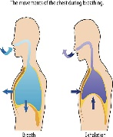
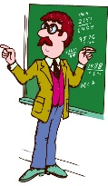
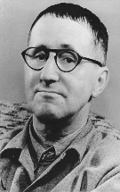
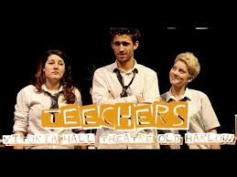
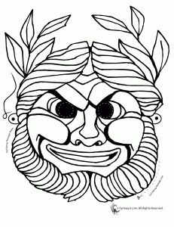
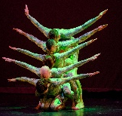
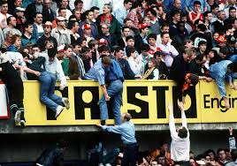
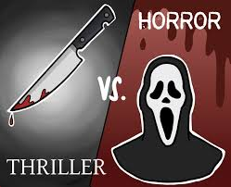
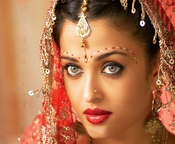
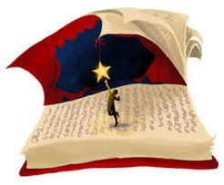
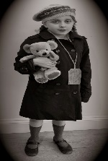
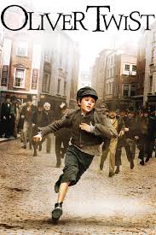
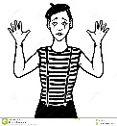
Virtues
Cross Curricular Links
Knowledge
Subject Specific Skills
Underlined = Deeper development of earlier skills / knowledge
Drama Learning Journey
Question: Is it important to stay true to a playwright’s intention?
Component 2 - Understanding Drama – performing two extracts from the same text.
Attentiveness
Self control
Reflection
Confidence
Progression to next stage of learning:
A Level Drama & Theatre
BTEC Performing Arts
Performing Arts Colleges
Scripted Performance
Hard To Swallow
11
Science
Breathing
Y8
Playwright intentions, deconstructing text, Mark Wheeller, Social & Historical context
Set & Staging
Costume
Lighting
Sound
Question: How can you explore the role of designer, actor, director for performance?
C3 study of text
Question: Whose style is it anyway?
Component 2 intro to devising – workshop practitioner’s style
Proxemics
Staging
Narration
Mime
Lighting
Sound
Honesty
Kindness
Forgiveness
Question: How can we devise a piece of original drama from stimuli?
Component 1 Study of Text
Devising
Drama
10
Devising Drama / portfolio / evaluation
Courage
Curiosity
Respect
Play
Brecht, Stanislavski,
Berkoff, Artaud,
Frantic Assembly, Kneehigh
Question: What makes good theatre?
Students will explore a range of stimuli & use their knowledge of performance styles, genre & form to devise a piece of theatre Component 2
Question: Does
an actor
have to have experienced
the same
emotions as a
character to give
a believable performance
Practitioners
Direct Address
Narration, Multi Role
Question: What type theatre is more powerful, naturalistic or non-naturalistic? Explore a range of performance styles including Brecht, Artaud, Physical Theatre
Attentiveness
Self control
Reflection
Confidence
Crime and Gang Culture
DNA
Science
Breathing
Y8
Curious
Incident
Reflection
Kindness
Hope
Confidence,
Play
Sense of humour
PSHE
Mental Health Y8
History - Weimar & Nazi Germany
John Godber,
Episodic Structure,
Greek Chorus
Question: How did it all begin? Greek Theatre – To explore the beginnings of theatre, including the amphitheatres, Greek mythology and features of Greek performance
Narration, Flashback, Mime, Crosscutting
Question: Theatre should connect to people’s lives not be a piece of candy floss. Agree or Disagree? Component 3 Intro to performance using John Godber Text Teechers
Ensemble
Choral Movement
Performance Styles
Determination
Compassion
Integrity
Trust
Reflection
Deliberation
Respect
Y7 Narration, Flashback, Cross-cutting, Monologues
Greek Theatre
9
Iambic
Pentameter
Genre
Characterisation
Vocal Skills
Physical Skills
English – Greek Heroes
Art - Composition Artists Y9
Question: Is our own future success decided at birth?
Scripted performance
Learners develop their knowledge of social class and morality and explore the text Blood Brothers.
Question: What's in a name?
Exploring plot, character,
language & structure of
a tragedy
Solidarity
Compassion
Love
Forgiveness
Trust
Bravery
Prudence
Determination
English –
Romeo & Juliet Y10
English - Intro to Shakespeare Y7
English – Macbeth Y9
Romeo
and Juliet
Staging
Accent, protagonist
Physical
Theatre
History – 20th Century Britain
Hillsborough
Music
Playmaking Y7
Love of learning
Sense of humour
Play
Confidence
Blood Brothers
Question: How can we use symbolism & metaphors in performance?
Developing ensemble skills to
Create abstract drama
Iambic Pentameter
Text exploration
Question: Is Shakespeare
relevant to today's society?
MSND – learners will
explore plot, character,
language, structure
Narration, Flashback
Crosscutting, Tableau
Devising drama
Stimuli
Horror
And
Thriller
Question: Should drama help to retell the past?
Using historical facts to develop empathy, leading to a performance using the conventions to show the journey and life of an Evacuee
Cultural Drama
Midsummer Night’s Dream
Playmaking
8
Question: How important is performance to cultural identity? Bollywood – Introduction
Motif, Performance Style
Question: What are the stages in putting on a play?
Learners explore extracts from the school production and understand the performing arts industry roles.
Question: Should watching drama be unnerving?
Exploring the Artaud genre, Macbeth/Sweeney Todd and Shadows as stimuli for devising.
Science – Muscles & Bones
Evacuees
Narration
Drama conventions
Ensemble performance
Tableau, TT,
Narration,
Flashback
The Victorians
7
Documentary Drama
The Chair / Island
History – WW2 – Y8
Improvisation
Scripted performance
PSHE – Prejudice
RE – Belonging
History – Victorian era
English literature
Solidarity
Compassion
Respect
Kindness
Patience
Forgiveness
Freeze frames
Character, role-play, thought-tracking
Question: Does good drama need a linear structure?
Drama Conventions - using Oliver Twist by Dickens learners will explore themes of poverty and social class using a range of drama conventions.
Script
Sub-text
Monologue
Question: What’s more important dialogue or action? The Chair – learners created a mimed/role-play scenario from a chair stimuli.
Confidence, resilience

