Slide 1
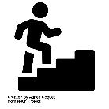
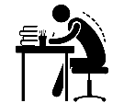
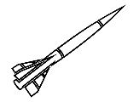
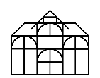
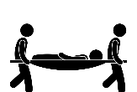
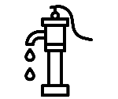
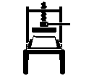
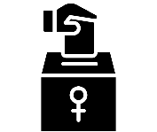
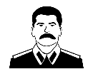
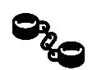
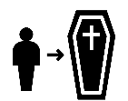
History Learning Journey
GCSE History exam
The origins of the Cold War
The end of the Cold War, 1970-91
Challenges to Elizabeth at home and abroad, 1569-88
YEAR
More Revision
11
Revision
Life in Nazi Germany
Cold War crises, 1958-70
Queen, government and religion, 1558 -69
Elizabethan society in the Age of Exploration, 1558-1588
Nazi
control and dictatorship
Hitler’s rise to power
Medicine in 18th & 19th century Britain
Medicine in Medieval England
Medicine on the Western Front
YEAR
10
Start of GCSE History
Edexcel Specification
The Weimar Republic
Medicine in modern Britain
The Medical Renaissance in England
Did World War One bring equality for women?
Was the Second World War a global war?
How did Black Americans fight for equality?
YEAR
9
How was the First World War fought?
Rise of Dictators
The Holocaust
Why did the First World War begin in 1914?
What was the impact of the British Empire in India?
Why was cotton king in Tameside?
YEAR
8
How far was England from a revolution?
What was Manchester’s role in the Slave Trade?
How did parliament end up in charge?
How did a French man control England?
How did the Tudors stay powerful?
YEAR
7
Who was more important – the Church or the King?
Why did England kill their king?
Welcome!
How British are the British?
“A people without knowledge of their past history, origin and culture is like a tree without roots” Marcus Garvey

