Slide 1

Welcome to Longdendale’s
CLASS OF
2026

Slide 2


Miss Melanie Wicks
Executive Headteacher

Slide 3
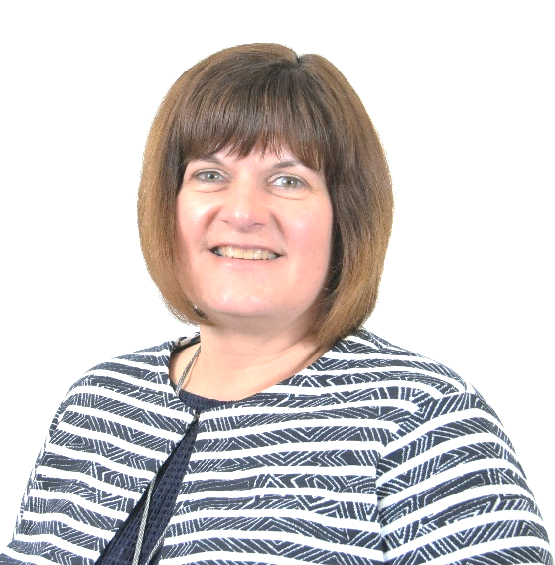
Mrs Andrea Jones
Headteacher

Slide 4


Mr Alex Hulley
Head of Year 7

Slide 5
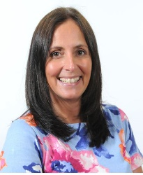
Mrs Willis
Assistant Headteacher Years 7, 8 & 9

Slide 6
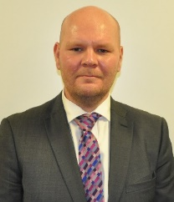
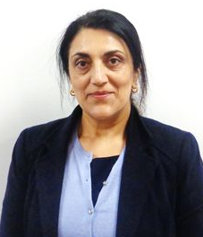
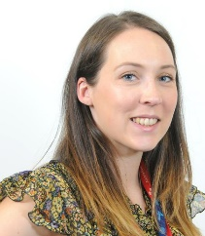
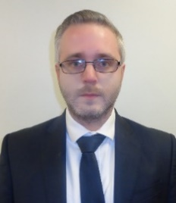
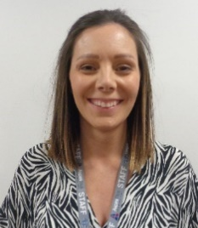
Inclusion / Transition Team
Mr Chris Major – Deputy Headteacher Inclusion
Mrs Jenny Willis – Assistant Headteacher Inclusion
Years 7/8/9
Dr Alex Glancey – Assistant Headteacher Inclusion
Years 10/11
Mrs Jas Gill – SENDCo – Trust Director of SEND
Mrs Natalie Parker – Assistant SENDCo
Mrs Marie Murphy – Transition Mentor
Mr Chris Major
Mrs Jas Gill
Mrs Jenny Willis
Mrs Natalie Parker
Dr Alex Glancey
Mrs Marie Murphy

Slide 7
If you have any questions we have not answered please either:
1. Visit our website
2. Email us on newintake@lhs.aspireplus.org.uk
3. Or telephone the school admin team on 01457 764006
4. Follow us on Twitter: @LHS_HighSchool
5. Like us on Facebook:
‘Rayner Stephens High School’

