Slide 1
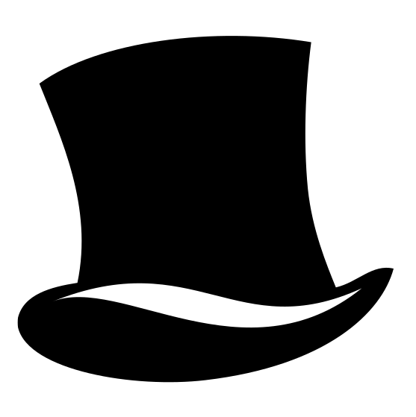
English Learning Journey
Boys Don’t Cry by Malorie Blackman
Romeo and Juliet or Macbeth
A Christmas Carol or Dr Jekyll and Mr Hyde
Conflict and Unseen Poetry
Revision and consolidation
Literature Paper 1: Shakespeare and Contemporary Fiction
Literature Paper 2: 19th Century Novel and Poetry
YEAR
11
Literature Paper 1: Animal Farm by George Orwell
Language Paper 2: Non-fiction Reading and Transactional Writing
Language Paper 1: 19th Century Fiction and Imaginative Writing
Language Paper 1: Imaginative Writing
Language: Spoken Language Endorsement
Literature Paper 2: A Christmas Carol by Charles Dickens
Literature Paper 2: Conflict Poetry and Unseen Poetry
YEAR
10
Language Paper 1: 19th Century Fiction
Literature Paper 1: Macbeth by William Shakespeare
Language Paper 2: Non-Fiction Reading
Romeo and Juliet by William Shakespeare
Imaginative writing: describing character, setting and mood
Contemporary literature anthology: fiction, non-fiction and poetry.
Faster Reading: Bloody Brothers by Willy Russell
YEAR
Much Ado About Nothing by William Shakespeare
9
Reading for pleasure: Noughts and Crosses by Malorie Blackman
An introduction to Victorian literature
Reading for pleasure: The Woman in Black by Susan Hill
Social issues: war, identity and social class
Social issues: poverty, crime, equality and marriage
Reading for pleasure: Of Mice and Men by John Steinbeck
Read and explore Refugee Boy by Benjamin Zephaniah
Reading for pleasure: The Curious Incident of the Dog in the Night Time by Mark Haddon
YEAR
8
Imaginative writing: describing character, setting and mood
An introduction to Victorian literature
Effective writing: pathos, logos and ethos
Identify and analyse narrative voice
Much Ado About Nothing by William Shakespeare
Early story-telling: myths and legends
Epic poetry and Chaucer’s Tales
YEAR
7
Read and explore Once by Morris Gleitzman
Presentations analysing Holocaust poetry
Reading for pleasure: Kensuke’s Kingdom by Michael Morpurgo
Reading for pleasure: Alice’s Adventures in Wonderland by Lewis Carrol
“Remember: one book, one pen, one child, and one teacher can change the world.” Malala Yousafzai

