Slide 1
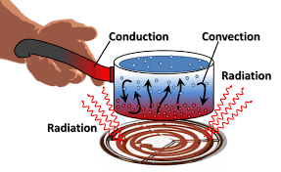
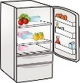
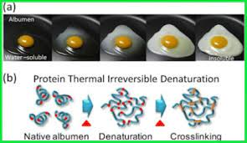
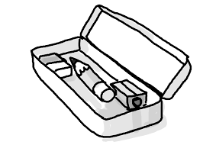
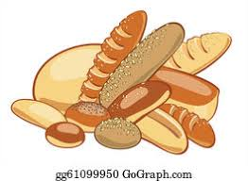
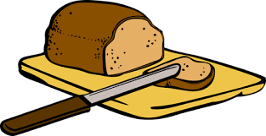
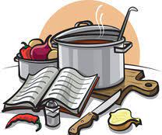
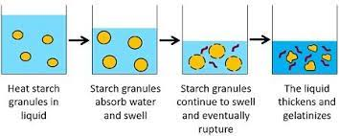
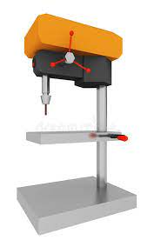
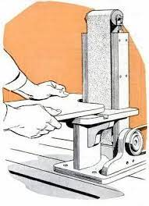
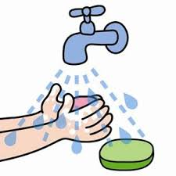
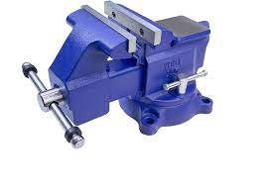
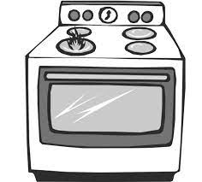
Technology Learning Journey
Final Exam
NEA1 Food Investigation
On-going F&N revision
F&N Mock Exam
NEA2 Food Preparation Assessment
NEA D&T
Final Outcome
YEAR
11
NEA D&T coursework
On-going D&T revision
D&T Mock Exam
NEA D&T research
NEA D&T design ideas
NEA D&T
development
Introduction to GCSE coursework
CAD/CAM stationery
Storage project
Food miles and carbon footprint
Spice jar storage project
Plastic clock project
Pewter Jewellery project
Soma cube project
YEAR
10
Vacuum plastic formed door sign
Macronutrients
Raising Agents
Heat Transfer
Food labels
Micro-organisms
Storing food safely
High risk foods
Swap on the carousel
Acrylic coat hook
Personal Hygiene
Coagulation
YEAR
9
Mould making
Advanced sauce making
Complex dishes
Acrylic
Key fob
Mobile Phone Holder
Swap on the carousel
Pastry theory
Heat transfer
Pencil Box
Bread theory
YEAR
8
Developing
Practical skills
Monster pencil holder project
Cake making
Intro to food science
More complex dishes
Bag tag Project
Jigsaw project
Knife safety
Bread making
Test
Ruler Project
YEAR
7
Hygiene and Safety
Using the hob & oven
Using the equipment
Sauce making, Gelatinisation
Swap on the carousel
‘ Design is intelligence made visible’ Alina Wheeler, Author.

