Slide 1
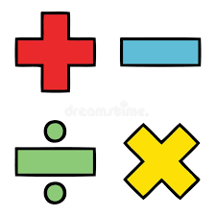
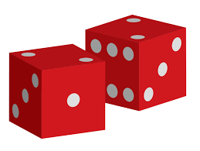
Maths Learning Journey
Exam Skills
Straight Line and Non-Linear Graphs
Real Life Graphs
Transformations
Simultaneous Equations
Functions
Co-ordinate Geometry
Compound Measures
Congruence and Similar Shapes
Probability
Histograms
Vectors
Venn Diagrams
Proof
YEAR
Iteration
11
Quadratic Equations
Pie Charts
Time Series
Circles and Arcs and Sectors
Angles
Solving Equations
Expand and Simplify
Proportion
Functions of a Calculator
Frequency Diagrams and Scatter Graphs
Plans and Elevations
Forming and Solving Equations
Sequences
Reverse Percentages
Fractions
Frequency Trees
Averages
YEAR
10
Sampling
Surface Area and Volume
Constructions
Changing the subject
Inequalities
Two Way Tables
Number Transition to GCSE unit
Trigonometry
Interest and Depreciation
HCF/LCM
Standard Index Form
Factorising
Index Laws
Ratio
Rounding, Error Intervals and Estimating
YEAR
Algebraic Manipulation
9
Angles
Forming and Solving Equations
Collecting and Displaying data
Constructions
Trigonometry and Pythagoras
Higher Probability
Reasoning with data
YEAR
8
Reasoning with number
Developing Geometry
Developing Number
Algebraic Techniques
Representations
Proportional Reasoning
Lines and Angles
YEAR
7
Algebraic Thinking
Place Value and Proportion
Applications of Number
Directed Number
Fractional Thinking
‘ The best way to LEARN Mathematics is to DO Mathematics’ Paul Halmos

