Slide 1
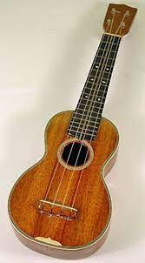
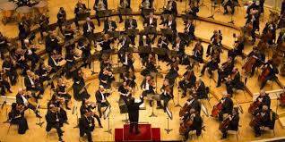
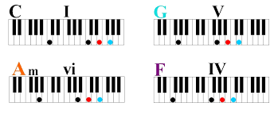
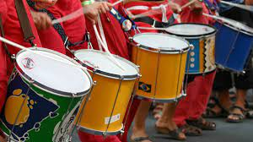
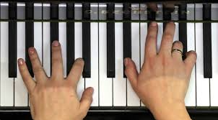
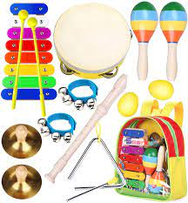
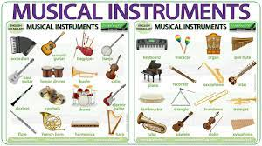
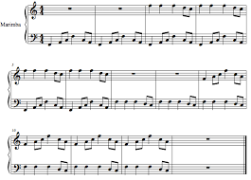
Music Learning Journey
Text box
End of course
All units
YEAR
Unit 1 and Unit 2
Unit 2 and Unit 7
Unit 1 and Unit 5
11
Unit 2
Unit 5/7
Unit 5 and Unit 7
Unit 1 and Unit 5
Unit 3 and Unit 5/7
Unit 1 and Unit 5
YEAR
10
Class Concert
Composition
YEAR
The Ukulele Unit
Live Sound/Pop Research
Band Musicianship
9
Film music
Class Concert
Music and advertising
YEAR
The Four Chords
Samba
Orchestral music
History of pop music
8
Introduction to Ukulele
Dance music skills
YEAR
Introduction to music skills
Recognising musical instruments
7
The Blues
Ostinato composition
‘ Quote’ ?

