Slide 1
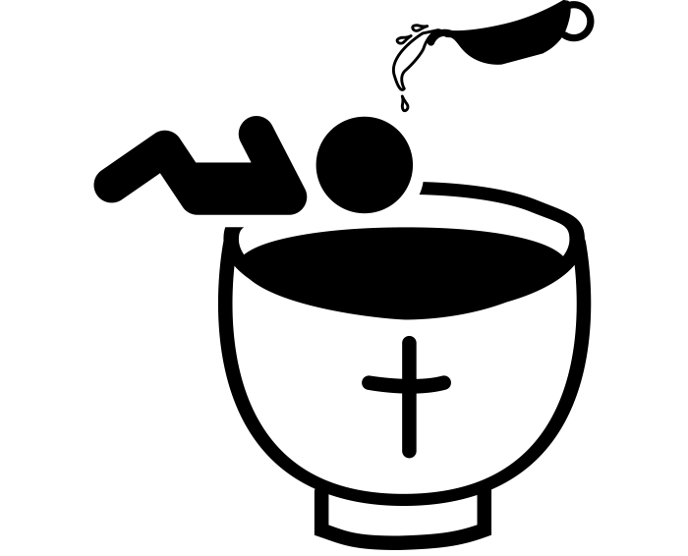
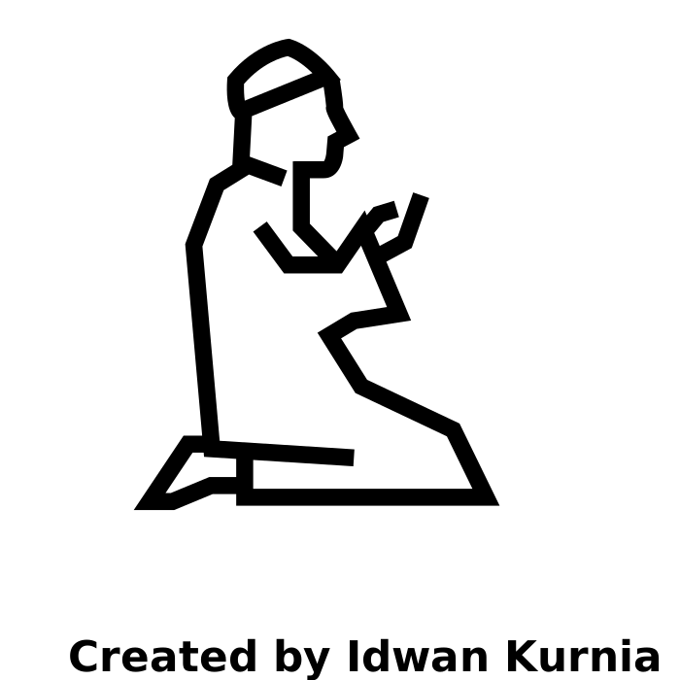
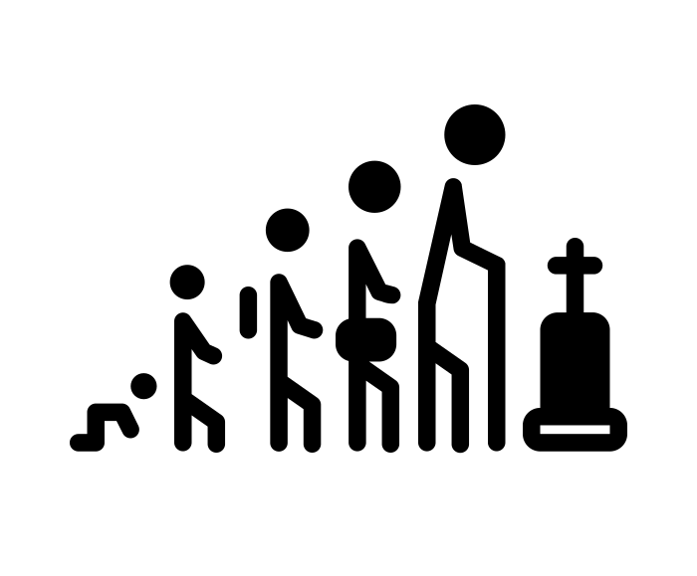
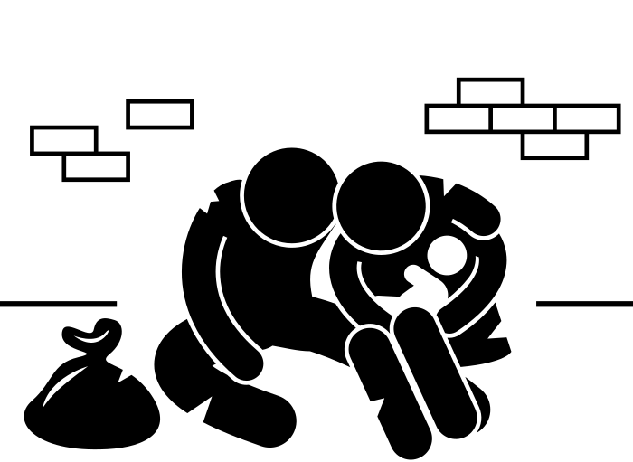
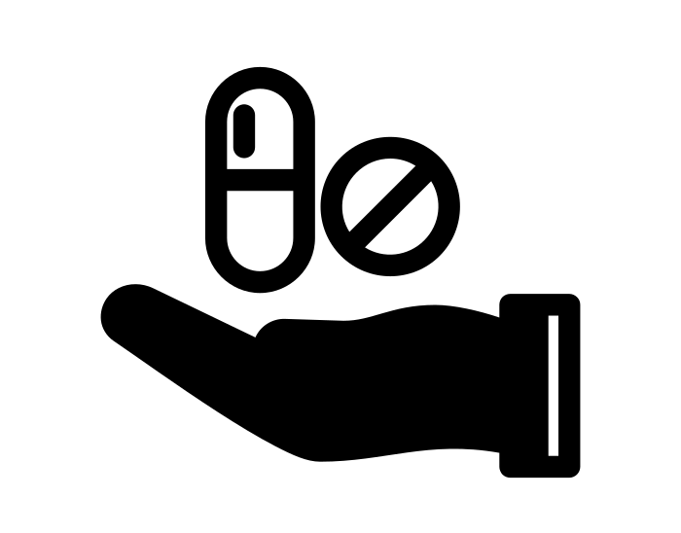
RE Learning Journey
Revision opportunities.
Human Rights.
Islam practises.
Christianity (practises).
YEAR
Good and Evil.
11
Relationships.
Christianity (beliefs).
Islam (beliefs).
Life and Death.
YEAR
10
What is suffering?
What are different forms of Religious Expression?
Medical Ethics.
How do Human Rights affect Religious Expression?
Medical Ethics.
Is punishment a religious idea?
What is suffering?
YEAR
9
Is punishment a religious idea?
Why is Christianity so popular?
Is it hard to be a Muslin?
YEAR
8
Why is Christianity so popular?
Is it hard to be a Muslim?
Introduction to Buddhism.
Introduction to Christianity.
Introduction to Sikhism.
YEAR
7
Introduction to Islam.
Introduction to Hinduism.
Introduction to Judaism.
‘I think, therefore I am’

