Slide 1
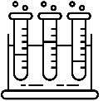
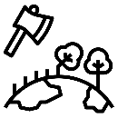
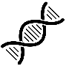
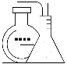
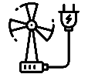
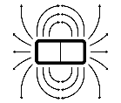
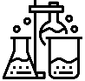
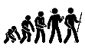
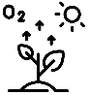
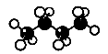
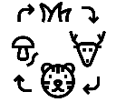
Science Learning Journey
GCSE Examinations
Using Resources
Forces
Inheritance, Variation & Evolution
Waves
Organic Chemistry
Chemistry of the Atmosphere
YEAR
11
Chemical Analysis
Homeostasis & Response
Rate of Chemical Change
Ecology
Magnetism & Electromagnetism
Energy Changes
Atomic
Structure
Chemical Changes
Particle model of Matter
Infection & Response
Bonding & Structure
Energy
Cell
Biology
YEAR
10
Bioenergetics
Using resources
Quantitative
Chemistry
Electricity
Organisation
Atomic
Structure
Home electricity
Growth and differentiation
Acceleration
Introduction to quantitative chemistry
Genetics
YEAR
Sound and waves
9
Nutrition
The Periodic table
Human interaction
Heating
Electric circuits: resistance
Life diversity
Respiration and photosynthesis
Acids & Alkalis
Movement and pressure
Earth systems
YEAR
8
Magnetism
Light
Changing substances
Tissues and organs
Electric circuits: current and voltage
Cells
Forces
Elements, atoms and compounds
Energy Stores & Transfers
Interdependence
YEAR
7
Particles
Reproduction
Gravity
Mixtures
The nitrogen in our DNA, the calcium in our teeth, the iron in our blood, the carbon in our apple pies were made in the interior of collapsing stars. We are made of star stuff – Carl Sagan

