Slide 1
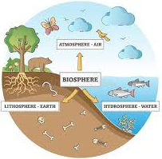
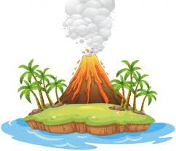
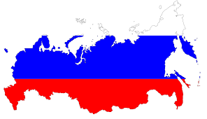
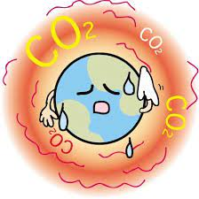
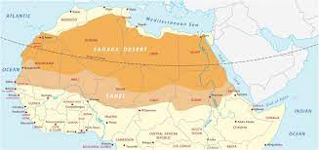
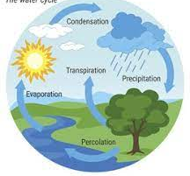
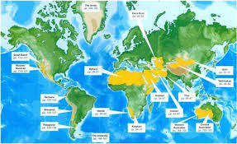
Geography Learning Journey
Revision, Recall and Examinations
Topic 1 Changing Climate
Topic 3 UK in the 21st Century
Topic 2 Ecosystems
YEAR
Fieldwork (Human)
Mock Examination Paper 3
11
Mock Examination Paper 1 or 2
Topic 5 & 6 Distinctive Landscapes part 1 & 2
Topic 3 Urban Futures
Fieldwork (Physical)
Topic 1 Global Hazards Extreme Weather!
Topic 4 Resource Reliance!
Topic 2 Dynamic Development!
YEAR
10
Topic 5 & 6 Global Hazards Tectonics Chapter 2! Everything gets a bit shaken up from here on in!
Mitigating Risk DME (Human)
Topic 3 Pole to Pole comparisons of the Arctic to the Antarctic
Topic 4 Glorious Glaciation! It’s a bit of a ‘frosty’ subject!
Topic 1 and 2 is all about The Rise… and Rise of China and it’s booming population!
Topic 5 Incredible India- We will study India from the top of ‘Mother Ganga’, right down to the slums of Mumbai!
YEAR
Topic 3 Curious Climate Change- Geo Politics and the future of the planet
Topic 2 The Mega Middle East! This topic covers a diverse range of physical, human and environmental factors, and even geo-politics!
9
Topic 6 is The Almighty Dollar
Topic 4 Raging Russia
Journey to School Fieldwork (Human)
Topic 1 is What is Geography? This is the first topic students study, the geographical overview of this topic gives students a flavour of what to expect throughout their KS3 journey
Topic 1 In Year 8 is Deceiving Deserts
Topic 4 is examining the Cracking Coastlines of the UK!
YEAR
8
YEAR
7
Baseline KS3 assessment
Topic 6 is Booming Biomes!
Topic 2 we study the Wicked Water Cycle and Weather!
Topic 3 Raging Rivers allows us to look at some of the most spectacular drainage basins in the world and the River Tees in the UK!
Microclimate Fieldwork (Physical)
Topic 5 is all about Amazing Africa and exploring the huge continent!
"I wish the world was twice as big and half of it was still unexplored.“- Sir David Attenborough

