Slide 1
Test 1 Revision
Year 10 core

Slide 2
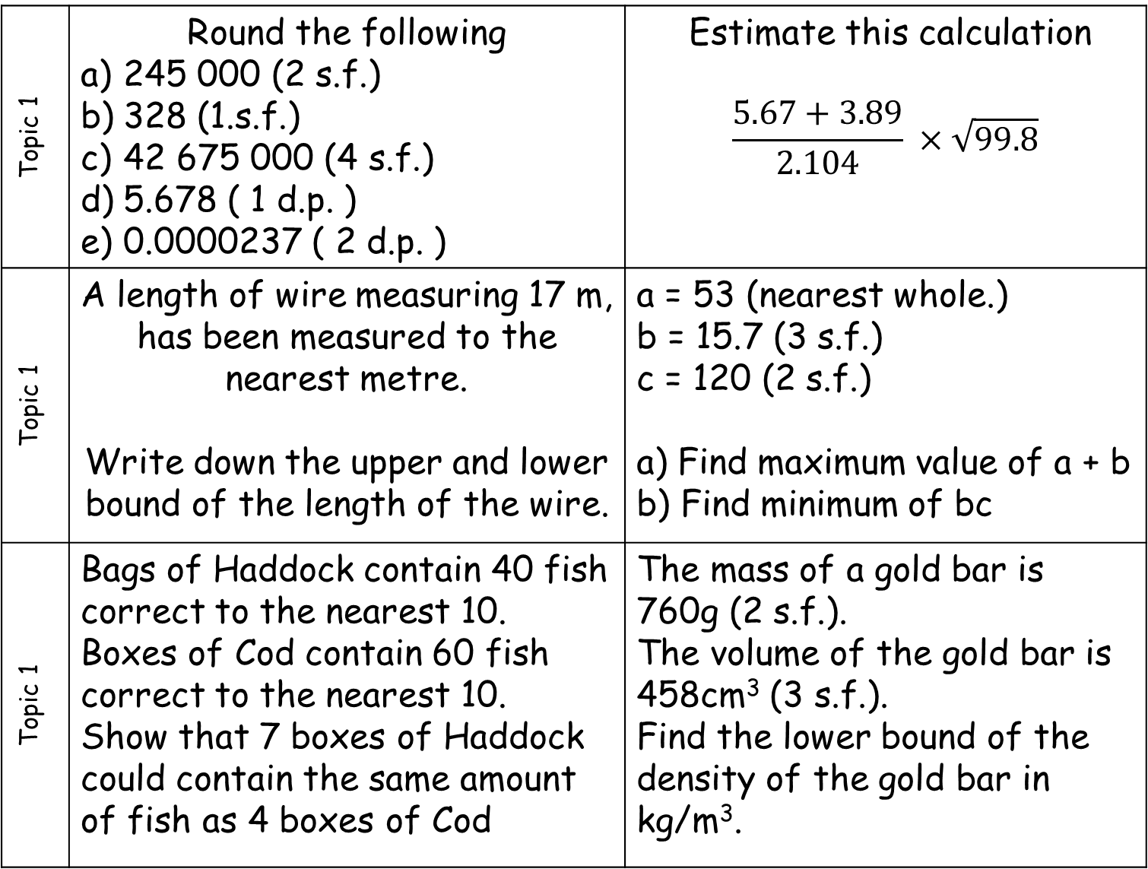
Topic 1 | Round the following 245 000 (2 s.f.) 328 (1.s.f.) 42 675 000 (4 s.f.) 5.678 ( 1 d.p. ) 0.0000237 ( 2 d.p. ) | Estimate this calculation $$\frac{5.67+3.89}{2.104} ×\sqrt{99.8}$$
Topic 1 | A length of wire measuring 17 m, has been measured to the nearest metre. Write down the upper and lower bound of the length of the wire. | a = 53 (nearest whole.) b = 15.7 (3 s.f.) c = 120 (2 s.f.) a) Find maximum value of a + b b) Find minimum of bc
Topic 1 | Bags of Haddock contain 40 fish correct to the nearest 10. Boxes of Cod contain 60 fish correct to the nearest 10. Show that 7 boxes of Haddock could contain the same amount of fish as 4 boxes of Cod | The mass of a gold bar is 760g (2 s.f.). The volume of the gold bar is 458cm³ (3 s.f.). Find the lower bound of the density of the gold bar in kg/m³.

Slide 3
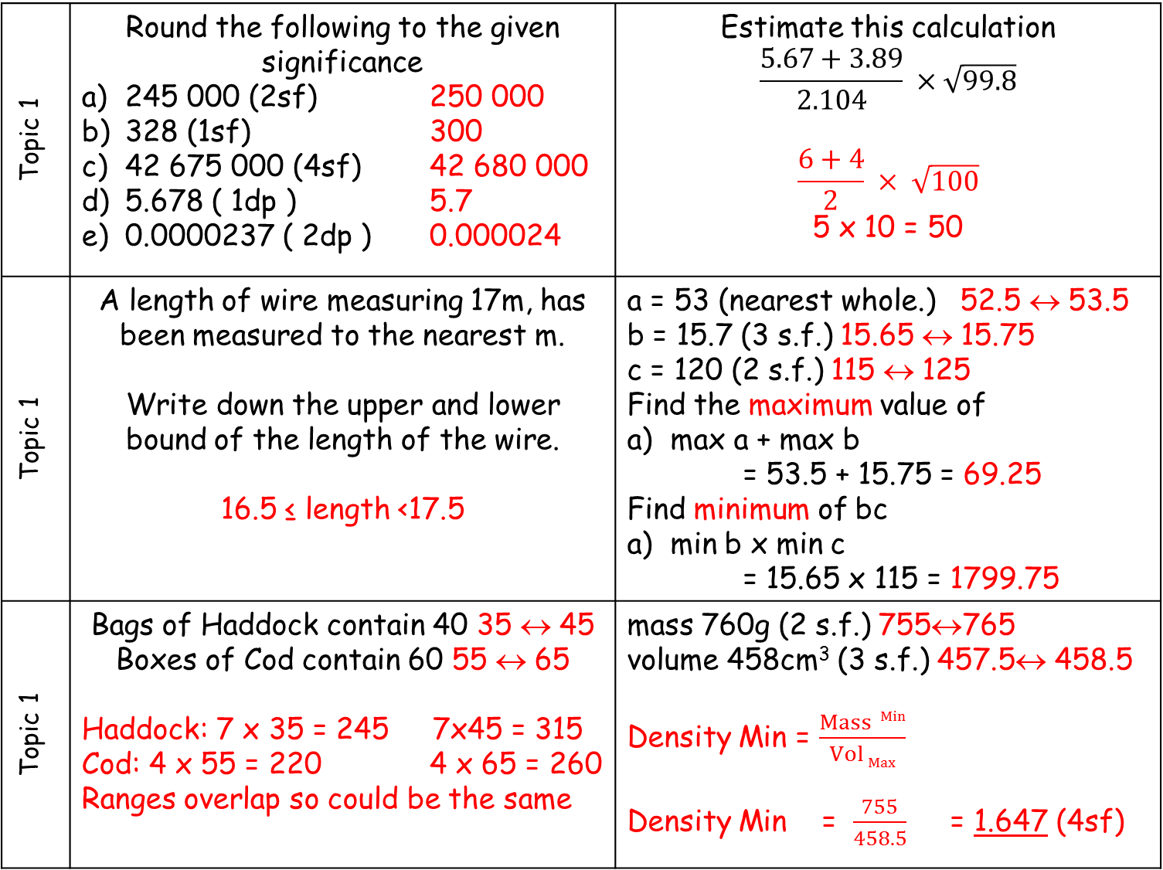
Topic 1 | Round the following to the given significance 245 000 (2sf) 250 000 328 (1sf) 300 42 675 000 (4sf) 42 680 000 5.678 ( 1dp ) 5.7 0.0000237 ( 2dp ) 0.000024 | Estimate this calculation $$\frac{5.67+3.89}{2.104} ×\sqrt{99.8}$$ $$\frac{6+4}{2} × \sqrt{100}$$ 5 x 10 = 50
Topic 1 | A length of wire measuring 17m, has been measured to the nearest m. Write down the upper and lower bound of the length of the wire. 16.5 ≤ length <17.5 | a = 53 (nearest whole.) 52.5 ↔ 53.5 b = 15.7 (3 s.f.) 15.65 ↔ 15.75 c = 120 (2 s.f.) 115 ↔ 125 Find the maximum value of max a + max b = 53.5 + 15.75 = 69.25 Find minimum of bc min b x min c = 15.65 x 115 = 1799.75
Topic 1 | Bags of Haddock contain 40 35 ↔ 45 Boxes of Cod contain 60 55 ↔ 65 Haddock: 7 x 35 = 245 7x45 = 315 Cod: 4 x 55 = 220 4 x 65 = 260 Ranges overlap so could be the same | mass 760g (2 s.f.) 755↔765 volume 458cm³ (3 s.f.) 457.5↔ 458.5 Density Min = $\frac{Mass Min}{Vol Max}$ Density Min = $\frac{755}{458.5}$ = 1.647 (4sf)

Slide 4
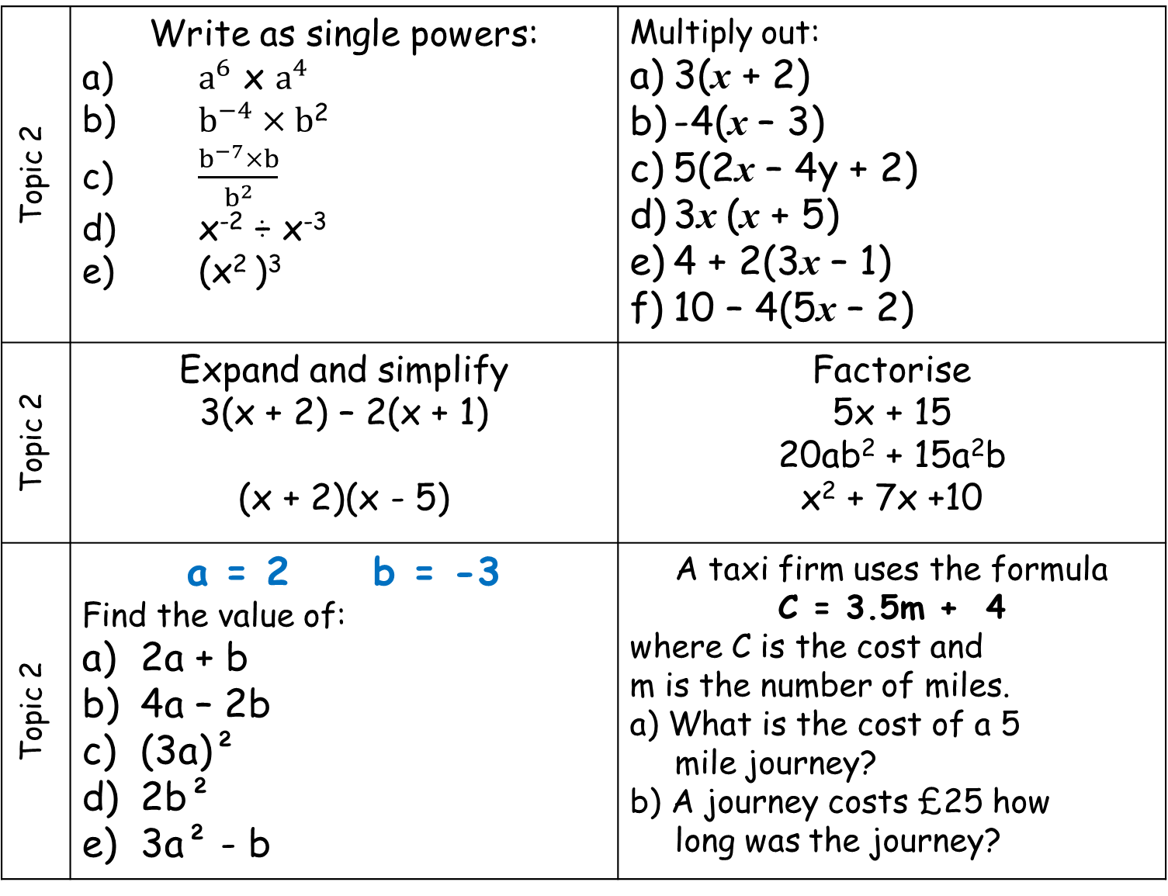
Topic 2 | Write as single powers: a) $a^{6}$ x $a^{4}$ b) $b^{−4}×b$² c) $\frac{b^{−7}×b}{b^{2}}$ d) x⁻² ÷ x⁻³ e) (x² )³ | Multiply out: 3(x + 2) -4(x – 3) 5(2x – 4y + 2) 3x (x + 5) 4 + 2(3x – 1) 10 – 4(5x – 2)
Topic 2 | Expand and simplify 3(x + 2) – 2(x + 1) (x + 2)(x - 5) | Factorise 5x + 15 20ab² + 15a²b x² + 7x +10
Topic 2 | a = 2 b = -3 Find the value of: 2a + b 4a – 2b (3a)² 2b² 3a² - b | A taxi firm uses the formula C = 3.5m + 4 where C is the cost and m is the number of miles. a) What is the cost of a 5 mile journey? b) A journey costs £25 how long was the journey?

Slide 5
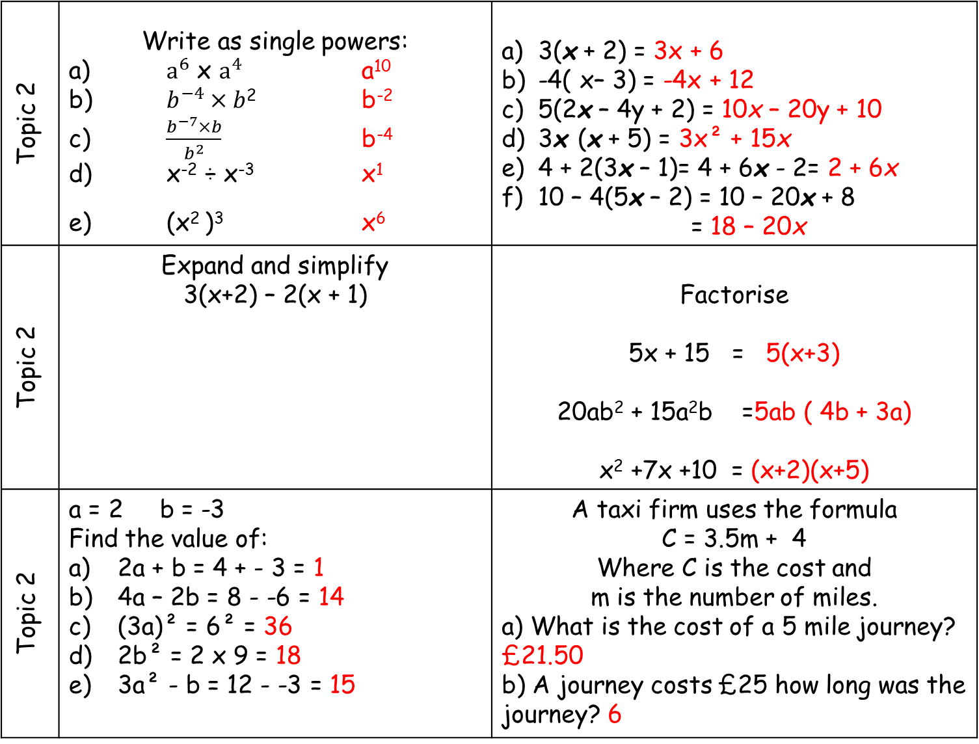
Topic 2 | Write as single powers: a) $a^{6}$ x $a^{4}$ a¹⁰ b) $b^{−4}×b$² b⁻² c) $\frac{b^{−7}×b}{b^{2}}$ b⁻⁴ d) x⁻² ÷ x⁻³ x¹ e) (x² )³ x⁶ | 3(x + 2) = 3x + 6 -4( x– 3) = -4x + 12 5(2x – 4y + 2) = 10x – 20y + 10 3x (x + 5) = 3x² + 15x 4 + 2(3x – 1)= 4 + 6x - 2= 2 + 6x 10 – 4(5x – 2) = 10 – 20x + 8 = 18 – 20x
Topic 2 | Expand and simplify 3(x+2) – 2(x + 1) | Factorise 5x + 15 = 5(x+3) 20ab² + 15a²b =5ab ( 4b + 3a) x² +7x +10 = (x+2)(x+5)
Topic 2 | a = 2 b = -3 Find the value of: 2a + b = 4 + - 3 = 1 4a – 2b = 8 - -6 = 14 (3a)² = 6² = 36 2b² = 2 x 9 = 18 3a² - b = 12 - -3 = 15 | A taxi firm uses the formula C = 3.5m + 4 Where C is the cost and m is the number of miles. a) What is the cost of a 5 mile journey? £21.50 b) A journey costs £25 how long was the journey? 6
3x + 6 – 2x - 2
x + 4
(x+2)(x-5)
= x² +2x -5x-10
= x² -3x-10

Slide 6
Topic 3 | Find the median, mode, range and mean of the following 1, 3, 6, 10, 12, 13, 15 | The mean of 8 numbers is 14. The mean of 2 of the numbers is 10. what is the mean of the other 6 numbers?
Topic 3 | The range of 4 cards is 6 The median is 7 and the mean is 7. what are the 4 cards | Calculate the mean, mode and range from the table
Topic 3 | Calculate an estimate for the mean
Time (minutes) | Frequency
4 | 10
5 | 12
6 | 14
7 | 9
Find the modal class interval and an estimate for the mean
Time | Frequency
0 < t ≤ 6 | 1
6 < t ≤ 10 | 15
10 < t ≤ 14 | 12
14 < t ≤ 30 | 2
Height, h, cm | Frequency
110 < h ≤ 120 | 3
120 < h ≤ 130 | 8
130 < h ≤ 140 | 9
140 < h ≤ 150 | 23
150 < h ≤ 160 | 7

Slide 7
Topic 3 | 1, 3, 6, 10, 12, 13, 18 Mode = no mode Range = 17 Median = 10 Mean = 63 ÷ 7 = 9 | The mean of 8 numbers is 14. The mean of 2 of the numbers is 10. what is the mean of the other 6 numbers?
Topic 3 | Total → ÷ 4 numbers → mean of 7 28 ← x 4 ← mean of 7 | Mean = 247/45 = 5.48 Mode = 6 minutes appears 14 times Range = 7- 4 = 3 minutes
8 x 14 = 112
2 x 10
= 20
6 parts add up to 92
92 ÷ 6 = 15.3333..
Time (minutes) | Frequency
4 | 10 | 40
5 | 12 | 60
6 | 14 | 84
7 | 9 | 63
 | 45 | 247
Range of 6
4 | 6 | 8 | 10
Median of 7

Slide 8
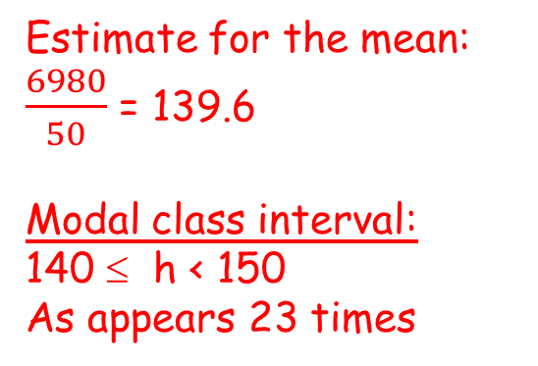
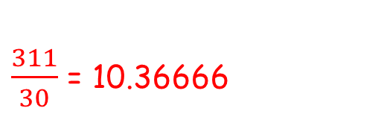
Calculate an estimate for the mean
Time | Frequency | MIDPOINT | M X F
0 < t ≤ 6 | 1 | 3 | 3
6 < t ≤ 10 | 15 | 8 | 120
10 < t ≤ 14 | 12 | 12 | 144
14 < t ≤ 30 | 2 | 22 | 44
Total | 30 |  | 311
Estimate for the mean
$\frac{311}{30}$ = 10.36666
Height, h, cm | Frequency | MIDPOINT | M X F
110 < h ≤ 120 | 3 | 115 | 345
120 < h ≤ 130 | 8 | 125 | 1000
130 < h ≤ 140 | 9 | 135 | 1215
140 < h ≤ 150 | 23 | 145 | 3335
150 < h ≤ 160 | 7 | 155 | 1085
Total | 50 | Total | 6980
Estimate for the mean:
$\frac{6980}{50}$ = 139.6
Modal class interval:
140 ≤ h < 150
As appears 23 times

Slide 9
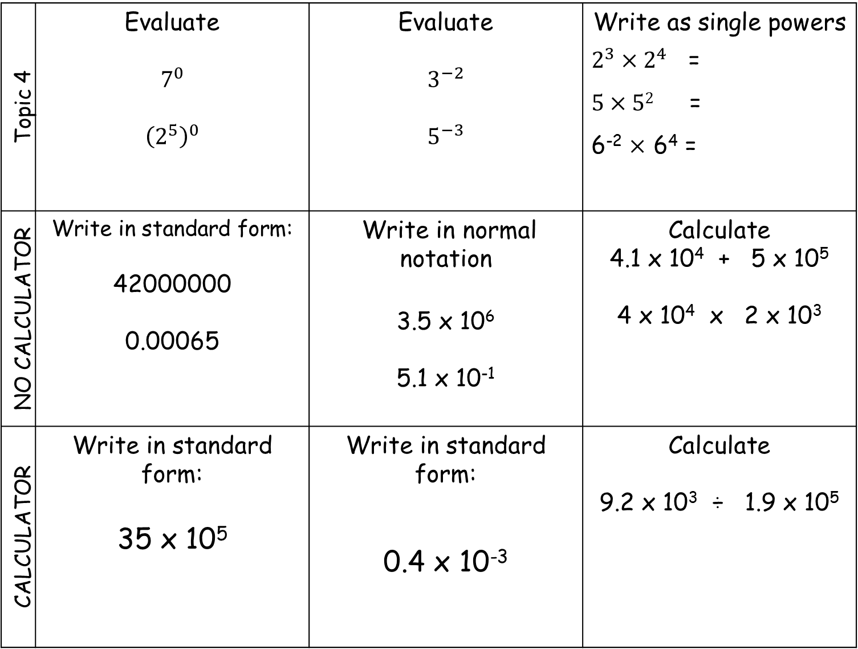
Topic 4 | Evaluate $$7^{0}$$ $${\left(2^{5}\right)}^{0}$$ | Evaluate $$3^{−2}$$ $$5^{−3}$$ | Write as single powers $2^{3}×2^{4}$ = $5×52$ = 6⁻² $×$ 6⁴ =
NO CALCULATOR | Write in standard form: 42000000 0.00065 | Write in normal notation 3.5 x 10⁶ 5.1 x 10⁻¹ | Calculate 4.1 x 10⁴ + 5 x 10⁵ 4 x 10⁴ x 2 x 10³
CALCULATOR | Write in standard form: 35 x 10⁵ | Write in standard form: 0.4 x 10⁻³ | Calculate 9.2 x 10³ ÷ 1.9 x 10⁵

Slide 10
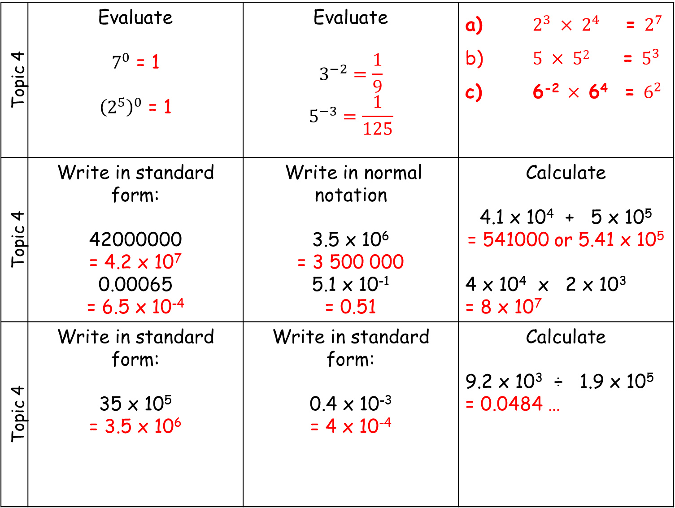
Topic 4 | Evaluate $7^{0}$ = 1 ${\left(2^{5}\right)}^{0}$ = 1 | Evaluate $$3^{−2}=\frac{1}{9}$$ $$5^{−3}=\frac{1}{125}$$ | a) $2^{3}$ $×$ $2^{4}$ = $2^{7}$ b) $5$ $×$ $52$ = $5^{3}$ c) 6⁻² $×$ 6⁴ = $6^{2}$
Topic 4 | Write in standard form: 42000000 = 4.2 x 10⁷ 0.00065 = 6.5 x 10⁻⁴ | Write in normal notation 3.5 x 10⁶ = 3 500 000 5.1 x 10⁻¹ = 0.51 | Calculate 4.1 x 10⁴ + 5 x 10⁵ = 541000 or 5.41 x 10⁵ 4 x 10⁴ x 2 x 10³ = 8 x 10⁷
Topic 4 | Write in standard form: 35 x 10⁵ = 3.5 x 10⁶ | Write in standard form: 0.4 x 10⁻³ = 4 x 10⁻⁴ | Calculate 9.2 x 10³ ÷ 1.9 x 10⁵ = 0.0484 …

