Slide 1
Test 3 Revision
Year 10 Enhanced

Slide 2
Percentages Topic 9 | Write down the decimal multiplier to (a) increase and (b) decrease an amount by: 15% 7% 4.8% | William’s salary is £24 000. His salary increases by 4%. Work out William’s new salary. | Ann buys a dress in a sale. The normal price of the dress is reduced by 20%. The normal price is £36.80 Work out the sale price of the dress.
 | A person's weekly wage was £336, but now he earns £420. What is the percentage increase in their wage? | Jack invests £3000 for 2 years at 4% per annum compound interest. Work out the value of the investment at the end of 2 years. | A company bought a van that had a value of £12 000 The value of the van depreciates by 25% per annum. Work out the value at the end of three years.
 | Mrs Pitt sold their house for £168 000. They made a profit of 12% on the price they paid for the house. Calculate how much they paid for the house. | In a sale, normal prices are reduced by 12%. The sale price of a laptop is £242. Work out the normal price of the lap top. | Sally invested some money. The interest for the 1st year was 3%. For the next two years she was paid interest at 2%. At the end of the third year she had £3750.64. What did she originally invest?

Slide 3
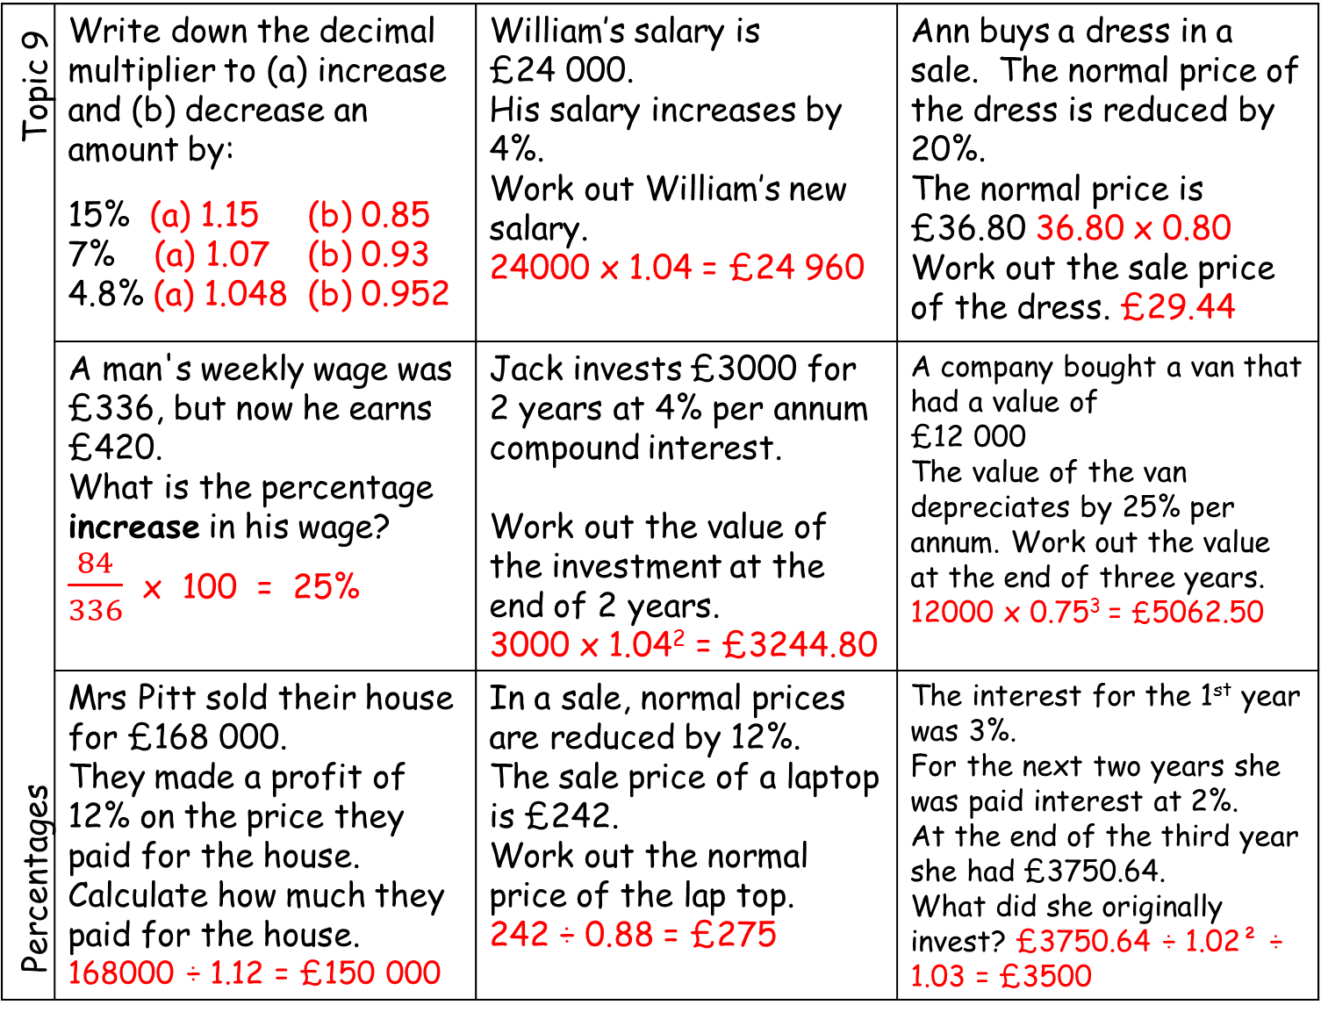
Percentages Topic 9 | Write down the decimal multiplier to (a) increase and (b) decrease an amount by: 15% (a) 1.15 (b) 0.85 7% (a) 1.07 (b) 0.93 4.8% (a) 1.048 (b) 0.952 | William’s salary is £24 000. His salary increases by 4%. Work out William’s new salary. 24000 x 1.04 = £24 960 | Ann buys a dress in a sale. The normal price of the dress is reduced by 20%. The normal price is £36.80 36.80 x 0.80 Work out the sale price of the dress. £29.44
 | A man's weekly wage was £336, but now he earns £420. What is the percentage increase in his wage? $\frac{84}{336}$ x 100 = 25% | Jack invests £3000 for 2 years at 4% per annum compound interest. Work out the value of the investment at the end of 2 years. 3000 x 1.04² = £3244.80 | A company bought a van that had a value of £12 000 The value of the van depreciates by 25% per annum. Work out the value at the end of three years. 12000 x 0.75³ = £5062.50
 | Mrs Pitt sold their house for £168 000. They made a profit of 12% on the price they paid for the house. Calculate how much they paid for the house. 168000 ÷ 1.12 = £150 000 | In a sale, normal prices are reduced by 12%. The sale price of a laptop is £242. Work out the normal price of the lap top. 242 ÷ 0.88 = £275 | The interest for the 1st year was 3%. For the next two years she was paid interest at 2%. At the end of the third year she had £3750.64. What did she originally invest? £3750.64 ÷ 1.02² ÷ 1.03 = £3500

Slide 4
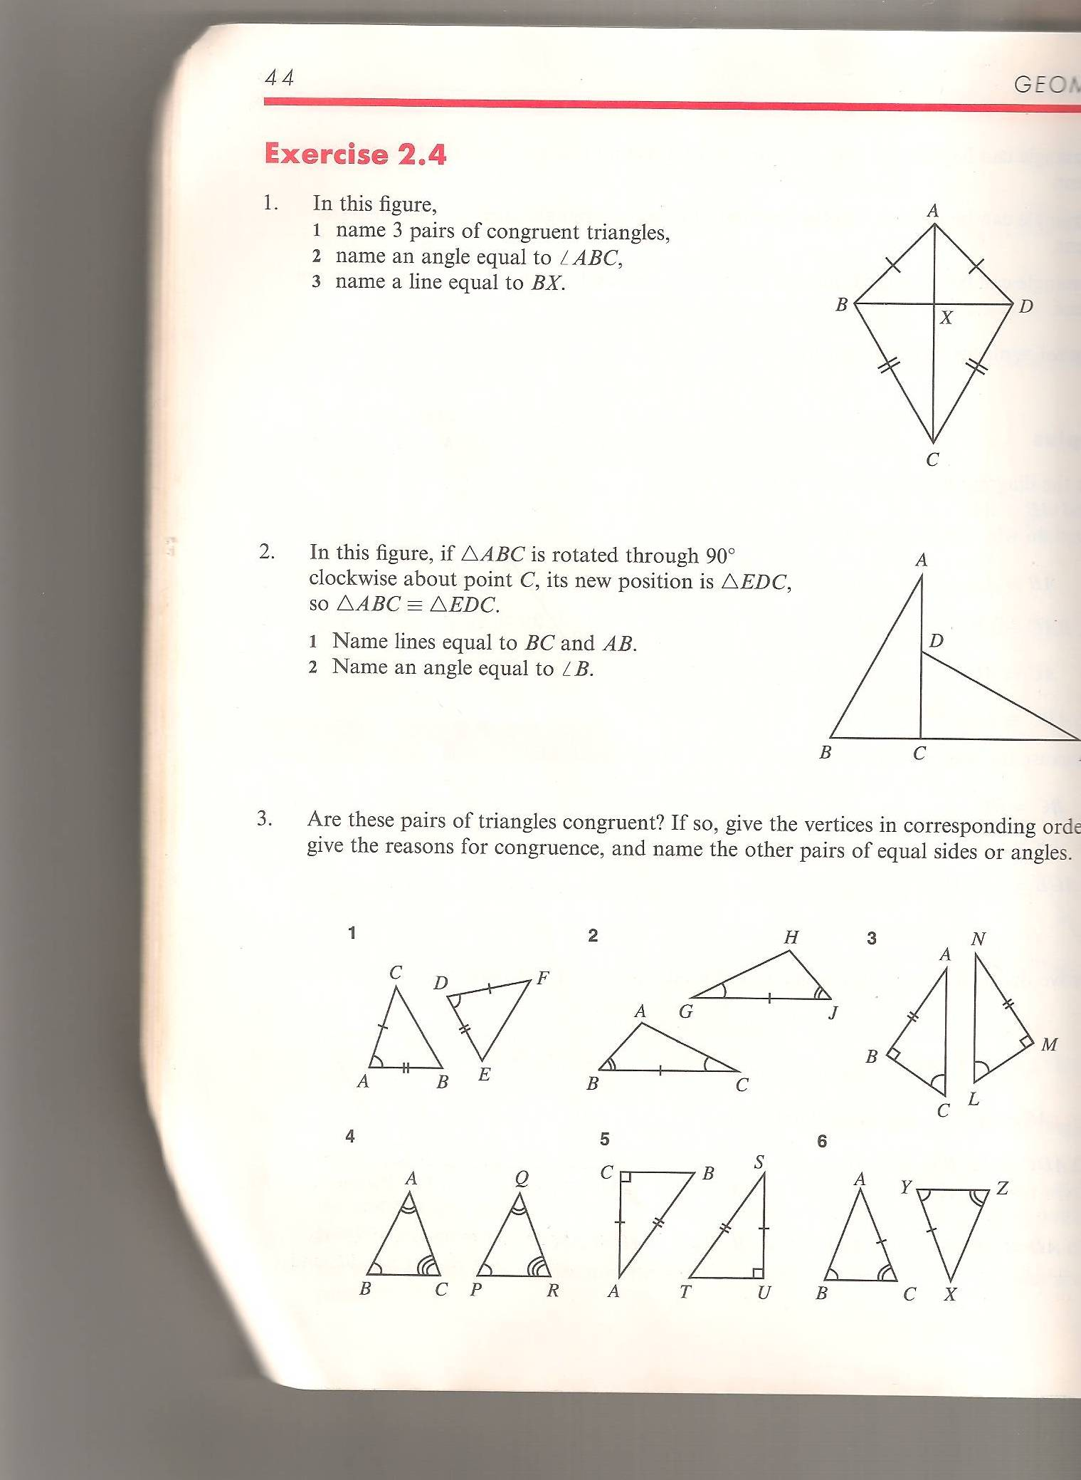
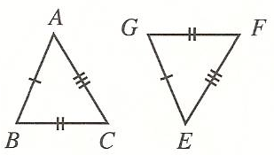
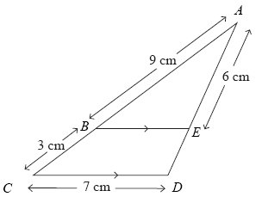
Congruence and Similarity Topic 10 | Decide if these triangles are congruent. State the congruency rule used. | AB is parallel to DC. The lines AC and BD intersect at E. a) Explain why triangle ABE and triangle CDE are similar. b) Calculate the length of AC.
 | Calculate the length of BE. Calculate the length of ED | Two cones, P and Q, are similar. The total surface area of cone P is 24 cm². The total surface area of cone Q is 96 cm² The height of cone P is 4 cm. (a) Work out the height of cone Q. The volume of cone P is 12 cm³. (b) Work out the volume of cone Q.

Slide 5
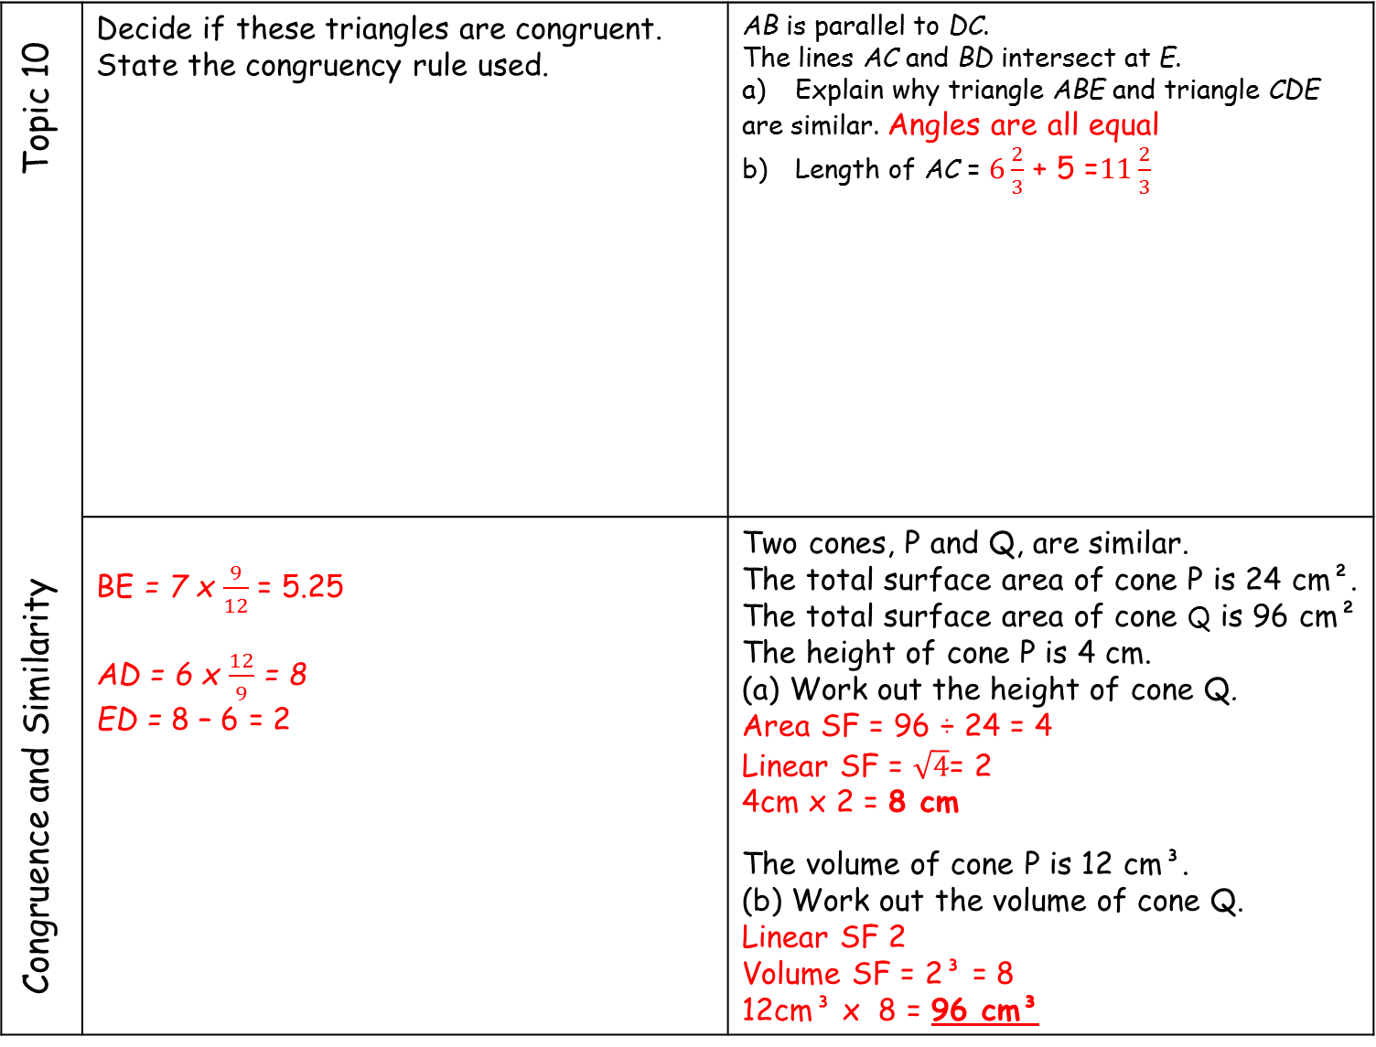

Congruence and Similarity Topic 10 | Decide if these triangles are congruent. State the congruency rule used. | AB is parallel to DC. The lines AC and BD intersect at E. a) Explain why triangle ABE and triangle CDE are similar. Angles are all equal b) Length of AC = $6\frac{2}{3}$ + 5 =$11\frac{2}{3}$
 | BE = 7 x $\frac{9}{12}$ = 5.25 AD = 6 x $\frac{12}{9}$ = 8 ED = 8 – 6 = 2 | Two cones, P and Q, are similar. The total surface area of cone P is 24 cm². The total surface area of cone Q is 96 cm² The height of cone P is 4 cm. (a) Work out the height of cone Q. Area SF = 96 ÷ 24 = 4 Linear SF = $\sqrt{4}$= 2 4cm x 2 = 8 cm The volume of cone P is 12 cm³. (b) Work out the volume of cone Q. Linear SF 2 Volume SF = 2³ = 8 12cm³ x 8 = 96 cm³
YES SSS
YES SAS
AE =5 x $\frac{8}{6}$ = 6$\frac{2}{3}$
NO

Slide 6
y = mx + c Topic 11 | What is the equation of the line? | 4y – 5x = 2 Write down the: y intercept gradient perpendicular gradient | 2y - 6x – 5 = 0 Write down the: y intercept gradient perpendicular gradient
 |  | Find the gradient of the line joining (-2, 4) and (7, 9) | Find the equation of the line which passes through the point (3, 2) and is parallel to y = 2x + 3
 | Find the equation of the line which passes through the point (8, 3) and is perpendicular to y = 4x - 1 | A triangle has vertices P, Q and R. The coordinates of P are (−3, −6) The coordinates of Q are (1, 4) The coordinates of R are (5, −2) M is the midpoint of PQ. N is the midpoint of QR. Prove that MN is parallel to PR. You must show each stage of your working.

Slide 7
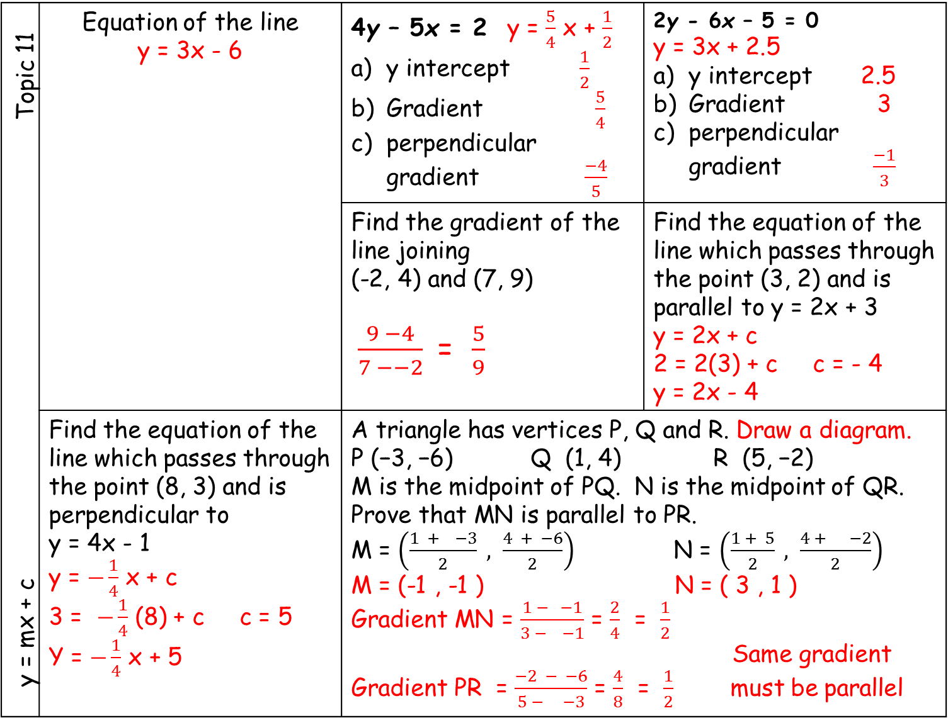
y = mx + c Topic 11 | Equation of the line y = 3x - 6 | 4y – 5x = 2 y = $\frac{5}{4}$ x + $\frac{1}{2}$ y intercept $\frac{1}{2}$ Gradient $\frac{5}{4}$ perpendicular gradient $\frac{−4}{5}$ | 2y - 6x – 5 = 0 y = 3x + 2.5 y intercept 2.5 Gradient 3 perpendicular gradient $\frac{−1}{3}$
 |  | Find the gradient of the line joining (-2, 4) and (7, 9) $\frac{9 −4}{7 −−2}$ = $\frac{5}{9}$ | Find the equation of the line which passes through the point (3, 2) and is parallel to y = 2x + 3 y = 2x + c 2 = 2(3) + c c = - 4 y = 2x - 4
 | Find the equation of the line which passes through the point (8, 3) and is perpendicular to y = 4x - 1 y = $−\frac{1}{4}$ x + c 3 = $−\frac{1}{4}$ (8) + c c = 5 Y = $−\frac{1}{4}$ x + 5 | A triangle has vertices P, Q and R. Draw a diagram. P (−3, −6) Q (1, 4) R (5, −2) M is the midpoint of PQ. N is the midpoint of QR. Prove that MN is parallel to PR. M = $\left(\frac{1 + −3}{2} , \frac{4 + −6}{2}\right)$ N = $\left(\frac{1 + 5}{2} , \frac{4 + −2}{2}\right)$ M = (-1 , -1 ) N = ( 3 , 1 ) Gradient MN = $\frac{1 − −1}{3 − −1}$ = $\frac{2}{4}$ = $\frac{1}{2}$ Same gradient Gradient PR = $\frac{−2 − −6}{5 − −3}$ = $\frac{4}{8}$ = $\frac{1}{2}$ must be parallel

Slide 8
Scatter Graphs and Time Series Topic 12 | The scatter graph shows information about the height and weight of ten students. a) What type of correlation does this scatter graph show? One pupil had their height incorrectly measured. Write down the co-ordinate of this pupil. c) Another student is 110 cm tall. Would it be sensible to estimate their weight? Explain.

Slide 9
Scatter Graphs and Time Series Topic 12 | The scatter graph shows information about the height and weight of ten students. a) What type of correlation does this scatter graph show? One pupil had their height incorrectly measured. Write down the co-ordinate of this pupil. c) Another student is 110 cm tall. Would it be sensible to estimate their weight? Explain.
positive
(140, 40)
110cm is outside the range of data collected so it would not be an accurate prediction as it would be extrapolated.

Slide 10
Scatter Graphs and Time Series Topic 12 | The scatter diagram shows information about 12 girls. It shows the age of each girl and the best time she takes to run 100 metres. Write down the type of correlation. Kristina is 11 years old. Her best time to run 100 metres is 12 seconds. The point representing this information would be an outlier on the scatter diagram. Explain why. c) Debbie is 15 years old. Debbie says, “The scatter diagram shows I should take less than 12 seconds to run 100 metres.” Comment on what Debbie says.
Time in seconds

Slide 11
Scatter Graphs and Time Series Topic 12 | The scatter diagram shows information about 12 girls. It shows the age of each girl and the best time she takes to run 100 metres. Write down the type of correlation. Kristina is 11 years old. Her best time to run 100 metres is 12 seconds. The point representing this information would be an outlier on the scatter diagram. Explain why. c) Debbie is 15 years old. Debbie says, “The scatter diagram shows I should take less than 12 seconds to run 100 metres.” Comment on what Debbie says.
negative
Time in seconds
It would not follow the general
pattern of the rest of the data
15 years is outside the range of data collected, so this value has been
extrapolated and is therefore not accurate.

Slide 12
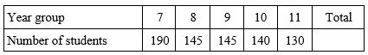
Scatter Graphs and Time Series Topic 12 | The table shows the number of students in each year group at a school. Jenny is carrying out a survey for her GCSE Mathematics project. She uses a stratified sample of 60 students according to year group. Calculate the number of Year 11 students that should be in her sample. |  | Mary wants to estimate the number of fish in a lake. She catches 40 fish, marks them and puts them back in the lake. Later she catches another 40 fish and finds that 5 of them are marked. Work out an estimate for the number of fish in the lake.
 | A gift shop sells wrapping paper. The table gives information about the sales of wrapping paper for successive four-month periods from the start of 2017 to the end of 2018. Complete the table to show the last two 3 three-point moving averages.
Year |  | Sales (£ hundreds) | Three point moving average
2017 | Jan – Apr | 20
 | May – Aug | 22 | 25
 | Sept - Dec | 33 | 27
2018 | Jan – Apr | 26
 | May – Aug | 25
 | Sept - Dec | 36

Slide 13


Scatter Graphs and Time Series Topic 12 | The table shows the number of students in each year group at a school. Jenny is carrying out a survey for her GCSE Mathematics project. She uses a stratified sample of 60 students according to year group. Calculate the number of Year 11 students that should be in her sample. |  | Mary wants to estimate the number of fish in a lake. She catches 40 fish, marks them and puts them back in the lake. Later she catches another 40 fish and finds that 5 of them are marked. Work out an estimate for the number of fish in the lake.
 | A gift shop sells wrapping paper. The table gives information about the sales of wrapping paper for successive four-month periods from the start of 2002 to the end of 2004. Complete the table to show the last two 3 three-point moving averages.
$\frac{130}{750}$ $×60=10$
$$\frac{40}{N}=\frac{5}{40}$$
N = 320
Year |  | Sales (£ hundreds) | Three point moving average
2017 | Jan – Apr | 20
 | May – Aug | 22 | 25
 | Sept - Dec | 33 | 27
2018 | Jan – Apr | 26 | (33 + 26 + 25) ÷ 3 = 28
 | May – Aug | 25 | (26 + 25 + 36) ÷ 3 = 29
 | Sept - Dec | 36

