Slide 1
Test 4 Revision
Year 10 Enhanced

Slide 2
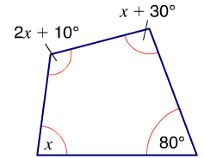
Algebra : Equations and proof Topic 13 | Rearrange to make $x$ the subject: a) $3x + 5 =y$ b) $x^{2}−5=y$ c) $\sqrt{3x+4}=y$ | Rearrange to make $r$ the subject: a) $\frac{5(r+5)}{2}=2p$ b) $V= πr^{2}h$ c) $d=20 −ar^{3}$ | Rearrange to make $b$ the subject: a) $C = 3ab+ 7b$ b) $aC= 2b – 5ab$ c) $A = \frac{3b+5}{2b+1}$
 | Work out the value of x. | Work out the value of x. | Work out the value of x.
 | The area of this shape is 44 cm². Work out the perimeter of the shape. |  | Jessica is 4 years older than Georgina. Angela is 3 times as old as Jessica. The total of their ages is 41. Find how old Jessica is.
64
4(x - 8)
2x + 13

Slide 3
Algebra : Equations and proof Topic 13 | Rearrange to make $x$ the subject: a) $3x + 5 =y$ $x^{2}−5=y$ c) $\sqrt{3x+4}=y$ | Rearrange to make $r$ the subject: $\frac{5(r+5)}{2}=2p$ b) $V= πr^{2}h$ c) $d=20 −ar^{3}$ | Rearrange to make $b$ the subject: a) $C = 3ab+ 7b$ b) $aC−5ab= 2b$ c) $a = \frac{3b+5}{2b+1}$
 | Work out the value of x. $$x=22.5$$ | Work out the value of x. $$x=60$$ | Work out the value of x. $$x=4.5$$
 | The area of this shape is 44 cm². Work out the perimeter of the shape. $$x=9$$ $$P=48 cm$$ |  | Jessica is 4 years older than Georgina. Angela is 3 times as old as Jessica. The total of their ages is 41. Find how old Jessica is. $$j=9$$
$$b=\frac{C}{3a+7}$$
$$x=\frac{y−5}{3}$$
$$r=\frac{4p−25}{5}$$
$$r=\sqrt{\frac{V}{πh}}$$
$$b=\frac{C}{2+5a}$$
$$x=\sqrt{y+5}$$
$$r=\sqrt[3]{\frac{20−d}{a}}$$
$$b=\frac{5−a}{2a−3}$$
$$x=\frac{y^{2}−4 }{3}$$
64
4(x - 8)
2x + 13

Slide 4
Algebra : Equations and proof Topic 13 | Solve: a) $\frac{x + 1}{3}=2$ b) $x=\frac{x − 2}{4}$ c) $\frac{1 − 2x}{5}=2$ | Solve: a) $\frac{3(x+5)}{2}=x+1$ b) $\frac{16−x}{4}=\frac{x+2}{5}$ c) $\frac{9−x}{5}=3−x$ | Solve: a) $\frac{3(x + 5)}{2}=\frac{x}{3}+6$ b) $\frac{5 − x}{4}=1+2x$ c) $\frac{3x+6}{10}+\frac{5−2x}{5}=6$
 | Prove that the sum of any three consecutive numbers is always a multiple of 3. | Prove that $$\left(n+1\right)\left(n+2\right)−n(n+3)$$ is always 2. | Prove that: $$\left(n+1\right)\left(n+2\right)−n(n+1)=2\left(n+1\right)$$
 | Find the volume of the cuboid | Expand and simplify (x - 2)(x + 1)² | Expand and simplify: (x - 1)³
$$2x$$
$3x$- 1
$$x+4$$

Slide 5
Algebra : Equations and proof Topic 13 | Solve: a) $\frac{x + 1}{3}=2 x=5$ b) $x=\frac{x − 2}{4} x=\frac{−2}{3}$ c) $\frac{1 − 2x}{5}=2 x=\frac{−9}{2}$ | Solve: a) $\frac{3(x+5)}{2}=x+1$ $x=−13$ b) $\frac{16−x}{4}=\frac{x+2}{5}$ $x=8$ c) $\frac{9−x}{5}=3−x x=\frac{−3}{2}$ | Solve: a) $\frac{3(x + 5)}{2}=\frac{x}{3}+6 x=\frac{9}{7}$ b) $\frac{5− x}{4}=1+2x$ $x=\frac{1}{7}$ c) $\frac{3x+6}{10}+\frac{5−2x}{5}=6$ $$x=−44$$
 | Prove that the sum of any three consecutive numbers is always a multiple of 3. $$n + n + 1 + n + 2$$ $$= 3n + 3 = 3(n + 1)$$ | Prove that $$\left(n+1\right)\left(n+2\right)−n(n+3)$$ is always 2. $$n^{2}+3n+2−n^{2}+3n$$ $$=2$$ | Prove that: $$\left(n+1\right)\left(n+2\right)−n(n+1)=2\left(n+1\right)$$ $$n^{2}+3n+2−n^{2}−n$$ $$=2n+2=2(n+1)$$
 | Find the volume of the cuboid | Expand and simplify (x - 2)(x + 1)² $$x^{3}−3x−2$$ | Expand and simplify: (x - 1)³ $$x^{3}−3x^{2}−x−1$$
$$2x$$
$3x$- 1
$$x+4$$
$$2x\left(x+4\right)\left(3x−1\right)$$
$${6x}^{3}+{22x}^{2}−8x$$

Slide 6
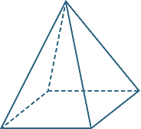
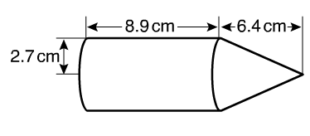
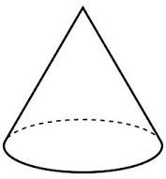
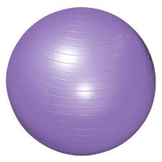
Geometry: Volume and Surface area Topic 14 | Find the volume of this square based pyramid. | Find the volume of this compound solid. | Find the volume of this compound solid.
 | This cylinder has a capacity of 2000 cm³. What is its height to 1 d.p. ? | This cone has a volume of 8π and a height of 6 cm. What is the radius of the cone? | A sphere has a volume of 36π cm³ What is the radius of the sphere?
 | A cone has a curved surface area of 60πcm² and a radius of 6cm. What is the volume of the cone? | A cone is joined to a hemisphere. The solid is protected by a spray which cost 19p per cm². How much will it cost to spray the whole solid?
10 cm
6 cm
21cm
7cm

Slide 7
Geometry: Volume and Surface area Topic 14 | Find the volume of this square based pyramid. 120 cm³ | Find the volume of this compound solid. 204 + 48.9 = 253 cm³ | Find the volume of this compound solid. 168 + 134 = 302 cm³
 | This cylinder has a capacity of 2000 cm³. What is its height to 1 d.p. ? $$\frac{2000}{π×6^{2}}$$ = 17.7 cm | This cone has a volume of 8π and a height of 6 cm. What is the radius of the cone? $$\sqrt{\frac{8π×3}{6π}}$$ = 2 cm | A sphere has a volume of 36π cm³ What is the radius of the sphere? $$\sqrt[3]{\frac{36π×3}{4×π}}$$ = 3 cm
 | A cone has a curved surface area of 60πcm² and a radius of 6cm. What is the volume of the cone? L = 10cm H = 8 V=$\frac{1}{3}×π×36 × 8=72π$ | A cone is joined to a hemisphere. The solid is protected by a spray which cost 19p per cm². How much will it cost to spray the whole solid? $l$ = 22.1 $πrl$ = $π ×7 ×$22.1 = 486cm² $$4πr^{2} ÷2=307.9 cm2$$ Total x £0.19 = £151
10 cm
6 cm
21cm
7cm

Slide 8
Algebra: Simultaneous Equations Topic 15 | Solve these simultaneous equations. $$4x+3y=3$$ $$6x+5y=7$$ | Solve these simultaneous equations. $$2x+5y=16$$ $$5x−2y=11$$ | Solve these simultaneous equations. $$5x−3y=14$$ $$7x−5y=20$$
 | 6 pencils and 2 crayons cost £2.70. 5 pencils and 3 crayons cost £2.45. Work out the cost of a pencil and the cost of a crayon. | 6 cups of tea and 4 cakes cost £13.20 5 cups of tea and 2 cakes cost £9.00 Is £10 enough to buy 3 cups of tea and 4 cakes? | This is a rectangle. Work out the values of a and b.
 | Solve these simultaneous equations. $$y= x^{2}$$ $$y=x+2$$ | Solve these simultaneous equations. $$x^{2} −2y=2$$ $$y=x+3$$ | Solve simultaneously $$x^{2}+y^{2}=17$$ $$y=x+3$$

Slide 9
Algebra: Simultaneous Equations Topic 15 | Solve these simultaneous equations. $$4x+3y=3$$ $$6x+5y=7$$ $$x=4.5 and y=−4$$ | Solve these simultaneous equations. $$2x+5y=16$$ $$5x−2y=11$$ $$x=3 and y=2$$ | Solve these simultaneous equations. $$5x−3y=14$$ $$7x−5y=20$$ $$x=2.5 and y=−0.5$$
 | 6 pencils and 2 crayons cost £2.70. 5 pencils and 3 crayons cost £2.45. Work out the cost of a pencil and the cost of a crayon. p = 40p c = 15p | 6 cups of tea and 4 cakes cost £13.20 5 cups of tea and 2 cakes cost £9.00 Is £10 enough to buy 3 cups of tea and 4 cakes? t= £1.20 c= £1.50 yes | This is a rectangle. Work out the values of a and b. a = 4 b = -1
 | Solve these simultaneous equations. $$y= x^{2}$$ $$y=x+2$$ $$x= 2 and y=4$$ $$x= −1 and y=1$$ | Solve these simultaneous equations. $$x^{2} −2y=2$$ $$y=x+3$$ $$x= 4 and y=7$$ $$x= −2 and y=1$$ | Solve simultaneously $$x^{2}+y^{2}=17$$ $$y=x+3$$ $$x= −4 and y=−1$$ $$x= 1 and y=4$$

Slide 10
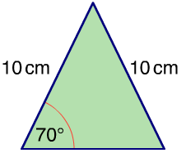
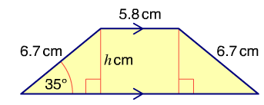
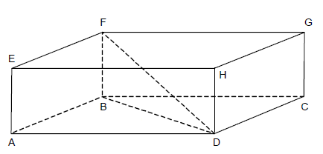
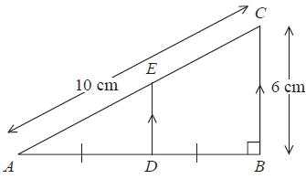
Geometry: Trigonometry Topic 16 | Find the area of this triangle. | Find the area of this trapezium. | Find the area of this parallelogram.
 | AD = 6cm AB = 4cm and DH = 5cm Calculate the angle between FD and the base. | Calculate the length of CD. Give your answer correct to 3 significant figures.
 |  | D is the midpoint of AB. Work out the area of trapezium BCED.

Slide 11
Geometry: Trigonometry Topic 16 | Find the area of this triangle. 32cm² | Find the area of this trapezium. 43cm² | Find the area of this parallelogram. 7x3.21 = 22.5 cm²
 | AD = 6cm and AB = 4cm DH = 5cm Calculate the angle between FD and the base. 34.7⁰ | Calculate the length of CD. Give your answer correct to 3 significant figures.
 |  | D is the midpoint of AB. Work out the area of trapezium BCED. $$\frac{3+6}{2}×4=18{cm}^{2}$$
$$3.21$$
$$\sqrt{112}$$
$$16.5$$
$$3 cm$$
$$36.9°$$
$$4 cm$$
$$8 cm$$

