Slide 1
Test 2 Revision
YEAR 10 ENHANCED

Slide 2
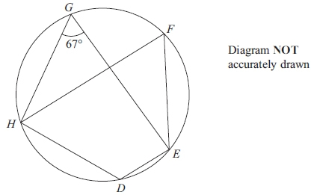
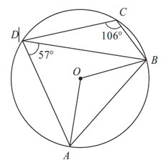
Topic 5 | Angle EGH = 67° Find the size of angle EFH. Find the size of angle HDE. | Angle ADB = 57°. Angle BCD = 106°. Calculate the size of angle AOB. Calculate the size of angle BAD.
 | AC and BC are tangents to the circle. Angle ACB = 36°. Find the size of angle OBA. | AT is a diameter of the circle. Angle BTC = 40° Angle TAB = 30° Explain why TC cannot be a tangent to the circle.

Slide 3
Topic 5 | Angle EGH = 67° Find the size of angle EFH. 67° Find the size of angle HDE. 113° | Angle ADB = 57°. Angle BCD = 106°. Calculate the size of angle AOB. 114° Calculate the size of angle BAD. 74°
 | AC and BC are tangents to the circle. Angle ACB = 36°. Find the size of angle OBA. 18° | AT is a diameter of the circle. Angle BTC = 40° Angle TAB = 30° Explain why TC cannot be a tangent to the circle.
OTC ≠ 90°
So can’t be a tangent
60°
144

Slide 4
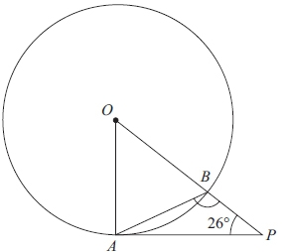
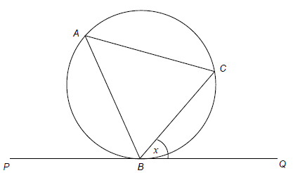
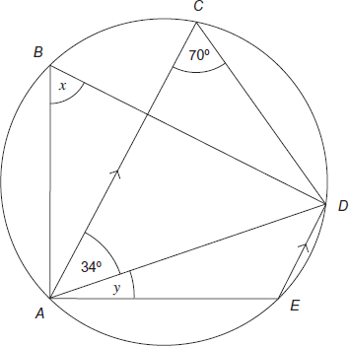
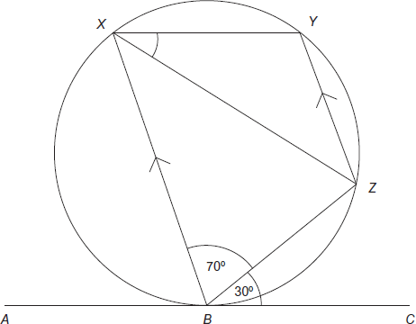
Topic 5 | PA is the tangent to the circle at A. OBP is a straight line. ∠APO = 26° Calculate the size of ∠ABP. | A, B and C are points on a circle. • BC bisects angle ABQ. • PBQ is a tangent to the circle. Angle CBQ = x Prove that AC = BC
Topic 5 | Work out the size of angle ZXY. | Write down the size of a) angle x. b) angle y.

Slide 5
Topic 5 | PA is the tangent to the circle at A. OBP is a straight line. ∠APO = 26° Calculate the size of ∠ABP. | A, B and C are points on a circle. • BC bisects angle ABQ. • PBQ is a tangent to the circle. Angle CBQ = x Prove that AC = BC
Topic 5 | Work out the size of angle ZXY. | Write down the size of a) angle x. b) angle y.
117°
x
54°
63°
x
40°
110°
30°
70°
30°
80°
34°
36°
110°
80°

Slide 6

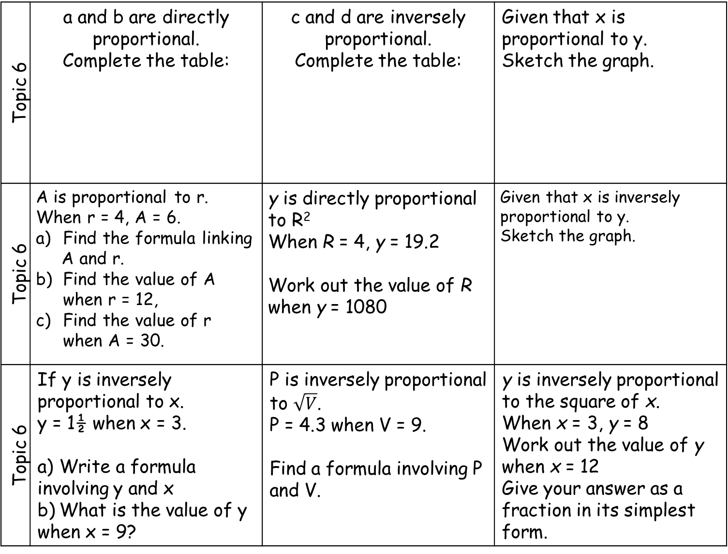



Topic 6 | a and b are directly proportional. Complete the table: | c and d are inversely proportional. Complete the table: | Given that x is proportional to y. Sketch the graph.
Topic 6 | A is proportional to r. When r = 4, A = 6. Find the formula linking A and r. Find the value of A when r = 12, Find the value of r when A = 30. | y is directly proportional to R² When R = 4, y = 19.2 Work out the value of R when y = 1080 | Given that x is inversely proportional to y. Sketch the graph.
Topic 6 | If y is inversely proportional to x. y = 1½ when x = 3. a) Write a formula involving y and x b) What is the value of y when x = 9? | P is inversely proportional to $\sqrt{V}$. P = 4.3 when V = 9. Find a formula involving P and V. | y is inversely proportional to the square of x. When x = 3, y = 8 Work out the value of y when x = 12 Give your answer as a fraction in its simplest form.
$$y$$
a | 4 | 10
b | 18 |  | 90
c | 5 | 12
d | 2 |  | 0.25
$$x$$
$$y$$
$$x$$

Slide 7
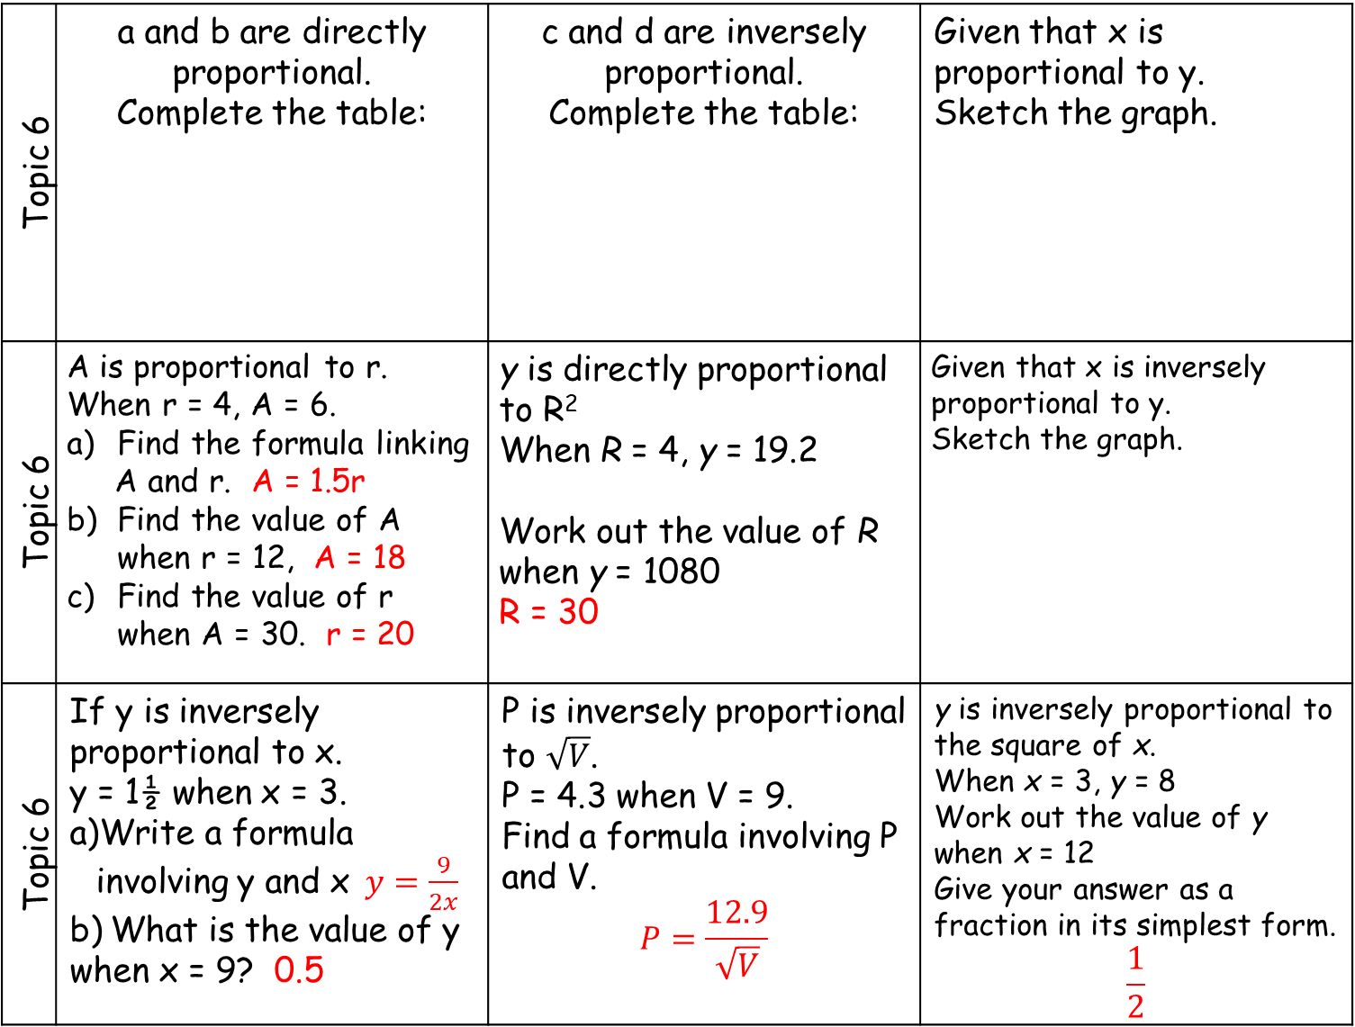
Topic 6 | a and b are directly proportional. Complete the table: | c and d are inversely proportional. Complete the table: | Given that x is proportional to y. Sketch the graph.
Topic 6 | A is proportional to r. When r = 4, A = 6. Find the formula linking A and r. A = 1.5r Find the value of A when r = 12, A = 18 Find the value of r when A = 30. r = 20 | y is directly proportional to R² When R = 4, y = 19.2 Work out the value of R when y = 1080 R = 30 | Given that x is inversely proportional to y. Sketch the graph.
Topic 6 | If y is inversely proportional to x. y = 1½ when x = 3. Write a formula involving y and x$y=\frac{9}{2x}$ b) What is the value of y when x = 9? 0.5 | P is inversely proportional to $\sqrt{V}$. P = 4.3 when V = 9. Find a formula involving P and V. $$P=\frac{12.9}{\sqrt{V}}$$ | y is inversely proportional to the square of x. When x = 3, y = 8 Work out the value of y when x = 12 Give your answer as a fraction in its simplest form. $$\frac{1}{2}$$
$$y$$
a | 4 | 10 | 20
b | 18 | 45 | 90
c | 5 | 12 | 40
d | 2 | 1.2 | 0.25
$$x$$
$$y$$
$$x$$

Slide 8
Topic 7 | Find the next two terms for this geometric sequence: a, 2a, 4a, 8a, … , … | 3, 5, 8, 13, … is a Fibonacci sequence. Find the value of the 6th term. | The n^{th} term of a sequence is n² + 50 Work out the first three terms of the sequence.
Topic 7 | Find the next two terms for this geometric sequence: 3a, 6a³ , 12a⁵ , …… , …… | 5, -3, 2, -1, … is a Fibonacci sequence. Find the value of the 7th term. | 5, 8, 13, 20, 29, …… Find the rule for the n^{th} term of this quadratic sequence
Topic 7 | …, 2, 3, 4.5, 6.75, … Is a geometric sequence a) Work out the 6th term of the sequence b) Work out the 1st term of the sequence | 2a, -3, 2a - 3, 2a - 6, … is a Fibonacci sequence Find the value of the 6th term. | 5, 9, 15, 23, 33, …… Find the rule for the n^{th} term of this quadratic sequence

Slide 9
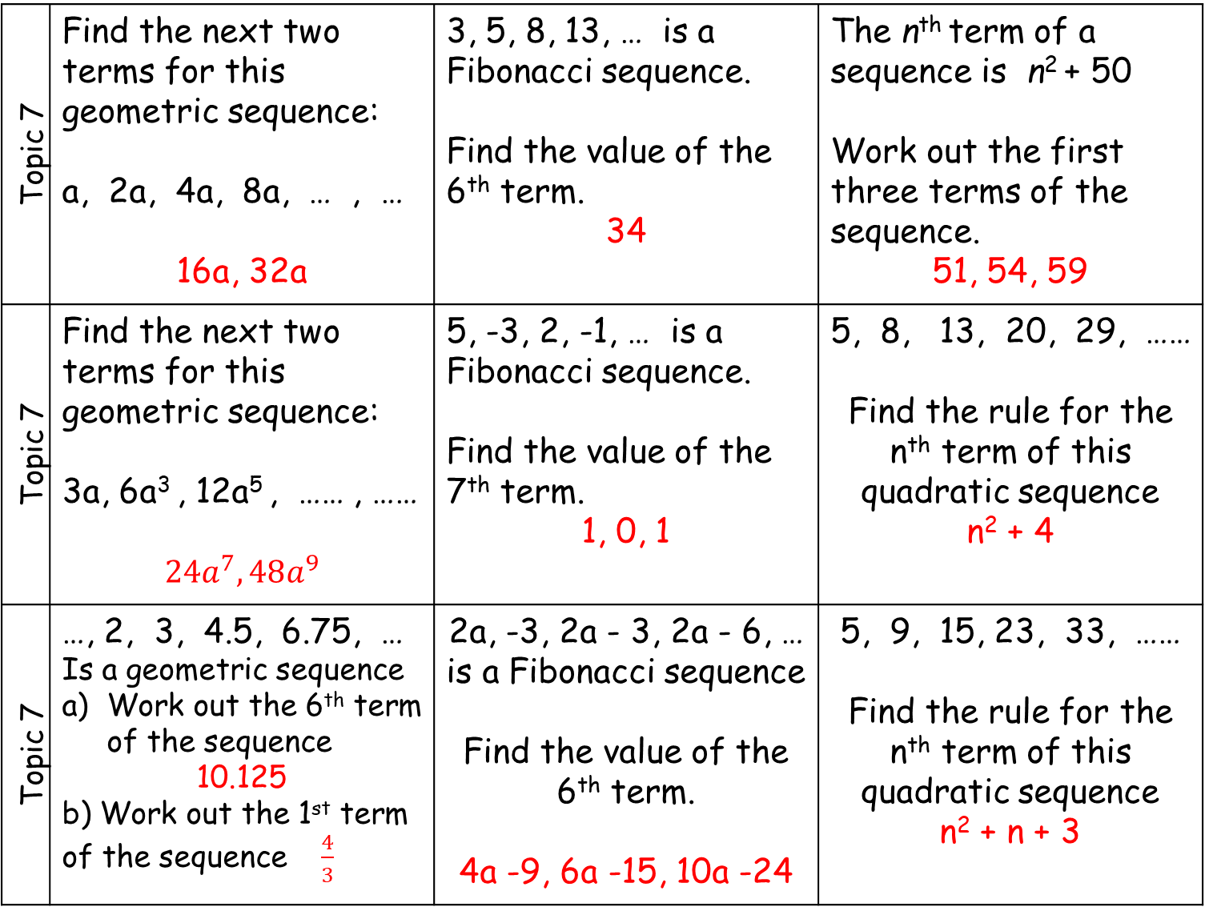
Topic 7 | Find the next two terms for this geometric sequence: a, 2a, 4a, 8a, … , … 16a, 32a | 3, 5, 8, 13, … is a Fibonacci sequence. Find the value of the 6th term. 34 | The n^{th} term of a sequence is n² + 50 Work out the first three terms of the sequence. 51, 54, 59
Topic 7 | Find the next two terms for this geometric sequence: 3a, 6a³ , 12a⁵ , …… , …… $$24a^{7}, 48a^{9}$$ | 5, -3, 2, -1, … is a Fibonacci sequence. Find the value of the 7th term. 1, 0, 1 | 5, 8, 13, 20, 29, …… Find the rule for the n^{th} term of this quadratic sequence n² + 4
Topic 7 | …, 2, 3, 4.5, 6.75, … Is a geometric sequence Work out the 6th term of the sequence 10.125 b) Work out the 1st term of the sequence $\frac{4}{3}$ | 2a, -3, 2a - 3, 2a - 6, … is a Fibonacci sequence Find the value of the 6th term. 4a -9, 6a -15, 10a -24 | 5, 9, 15, 23, 33, …… Find the rule for the n^{th} term of this quadratic sequence n² + n + 3

Slide 10
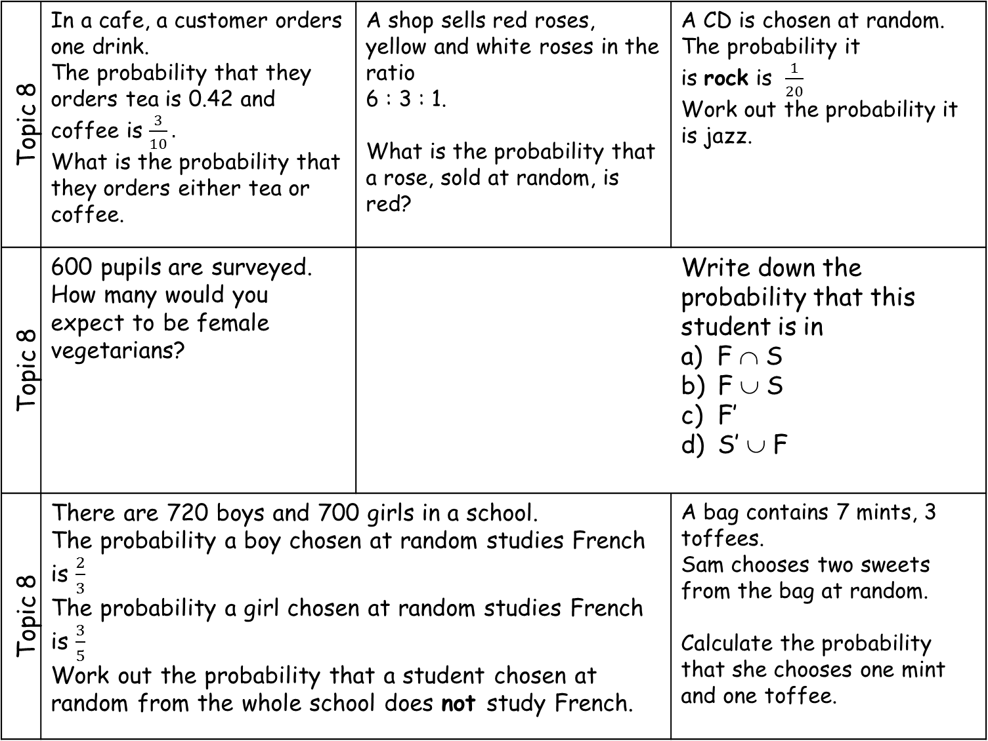
Topic 8 | In a cafe, a customer orders one drink. The probability that they orders tea is 0.42 and coffee is $\frac{3}{10}.$ What is the probability that they orders either tea or coffee. | A shop sells red roses, yellow and white roses in the ratio 6 : 3 : 1. What is the probability that a rose, sold at random, is red? | A CD is chosen at random. The probability it is rock is $\frac{1}{20}$ Work out the probability it is jazz.
Topic 8 | 600 pupils are surveyed. How many would you expect to be female vegetarians? |  | Write down the probability that this student is in a) F ∩ S F ∪ S F’ S’ ∪ F
Topic 8 | There are 720 boys and 700 girls in a school. The probability a boy chosen at random studies French is $\frac{2}{3}$ The probability a girl chosen at random studies French is $\frac{3}{5}$ Work out the probability that a student chosen at random from the whole school does not study French. |  | A bag contains 7 mints, 3 toffees. Sam chooses two sweets from the bag at random. Calculate the probability that she chooses one mint and one toffee.
Type | Rock | Pop | Jazz
Number of CDs | 2 | x | 2x + 5
F
S
8
3
5
 | Boys | Girls
Vegetarian | 0.05 | 0.2
Non-vegetarian | 0.4 | 0.35
4

Slide 11
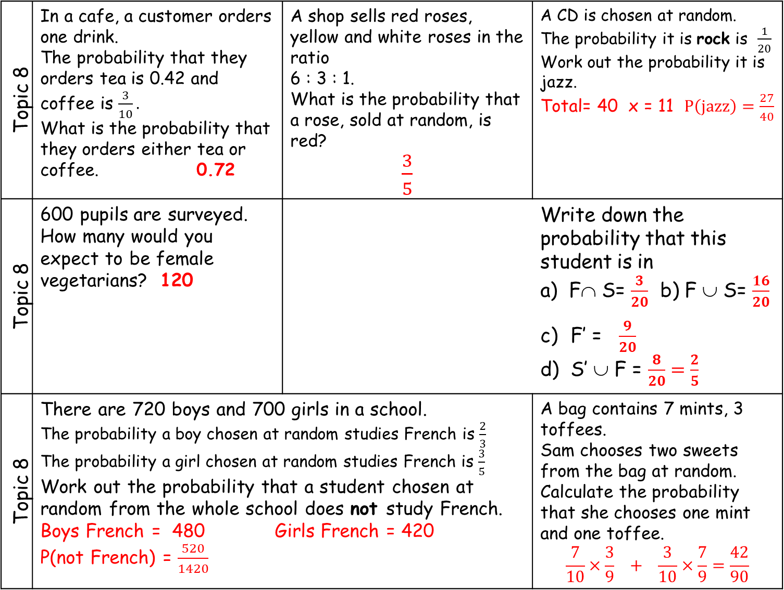
Topic 8 | In a cafe, a customer orders one drink. The probability that they orders tea is 0.42 and coffee is $\frac{3}{10}.$ What is the probability that they orders either tea or coffee. 0.72 | A shop sells red roses, yellow and white roses in the ratio 6 : 3 : 1. What is the probability that a rose, sold at random, is red? $\frac{3}{5}$ | A CD is chosen at random. The probability it is rock is $\frac{1}{20}$ Work out the probability it is jazz. Total= 40 x = 11 $P\left(jazz\right)=\frac{27}{40}$
Topic 8 | 600 pupils are surveyed. How many would you expect to be female vegetarians? 120 |  | Write down the probability that this student is in a) F∩ S= $\frac{3}{20}$ b) F ∪ S= $\frac{16}{20}$ c) F’ = $\frac{9}{20}$ d) S’ ∪ F = $\frac{8}{20}=\frac{2}{5}$
Topic 8 | There are 720 boys and 700 girls in a school. The probability a boy chosen at random studies French is $\frac{2}{3}$ The probability a girl chosen at random studies French is $\frac{3}{5}$ Work out the probability that a student chosen at random from the whole school does not study French. Boys French = 480 Girls French = 420 P(not French) = $\frac{520}{1420}$ |  | A bag contains 7 mints, 3 toffees. Sam chooses two sweets from the bag at random. Calculate the probability that she chooses one mint and one toffee. $$\frac{7}{10}×\frac{3}{9} + \frac{3}{10}×\frac{7}{9}=\frac{42}{90}$$
Type | Rock | Pop | Jazz
Number of CDs | 2 | x | 2x + 5
F
S
8
3
5
 | Boys | Girls
Vegetarian | 0.05 | 0.2
Non-vegetarian | 0.4 | 0.35
4

