Slide 1
Test 5 Revision
Year 11 Enhanced

Slide 2
Topic 17 : Common Graphs Match up the graphs, sketch the remaining two

Slide 3
Topic 17 : Common Graphs Match up the graphs, sketch the remaining two
12
5
3
10
6
7
9
4
11
2
8
1

Slide 4
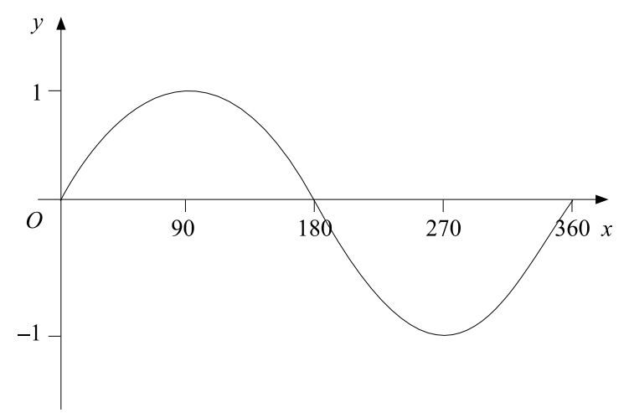
Topic 17 : Common Graphs
Here is a sketch of the curve $y= sinx$for $0≤x≤360$
Given that $sin30= \frac{1}{2}$ write down the value of:
$sin150$
$sin330$
Sketch the graphs$y=cosx$and $y=tanx$ for values $−180≤x≤360$

Slide 5
Topic 17 : Common Graphs
Here is a sketch of the curve $y= sinx$for $0≤x≤360$
Given that $sin30= \frac{1}{2}$ write down the value of:
$sin150$
$sin330$
$$=\frac{1}{2}$$
$$=−\frac{1}{2}$$
Sketch the graphs$y=cosx$and $y=tanx$ for values $−180≤x≤360$

Slide 6
$$y=cosx$$
$$y=tanx$$

Slide 7
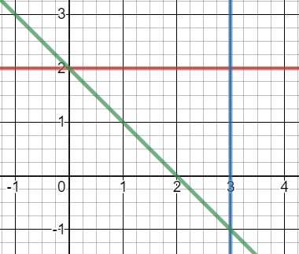
Topic 18 Inequalities |  |  | Write down the inequality shown by the diagrams.
 | Solve the inequalities: $3x+5 ≤17$ $4x −3≥−11$ $9 −2x >3$ $5x+2 <3x+11$ $3x+15 ≥9x−2$ | Work out the integers which satisfy the inequality: $$−11≤2y −3<7$$ | Solve the following quadratic inequalities $x^{2}+6x+8 <0$ $x^{2}−7x+12>0$ $x^{2}+3x−40<0$ $x^{2}−4x>21$
 | Draw a coordinate grid with $x$ and $y$ values from -5 to 5 Shade the region which satisfies $$y<−3 x≥−2$$ $$x+y≤2$$ | Use inequalities to describe the region shown

Slide 8
Topic 18 Inequalities |  |  | Write down the inequality shown by the diagrams.
 | Solve the inequalities: $3x+5 ≤17$ $4x −3≥−11$ $9 −2x >3$ $5x+2 <3x+11$ $3x+15 ≥9x−2$ | Work out the integers which satisfy the inequality: $$−11≤2y −3<7$$ | Solve the following qua dratic inequalities $x^{2}+6x+8 <0$ $x^{2}−7x−12>0$ $x^{2}+3x−40<0$ $x^{2}−4x>21$
 | Draw a coordinate grid with $x$ and $y$ values from -5 to 5 Shade the region which satisfies $$y<−4 x≥−2$$ $$x+y≤4$$ | Use inequalities to describe the region shown
$$x≥−1$$
$$x<−1$$
$−2 <x≤$3
$$x≤4$$
$$x≥−2$$
$$−4 <x<−2$$
$$x<3$$
$x<$3 & $x>4$
$$x<\frac{9}{2}$$
$$−8 <x<5$$
$$x≤\frac{17}{6}$$
-4, -3, -2, -1 0, 1,2 ,3, 4
$x<$-3 & $x>7$
$$x≤3$$
$$y≤2$$
$$x+y≥2$$

Slide 9
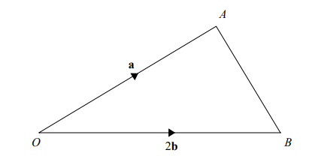
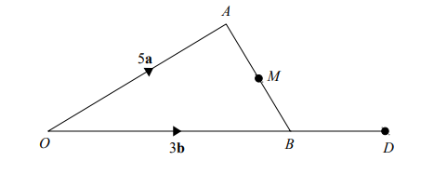
Topic 19 Loci and Vectors | Construct a perpendicular bisector of a line which is 6cm long | Construct a 30⁰ angle |  | Draw a rectangle where AB = CD = 5cm and BC =DA = 4cm Show the region which is closer to the line BC than CD but within 3.5cm of A
 | $$a= \left({5 \atop −6}\right) b=\left({−3 \atop 2}\right)$$ Find $a+b$ $a−b$ 3$a+2b$ | Calculate $\overset{→}{AB}$ Point C lies on the line AB so the ratio of AC:CB is 3:1. Calculate $\overset{→}{BC}$
 |  |  | C is the point such that OC:CA = 4:1 M is the midpoint of AB D is the point such that OB:OD = 3:4 Show that C, M and D are on the same straight line.

Slide 10
Topic 19 Loci and Vectors | Construct a perpendicular bisector of a line which is 6cm long | Construct a 30⁰ angle |  | Draw a rectangle where AB = CD = 5cm and BC =DA = 4cm Show the region which is closer to the line BC than CD but with 3.5cm of A
 | $$a= \left({5 \atop −6}\right) b=\left({−3 \atop 2}\right)$$ Find $a+b$ $a−b$ 3$a+2b$ | Calculate $\overset{→}{AB}$ Point C lies on the line AB so the ratio of AC:CB is 3:1. Calculate $\overset{→}{BC}$
 |  |  | C is the point such that OC:CA = 4:1 M is the midpoint of AB D is the point such that OB:OD = 3:4 Show that C, M and D are on the same straight line.
-a + 2b
$$\left({2 \atop −4}\right)$$
$$\left({8 \atop −8}\right)$$
$$\left({9 \atop −14}\right)$$
¼(a - 2b)
$\overset{→}{CM}$
= $−\frac{3}{2}a+\frac{3}{2}b$
$\overset{→}{MD}$
= $−\frac{5}{2}a+\frac{5}{2}b$
Multiples with a common point therefore they are on a straight line

Slide 11
Algebra: Algebraic fractions Topic 20 | Simplify $$\frac{x^{2}+3x}{x^{2}+4x+3}$$ | Simplify $$\frac{{2x}^{2}−4x}{x^{2}+3x−10}$$ | Simplify $$\frac{x^{2}+3x+2}{x^{2}−4}$$
 | Calculate $$\frac{3}{x+2}+\frac{5}{x}$$ | Calculate $$\frac{3}{x+1}+\frac{2}{x−5}$$ | Calculate $$\frac{6}{x+4}−\frac{2}{x−1}$$
 | Calculate $$\frac{x^{2}+3x+2}{4x+6}×\frac{4x}{x^{2}+5x+5}$$ | Calculate $$\frac{3x+1}{x^{2}−4}×\frac{x^{2}+3x+2}{6x+2}$$ | Calculate $$\frac{x^{2}−1}{x^{2}+2x−3}÷\frac{x^{2}+4x+3}{x^{2}+2x+1}$$

Slide 12
Algebra: Algebraic fractions Topic 20 | Simplify $$\frac{x^{2}+3x}{x^{2}+4x+3}$$ = $\frac{x(x+3)}{\left(x+1\right)(x+3)}=\frac{x}{x+1}$ | Simplify $$\frac{{2x}^{2}−4x}{x^{2}+3x−10}$$ = $\frac{2x(x−2)}{\left(x−2\right)(x+5)}=\frac{2x}{x+5}$ | Simplify $$\frac{x^{2}+3x+2}{x^{2}−4}$$ = $\frac{(x+1)(x+2)}{\left(x−2\right)(x+2)}=\frac{x+1}{x−2}$
 | Calculate $$\frac{3}{x+2}+\frac{5}{x}$$ = $\frac{3x+5x+10}{x (x+2)}=\frac{2(4x+5)}{x(x+2)}$ | Calculate $$\frac{3}{x+1}+\frac{2}{x−5}$$ = $\frac{3x−15+2x+2}{\left(x+1\right)(x−5)}=\frac{5x−13}{(x+1)(x−5)}$ | Calculate $$\frac{6}{x+4}−\frac{2}{x−1}$$ = $\frac{6x−6−2x−8}{\left(x+4\right)(x−1)}=\frac{2(x−7)}{\left(x+4\right)(x−1)}$
 | Calculate $$\frac{x^{2}+3x+2}{4x+6}×\frac{4x}{x^{2}+5x+5}$$ = $\frac{2x(x+2)}{\left(x+3\right)(x+5)}$ | Calculate $$\frac{3x+1}{x^{2}−4}×\frac{x^{2}+3x+2}{6x+2}$$ = $\frac{(x+1)}{2\left(x−2\right)(3x+1)}$ | Calculate $$\frac{x^{2}−1}{x^{2}+2x−3}÷\frac{x^{2}+4x+3}{x^{2}+2x+1}$$ = $\frac{(x−1)(x+1)}{\left(x−1\right)(x+3)}×\frac{(x+3)(x+1)}{\left(x+1\right)(x+1)}$ = 1

