Slide 1
Test 3 Revision
Year 10 Higher

Slide 2
Number : %/decimal/fraction Topic 9 | Calculate the decimal multiplier to find: 35% 17% 3.25% | Write down the decimal multiplier to increase an amount by:​ 15%​ 7%​ 4.8% | Write down the decimal multiplier to decrease an amount by:​ ​ 15%​ 7%​ 4.8%
 | Adam gets a bonus of 30% of £80​ Katy gets a bonus of £28.​ ​ Work out the difference between the bonus Adam gets and the bonus Katy gets. | A shop has a 35% sale. The normal price of a TV is £450. How much does the TV cost in the sale? | A board 130 cm long is trimmed to 104 cm. ​ ​ What percentage has been removed ?
 | The price of a dishwasher is £414. This price includes VAT at a rate of 20%. What was the price before VAT was added? | Bill wants to increase 150 by 3%​ He writes ​ 150 × 1.3 = 195​ ​ Bill’s answer is wrong.​ Explain why. | A person weighs 65 kg. ​ After two weeks on a diet they weigh 58 kg. ​ ​ What is the percentage decrease in weight ?​ Give your answer to 2 d.p.

Slide 3
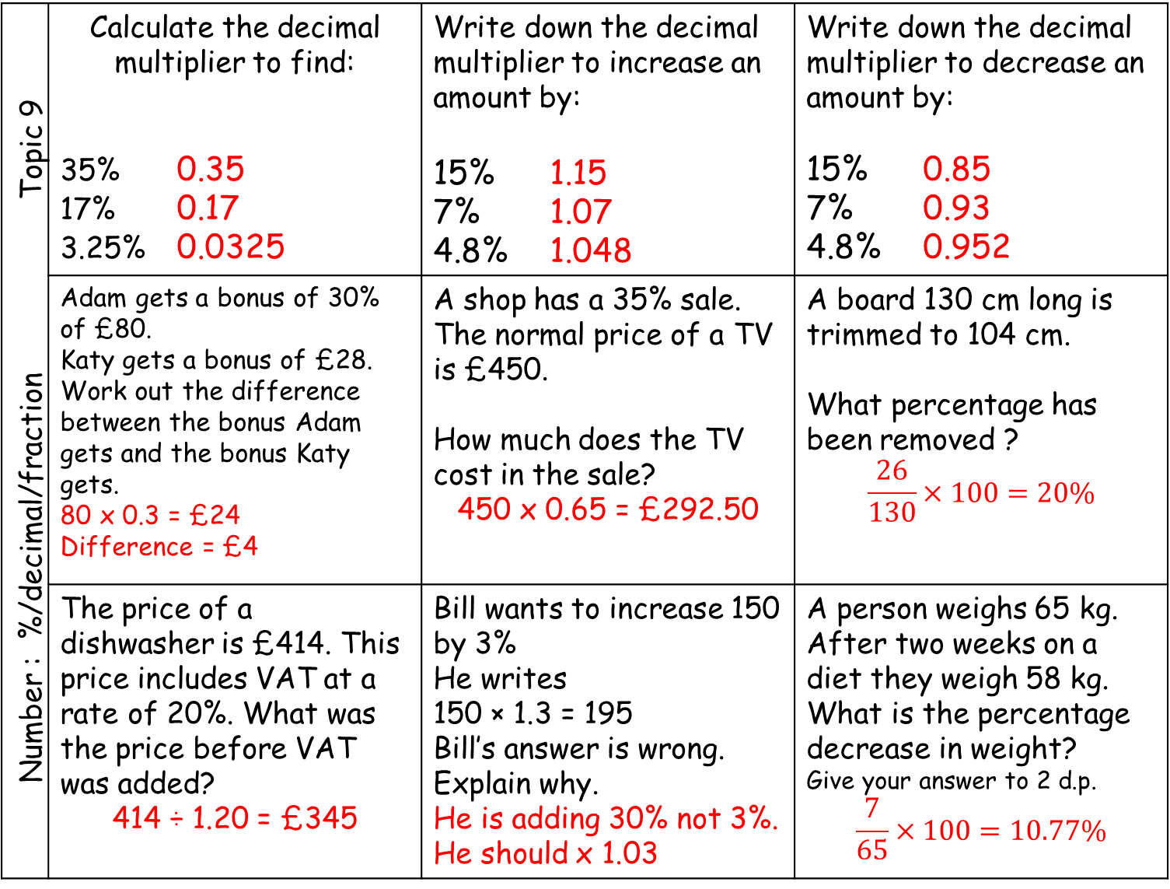
Number : %/decimal/fraction Topic 9 | Calculate the decimal multiplier to find: 35% 0.35 17% 0.17 3.25% 0.0325 | Write down the decimal multiplier to increase an amount by:​ ​ 15%​ 1.15​ 7% 1.07​ 4.8% 1.048 | Write down the decimal multiplier to decrease an amount by:​ ​ 15%​ 0.85 7%​ 0.93 4.8% 0.952
 | Adam gets a bonus of 30% of £80​. Katy gets a bonus of £28.​ Work out the difference between the bonus Adam gets and the bonus Katy gets. 80 x 0.3 = £24 Difference = £4 | A shop has a 35% sale. The normal price of a TV is £450. How much does the TV cost in the sale? 450 x 0.65 = £292.50 | A board 130 cm long is trimmed to 104 cm. ​ ​ What percentage has been removed ? $$\frac{26}{130}×100=20\%$$
 | The price of a dishwasher is £414. This price includes VAT at a rate of 20%. What was the price before VAT was added? 414 ÷ 1.20 = £345 | Bill wants to increase 150 by 3%​ He writes ​ 150 × 1.3 = 195​ Bill’s answer is wrong.​ Explain why. He is adding 30% not 3%. He should x 1.03 | A person weighs 65 kg. ​ After two weeks on a diet they weigh 58 kg. ​ What is the percentage decrease in weight?​ Give your answer to 2 d.p. $$\frac{7}{65}×100=10.77\%$$

Slide 4
Number : Percentages Topic 9 | William’s salary is £24 000. His salary increases by 4%. Work out William’s new salary. | In 2000 the minimum wage for adults was £3.60 per hour. In 2019 it is £8.10. Work out the percentage increase in the minimum wage. | A company bought a van that had a value of £12 000 The value of the van depreciates by 25% per annum. Work out the value at the end of three years.
 | Last year Jo paid £245 for her car insurance. This year she has to pay £883 for her car insurance. Work out the percentage increase in the cost of her car insurance. | In 2003, Jerry bought a house. In 2007, Jerry sold the house to Mia. He made a profit of 20%. In 2012, Mia sold the house for £162 000. She made a loss of 10% Work out how much Jerry paid for the house in 2003.
 | Jack invests £3000 for 2 years at 4% per annum compound interest. Work out the value of the investment at the end of 2 years. | Mrs Pitt sold their house for £168 000. They made a profit of 12% on the price they paid for the house. Calculate how much they paid for the house. | In a sale, normal prices are reduced by 12%. The sale price of a laptop is £242. Work out the normal price of the lap top.

Slide 5
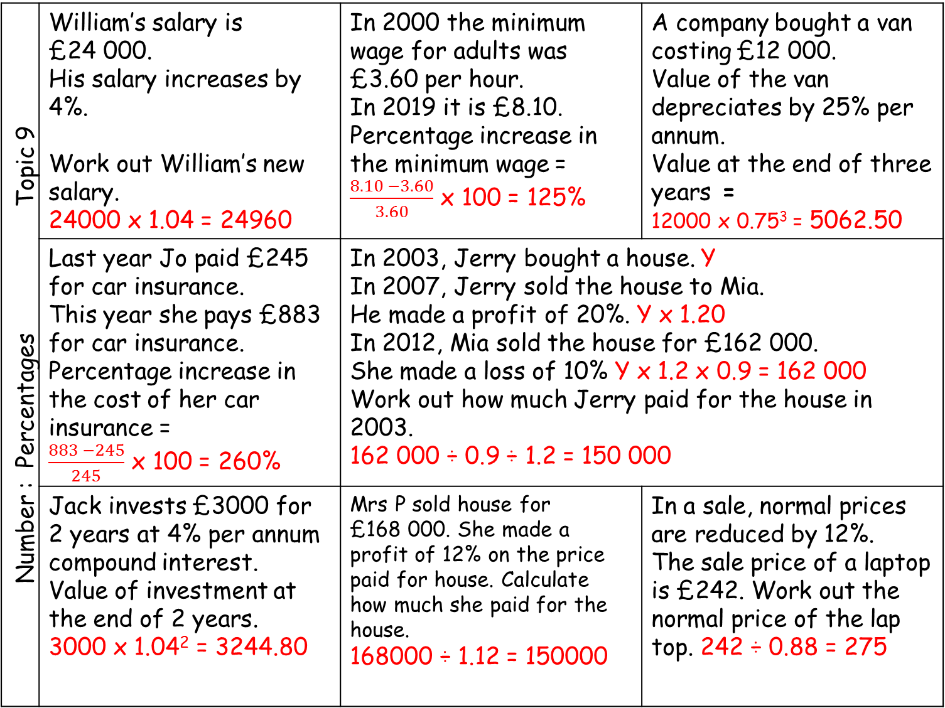
Number : Percentages Topic 9 | William’s salary is £24 000. His salary increases by 4%. Work out William’s new salary. 24000 x 1.04 = 24960 | In 2000 the minimum wage for adults was £3.60 per hour. In 2019 it is £8.10. Percentage increase in the minimum wage = $\frac{8.10 −3.60}{3.60}$ x 100 = 125% | A company bought a van costing £12 000. Value of the van depreciates by 25% per annum. Value at the end of three years = 12000 x 0.75³ = 5062.50
 | Last year Jo paid £245 for car insurance. This year she pays £883 for car insurance. Percentage increase in the cost of her car insurance = $\frac{883 −245}{245}$ x 100 = 260% | In 2003, Jerry bought a house. Y In 2007, Jerry sold the house to Mia. He made a profit of 20%. Y x 1.20 In 2012, Mia sold the house for £162 000. She made a loss of 10% Y x 1.2 x 0.9 = 162 000 Work out how much Jerry paid for the house in 2003. 162 000 ÷ 0.9 ÷ 1.2 = 150 000
 | Jack invests £3000 for 2 years at 4% per annum compound interest. Value of investment at the end of 2 years. 3000 x 1.04² = 3244.80 | Mrs P sold house for £168 000. She made a profit of 12% on the price paid for house. Calculate how much she paid for the house. 168000 ÷ 1.12 = 150000 | In a sale, normal prices are reduced by 12%. The sale price of a laptop is £242. Work out the normal price of the lap top. 242 ÷ 0.88 = 275

Slide 6
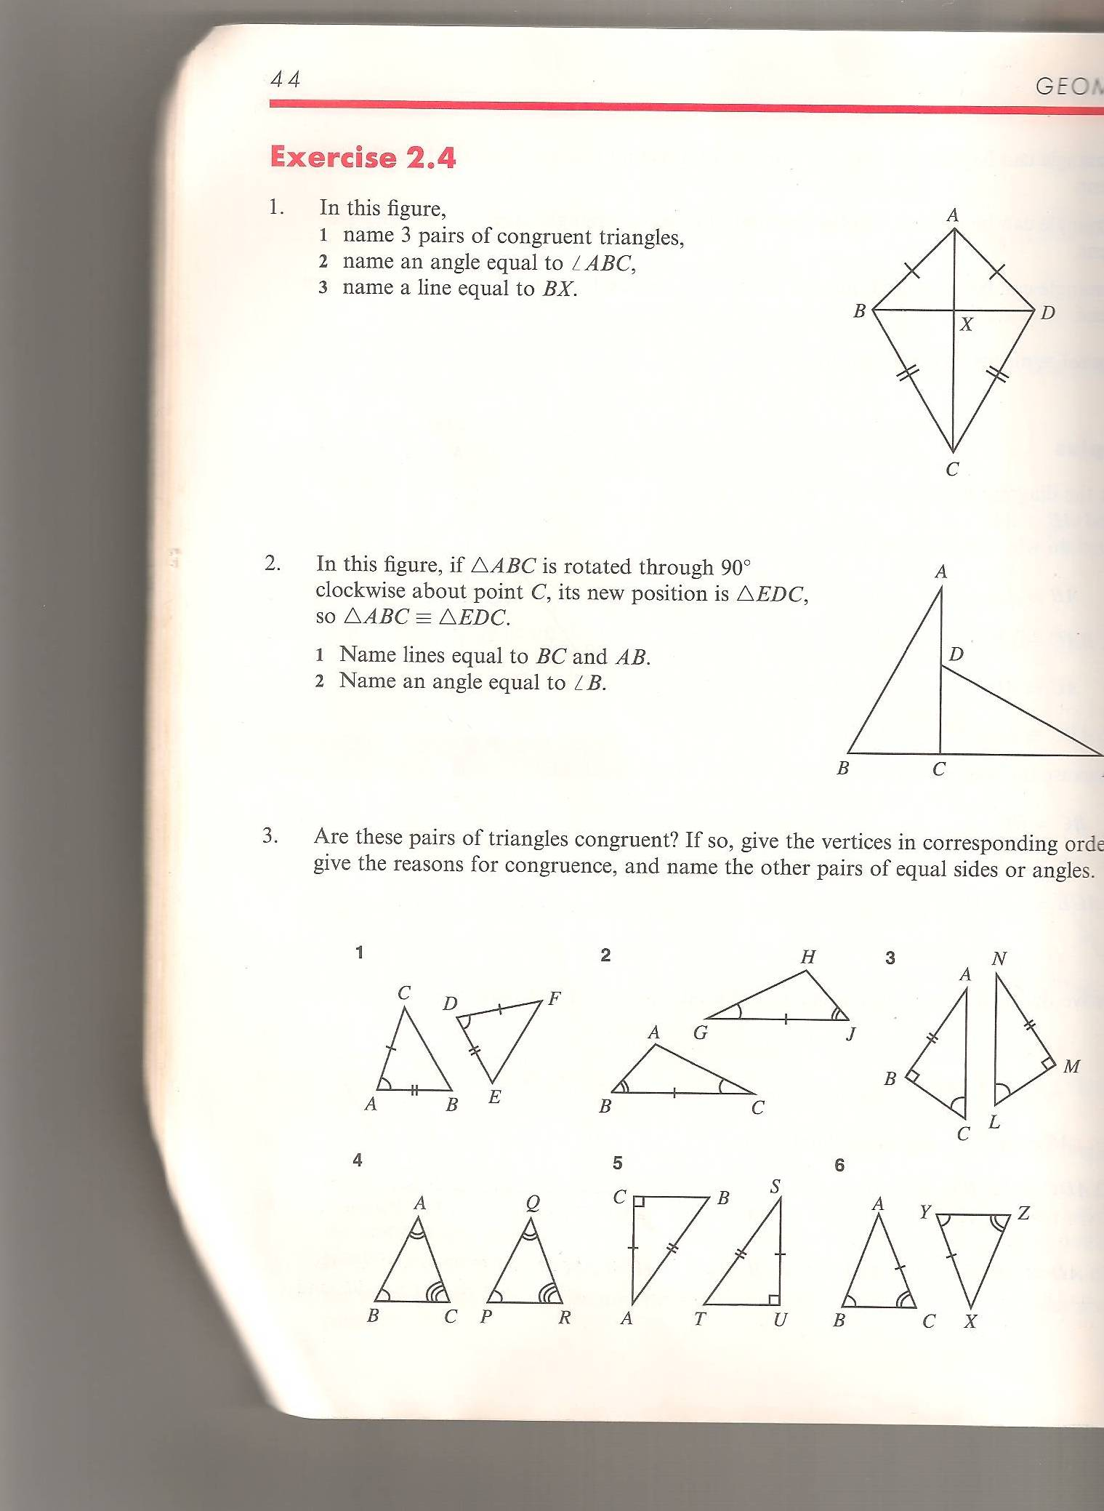
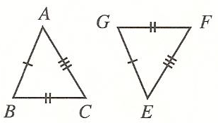
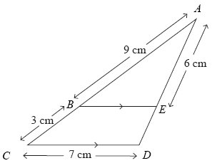
Geometry: Similarity and congruency Topic 10 | Decide if these triangles are congruent. State the congruency rule used. | AB is parallel to DC. The lines AC and BD intersect at E. a) Explain why triangle ABE and triangle CDE are similar. b) Calculate the length of AC.
 | Work out the length of PQ. Work out the length of BP. | Calculate the length of BE. Calculate the length of ED

Slide 7

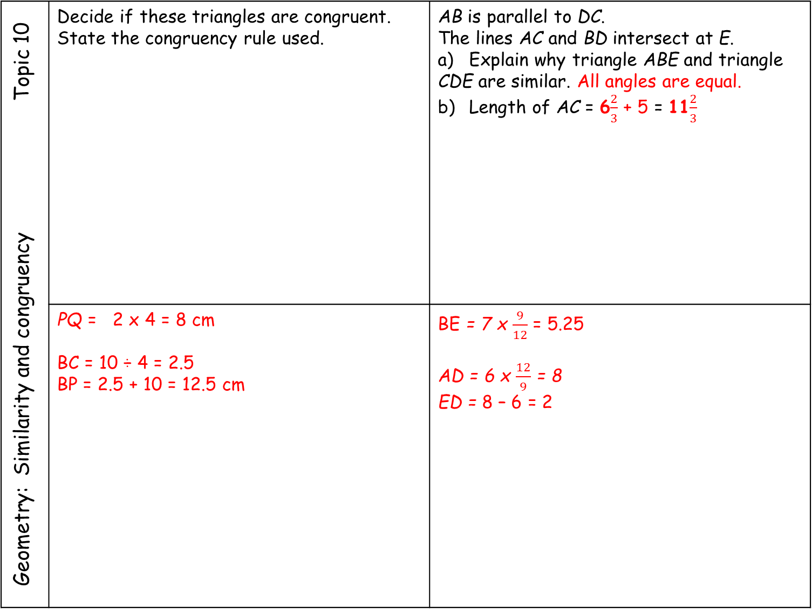
Geometry: Similarity and congruency Topic 10 | Decide if these triangles are congruent. State the congruency rule used. | AB is parallel to DC. The lines AC and BD intersect at E. a) Explain why triangle ABE and triangle CDE are similar. All angles are equal. b) Length of AC = 6$\frac{2}{3}$ + 5 = 11$\frac{2}{3}$
 | PQ = 2 x 4 = 8 cm BC = 10 ÷ 4 = 2.5 BP = 2.5 + 10 = 12.5 cm | BE = 7 x $\frac{9}{12}$ = 5.25 AD = 6 x $\frac{12}{9}$ = 8 ED = 8 – 6 = 2
YES SSS
AE =5 x $\frac{8}{6}$ = 6$\frac{2}{3}$
YES SAS
NO

Slide 8
Geometry: Similarity and congruency Topic 10 | Construct the triangle ABC where : AB = 6.5 cm Angle A = 106° Angle B = 38° | Construct an accurate scale diagram of the triangle DEF using the scale 1cm = 4m.
16m
20m
30m
Diagram not drawn to accurately.

Slide 9


Geometry: Similarity and congruency Topic 10 | Construct the triangle ABC where AB = 6.5 cm Angle A = 106° Angle B = 38° | Construct an accurate scale diagram of the triangle DEF using the scale 1 cm = 4 m.
16m
20m
30m
Diagram not drawn to accurately.
16 m = 4 cm
20 m = 5 cm
30 m = 7.5 cm
$$106°$$
38$°$
A
B
6.5 cm
4cm
5cm
7.5cm

Slide 10
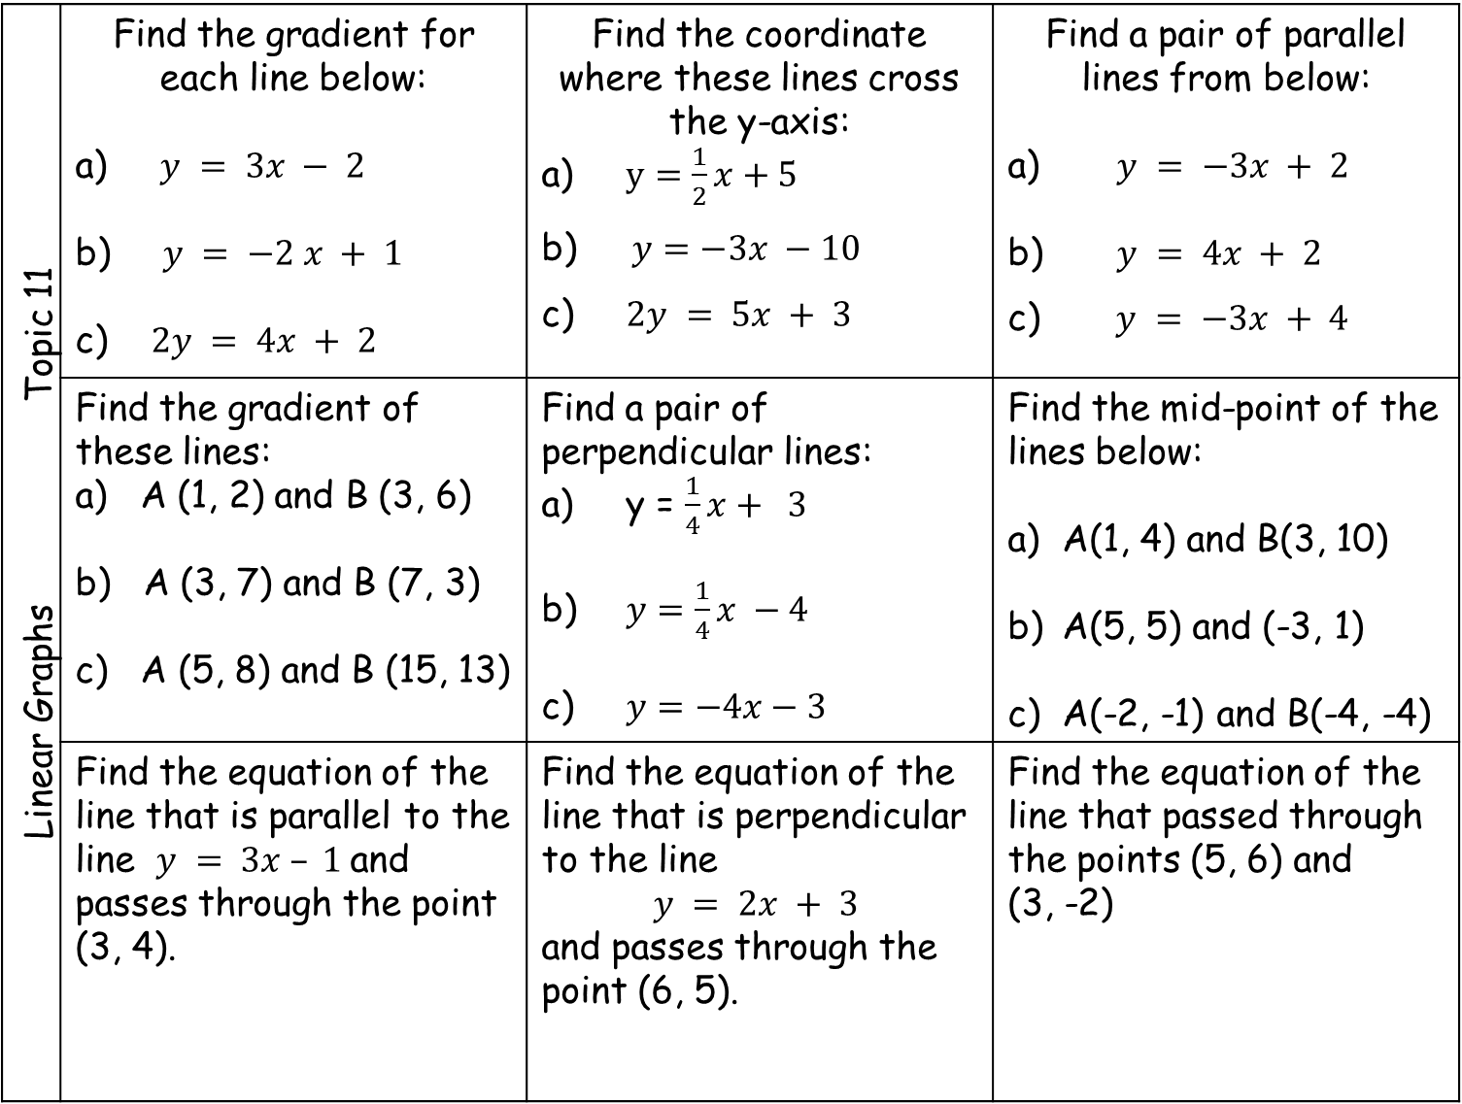
Linear Graphs Topic 11 | Find the gradient for each line below: a) $y = 3x − 2$ $y = −2 x + 1$ c) $2y = 4x + 2$ | Find the coordinate where these lines cross the y-axis: a) $y=\frac{1}{2}x+5$ b) $y=−3x −10$ c) $2y = 5x + 3$ | Find a pair of parallel lines from below: $y = −3x + 2$ $y = 4x + 2$ c) $y = −3x + 4$
 | Find the gradient of these lines: a) A (1, 2) and B (3, 6) b) A (3, 7) and B (7, 3) A (5, 8) and B (15, 13) | Find a pair of perpendicular lines: a) y = $\frac{1}{4}x+ 3$ b) $y=\frac{1}{4}x −4$ c) $y=−4x−3$ | Find the mid-point of the lines below: A(1, 4) and B(3, 10) A(5, 5) and (-3, 1) A(-2, -1) and B(-4, -4)
 | Find the equation of the line that is parallel to the line $y = 3x – 1$and passes through the point (3, 4). | Find the equation of the line that is perpendicular to the line $$y = 2x + 3$$ and passes through the point (6, 5). | Find the equation of the line that passed through the points (5, 6) and (3, -2)

Slide 11
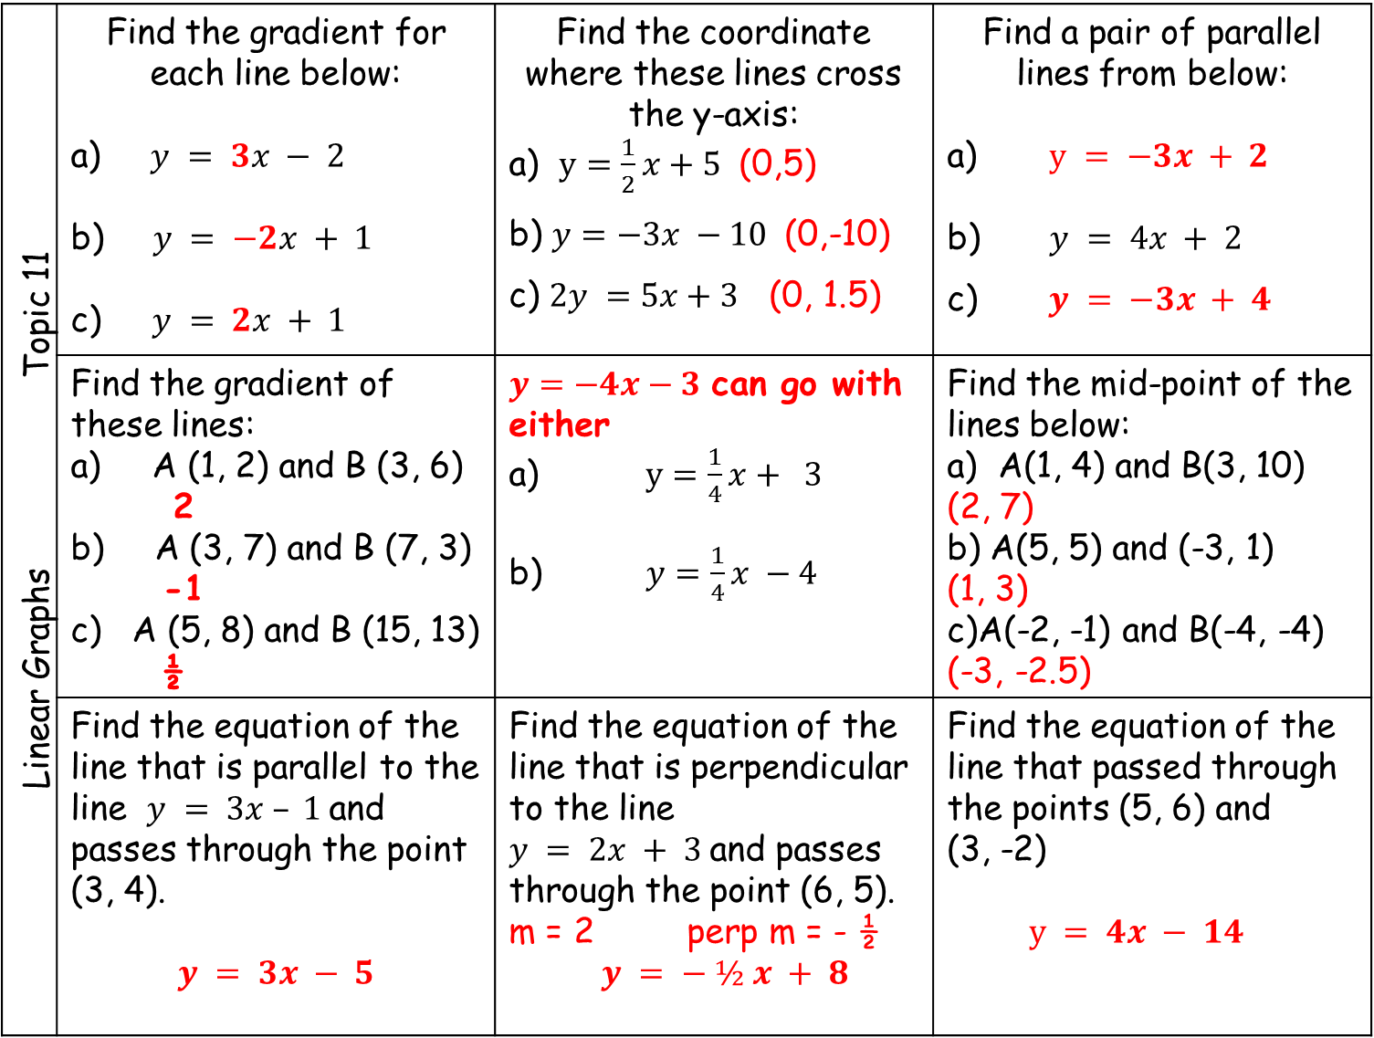
Linear Graphs Topic 11 | Find the gradient for each line below: a) $y = 3x − 2$ $y = −2x + 1$ c) $y = 2x + 1$ | Find the coordinate where these lines cross the y-axis: a) $y=\frac{1}{2}x+5$ (0,5) b) $y=−3x −10$ (0,-10) c) $2y =5x+3$(0, 1.5) | Find a pair of parallel lines from below: $y = −3x + 2$ $y = 4x + 2$ c) $y = −3x + 4$
 | Find the gradient of these lines: a) A (1, 2) and B (3, 6) 2 b) A (3, 7) and B (7, 3) -1 A (5, 8) and B (15, 13) ½ | $y=−4x−3$ can go with either a) $y=\frac{1}{4}x+ 3$ b) $y=\frac{1}{4}x −4$ | Find the mid-point of the lines below: A(1, 4) and B(3, 10) (2, 7) b) A(5, 5) and (-3, 1) (1, 3) c)A(-2, -1) and B(-4, -4) (-3, -2.5)
 | Find the equation of the line that is parallel to the line $y = 3x – 1$and passes through the point (3, 4). $$y = 3x − 5$$ | Find the equation of the line that is perpendicular to the line $y = 2x + 3$and passes through the point (6, 5). m = 2 perp m = - ½ $y = − ½ x + 8$ | Find the equation of the line that passed through the points (5, 6) and (3, -2) $y = 4x − 14$

Slide 12
Statistics: Data display Topic 12 | The scatter graph shows information about the height and the weight for ten students. a) What type of correlation does this scatter graph show? One pupil had their height incorrectly measured. Write down the co-ordinate of this pupil. c) Another student is 110 cm tall. Would it be sensible to estimate the weight of for them? Explain.
Height
in cm

Slide 13
Statistics: Data display Topic 12 | The scatter graph shows information about the height and the weight for ten students. a) What type of correlation does this scatter graph show? Positive One pupil had their height incorrectly measured. Write down the co-ordinate of this pupil. (145, 50) c) Another student is 110 cm tall. Not as reliable as extrapolating data. Would it be sensible to estimate the weight of for them? Explain.
Height
in cm

Slide 14
Statistics: Data display Topic 12 | The scatter diagram shows information about 12 girls. It shows the age of each girl and the best time she takes to run 100 metres. Write down the type of correlation. Kristina is 11 years old. Her best time to run 100 metres is 12 seconds. The point representing this information would be an outlier on the scatter diagram. Explain why. c) Debbie is 15 years old. Debbie says, “The scatter diagram shows I should take less than 12 seconds to run 100 metres.” Comment on what Debbie says.
Time in seconds

Slide 15
Statistics: Data display Topic 12 | The scatter diagram shows information about 12 girls. It shows the age of each girl and the best time she takes to run 100 metres. Write down the type of correlation. Negative Kristina is 11 years old. Her best time to run 100 metres is 12 seconds. The point representing this information would be an outlier on the scatter diagram. Does not fit with the current trend c) Debbie is 15 years old. “The scatter diagram shows I should take less than 12 seconds to run 100 metres.” Not reliable as extrapolating data (outside the range of data collected)
Time in seconds

