Slide 1
Test 4 Revision
Year 10 Higher

Slide 2
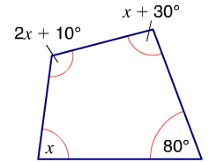
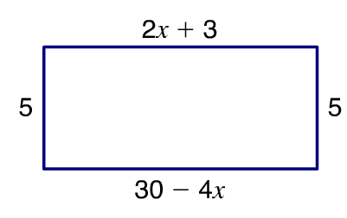
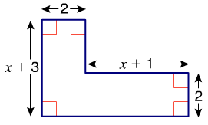
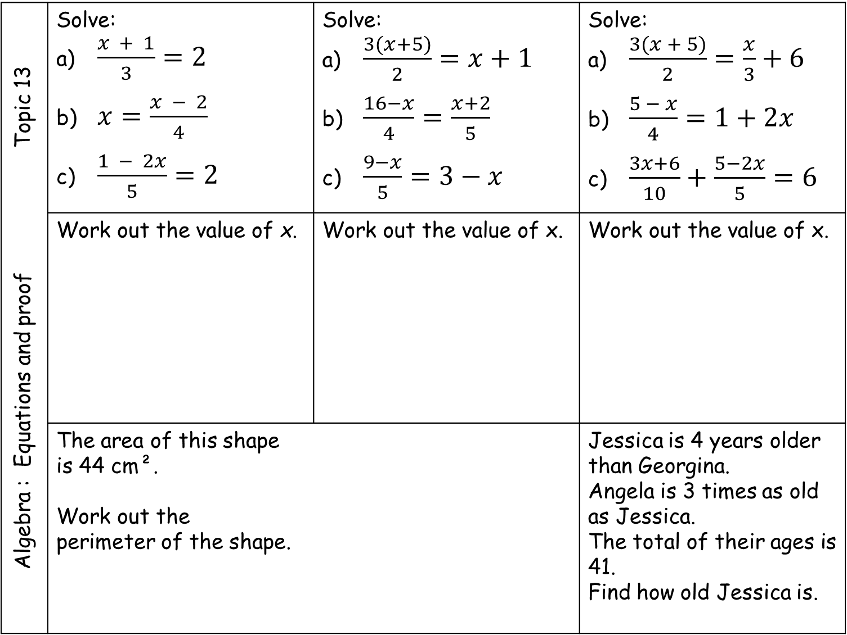
Algebra : Equations and proof Topic 13 | Solve: a) $\frac{x + 1}{3}=2$ b) $x=\frac{x − 2}{4}$ c) $\frac{1 − 2x}{5}=2$ | Solve: a) $\frac{3(x+5)}{2}=x+1$ b) $\frac{16−x}{4}=\frac{x+2}{5}$ c) $\frac{9−x}{5}=3−x$ | Solve: a) $\frac{3(x + 5)}{2}=\frac{x}{3}+6$ b) $\frac{5 − x}{4}=1+2x$ c) $\frac{3x+6}{10}+\frac{5−2x}{5}=6$
 | Work out the value of x. | Work out the value of x. | Work out the value of x.
 | The area of this shape is 44 cm². Work out the perimeter of the shape. |  | Jessica is 4 years older than Georgina. Angela is 3 times as old as Jessica. The total of their ages is 41. Find how old Jessica is.
64
4(x - 8)
2x + 13

Slide 3
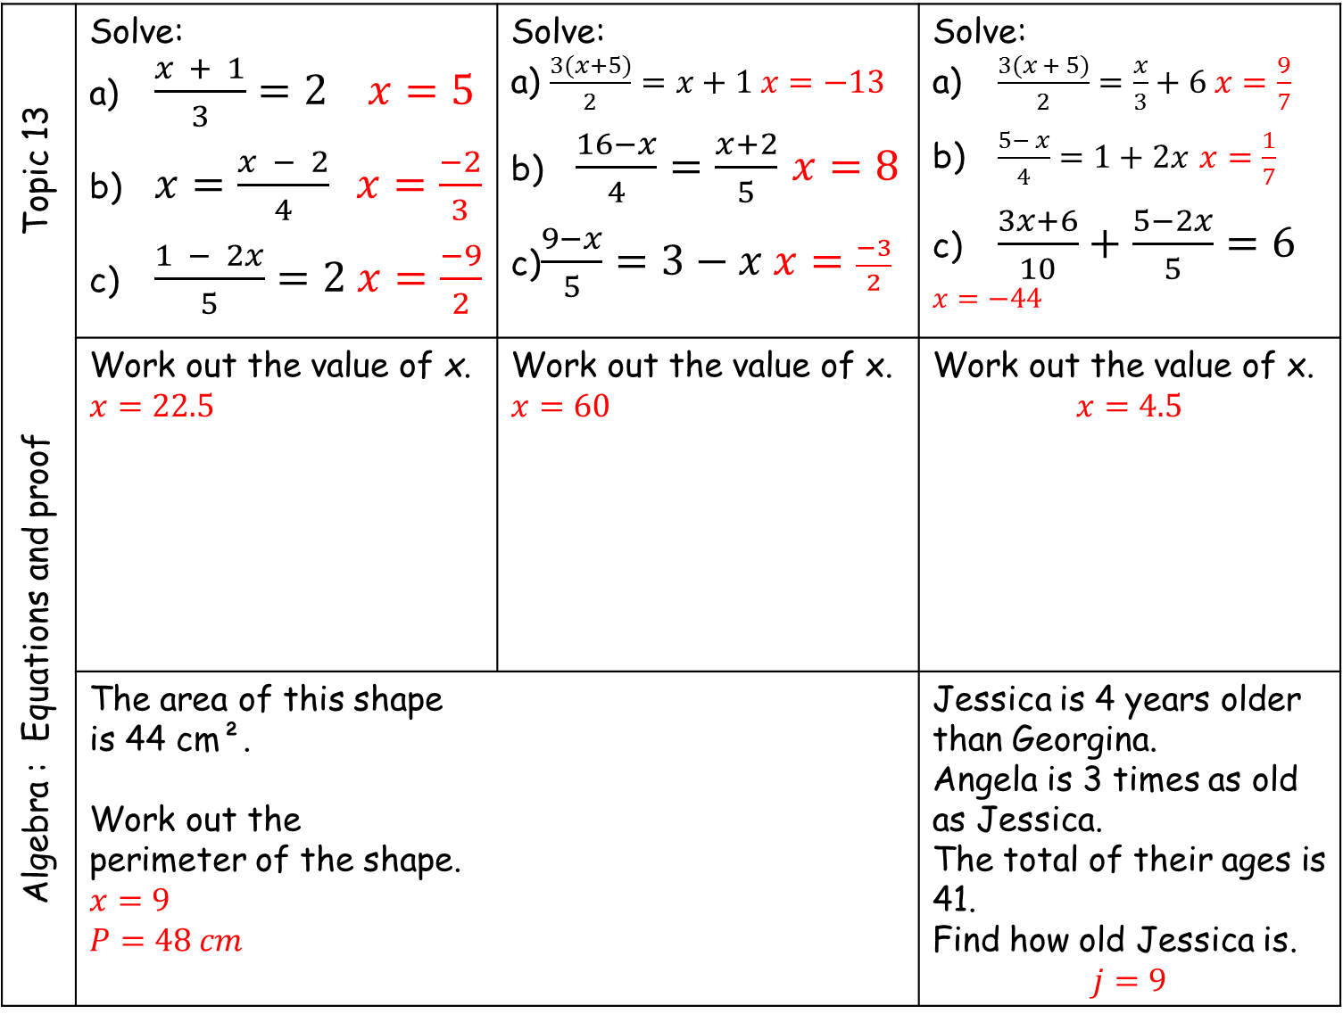
Algebra : Equations and proof Topic 13 | Solve: a) $\frac{x + 1}{3}=2 x=5$ b) $x=\frac{x − 2}{4} x=\frac{−2}{3}$ c) $\frac{1 − 2x}{5}=2 x=\frac{−9}{2}$ | Solve: a) $\frac{3(x+5)}{2}=x+1$ $x=−13$ b) $\frac{16−x}{4}=\frac{x+2}{5}$ $x=8$ c)$\frac{9−x}{5}=3−x x=\frac{−3}{2}$ | Solve: a) $\frac{3(x + 5)}{2}=\frac{x}{3}+6 x=\frac{9}{7}$ b) $\frac{5− x}{4}=1+2x$ $x=\frac{1}{7}$ c) $\frac{3x+6}{10}+\frac{5−2x}{5}=6$ $$x=−44$$
 | Work out the value of x. $$x=22.5$$ | Work out the value of x. $$x=60$$ | Work out the value of x. $$x=4.5$$
 | The area of this shape is 44 cm². Work out the perimeter of the shape. $$x=9$$ $$P=48 cm$$ |  | Jessica is 4 years older than Georgina. Angela is 3 times as old as Jessica. The total of their ages is 41. Find how old Jessica is. $$j=9$$
64
4(x - 8)
2x + 13

Slide 4
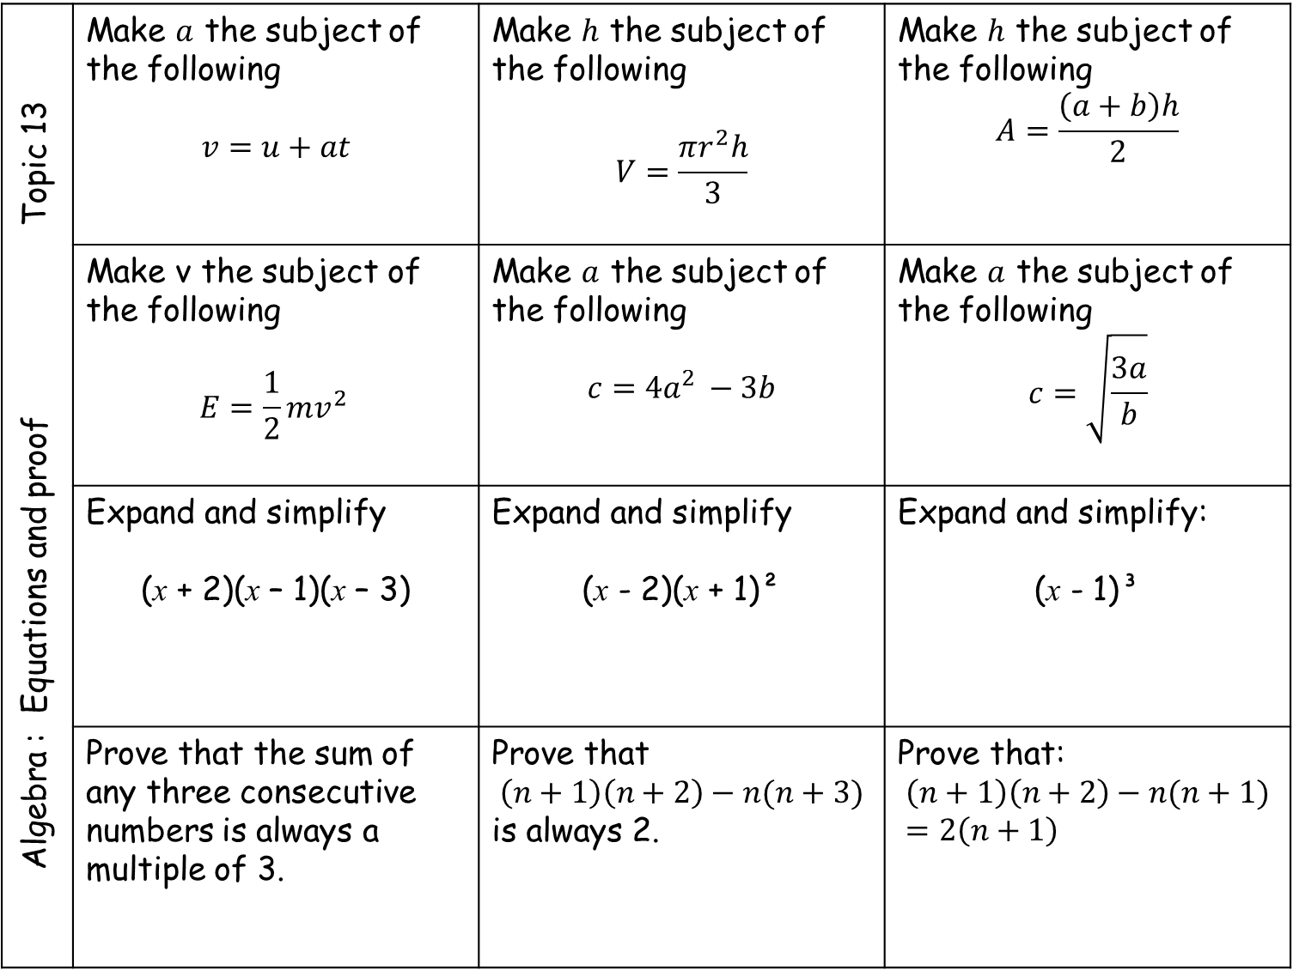
Algebra : Equations and proof Topic 13 | Make $a$ the subject of the following $$v=u+at$$ | Make $h$ the subject of the following $$V=\frac{πr^{2}h}{3}$$ | Make $h$ the subject of the following $$A=\frac{\left(a+b\right)h}{2}$$
 | Make v the subject of the following $$E={\frac{1}{2}mv}^{2 }$$ | Make $a$ the subject of the following $$c={4a}^{2 }−3b$$ | Make $a$ the subject of the following $$c=\sqrt{\frac{3a}{b}}$$
 | Expand and simplify (x + 2)(x – 1)(x – 3) | Expand and simplify (x - 2)(x + 1)² | Expand and simplify: (x - 1)³
 | Prove that the sum of any three consecutive numbers is always a multiple of 3. | Prove that $$\left(n+1\right)\left(n+2\right)−n(n+3)$$ is always 2. | Prove that: $$\left(n+1\right)\left(n+2\right)−n(n+1)=2\left(n+1\right)$$

Slide 5
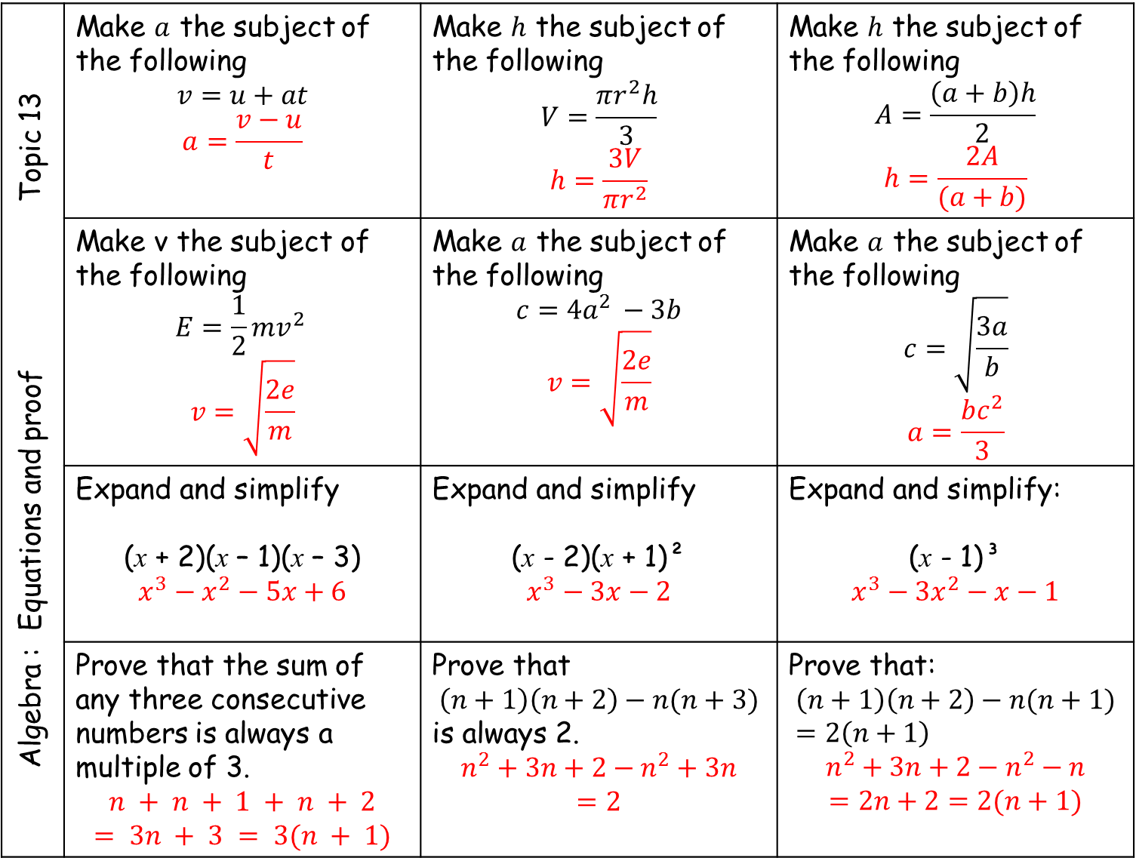
Algebra : Equations and proof Topic 13 | Make $a$ the subject of the following $$v=u+at$$ $$a=\frac{v−u}{t}$$ | Make $h$ the subject of the following $$V=\frac{πr^{2}h}{3}$$ $$h=\frac{3V}{πr^{2}}$$ | Make $h$ the subject of the following $$A=\frac{\left(a+b\right)h}{2}$$ $$h=\frac{2A}{(a+b)}$$
 | Make v the subject of the following $$E={\frac{1}{2}mv}^{2 }$$ $$v=\sqrt{\frac{2e}{m}}$$ | Make $a$ the subject of the following $$c={4a}^{2 }−3b$$ $$v=\sqrt{\frac{2e}{m}}$$ | Make $a$ the subject of the following $$c=\sqrt{\frac{3a}{b}}$$ $$a=\frac{bc^{2}}{3}$$
 | Expand and simplify (x + 2)(x – 1)(x – 3) $$x^{3}−x^{2}−5x+6$$ | Expand and simplify (x - 2)(x + 1)² $$x^{3}−3x−2$$ | Expand and simplify: (x - 1)³ $$x^{3}−3x^{2}−x−1$$
 | Prove that the sum of any three consecutive numbers is always a multiple of 3. $$n + n + 1 + n + 2$$ $$= 3n + 3 = 3(n + 1)$$ | Prove that $$\left(n+1\right)\left(n+2\right)−n(n+3)$$ is always 2. $$n^{2}+3n+2−n^{2}+3n$$ $$=2$$ | Prove that: $$\left(n+1\right)\left(n+2\right)−n(n+1)=2\left(n+1\right)$$ $$n^{2}+3n+2−n^{2}−n$$ $$=2n+2=2(n+1)$$

Slide 6
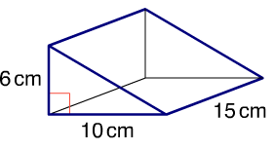
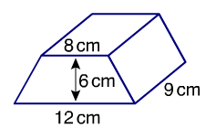
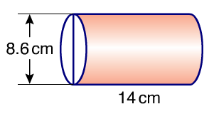
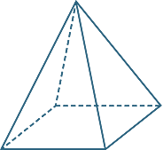
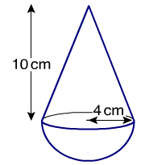
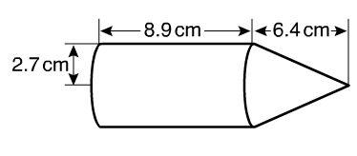
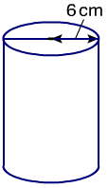
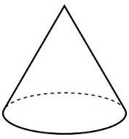
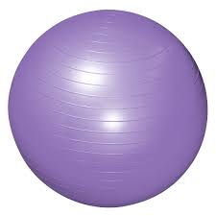
Geometry: Volume and Surface area Topic 14 | Find the volume of this prism. | Find the volume of this prism. | Find the volume of this cylinder.
 | Find the volume of this square based pyramid. | Find the volume of this compound solid. | Find the volume of this compound solid.
 | This cylinder has a capacity of 2000 cm³. What is its height to 1 d.p. ? | This cone has a volume of 8π and a height of 6 cm. What is the radius of the cone? | A sphere has a volume of 36π cm³ What is the radius of the sphere?
10 cm
6 cm

Slide 7
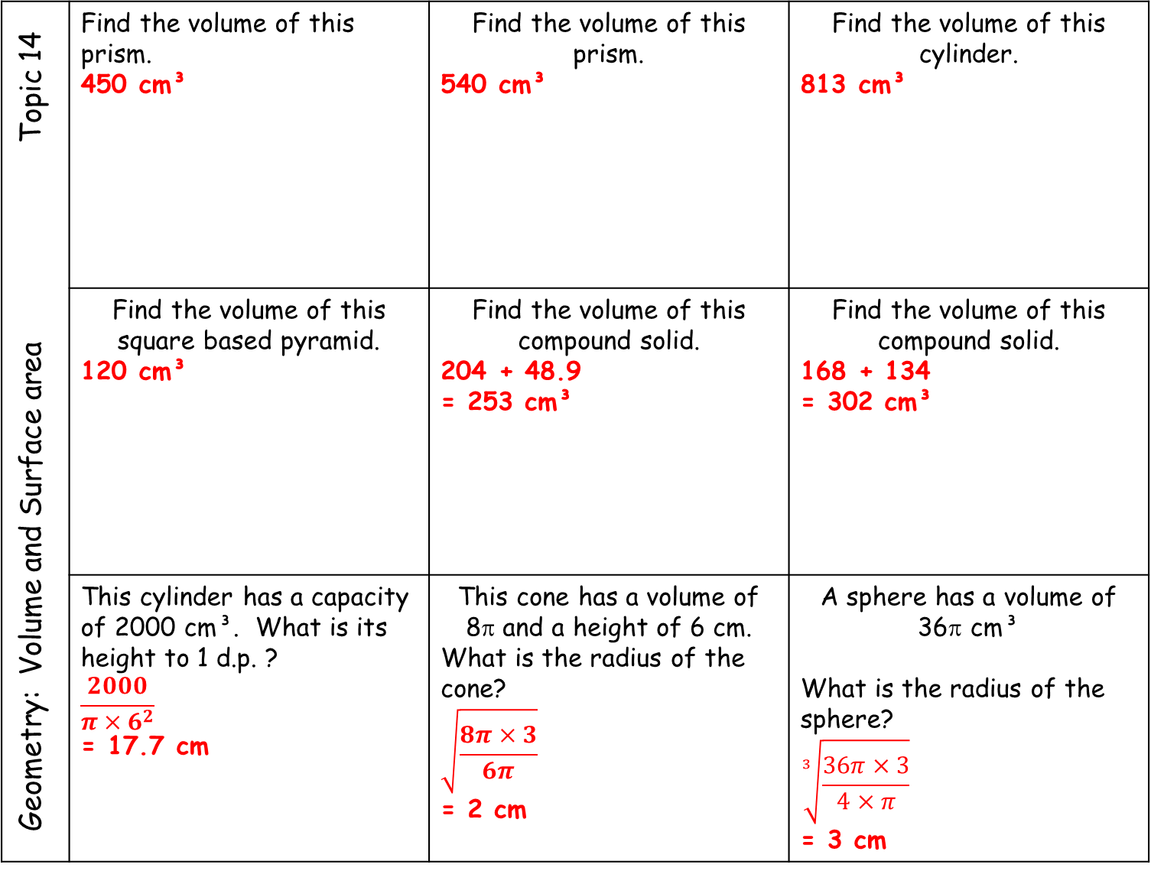
Geometry: Volume and Surface area Topic 14 | Find the volume of this prism. 450 cm³ | Find the volume of this prism. 540 cm³ | Find the volume of this cylinder. 813 cm³
 | Find the volume of this square based pyramid. 120 cm³ | Find the volume of this compound solid. 204 + 48.9 = 253 cm³ | Find the volume of this compound solid. 168 + 134 = 302 cm³
 | This cylinder has a capacity of 2000 cm³. What is its height to 1 d.p. ? $$\frac{2000}{π×6^{2}}$$ = 17.7 cm | This cone has a volume of 8π and a height of 6 cm. What is the radius of the cone? $$\sqrt{\frac{8π×3}{6π}}$$ = 2 cm | A sphere has a volume of 36π cm³ What is the radius of the sphere? $$\sqrt[3]{\frac{36π×3}{4×π}}$$ = 3 cm
10 cm
6 cm

Slide 8
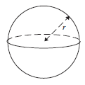
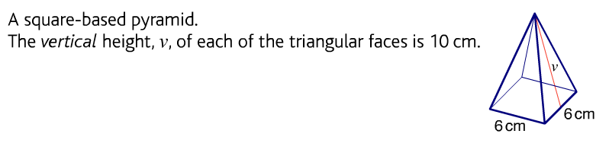
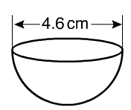
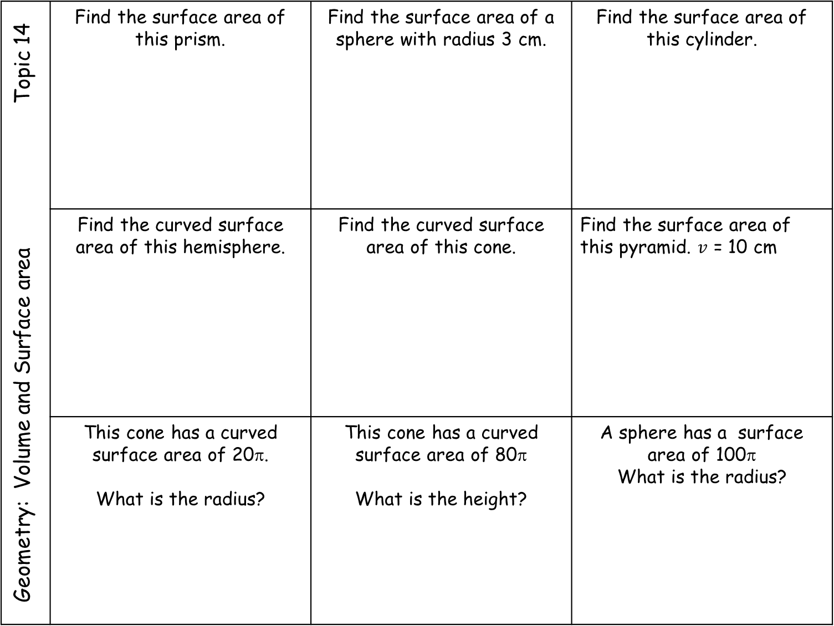
Geometry: Volume and Surface area Topic 14 | Find the surface area of this prism. | Find the surface area of a sphere with radius 3 cm. | Find the surface area of this cylinder.
 | Find the curved surface area of this hemisphere. | Find the curved surface area of this cone. | Find the surface area of this pyramid. $v$ = 10 cm
 | This cone has a curved surface area of 20π. What is the radius? | This cone has a curved surface area of 80π What is the height? | A sphere has a surface area of 100π What is the radius?
4 cm
8 cm
6 cm
12 cm
10 cm
8 cm
10 cm
h

Slide 9
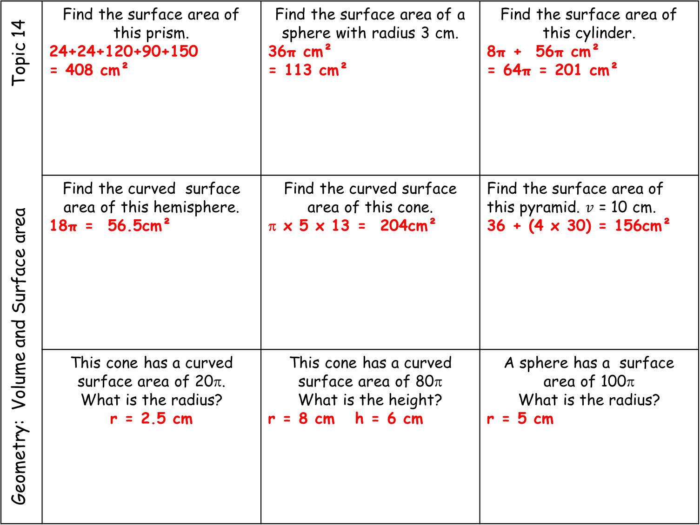
Geometry: Volume and Surface area Topic 14 | Find the surface area of this prism. 24+24+120+90+150 = 408 cm² | Find the surface area of a sphere with radius 3 cm. 36π cm² = 113 cm² | Find the surface area of this cylinder. 8π + 56π cm² = 64π = 201 cm²
 | Find the curved surface area of this hemisphere. 18π = 56.5cm² | Find the curved surface area of this cone. π x 5 x 13 = 204cm² | Find the surface area of this pyramid. $v$ = 10 cm. 36 + (4 x 30) = 156cm²
 | This cone has a curved surface area of 20π. What is the radius? r = 2.5 cm | This cone has a curved surface area of 80π What is the height? r = 8 cm h = 6 cm | A sphere has a surface area of 100π What is the radius? r = 5 cm
4 cm
8 cm
6 cm
12 cm
10 cm
8 cm
10 cm
h

Slide 10
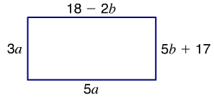
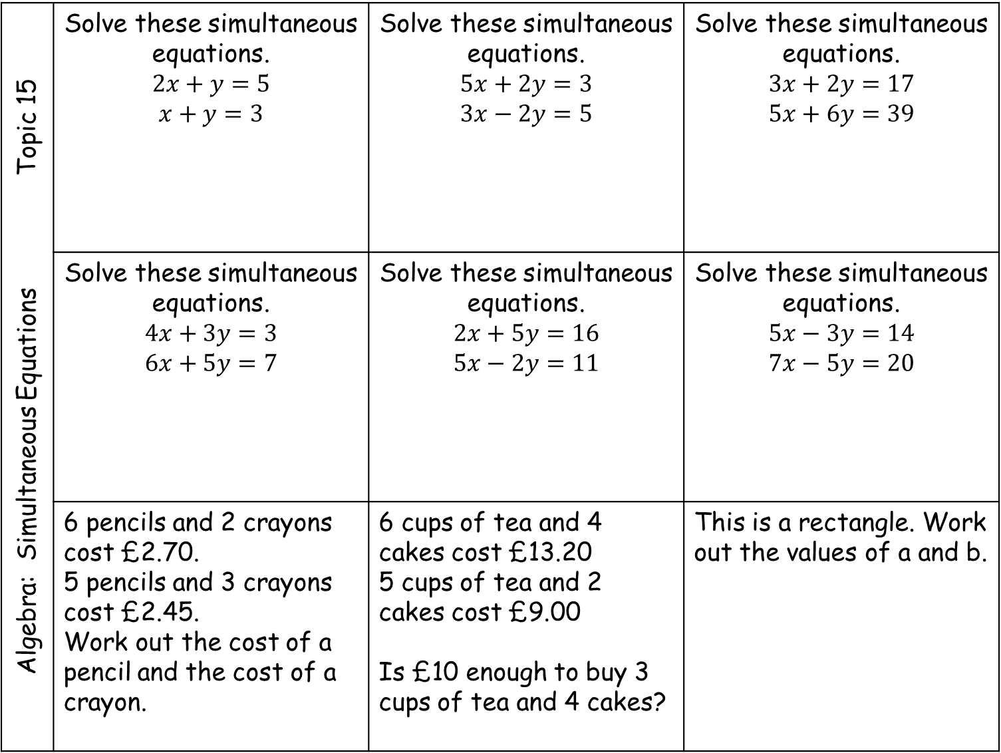
Algebra: Simultaneous Equations Topic 15 | Solve these simultaneous equations. $$2x+y=5$$ $$x+y=3$$ | Solve these simultaneous equations. $$5x+2y=3$$ $$3x−2y=5$$ | Solve these simultaneous equations. $$3x+2y=17$$ $$5x+6y=39$$
 | Solve these simultaneous equations. $$4x+3y=3$$ $$6x+5y=7$$ | Solve these simultaneous equations. $$2x+5y=16$$ $$5x−2y=11$$ | Solve these simultaneous equations. $$5x−3y=14$$ $$7x−5y=20$$
 | 6 pencils and 2 crayons cost £2.70. 5 pencils and 3 crayons cost £2.45. Work out the cost of a pencil and the cost of a crayon. | 6 cups of tea and 4 cakes cost £13.20 5 cups of tea and 2 cakes cost £9.00 Is £10 enough to buy 3 cups of tea and 4 cakes? | This is a rectangle. Work out the values of a and b.

Slide 11
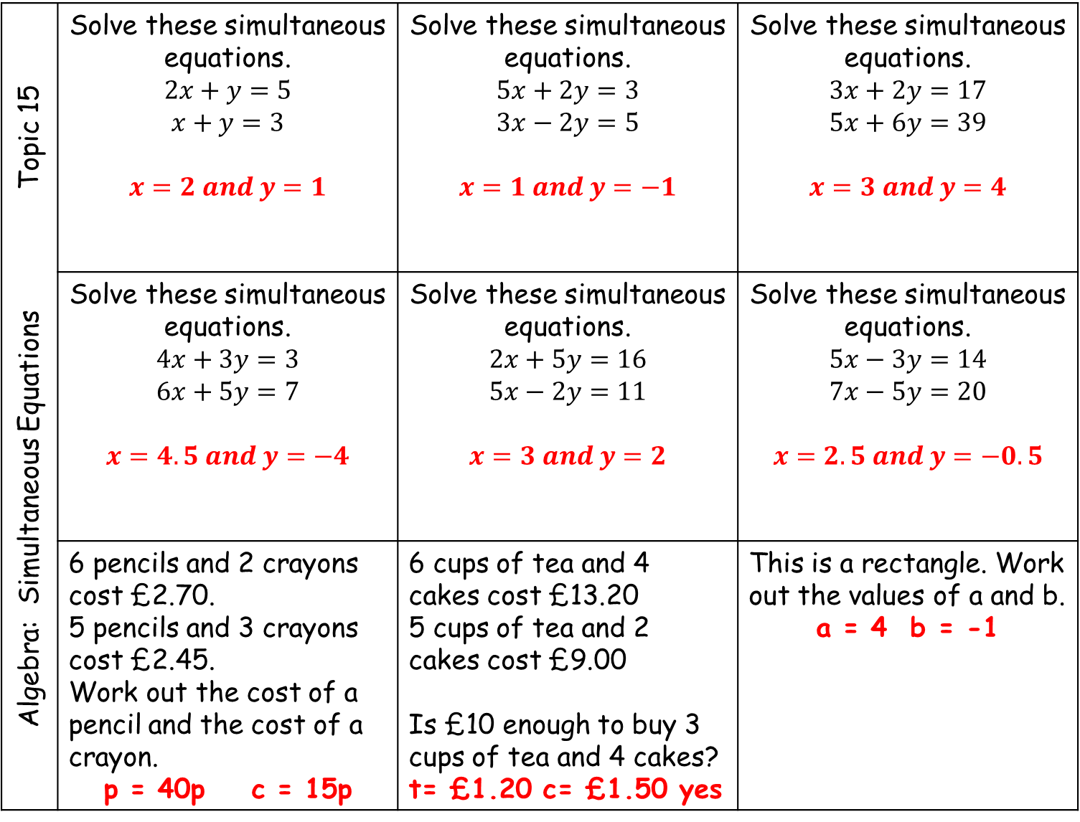
Algebra: Simultaneous Equations Topic 15 | Solve these simultaneous equations. $$2x+y=5$$ $$x+y=3$$ $$x=2 and y=1$$ | Solve these simultaneous equations. $$5x+2y=3$$ $$3x−2y=5$$ $$x=1 and y=−1$$ | Solve these simultaneous equations. $$3x+2y=17$$ $$5x+6y=39$$ $$x=3 and y=4$$
 | Solve these simultaneous equations. $$4x+3y=3$$ $$6x+5y=7$$ $$x=4.5 and y=−4$$ | Solve these simultaneous equations. $$2x+5y=16$$ $$5x−2y=11$$ $$x=3 and y=2$$ | Solve these simultaneous equations. $$5x−3y=14$$ $$7x−5y=20$$ $$x=2.5 and y=−0.5$$
 | 6 pencils and 2 crayons cost £2.70. 5 pencils and 3 crayons cost £2.45. Work out the cost of a pencil and the cost of a crayon. p = 40p c = 15p | 6 cups of tea and 4 cakes cost £13.20 5 cups of tea and 2 cakes cost £9.00 Is £10 enough to buy 3 cups of tea and 4 cakes? t= £1.20 c= £1.50 yes | This is a rectangle. Work out the values of a and b. a = 4 b = -1

Slide 12
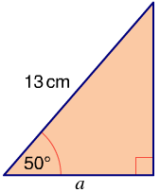
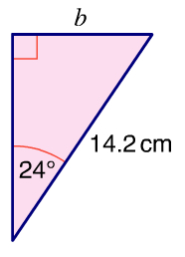
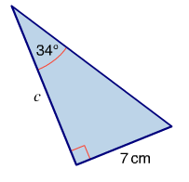
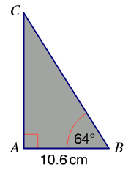
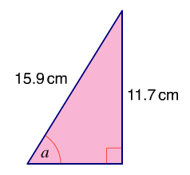
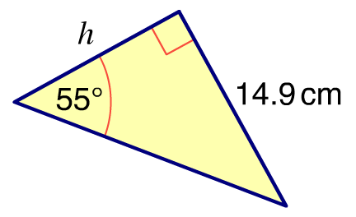
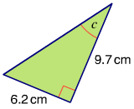
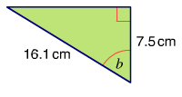
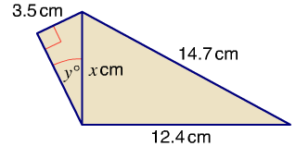
Geometry: Trigonometry Topic 16 | Find the length of side a. | Find the length of side b. | Find the length of side c.
 | Find the length of side h. | Find the length of BC. | Find the size of angle a.
 | Find the size of angle b. | Find the size of angle c. | Find the values of x and y.

Slide 13
Geometry: Trigonometry Topic 16 | Find the length of side a. 8.36 cm | Find the length of side b. 5.78 cm | Find the length of side c. 10.4 cm
 | Find the length of side h. 10.4cm | Find the length of BC. 24.2cm | Find the size of angle a. 47.4°
 | Find the size of angle b. 62.2° | Find the size of angle c. 32.6° | Find the values of x and y. 7.89cm 26.3°

Slide 14
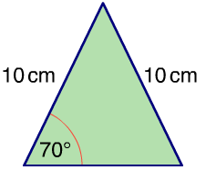
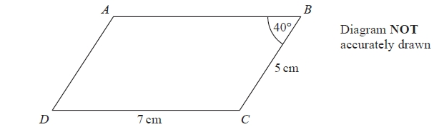
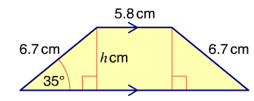
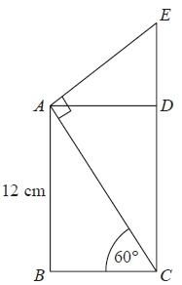
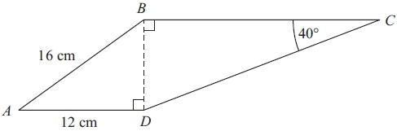
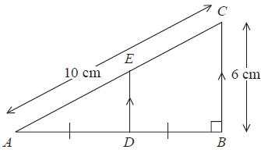
Geometry: Trigonometry Topic 16 | Find the area of this triangle. | Find the area of this trapezium. | Find the area of this parallelogram.
 | Calculate the length of CE. | Calculate the length of CD. Give your answer correct to 3 significant figures.
 |  | D is the midpoint of AB. Work out the area of trapezium BCED.

Slide 15











Geometry: Trigonometry Topic 16 | Find the area of this triangle. 32cm² | Find the area of this trapezium. 43cm² | Find the area of this parallelogram. 7x3.21 = 22.5 cm²
 | Calculate the length of CE. | Calculate the length of CD. Give your answer correct to 3 significant figures.
 |  | D is the midpoint of AB. Work out the area of trapezium BCED. $$\frac{3+6}{2}×4=18{cm}^{2}$$
$$3.21$$
$$\sqrt{112}$$
$$16.5$$
$$16$$
$$8\sqrt{3}$$
$$30°$$
$$3 cm$$
$$36.9°$$
$$4 cm$$
$$8 cm$$

