Slide 1
Test 5 Revision
Year 11 Higher

Slide 2
Algebra : Graphs Topic 17 | 1 | 2 | 3 | A $y=x+1$ B $y=2x$ C $y=1−\frac{1}{2}x$
 | 4 | 5 | 6 | A $y=x^{3}$ B $y={−x}^{3}$ C $y=x^{3}−x$
 | 7 | 8 | 9 | A $y=\sin{x}$ B $y=2^{x}$ C $y=\frac{1}{x}$

Slide 3
Algebra : Graphs Topic 17 | 1 B | 2 C | 3 A | A $y=x+1$ B $y=2x$ C $y=1−\frac{1}{2}x$
 | 4 C | 5 A | 6 B | A $y=x^{3}$ B $y={−x}^{3}$ C $y=x^{3}−x$
 | 7 B | 8 A | 9 C | A $y=\sin{x}$ B $y=2^{x}$ C $y=\frac{1}{x}$

Slide 4
Algebra : Graphs Topic 17 | 1 | 2 | 3 | A $y={−x}^{2}$ B$y={(x+1)}^{2}$ C $y=x^{2}−1$ D $y=x^{2}$ E $y={3−x}^{2}$ F $y=(x+3)(x−1)$ G $y=(x+1)(x−3)$ H $y=x^{2}+1$ I $y={(x−1)}^{2}$
 | 4 | 5 | 6
 | 7 | 8 | 9

Slide 5
Algebra : Graphs Topic 17 | 1 D | 2 H | 3 A | A $y={−x}^{2}$ B$y={(x+1)}^{2}$ C $y=x^{2}−1$ D $y=x^{2}$ E $y={3−x}^{2}$ F $y=(x+3)(x−1)$ G $y=(x+1)(x−3)$ H $y=x^{2}+1$ I $y={(x−1)}^{2}$
 | 4 I | 5 C | 6 F
 | 7 E | 8 G | 9 B

Slide 6
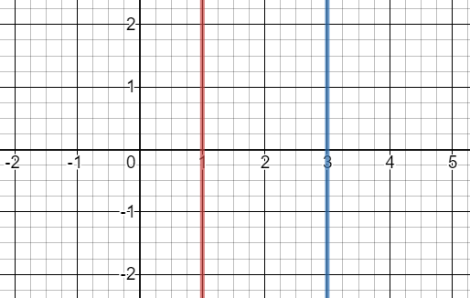
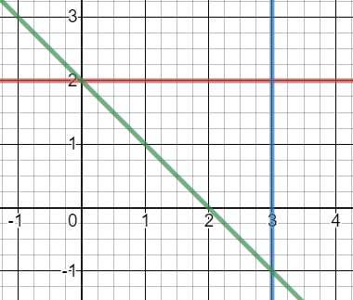
Algebra : Inequalities Topic 18 | List the integer solutions. Write the inequality shown. | Solve these inequalities: $$4\left(x−1\right)>2x+6$$ $$2x−1≤5x+11$$ | Solve these inequalities: $$3≤2x<11$$ $$2≤3x−4<17$$
 | Use inequalities to describe the region shown. |  | Solve $$x^{2}−x −6<0$$
 | Use inequalities to describe the region shown. |  | Solve $$x^{2}−5x+4≥0$$

Slide 7
Algebra : Inequalities Topic 18 | List the integer solutions. -2, -1,0, 1, 2 Write the inequality shown. $−2≤x<3$ | Solve these inequalities: $$4\left(x−1\right)>2x+6$$ $$x>5$$ $$2x−1≤5x+11$$ $$−4≤x$$ $$x≥−4$$ | Solve these inequalities: $$3≤2x<11$$ $$\frac{3}{2}≤x<\frac{11}{2}$$ $$2≤3x−4<17$$ $$2≤x<7$$
 | Use inequalities to describe the region shown. $$1≤x≤3$$ |  | Solve $x^{2}−x −6<0$ $$\left(x+2\right)\left(x−3\right)<0$$ $$−2<x<3$$
 | Use inequalities to describe the region shown. $$x≤3$$ $$y≤2$$ $$y≥−x+2$$ |  | Solve $x^{2}−5x+4≥0$ $$\left(x−1\right)\left(x−4\right)<0$$ $$x≤1 or x≥4$$

Slide 8
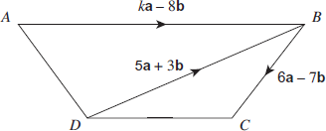
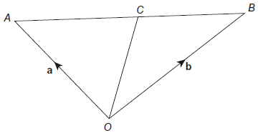
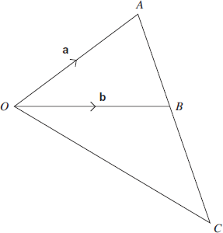
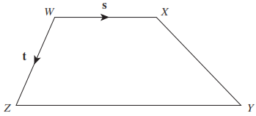
Geometry: Loci + vectors Topic 19 | $$a=\left(\begin{aligned}3 \\ −1\end{aligned}\right) b=\left(\begin{aligned}−4 \\ 4\end{aligned}\right)$$ Calculate: a + b 2b a - b | Write vector $\vec{DC}$ in terms of a and b.
 | Write down a vector that is the same size as $\vec{XY}$and perpendicular to $\vec{XY}$ | C is the midpoint of AB. Write vector $\vec{AC}$ in terms of a and b. | Write vector $\vec{AB}$ in terms of a and b. The point B divides $\vec{AC}$ in the ratio 2 : 3 Work out vector $\vec{AC}$ in terms of a and b.
 | WXYZ is a trapezium. $\vec{WX}$ = s $\vec{WZ}$ = t ZY : WX = 3 : 2 a) Write vector $\vec{ZY}$ in terms of s b) Work out vector $\vec{XY}$ in terms of s and t

Slide 9
Geometry: Loci + vectors Topic 19 | $$a=\left(\begin{aligned}3 \\ −1\end{aligned}\right) b=\left(\begin{aligned}−4 \\ 4\end{aligned}\right)$$ Calculate: a + b $\left(\begin{aligned}−1 \\ 3\end{aligned}\right)$ 2b $\left(\begin{aligned}−8 \\ 8\end{aligned}\right)$ a – b $\left(\begin{aligned}7 \\ −5\end{aligned}\right)$ | Write vector $\vec{DC}$ in terms of a and b. 11a - 4b
 | Write down a vector that is the same size as $\vec{XY}$and perpendicular to $\vec{XY}$ $\left(\begin{aligned}2 \\ −3\end{aligned}\right)$ or $\left(\begin{aligned}−2 \\ 3\end{aligned}\right)$ | C is the midpoint of AB. Write vector $\vec{AC}$ in terms of a and b. $$½ (−a + b)$$ | Write vector $\vec{AB}$ in terms of a and b. – a + b The point B divides $\vec{AC}$ in the ratio 2 : 3 Work out vector $\vec{AC}$ in terms of a and b. $\frac{5}{2}(−a+b)$
 | WXYZ is a trapezium. $\vec{WX}$ = s $\vec{WZ}$ = t ZY : WX = 3 : 2 a) Write vector $\vec{ZY}$ in terms of s 1.5 s b) Work out vector $\vec{XY}$ in terms of s and t t + 0.5 s

Slide 10
Algebra: Algebraic fractions Topic 20 | Simplify $$\frac{x^{2}+3x}{x^{2}+4x+3}$$ | Simplify $$\frac{{2x}^{2}−4x}{x^{2}+3x−10}$$ | Simplify $$\frac{x^{2}+3x+2}{x^{2}−4}$$
 | Calculate $$\frac{3}{x+2}+\frac{5}{x}$$ | Calculate $$\frac{3}{x+1}+\frac{2}{x−5}$$ | Calculate $$\frac{6}{x+4}−\frac{2}{x−1}$$
 | Calculate $$\frac{x^{2}+3x+2}{2x+4}×\frac{4x}{x^{2}+6x+5}$$ | Calculate $$\frac{3x+1}{x^{2}−4}×\frac{x^{2}+3x+2}{6x+2}$$ | Calculate $$\frac{x^{2}−1}{x^{2}+2x−3}÷\frac{x^{2}+4x+3}{x^{2}+2x+1}$$

Slide 11
Algebra: Algebraic fractions Topic 20 | Simplify $$\frac{x^{2}+3x}{x^{2}+4x+3}$$ $=\frac{x(x+3)}{\left(x+1\right)(x+3)}=\frac{x}{x+1}$ | Simplify $$\frac{{2x}^{2}−4x}{x^{2}+3x−10}$$ = $\frac{2x(x−2)}{\left(x−2\right)(x+5)}=\frac{2x}{x+5}$ | Simplify $$\frac{x^{2}+3x+2}{x^{2}−4}$$ = $\frac{(x+1)(x+2)}{\left(x−2\right)(x+2)}=\frac{x+1}{x−2}$
 | Calculate $$\frac{3}{x+2}+\frac{5}{x}$$ $$=\frac{3x+5x+10}{x (x+2)}=\frac{2(4x+5)}{x(x+2)}$$ | Calculate $$\frac{3}{x+1}+\frac{2}{x−5}$$ = $\frac{3x−15+2x+2}{\left(x+1\right)(x−5)}=\frac{5x−13}{(x+1)(x−5)}$ | Calculate $$\frac{6}{x+4}−\frac{2}{x−1}$$ = $\frac{6x−6−2x−8}{\left(x+4\right)(x−1)}=\frac{2(x−7)}{\left(x+4\right)(x−1)}$
 | Calculate $$\frac{x^{2}+3x+2}{2x+4}×\frac{4x}{x^{2}+6x+5}$$ $=\frac{2x}{ (x+5)}$ | Calculate $$\frac{3x+1}{x^{2}−4}×\frac{x^{2}+3x+2}{6x+2}$$ = $\frac{(x+1)}{2\left(x−2\right)}$ | Calculate $$\frac{x^{2}−1}{x^{2}+2x−3}÷\frac{x^{2}+2x+1}{x^{2}+4x+3}$$ = $\frac{(x−1)(x+1)}{\left(x−1\right)(x+3)}×\frac{(x+3)(x+1)}{\left(x+1\right)(x+1)}$ = 1

