Slide 1
Test 2 Revision
YEAR 10 Higher

Slide 2
Topic 5 | Find the perimeter Find the area | Find the arc length Find the area | The area is 100 cm². Work out the radius to 1 d.p.
Topic 5 | Find the missing length. | Find the missing length. | Find the area of this triangle.
Topic 5 | Is this triangle right angled? | Find the length of x. Give your answer to 1 d.p. | Find the distance between these co-ordinates. (4, -7) and (-2, -1)
60°
120°
12 cm
5 cm
r
25 cm
7.5 cm
7.5 cm
19.5 cm
10 cm
48 cm
11 cm
5 cm
6 cm
9 cm
14 cm
x
11 cm

Slide 3
Topic 5 | Find the perimeter Find the area a) 30.8 cm b) 56.5 cm² | Find the arc length Find the area a) 5.24 cm b) 13.1 cm² | The area is 100 cm². Work out the radius to 1 d.p. 9.8 cm
Topic 5 | Find the missing length. 12.5 cm | Find the missing length. 18 cm | Find the area of this triangle. Height= 7 cm Area= 168 cm²
Topic 5 | Is this triangle right angled? 121 ≠ 36 + 81 No | Find the length of x. Give your answer to 1 d.p. Height =5√3 x = 10 cm | Find the distance between these co-ordinates. (4, -7) and (-2, -1) 6√2 = 8.49
60°
120°
12 cm
5 cm
r
25 cm
7.5 cm
7.5 cm
19.5 cm
10 cm
48 cm
6 cm
9 cm
11 cm
5 cm
14 cm
x
11 cm

Slide 4
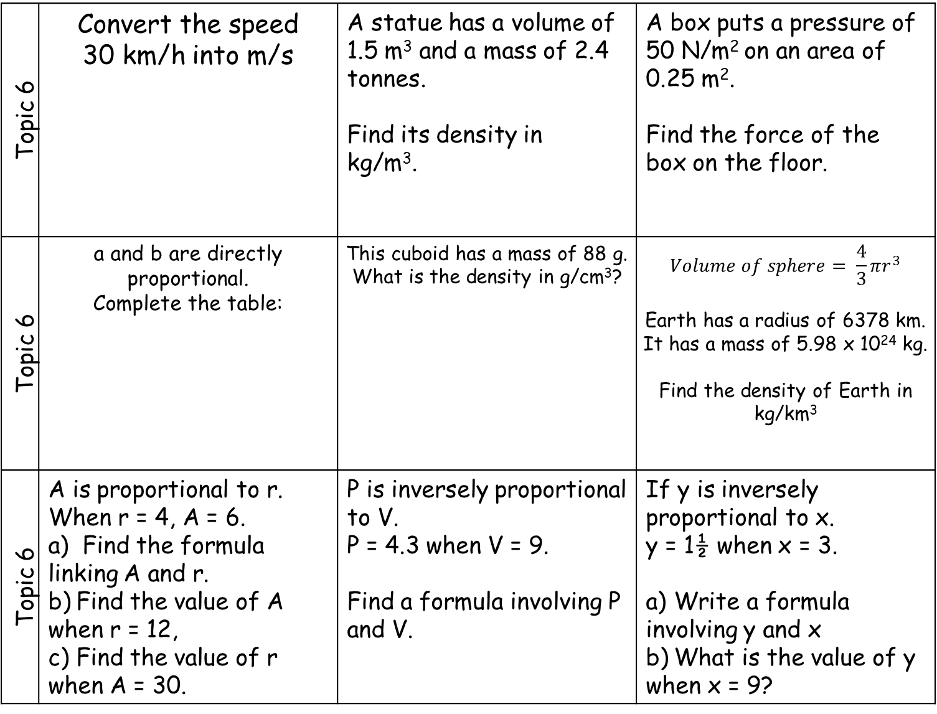
Topic 6 | Convert the speed 30 km/h into m/s | A statue has a volume of 1.5 m³ and a mass of 2.4 tonnes. Find its density in kg/m³. | A box puts a pressure of 50 N/m² on an area of 0.25 m². Find the force of the box on the floor.
Topic 6 | a and b are directly proportional. Complete the table: | This cuboid has a mass of 88 g. What is the density in g/cm³? | $$Volume of sphere= \frac{4}{3}πr^{3}$$ Earth has a radius of 6378 km. It has a mass of 5.98 x 10²⁴ kg. Find the density of Earth in kg/km³
Topic 6 | A is proportional to r. When r = 4, A = 6. a) Find the formula linking A and r. b) Find the value of A when r = 12, c) Find the value of r when A = 30. | P is inversely proportional to V. P = 4.3 when V = 9. Find a formula involving P and V. | If y is inversely proportional to x. y = 1½ when x = 3. a) Write a formula involving y and x b) What is the value of y when x = 9?
a | 4 | 12
b | 18 |  | 90
0.4cm
6.0cm
3.5cm

Slide 5
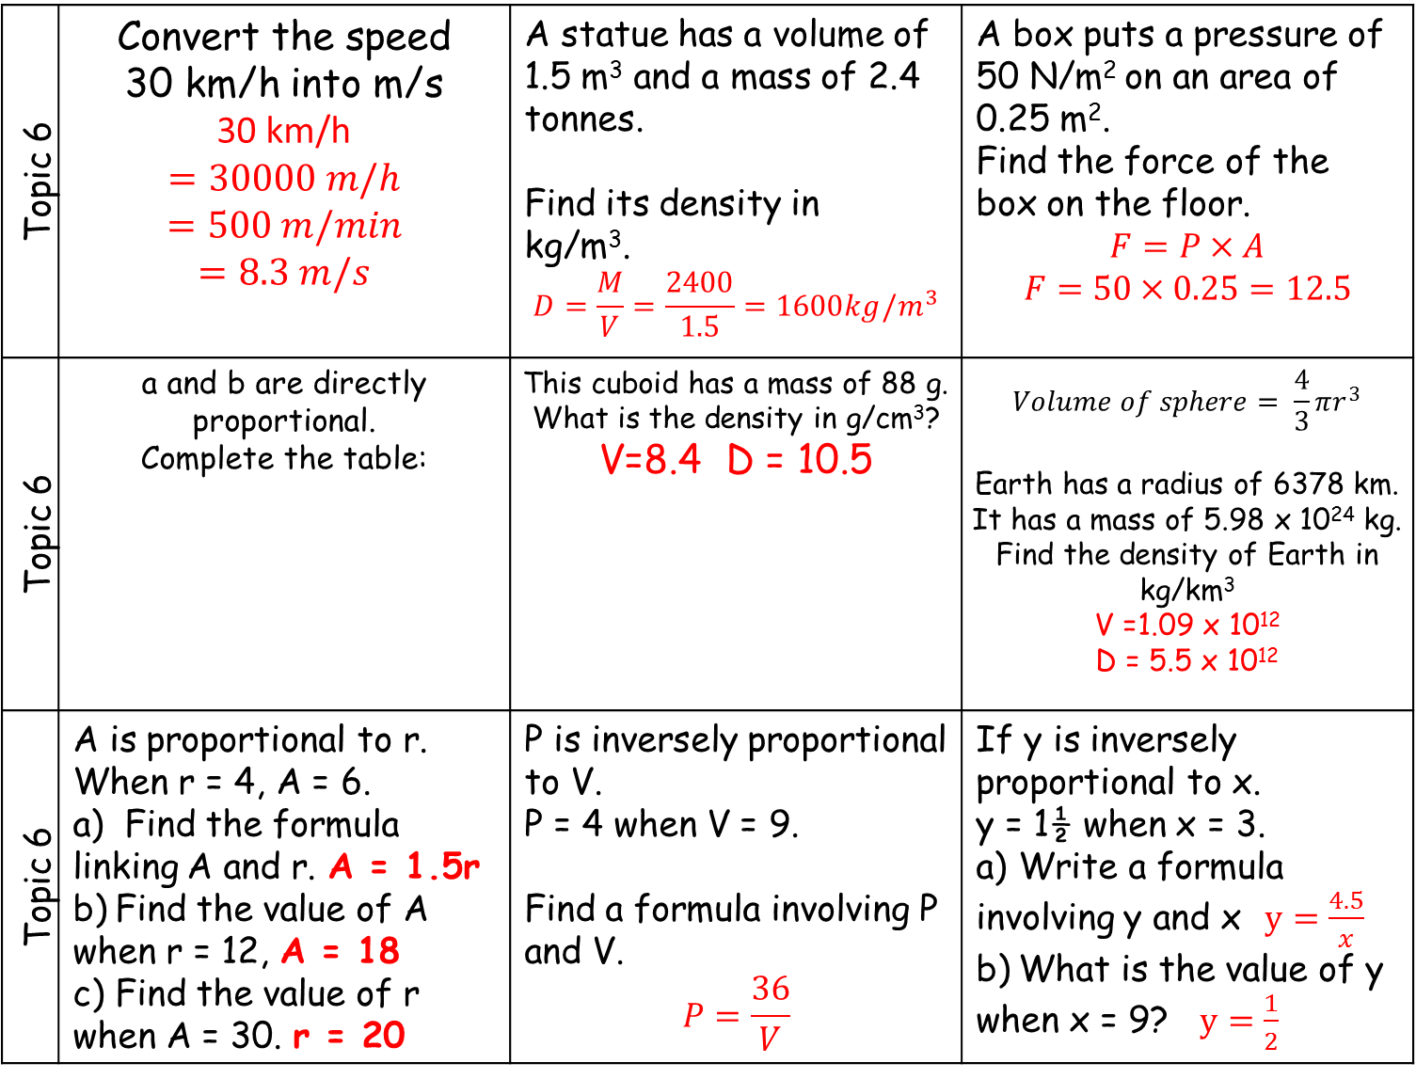
Topic 6 | Convert the speed 30 km/h into m/s 30 km/h $$=30000 m/h$$ $$=500 m/min$$ $$=8.3 m/s$$ | A statue has a volume of 1.5 m³ and a mass of 2.4 tonnes. Find its density in kg/m³. $$D=\frac{M}{V}=\frac{2400}{1.5}=1600kg/m^{3}$$ | A box puts a pressure of 50 N/m² on an area of 0.25 m². Find the force of the box on the floor. $$F=P×A$$ $$F=50×0.25=12.5$$
Topic 6 | a and b are directly proportional. Complete the table: | This cuboid has a mass of 88 g. What is the density in g/cm³? V=8.4 D = 10.5 | $$Volume of sphere= \frac{4}{3}πr^{3}$$ Earth has a radius of 6378 km. It has a mass of 5.98 x 10²⁴ kg. Find the density of Earth in kg/km³ V =1.09 x 10¹² D = 5.5 x 10¹²
Topic 6 | A is proportional to r. When r = 4, A = 6. a) Find the formula linking A and r. A = 1.5r b) Find the value of A when r = 12, A = 18 c) Find the value of r when A = 30. r = 20 | P is inversely proportional to V. P = 4 when V = 9. Find a formula involving P and V. $$P=\frac{36}{V}$$ | If y is inversely proportional to x. y = 1½ when x = 3. a) Write a formula involving y and x$y=\frac{4.5}{x}$ b) What is the value of y when x = 9? $y=\frac{1}{2}$
a | 4 | 12 | 20
b | 18 | 54 | 90
0.4cm
6.0cm
3.5cm

Slide 6
Topic 7 | Find the next two terms for this geometric sequence: a, 2a, 4a, 8a, … , … | 3, 5, 8, 13, … is a Fibonacci sequence. Find the value of the 6th term. | The n^{th} term of a sequence is n² + 50 Work out the first three terms of the sequence.
Topic 7 | Find the next two terms for this geometric sequence: 3a, 6a³ , 12a⁵ , …… , …… | 5, -3, 2, -1, … is a Fibonacci sequence. Find the value of the 7th term. | 5, 8, 13, 20, 29, …… Find the rule for the n^{th} term of this quadratic sequence
Topic 7 | …, 2, 3, 4.5, 6.75, … Is a geometric sequence a) Work out the 6th term of the sequence b) Work out the 1st term of the sequence | 2a, -3, 2a - 3, 2a - 6, … is a Fibonacci sequence Find the value of the 6th term. | 5, 9, 15, 23, 33, …… Find the rule for the n^{th} term of this quadratic sequence

Slide 7
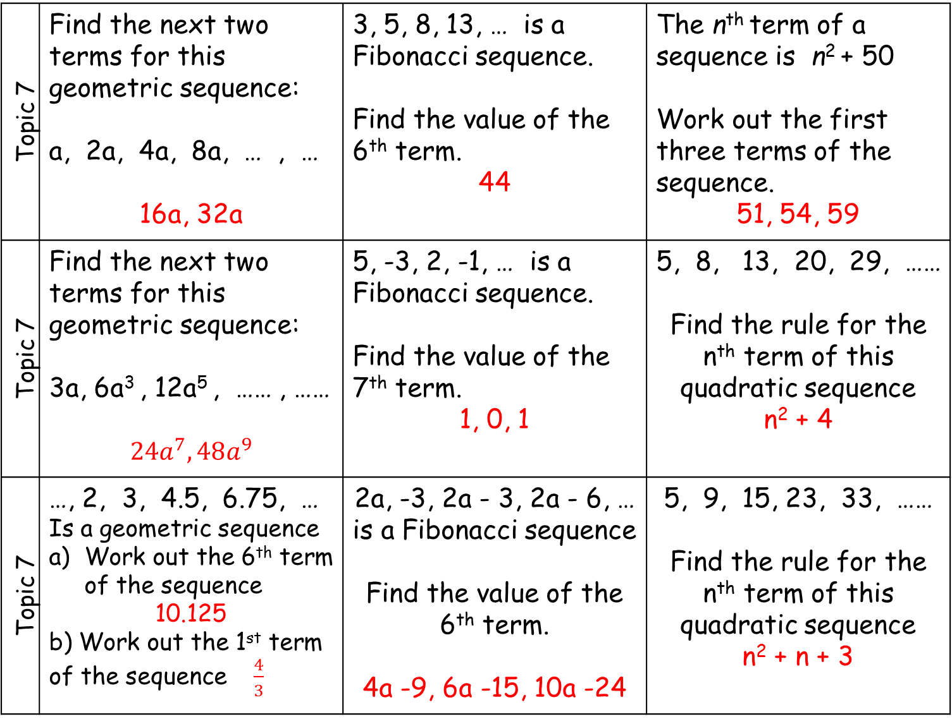
Topic 7 | Find the next two terms for this geometric sequence: a, 2a, 4a, 8a, … , … 16a, 32a | 3, 5, 8, 13, … is a Fibonacci sequence. Find the value of the 6th term. 44 | The n^{th} term of a sequence is n² + 50 Work out the first three terms of the sequence. 51, 54, 59
Topic 7 | Find the next two terms for this geometric sequence: 3a, 6a³ , 12a⁵ , …… , …… $$24a^{7}, 48a^{9}$$ | 5, -3, 2, -1, … is a Fibonacci sequence. Find the value of the 7th term. 1, 0, 1 | 5, 8, 13, 20, 29, …… Find the rule for the n^{th} term of this quadratic sequence n² + 4
Topic 7 | …, 2, 3, 4.5, 6.75, … Is a geometric sequence Work out the 6th term of the sequence 10.125 b) Work out the 1st term of the sequence $\frac{4}{3}$ | 2a, -3, 2a - 3, 2a - 6, … is a Fibonacci sequence Find the value of the 6th term. 4a -9, 6a -15, 10a -24 | 5, 9, 15, 23, 33, …… Find the rule for the n^{th} term of this quadratic sequence n² + n + 3

Slide 8
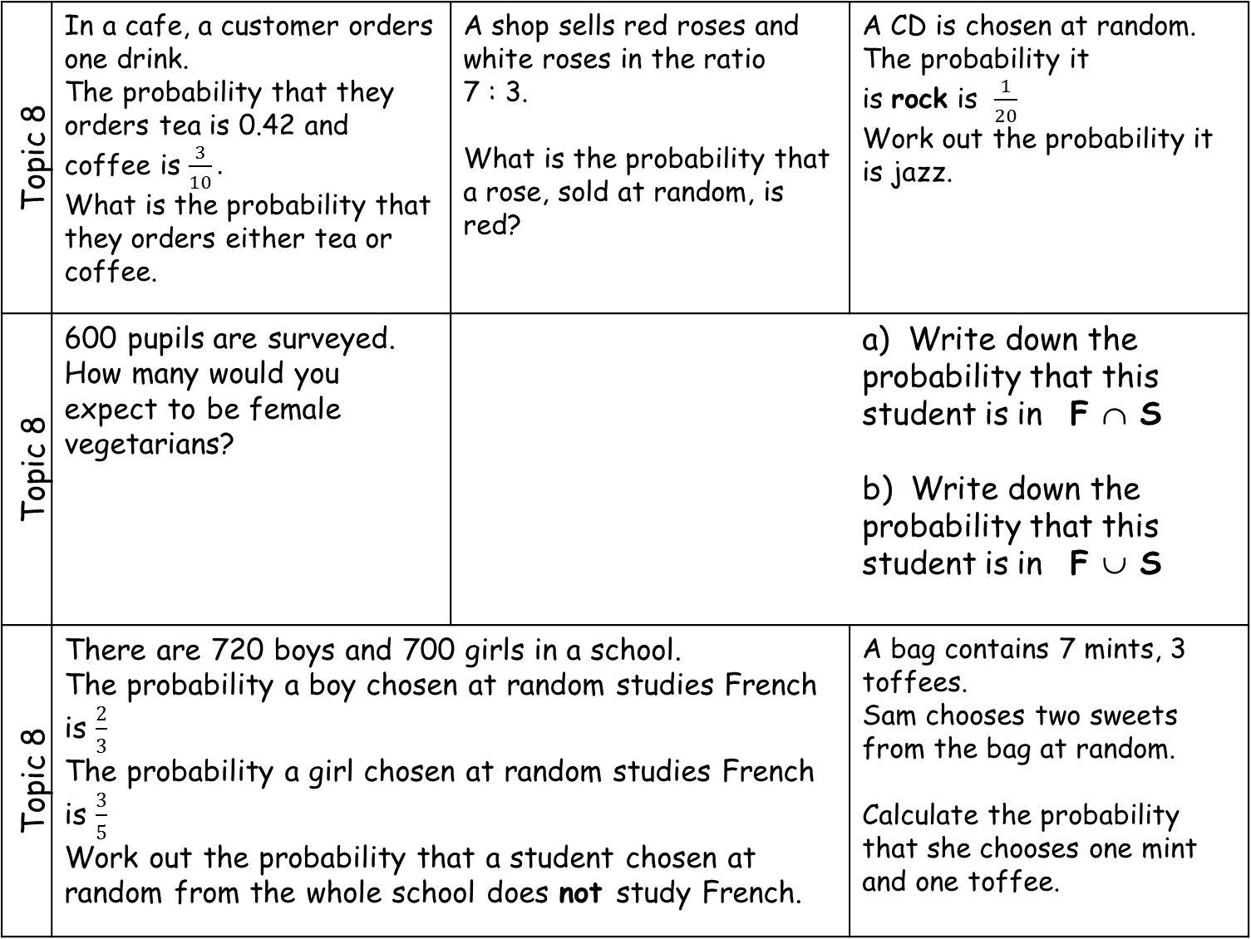
Topic 8 | In a cafe, a customer orders one drink. The probability that they orders tea is 0.42 and coffee is $\frac{3}{10}.$ What is the probability that they orders either tea or coffee. | A shop sells red roses and white roses in the ratio 7 : 3. What is the probability that a rose, sold at random, is red? | A CD is chosen at random. The probability it is rock is $\frac{1}{20}$ Work out the probability it is jazz.
Topic 8 | 600 pupils are surveyed. How many would you expect to be female vegetarians? |  | a) Write down the probability that this student is in F ∩ S b) Write down the probability that this student is in F ∪ S
Topic 8 | There are 720 boys and 700 girls in a school. The probability a boy chosen at random studies French is $\frac{2}{3}$ The probability a girl chosen at random studies French is $\frac{3}{5}$ Work out the probability that a student chosen at random from the whole school does not study French. |  | A bag contains 7 mints, 3 toffees. Sam chooses two sweets from the bag at random. Calculate the probability that she chooses one mint and one toffee.
Type | Rock | Pop | Jazz
Number of CDs | 2 | x | 2x + 5
F
S
8
3
5
 | Boys | Girls
Vegetarian | 0.05 | 0.2
Non-vegetarian | 0.4 | 0.35
4

Slide 9
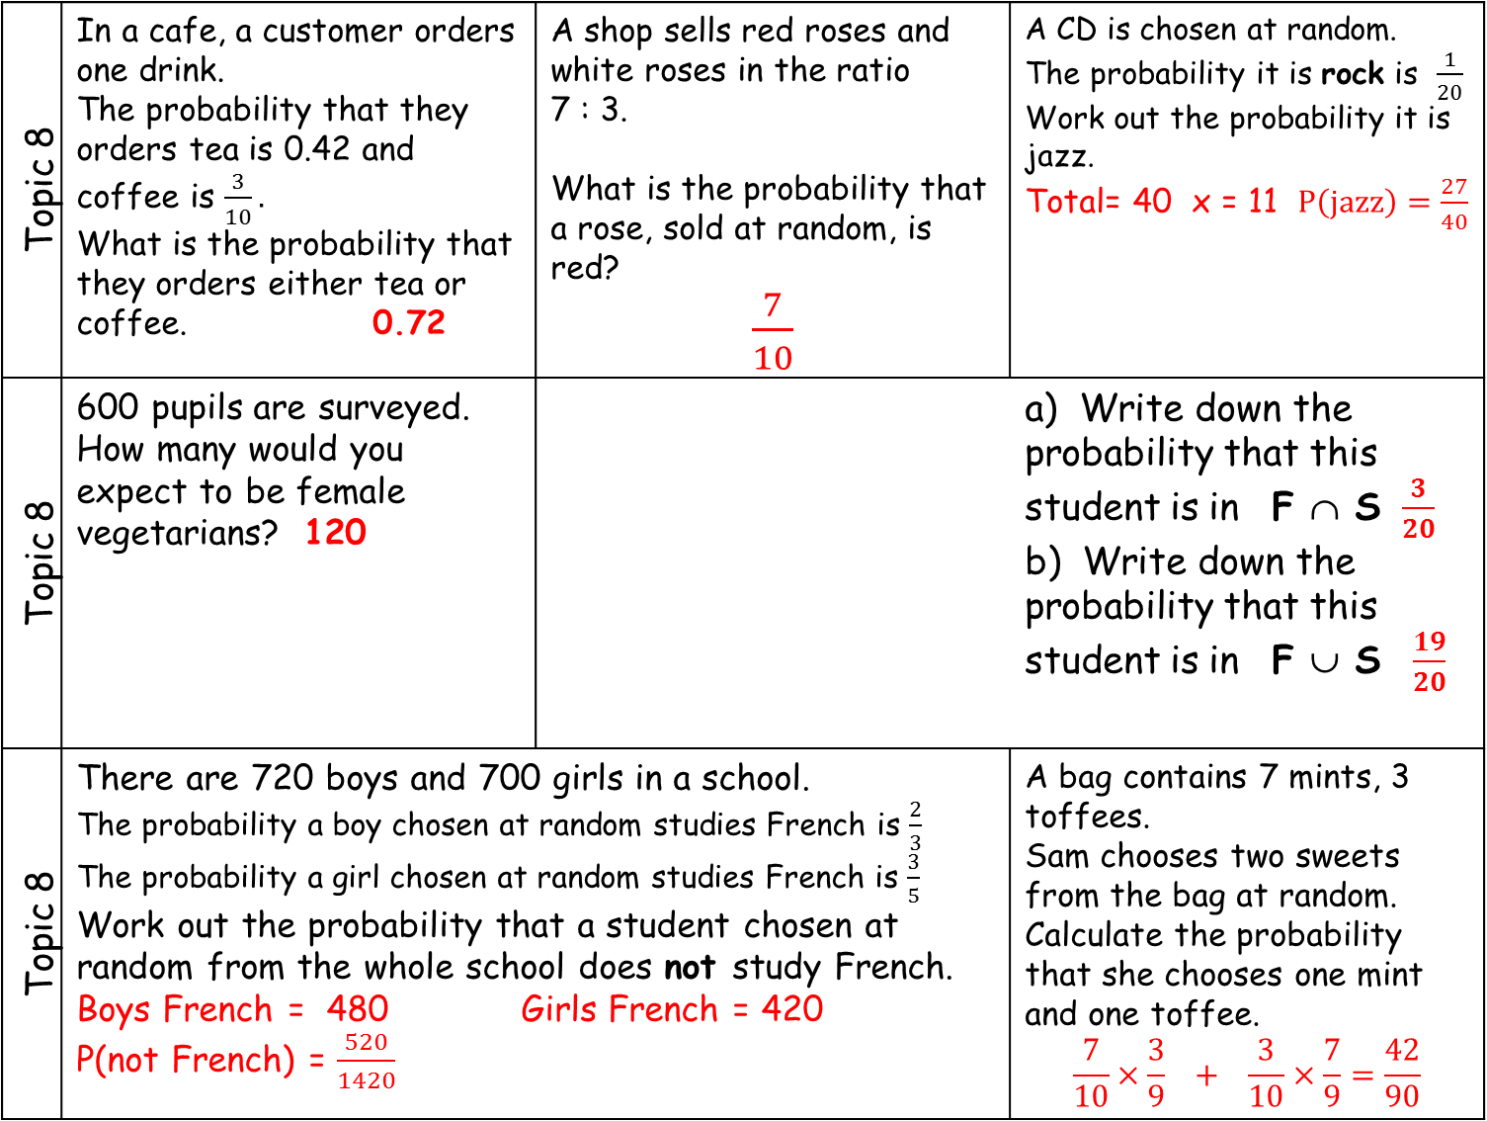
Topic 8 | In a cafe, a customer orders one drink. The probability that they orders tea is 0.42 and coffee is $\frac{3}{10}.$ What is the probability that they orders either tea or coffee. 0.72 | A shop sells red roses and white roses in the ratio 7 : 3. What is the probability that a rose, sold at random, is red? $\frac{7}{10}$ | A CD is chosen at random. The probability it is rock is $\frac{1}{20}$ Work out the probability it is jazz. Total= 40 x = 11 $P\left(jazz\right)=\frac{27}{40}$
Topic 8 | 600 pupils are surveyed. How many would you expect to be female vegetarians? 120 |  | a) Write down the probability that this student is in F ∩ S $\frac{3}{20}$ b) Write down the probability that this student is in F ∪ S $\frac{19}{20}$
Topic 8 | There are 720 boys and 700 girls in a school. The probability a boy chosen at random studies French is $\frac{2}{3}$ The probability a girl chosen at random studies French is $\frac{3}{5}$ Work out the probability that a student chosen at random from the whole school does not study French. Boys French = 480 Girls French = 420 P(not French) = $\frac{520}{1420}$ |  | A bag contains 7 mints, 3 toffees. Sam chooses two sweets from the bag at random. Calculate the probability that she chooses one mint and one toffee. $$\frac{7}{10}×\frac{3}{9} + \frac{3}{10}×\frac{7}{9}=\frac{42}{90}$$
Type | Rock | Pop | Jazz
Number of CDs | 2 | x | 2x + 5
F
S
9
3
7
 | Boys | Girls
Vegetarian | 0.05 | 0.2
Non-vegetarian | 0.4 | 0.35
1

