Slide 1
Test 4 Revision
Year 10 CORE

Slide 2
Shape & Measure: Compound Measures Topic 13 | Dave travels 60 miles in 5 hours. What is his speed? | A runner ran a 400 m race in 1 min 40 sec. Calculate his average speed in m/sec. | Tiah travels 15 miles in 40 minutes. What is her speed?
 | Convert 20 mph to km/h. | Convert 28 km/h to mph. | A girl has a weight of 450 N and her feet have a total area of 300 cm². Calculate the pressure her feet put on the ground.
 | Calculate the area of a dart which hits the dartboard with a force of 10 N and pressure of 2000 N/cm². | Find the density of a stone with Mass = 45 g and Volume = 5 cm³ | Lead has a density of 11.5 g/cm³. A cuboid block of lead measures 7 × 5 × 2 cm. a)Find the volume of the block of lead. b)Find the mass of the block of lead

Slide 3
Shape & Measure: Compound Measures Topic 13 | Dave travels 60 miles in 5 hours. What is his speed? 12 mph | A runner ran a 400 m race in 1 min 40 sec. Calculate his average speed in m/sec. 4 m/sec | Tiah travels 15 miles in 40 minutes. What is her speed? 22.5 mph
 | Convert 20 mph to km/h. 32 km/h | Convert 28 km/h to mph. 17.5 mph | A girl has a weight of 450 N and her feet have a total area of 300 cm². Calculate the pressure her feet put on the ground. 450 ÷ 300 = 1.5 N/cm²
 | Calculate the area of a dart which hits the dartboard with a force of 10 N and pressure of 2000 N/cm². 10 ÷ 2000 = 0.005 cm² | Find the density of a stone with Mass = 45 g and Volume = 5 cm³ 45 ÷ 5 = 9 g/cm³ | Lead density =11.5 g/cm³. A cuboid block of lead measures 7 × 5 × 2 cm. a)Volume of block = 7 × 5 × 2 = 70 cm³ b)Mass of block of lead = 11.5 x 70 = 805 g

Slide 4
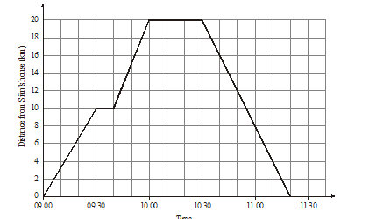
Distance Time Graphs
The graph shows Sian’s journey from home to the library and back again.
What time does Sian stop for a break?
2) How long does Sian spend at the library?
3) What is Sians speed for the first part of the journey?
4) What is Sians speed for the return journey?

Slide 5
Distance Time Graphs
The graph shows Sian’s journey from home to the library and back again.
What time does Sian stop for a break? 09 30
2) How long does Sian spend at the library? 30 mins
3) What is Sians speed for the first part of the journey?
20 km/h
4) What is Sians speed for the return journey? 24 km/h

Slide 6
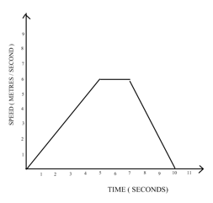
Velocity Time
The graph shows the speed of a car in metres per second.
a) For how many seconds is the car at a constant speed? ………………… sec
b) Work out the total distance travelled by the car.
………………… m
c) Work out the gradient of the graph during the first 5 seconds.
……………… m/s²
d) What does the gradient in part (c) represent? Circle your answer.
time speed distance acceleration
e) Work out the gradient of the graph during the last 3 seconds.
………………. m/s²
f) What does the gradient in part (e) represent? Circle your answer.
speed distance acceleration deceleration

Slide 7
Velocity Time
a) For how many seconds is the car at a constant speed? 2 sec
b) Work out the total distance travelled by the car.
6 + 6 = 12 m
c) Work out the gradient of the graph during the first 5 seconds. 6 ÷ 5 = 1.2 m/s²
d) What does the gradient in part (c) represent? Circle your answer.
time speed distance acceleration
e) Work out the gradient of the graph during the last 3 seconds.
6 ÷ 4 = 1.5 m/s²
f) What does the gradient in part (e) represent? Circle your answer.
speed distance acceleration deceleration

Slide 8
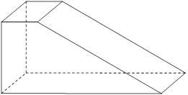
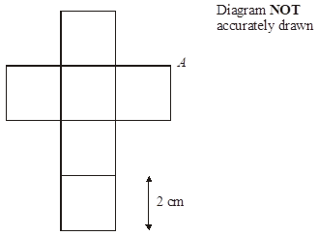
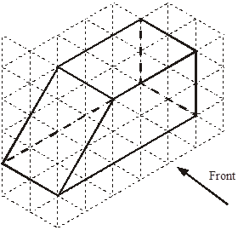
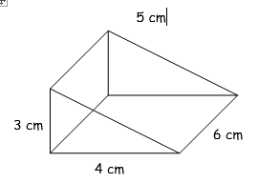
Geometry: Nets, Plans & Elevations Volume Area Topic 14 | Number of faces = Number of vertices = Number of edges = Planes of symmetry = |  | The net is folded to make the cube. Two other vertices meet at A. (a)Mark each of them with the letter A. (b)Work out the volume of the cube.
 | Draw the plan view. | Volume = 180 m² Height = Surface Area = | Volume = Surface Area =
 | Volume = (in terms of π) Surface area = |  | Volume = Total surface area = (leave your answers in terms of π) Volume = $\frac{1}{3}πr^{2}h$ Curved surface area = $πrl$
height
15 m
3 m
7 cm
9 cm
8 cm
6 cm
20 cm

Slide 9
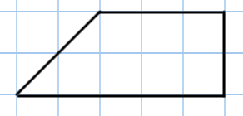
Geometry: Nets, Plans & Elevations Volume Area Topic 14 | Number of faces = 6 Number of vertices = 8 Number of edges = 12 Planes of symmetry = 1 |  | The net is folded to make the cube. Two other vertices meet at A. (a)Mark each of them with the letter A. (b)Work out the volume of the cube. 2 x 2 x 2 = 8 cm³
 |  | Volume = 180 m² Height = 4 m Surface Area = 234 m² | V = 3 x 4 ÷ 2 x 6 = 36 cm³ Surface Area = 84 cm²
 | Volume = 320π cm³ SA = 192π cm² |  | Volume = 108π cm³ Total SA = 78π cm² (leave your answers in terms of π) Volume = $\frac{1}{3}πr^{2}h$ Curved surface area = $πrl$
A
A
height
15 m
3 m
7 cm
9 cm
8 cm
6 cm
20 cm

Slide 10
Algebra: Solving Equations Topic 15 | Solve these equations. 7a – 11 = 24 3x + 7 = 16 | Solve these equations. 1 = 3a + 7 14 – 5x = 34 | Solve these equations. 8y – 5 = 9 5 = 6x + 9
 | Solve these equations. 2(3e + 1) = -8 -7 = 4(2f – 3) | Solve these equations. 3a – 4 = 2a + 9 5b + 7 = 5 + 2b | Solve these equations. 3(a + 4) = 2(a + 1) 3(1 – 2a) = 2(a + 3)
 | Find the value of x. | Area = 8 m². Find the value of a. | x has a value between 9 and 10. Use trial and improvement to find a value of x to 1 d.p.
2x
2a - 7
4
x | Answer | Comment
x
45

Slide 11
Algebra: Solving Equations Topic 15 | Solve these equations. 7a – 11 = 24 a = 5 3x + 7 = 16 x = 3 | Solve these equations. 1 = 3a + 7 a = -2 14 – 5x = 34 x = -4 | Solve these equations. 8y – 5 = 9 y = $\frac{7}{4}$ = $1\frac{3}{4}$ 5 = 6x + 9 x = $−\frac{2}{3}$
 | Solve these equations. 2(3e + 1) = -8 e = $−\frac{5}{3}$ = $−1\frac{2}{3}$ -7 = 4(2f – 3) f = $\frac{5}{8}$ | Solve these equations. 3a – 4 = 2a + 9 a = 13 5b + 7 = 5 + 2b b = $−\frac{2}{3}$ | Solve these equations. 3(a + 4) = 2(a + 1) a = -10 3(1 – 2a) = 2(a + 3) a = $−\frac{3}{8}$
 | Find the value of x. | Area = 8 m². Find the value of a.
x | Answer | Comment
9 | 78 | Too small
10 | 97 | Too big
9.5 | 87.25 | Too small
9.6 | 89.16 | Too small
9.7 | 91.09 | Too big
9.65 | 90.1225 | Too big
2x
2a - 7
4
x
45
4(2a – 7) = 8
a = $\frac{9}{2}$ = $4\frac{1}{2}$
3x + 45 = 180
x = 45
x = 9.6 to 1 d.p.

Slide 12
Algebra: Percentages Topic 16 | Convert the following to decimals: 76% 20% 8% 0.4% 115% | Without a calculator, Calculate 15% of 65g Calculate 23% of £86 With a calculator, Calculate 38% of £78 Calculate 53% of £75 | Bryan gets a pay rise of 12%. His original salary is £25000 per annum. Calculate his new salary.
 | A car is worth £9500. After 1 year the price has depreciated by 8%. Calculate the value of the car after 1 year. | On two similar science tests, Sophie gets $\frac{14}{30}$ and Harry gets $\frac{17}{40}$. Who performs better? | Adam buys a broken bike for £25. He fixes it and sells it on for £64. What is his percentage profit? Gerry buys a stereo for £80. He sells it after 3 years for £36. What is his percentage loss?
 | Millie puts £600 into a bank account. It pays 2% compound interest per annum. How much is in the account after 3 years? | There are 860 bacteria on a petri dish. An antibiotic is applied. After 1 day 44% of the bacteria are killed. After each subsequent day 15% are killed. How many are left after 5 days? | Rail fares increase by 5%. A new ticket costs £120. What did it cost before the increase?

Slide 13
Algebra: Percentages Topic 16 | Convert the following to decimals: 76% = 0.76 20% = 0.2 8% = 0.08 0.4% = 0.004 115% = 1.15 | Without a calculator, 15% of 65g = 9.75g 23% of £86 = £19.78 With a calculator, 38% of 78m = 29.64m 53% of £75 = £39.75 | Bryan gets a pay rise of 12%. His original salary is £25000 per annum. Calculate his new salary. £28000
 | A car is worth £9500. After 1 year the price has depreciated by 8%. Calculate the value of the car after 1 year. £8740 | On two similar science tests, Sophie gets $\frac{14}{30}$ and Harry gets $\frac{17}{40}$. Who performs better? $$\frac{14}{30}=46.\dot{6}\%, \frac{17}{40}=42.5\%$$ Sophie did better. | Adam buys a broken bike for £25. He fixes it and sells it on for £64. What is his percentage profit? 156% Gerry buys a stereo for £80. He sells it after 3 years for £36. What is his percentage loss? 55%
 | Millie puts £600 into a bank account. It pays 2% compound interest per annum. How much is in the account after 3 years? £636.72 | There are 860 bacteria on a petri dish. An antibiotic is applied. After 1 day 44% of the bacteria are killed. After each subsequent day 15% are killed. How many are left after 5 days? 251.4 | Rail fares increase by 5%. A new ticket costs £120. What did it cost before the increase? £114.29

