Slide 1
Test 3 Revision
Year 10 FOUDATION

Slide 2
Number : %/decimal/fraction Topic 9 |  | Convert these in to mixed numbers: a) $\frac{13}{4}$ b) $\frac{24}{5}$ c) $\frac{34}{7}$ | Convert these in to improper fractions: a) $2\frac{5}{6}$ b) $5\frac{3}{4}$ c) $2\frac{3}{8}$
 |  | Calculate: a) $\frac{2}{5} of £20$ b) $\frac{3}{8} of £16$ c) $\frac{4}{7} of £28$ | Convert in to decimals: a) $\frac{3}{8}$ b) $\frac{5}{11}$ c) $\frac{5}{6}$
 | Find the reciprocals: a) $\frac{3}{7}$ b) $4\frac{2}{5}$ c) $0.4$ | Calculate: a) $\frac{2}{5}+\frac{2}{3}$ b) $\frac{3}{4}−\frac{1}{6}$ c) $2\frac{4}{5}+1\frac{1}{4}$ | Calculate: a) $\frac{7}{8}×\frac{2}{3}$ b) $\frac{5}{7}÷\frac{5}{9}$ c) $3\frac{2}{3}÷1\frac{4}{5}$
Decimal | Percentage | Fraction (simplest form)
0.3
 | 45%
 |  | $$\frac{7}{10}$$
 | 24%
0.05
 |  | $$\frac{21}{25}$$
0.488

Slide 3
Number : %/decimal/fraction Topic 9 |  | Convert these in to mixed numbers: a) $\frac{13}{4}$ = $3\frac{1}{4}$ b) $\frac{24}{5}$ = $4\frac{4}{5}$ c) $\frac{34}{7}$ = $4\frac{6}{7}$ | Convert these in to improper fractions: a) $2\frac{5}{6}$ = $\frac{17}{6}$ b) $5\frac{3}{4}$ = $\frac{23}{4}$ c) $2\frac{3}{8}$ = $\frac{19}{8}$
 |  | Calculate: a) $\frac{2}{5} of £20$ = £8 b) $\frac{3}{8} of £16$ = £6 c) $\frac{4}{7} of £28$ = £16 | Convert in to decimals: a) $\frac{3}{8}$ = 0.375 b) $\frac{5}{11}$ = $0.\dot{4}\dot{5}$ c) $\frac{5}{6}$ = $0. 8\dot{3}$
 | Find the reciprocals: a) $\frac{3}{7}$ $\frac{7}{3}=2\frac{1}{3}$ b) $4\frac{2}{5}$ $=\frac{22}{5}$ $\frac{5}{22}$ c) $0.4$ $=\frac{2}{5}$ $\frac{5}{2}=2\frac{1}{2}$ | Calculate: a) $\frac{2}{5}+\frac{2}{3}$ $=\frac{16}{15}=1\frac{1}{15}$ b) $\frac{3}{4}−\frac{1}{6}$ $=\frac{7}{12}$ c) $2\frac{4}{5}+1\frac{1}{4}$ $=4\frac{1}{20}$ | Calculate: a) $\frac{7}{8}×\frac{2}{3}$ $=\frac{7}{12}$ b) $\frac{5}{7}÷\frac{5}{9}$ $=\frac{9}{7}=1\frac{2}{7}$ c) $3\frac{2}{3}÷1\frac{4}{5}$ $=\frac{55}{27}=2\frac{1}{27}$
0.3 | 30% | $$\frac{3}{10}$$
0.45 | 45% | $$\frac{9}{20}$$
0.7 | 70% | $$\frac{7}{10}$$
0.24 | 24% | $$\frac{6}{25}$$
0.05 | 5% | $$\frac{1}{20}$$
0.84 | 84% | $$\frac{21}{25}$$
0.488 | 48.8% | $$\frac{61}{125}$$

Slide 4
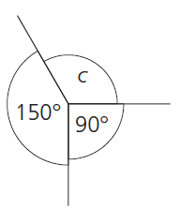
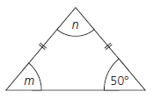
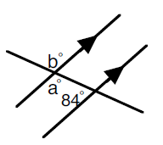
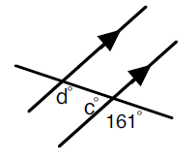
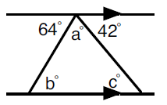
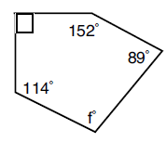
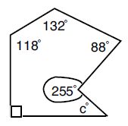
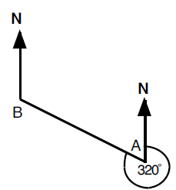
Geometry: Angles Topic 10 | Calculate the missing angles | Calculate the missing angles | Calculate the missing angle
 | Calculate the missing angles. Give reasons. | Calculate the missing angles. Give reasons. | Calculate the missing angles. Give reasons.
 | Calculate the missing angle. | Calculate the missing angle. | Calculate the bearings: a) B from A b) A from B

Slide 5
Geometry: Angles Topic 10 | Calculate the missing angles. | Calculate the missing angles. | Calculate the missing angles.
 | Calculate the missing angles. Give reasons. | Calculate the missing angles. Give reasons. | Calculate the missing angles. Give reasons.
 | Calculate the missing angle. | Calculate the missing angle. | Calculate the bearings: a) B from A b) A from B
a = 120°
b = 60°
c = 120°
c = 120°
c = 45°
m = 50°
n = 80°
a = 96°
b = 96°
c = 19°
d = 161°
c = 42°
b = 64°
a = 74°
a) 320°
b) 140°
c = 37°
f = 95°

Slide 6
Algebra: graphs Topic 11 | Name these two lines: | Which line is needed to make a square? | Copy and complete the for y = 2x + 3 b) Plot the graph of y = 2x + 3
 | Copy and complete the for y = -3x + 4 b) Plot the graph of y = -3x + 4 | Draw axes from -5 to 5 in both directions. Plot the lines: a) y = 2x – 1 b) y = -3x + 4 c) y = x - 3 | Name a line that has the same y intercept as: a) y = 5x + 6 b) y = 2x – 4 c) 3y = 12 – 9x
 | Name a line parallel to: a) y = 4x + 5 b) y = 6 – 3x c) 2y = 6x + 10 | Calculate the gradient of the line joining A and B: A = (2, 3) B = (6, 9) b) A = (-5, -9) B = (-2, 3) c) A = (-2, 8) B = (1, -1) | Find the midpoint of: a) (6, 11) and (10, 5) b) (5, 8) and (2, -6) c) (-4, 3) and (-9, -1)
b
x | -2 | -1 | 0 | 1 | 2 | 3
y
a
x | -2 | -1 | 0 | 1 | 2 | 3
y

Slide 7
Algebra: graphs Topic 11 | Name these two lines: | Which line is needed to make a square? | Copy and complete the for y = 2x + 3 b) Plot the graph of y = 2x + 3
 | Copy and complete the for y = -3x + 4 b) Plot the graph of y = -3x + 4 | Draw axes from -5 to 5 in both directions. Plot the lines: a) y = 2x – 1 b) y = -3x + 4 c) y = x - 3 | Name a line that has the same y intercept as: y = 5x + 6 y = mx + 6 b) y = 2x – 4 y = mx – 4 c) 3y = 12 – 9x y = mx + 4
 | Name a line parallel to: a) y = 4x + 5 y = 4x + c b) y = 6 – 3x y = -3x + c c) 2y = 6x + 10 y = 3x + c | Calculate the gradient of the line joining A and B: A = (2, 3) B = (6, 9) m = 2 b) A = (-5, -9) B = (-2, 3) m = 4 c) A = (-2, 8) B = (1, -1) m = -3 | Find the midpoint of: a) (6, 11) and (10, 5) (8, 8) b) (5, 8) and (2, -6) (3.5, 1) c) (-4, 3) and (-9, -1) (-6.5, 1)
b
x | -2 | -1 | 0 | 1 | 2 | 3
y | -1 | 1 | 3 | 5 | 7 | 9
y = -1
x = 3
y = 2
a
x | -2 | -1 | 0 | 1 | 2 | 3
y | 10 | 7 | 4 | 1 | -2 | -5

Slide 8
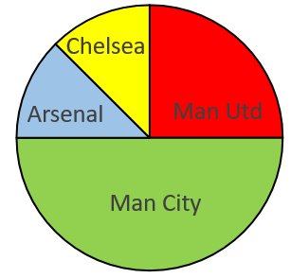
Statistics: Data display Topic 12 | What colour is the mode? | Complete this table: | 80 people = Man Utd fans How many fans did the other teams have.
 | Favourite colours. Total = 70 pupils How many pupils for each colour? | What is the mode? | Draw a time-series graph to represent:
 | Find the missing angles: | Find the missing angles: | Draw pie charts for the previous 2 questions.
Pet | Tally | Frequency
Cat | ││││ ││
Dog |  | 9
Other | ││││
10
8
6
4
2
0
Mon | 5°C | Fri | 12°C
Tue | 6°C | Sat | 9°C
Wed | 6°C | Sun | 4°C
Thurs | 8°C
frequency
7
8
9
10
age
 | Frequency | Angle
Red | 80
Blue | 60
Green | 40
Total | 180
 | Frequency | Angle
Red | 15
Blue | 20
Green | 25
Total | 60

Slide 9
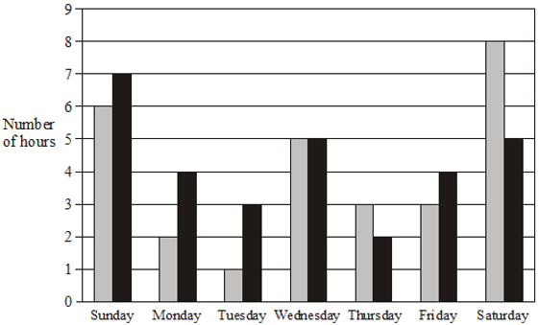
Statistics: Data display Topic 12 | The bar chart shows the hours of TV watched. On what day did they watch the same amount of TV? On how many days did Robin watch more TV than Helen? In total, how many hours of TV did Helen watch? |  | a) Represent this data in a stem and leaf diagram: 40, 43, 45, 47,52, 55, 57, 59, 61, 65, 71, 72, 79 Calculate the : b) Median c) Mode Range
 |  |  | a) Represent this data in a stem and leaf diagram: 0.3, 0.7, 0.9, 1.6, 1.8, 1.8, 1.9, 2.1, 2.3, 2.9, 3.3, 3.7 Calculate: b) Median c) Mode Range
 | Male weights (kg): 80, 96, 57, 64, 79, 88, 68, 74, 89, 65, 74, 72 Female weights (kg): 41, 70, 62, 68, 53, 55, 74, 62, 55, 84, 56, 64 | Draw a back to back stem and leaf to represent both sets of data. Calculate the median and range for both males and females. c) Compare the weights of the males and females.

Slide 10
Statistics: Data display Topic 12 | What colour is the mode? yellow | Complete this table: | 80 people = Man Utd fans C = 40 A = 40 MC = 160
 | Favourite colours. Total = 70 pupils G = 7 Y = 14 R = 21 B = 28 | What is the mode? | Draw a time-series graph to represent:
 | Find the missing angles: | Find the missing angles: | Draw pie charts for the previous 2 questions.
Pet | Tally | Frequency
Cat | ││││ ││ | 7
Dog | ││││ ││││ | 9
Other | ││││ | 4
10
8
6
4
2
0
Mon | 5°C | Fri | 12°C
Tue | 6°C | Sat | 9°C
Wed | 6°C | Sun | 4°C
Thurs | 8°C
frequency
7
8
9
10
age
8
 | Frequency | Angle
Red | 80 | 160
Blue | 60 | 120
Green | 40 | 80
Total | 180 | 360
 | Frequency | Angle
Red | 15 | 90
Blue | 20 | 120
Green | 25 | 150
Total | 60 | 360

Slide 11
Statistics: Data display Topic 12 | The bar chart shows the hours of TV watched. On what day did they watch the same amount of TV? On how many days did Robin watch more TV than Helen? In total, how many hours of TV did Helen watch? |  | a) Represent this data in a stem and leaf diagram: 40, 43, 45, 47,52, 55, 57, 59, 61, 65, 71, 72, 79 Calculate the : b) Median = 57 c) Mode = no mode d) Range = 39
 |  |  | a) Represent this data in a stem and leaf diagram: 0.3, 0.7, 0.9, 1.6, 1.8, 1.8, 1.9, 2.1, 2.3, 2.9, 3.3, 3.7 Calculate: b) Median = 1.85 c) Mode = 1.8 d) Range = 3.4
 | Male weights (kg): 80, 96, 57, 64, 79, 88, 68, 74, 89, 65, 74, 72 Female weights (kg): 41, 70, 62, 68, 53, 55, 74, 62, 55, 84, 56, 64 | On average males weigh more because they have a higher median The girls’ weights are more varied as they have a bigger range.
Wed
4
28
 | Median | Range
Males | 74 | 39
Females | 65 | 43

