Slide 1
Test 2 Revision
Year 10 Foundation

Slide 2
Topic 5 | Find the area: | Find the area: | The area is 48 cm² Find the height:
Topic 6 | Simplify: 55 cm : 210 mm £1.20 : 40p 2.25 hours : 30 min | Share £24 in the ratio 5 : 3. Share £42 in the ratio 4 : 3. | The ratio a : b = 2 : 3 The ratio b : c = 6 : 5 Find the ratio a : c. The ratio a : b = 5 : 4 The ratio b : c = 6 : 1 Find the ratio a : c.
Topic 7 | Find the n^{th} term: -10, -6, -2, 2, … b) 35, 30, 25, 20, … c) 2.8, 4, 5.2, 6.4, … | Find the first 3 terms: T(n) = 5n – 7 b) T(n) = 50 – 2n c) T(n) = 2n² | -4, -1, 2, 5, … Find the rule for the n^{th} term. b) Find the 20th term. c) Which term has a value of 119?
11 cm
16 cm
6 cm
8 cm
12 cm
3 cm
9 cm
9 cm
4 cm

Slide 3
Topic 5 | Find the area: 80cm² | Find the area: 88cm² | The area is 48 cm² Find the height: 8cm
Topic 6 | Simplify: 55 cm : 210 mm 11cm : 42cm b) £1.20 : 40p 3p : 1p c) 2.25 hours : 30 min 9mins : 2mins | Share £24 in the ratio 5 : 3. £15 : £9 Share £42 in the ratio 4 : 3. £24 : £18 | The ratio a : b = 2 : 3 The ratio b : c = 6 : 5 Find the ratio a : c. 4 : 5 The ratio a : b = 5 : 4 The ratio b : c = 6 : 1 Find the ratio a : c. 15 : 2
Topic 7 | Find the n^{th} term: -10, -6, -2, 2, … 4n -14 b) 35, 30, 25, 20, … -5n + 40 or 40 – 5n c) 2.8, 4, 5.2, 6.4, … 1.2n + 1.6 | Find the first 3 terms: T(n) = 5n – 7 -2, 3, 8, ….. b) T(n) = 50 – 2n 48, 46, 44, …. c) T(n) = 2n² 2, 8, 18, …. | -4, -1, 2, 5, … Find the rule for the n^{th} term. 3n - 7 b) Find the 20th term. 53 Which term has a value of 119? 42nd
11 cm
16 cm
6 cm
8 cm
12 cm
3 cm
9 cm
9 cm
4 cm

Slide 4
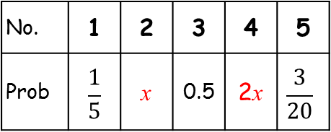
Topic 8 | What is the probability of picking a year 8 from Lennon? | What is the probability of picking a person who is an only child? | Calculate the missing probability:
 | Year 7 | Year 8
Newton | 12 | 14
Lennon | 19 | 25
brother
sister
No. | 1 | 2 | 3 | 4 | 5
Prob | $$\frac{1}{5}$$ | x | 0.5 | 2x | $$\frac{3}{20}$$
11
4
13
7

Slide 5
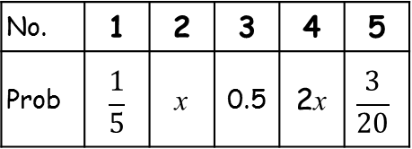
Topic 8 | What is the probability of picking a year 8 from Lennon? 14/70 | What is the probability of picking a person who is an only child? 7/35 | Calculate the missing probability: 0.05, 0.1
 | Year 7 | Year 8
Newton | 12 | 14
Lennon | 19 | 25
brother
sister
No. | 1 | 2 | 3 | 4 | 5
Prob | $$\frac{1}{5}$$ | x | 0.5 | 2x | $$\frac{3}{20}$$
11
4
13
7

