Slide 1
Test 3 Revision
Year 7 Core

Slide 2
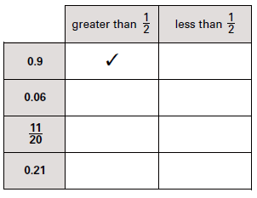
Number : %/decimal/fraction Topic 9 | Convert these decimals in to percentages a) 0.75 b) 0.2 c) 0.05 | Convert these fractions into percentages a) $\frac{1}{2}$ b) $\frac{3}{4}$ c) $\frac{31}{50}$ | Convert these percentages into fractions a) 25% b) 40% c) 15%
 | Calculate: a) $\frac{1}{5} of £30$ b) $\frac{1}{8} of £32$ c) $\frac{1}{7}of £35$ | Calculate: a) $\frac{2}{5} of £20$ b) $\frac{3}{8} of £16$ c) $\frac{4}{7} of £28$ | There are 30 people in a tennis club. $\frac{3}{5}$ of the members are male. How many female members are there?
 | Calculate: a) $\frac{2}{5}+\frac{1}{5}$ b) $\frac{5}{8}+\frac{1}{8}$ c) $\frac{3}{4}+\frac{3}{4}$ | Calculate: a) $\frac{2}{5}+\frac{3}{10}$ b) $\frac{7}{12}+\frac{1}{6}$ c) $\frac{3}{4}+\frac{5}{12}$

Slide 3
Number : %/decimal/fraction Topic 9 | Convert these decimals in to percentages a) 0.75 75% b) 0.2 20% c) 0.05 5% | Convert these fractions into percentages a) $\frac{1}{2}$ 50% b) $\frac{3}{4}$ 75% c) $\frac{31}{50}$ 62% | Convert these percentages into fractions a) 25% $\frac{1}{4}$ b) 40% $\frac{2}{5}$ c) 15% $\frac{3}{20}$
 | Calculate: a) $\frac{1}{5} of £30$ 6 b) $\frac{1}{8} of £32$ 4 c) $\frac{1}{7}of £35$ 5 | Calculate: a) $\frac{2}{5} of £20$ 8 b) $\frac{3}{8} of £16$ 6 c) $\frac{4}{7} of £28$ 16 | There are 30 people in a tennis club. $\frac{3}{5}$ of the members are male. How many female members are there? 12
 | Calculate: a) $\frac{2}{5}+\frac{1}{5}$ $\frac{3}{5}$ b) $\frac{5}{8}+\frac{1}{8}$ $\frac{6}{8}=\frac{3}{4}$ c) $\frac{3}{4}+\frac{3}{4}$ $\frac{6}{4}=\frac{3}{2}=1\frac{1}{2}$ | Calculate: a) $\frac{2}{5}+\frac{3}{10}$ $\frac{7}{10}$ b) $\frac{7}{12}+\frac{1}{6}$ $\frac{3}{4}$ c) $\frac{3}{4}+\frac{5}{12}$ $\frac{7}{6}=1\frac{1}{6}$
✓
✓
✓

Slide 4
Geometry: Angles Topic 10 | Name the type of angle | Name the type of angle | Name the type of angle
 | Name the polygon | Name the polygon | Name the polygon
 | Name the quadrilateral | Name the quadrilateral | Name the quadrilateral

Slide 5
Geometry: Angles Topic 10 | Name the type of angle Reflex | Name the type of angle Obtuse | Name the type of angle Acute
 | Name the polygon Regular Pentagon | Name the polygon Irregular concave pentagon | Name the polygon Irregular hexagon
 | Name the quadrilateral Parallelogram | Name the quadrilateral Kite | Name the quadrilateral Trapezium

Slide 6
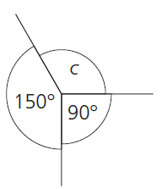
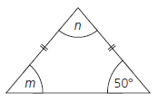
Geometry: Angles Topic 10 | Calculate the missing angles | Calculate the missing angles | Calculate the missing angle
 | Calculate the missing angle | Calculate the missing angle | Calculate the missing angle.
 | Calculate the missing angle | Calculate the missing angle | Calculate the missing angle

Slide 7
Geometry: Angles Topic 10 | Calculate the missing angles a = 120° b = 60° c = 120° | Calculate the missing angles u = 25° v = t = 155° | Calculate the missing angle c c = 120°
 | Calculate the missing angle 90° | Calculate the missing angle 40° | Calculate the missing angle. m = 50° n= 80°
 | Calculate the missing angle a = 50° | Calculate the missing angle b = 75° | Calculate the missing angle c = 45°

Slide 8
Algebra: graphs Topic 11 | Which colour line is Vertical horizontal | Red co-ordinate = Blue co-ordinate = | Red co-ordinate = Blue co-ordinate =
 | Name these two lines: | Name these two lines: | Name these two lines:
 | Draw the line x = 2 | Draw the line y = -3 | Which line is needed to make a square?
a
a
b
b
a
b

Slide 9
Algebra: graphs Topic 11 | Which colour line is Vertical purple Horizontal green | Red co-ordinate = (6,4) Blue co-ordinate =(0,2) | Red co-ordinate = (-3,1) Blue co-ordinate = (0,-3)
 | Name these two lines: | Name these two lines: | Name these two lines:
 | Draw the line x = 2 | Draw the line y = -3 | Which line is needed to make a square?y=2
a x=2
a x = -2
b x=3
b y = 2
a y=-1
b y=-3

Slide 10
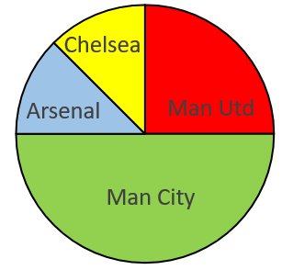
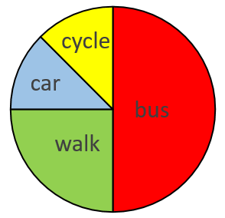
Statistics: Data display Topic 12 | What colour is the mode? | Complete this table: | How many people were questioned?
 | 80 people = Man Utd fans How many Fans did the Other teams have. | Total = 32 pupils How many came to school by each method. | Find the missing angles?
 | What is wrong with this bar chart? | What is wrong with this tally chart? | What was the mode?
Pet | Tally | Frequency
Cat | ││││ ││
Dog |  | 9
Other | ││││
10
8
6
4
2
0
A
B
C
D
 | Frequency | Angle
Red | 80
Blue | 60
Green | 40
Total | 180
10
8
6
4
2
0
10
8
6
4
2
0
Pet | Tally | Frequency
Cat | │││││││ | 7
Dog | │││││ | 5
Other | ││││ | 4
frequency
frequency
7
8
9
10
A
B
C
age

Slide 11
Statistics: Data display Topic 12 | What colour is the mode? yellow | Complete this table: | How many people were questioned? 22
 | 80 people = Man Utd fans How many Fans did the other teams have. 240 | Total = 32 pupils Bus = 16 Walk = 8 Car = 4 Cycle = 4 | Find the missing angles?
 | What is wrong with this bar chart? B too wide | What is wrong? 7 = ││││││ 5 =││││ | What was the mode? 8
Pet | Tally | Frequency
Cat | ││││ ││
Dog |  | 9
Other | ││││
10
8
6
4
2
0
7
4
A
B
C
D
 | Frequency | Angle
Red | 80 | 160
Blue | 60 | 120
Green | 40 | 80
Total | 180 | 360
10
8
6
4
2
0
10
8
6
4
2
0
Pet | Tally | Frequency
Cat | │││││││ | 7
Dog | │││││ | 5
Other | ││││ | 4
frequency
frequency
A
B
C
7
8
9
10
age

