Slide 1
Test 3 Revision
Year 7 Foundation

Slide 2
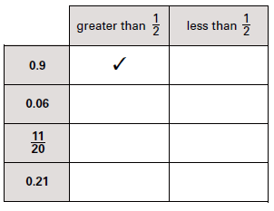
Number : %/decimal/fraction Topic 9 | Convert these decimals in to percentages a) 0.65 b) 0.2 c) 0.45 | Convert these fractions into percentages a) $\frac{1}{2}$ b) $\frac{3}{4}$ c) $\frac{31}{50}$ | Convert these percentages into fractions a) 25% b) 50% c) 70%
 | Calculate: a) $\frac{1}{2} of £20$ b) $\frac{1}{4} of £12$ c) $\frac{1}{7} of £21$ | Calculate: a) $\frac{2}{5} of £20$ b) $\frac{3}{4} of £16$ c) $\frac{3}{10} of £70$ | There are 30 people in a tennis club. $\frac{1}{5}$ of the members are male. How many male members are there?
 | Calculate: a) $\frac{2}{5}+\frac{1}{5}$ b) $\frac{5}{8}+\frac{1}{8}$ c) $\frac{3}{4}−\frac{1}{4}$ | Calculate: a) $\frac{2}{5}+\frac{3}{10}$ b) $\frac{4}{12}+\frac{1}{6}$ c) $\frac{3}{4}+\frac{1}{8}$

Slide 3
Number : %/decimal/fraction Topic 9 | Convert these decimals in to percentages a) 065 = 65% b) 0.2 = 20% c) 0.45 = 45% | Convert these fractions into percentages a) $\frac{1}{2}$ = 50% b) $\frac{3}{4}$ = 75% c) $\frac{31}{50}$ = 62% | Convert these percentages into fractions a) 25% $=\frac{1}{4}$ b) 50% $=\frac{1}{2}$ c) 70% $=\frac{70}{100}=\frac{7}{10}$
 | Calculate: a) $\frac{1}{2} of £20$ £10 b) $\frac{1}{4} of £12$ £3 c) $\frac{1}{7} of £21$ £3 | Calculate: a) $f £20$ £8 b) $\frac{3}{4} of £16$ £12 c) $\frac{3}{10} of £70$ £21 | There are 30 people in a tennis club. $\frac{1}{5}$ of the members are male. How many male members are there? 6
 | Calculate: a) $\frac{2}{5}+\frac{1}{5}$ $=\frac{3}{5}$ b) $\frac{5}{8}+\frac{1}{8}$ $=\frac{6}{8}=\frac{3}{4}$ c) $\frac{3}{4}−\frac{1}{4}$ $=\frac{2}{4}=\frac{1}{2}$ | Calculate: a) $\frac{2}{5}+\frac{3}{10}$ $=\frac{7}{10}$ b) $\frac{4}{12}+\frac{1}{6}$ $=\frac{6}{12}=\frac{1}{2}$ c) $\frac{3}{4}+\frac{1}{8}$ $=\frac{7}{8}$
✓
✓
✓

Slide 4
Geometry: Angles Topic 10 | Name the type of angle | Name the type of angle | Name the type of angle
 | Name the polygon | Name the polygon | Name the polygon
 | Name the quadrilateral | Name the quadrilateral | Name the quadrilateral

Slide 5
Geometry: Angles Topic 10 | Name the type of angle | Name the type of angle | Name the type of angle
 | Name the polygon | Name the polygon | Name the polygon
 | Name the quadrilateral Parallelogram | Name the quadrilateral Kite | Name the quadrilateral Trapezium
Reflex
Acute
Obtuse
Pentagon
Hexagon
Triangle

Slide 6
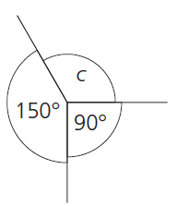
Geometry: Angles Topic 10 | Calculate the missing angles | Calculate the missing angles | Calculate the missing angle
 | Calculate the missing angle | Calculate the missing angle | Calculate the missing angle.
 | Calculate the missing angle | Calculate the missing angle | Calculate the missing angle

Slide 7
Geometry: Angles Topic 10 | Calculate the missing angles a = 120° b = 60° c = 120° | Calculate the missing angles t = 155° u = 25° v = 155° | Calculate the missing angle c = 120° c
 | Calculate the missing angle 90° | Calculate the missing angle 40° | Calculate the missing angle. 90°
 | Calculate the missing angle 50° | Calculate the missing angle 75° | Calculate the missing angle 45°

Slide 8
Algebra: graphs Topic 11 | Which colour line is vertical horizontal | Red co-ordinate = Blue co-ordinate = | Red co-ordinate = Blue co-ordinate =
 | Name these two lines: | Name these two lines: | Name these two lines:
 | What point will make a rectangle? | Draw the line x = 2 | Draw the line y = -3
y
a
a
y
y
b
b
b
x
x
a
x
y
y
x
x

Slide 9
Algebra: graphs Topic 11 | Which colour line is Vertical Black Horizontal Green | Red co-ordinate = (6,4) Blue co-ordinate = (0,2) | Red co-ordinate = (-3,2) Blue co-ordinate = (0, -3)
 | Name these two lines: a) x = 4 b) y = 3 | Name these two lines: a) x = -2 b) y = 2 | Name these two lines: a) y = -1 b) x = 3
 | What point will make a rectangle? (4, 0) | Draw the line x = 2 | Draw the line y = -3
a
b
y
a
b
b
a
x
y
y
x
x

Slide 10
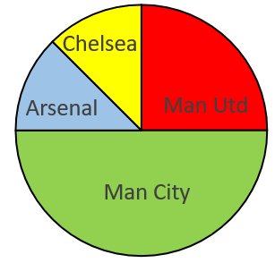
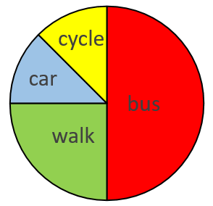
Statistics: Data display Topic 12 | What colour is the mode? | Complete this table: | How many people were questioned?
 | 20 people = Man Utd fans How many Fans did the Other teams have. | Total = 8 pupils How many came to school by each method. | Find the missing angles?
 | What is wrong with this bar chart? | What is wrong with this tally chart? | What was the mode?
Pet | Tally | Frequency
Cat | ││││ ││
Dog |  | 9
Other | ││││
10
8
6
4
2
0
A
B
C
D
 | Frequency | Angle
Red | 80
Blue | 60
Green | 40
Total | 180
10
8
6
4
2
0
10
8
6
4
2
0
Pet | Tally | Frequency
Cat | │││││││ | 7
Dog | │││││ | 5
Other | ││││ | 4
frequency
frequency
7
8
9
10
A
B
C
age

Slide 11
Statistics: Data display Topic 12 | What colour is the mode? | Complete this table: | How many people were questioned? 22
 | 20 people = Man Utd fans How many Fans did the Other teams have. A=10, C=10, MC=40 | Total = 8 pupils B=4,W=2, C & C = 1 each How many came to school by each method. | Find the missing angles?
 | What is wrong with this bar chart? | What is wrong with this tally chart? 5 bar gate | What was the mode? 8
Pet | Tally | Frequency
Cat | ││││ ││ | 7
Dog | ││││ ││││ | 9
Other | ││││ | 4
10
8
6
4
2
0
Yellow
A
B
C
D
 | Frequency | Angle
Red | 80 | 160
Blue | 60 | 120
Green | 40 | 80
Total | 180 | 360
10
8
6
4
2
0
10
8
6
4
2
0
 |  |  | TOO
 |  |  | WIDE
Pet | Tally | Frequency
Cat | │││││││ | 7
Dog | │││││ | 5
Other | ││││ | 4
frequency
frequency
7
8
9
10
A
B
C
age

