Slide 1
Test 3 Revision
Year 8 CORE

Slide 2
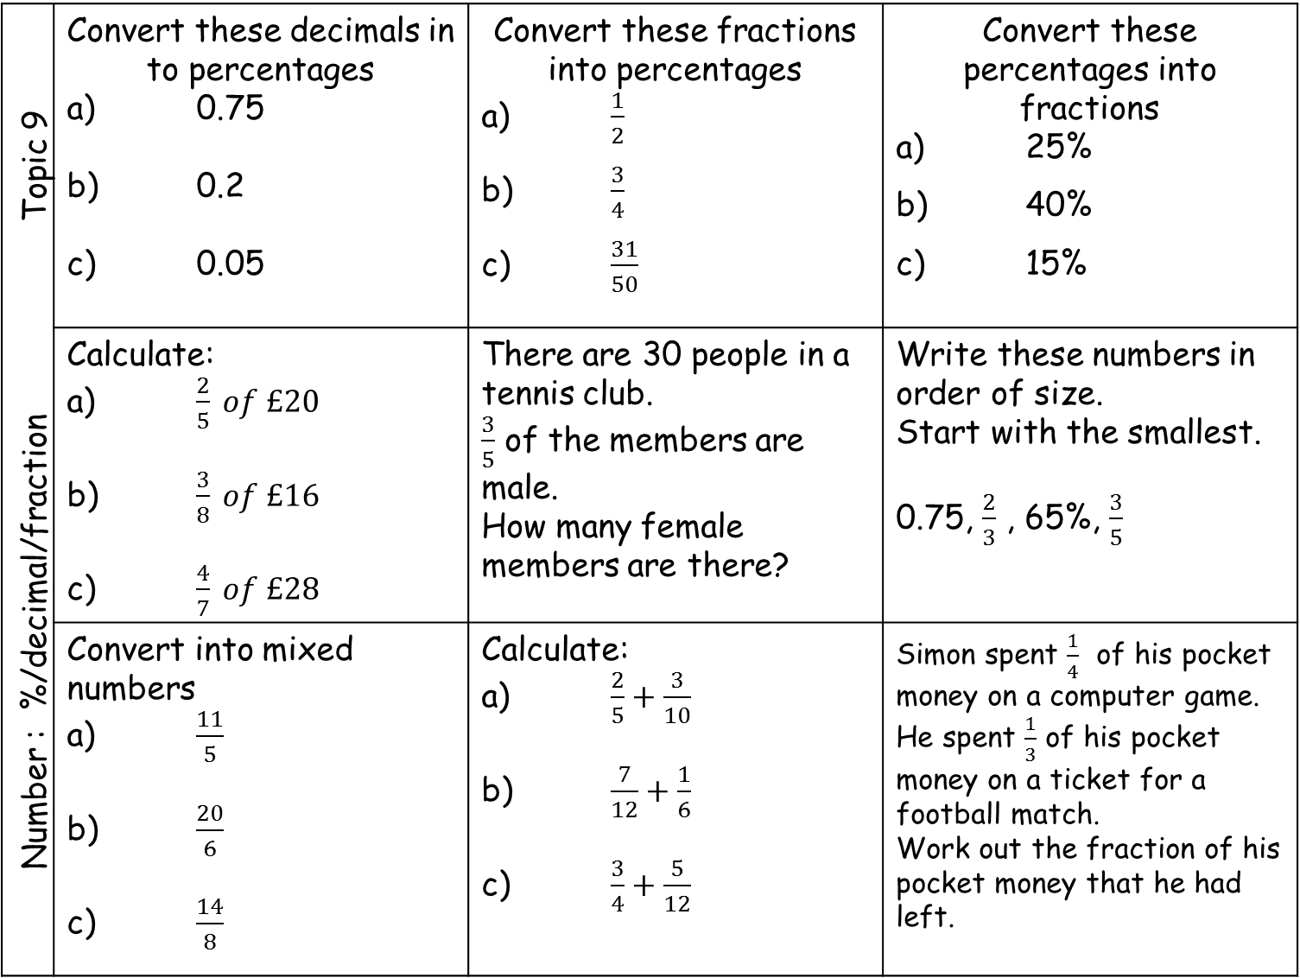
Number : %/decimal/fraction Topic 9 | Convert these decimals in to percentages a) 0.75 b) 0.2 c) 0.05 | Convert these fractions into percentages a) $\frac{1}{2}$ b) $\frac{3}{4}$ c) $\frac{31}{50}$ | Convert these percentages into fractions a) 25% b) 40% c) 15%
 | Calculate: a) $\frac{2}{5} of £20$ b) $\frac{3}{8} of £16$ c) $\frac{4}{7} of £28$ | There are 30 people in a tennis club. $\frac{3}{5}$ of the members are male. How many female members are there? | Write these numbers in order of size. Start with the smallest. 0.75, $\frac{2}{3}$ , 65%, $\frac{3}{5}$
 | Convert into mixed numbers a) $\frac{11}{5}$ b) $\frac{20}{6}$ c) $\frac{14}{8}$ | Calculate: a) $\frac{2}{5}+\frac{3}{10}$ b) $\frac{7}{12}+\frac{1}{6}$ c) $\frac{3}{4}+\frac{5}{12}$ | Simon spent $\frac{1}{4}$ of his pocket money on a computer game. He spent $\frac{1}{3}$ of his pocket money on a ticket for a football match. Work out the fraction of his pocket money that he had left.

Slide 3
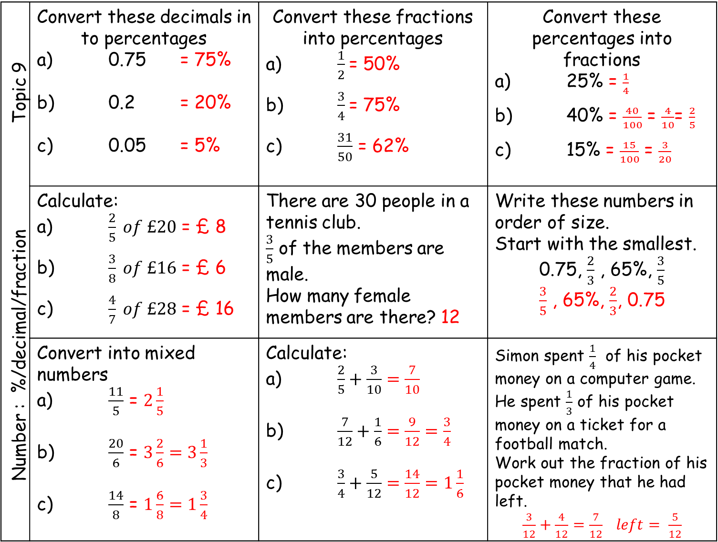
Number : %/decimal/fraction Topic 9 | Convert these decimals in to percentages a) 0.75 = 75% b) 0.2 = 20% c) 0.05 = 5% | Convert these fractions into percentages a) $\frac{1}{2}$= 50% b) $\frac{3}{4}$= 75% c) $\frac{31}{50}$ = 62% | Convert these percentages into fractions a) 25% = $\frac{1}{4}$ b) 40% = $\frac{40}{100}$ = $\frac{4}{10}$= $\frac{2}{5}$ c) 15% = $\frac{15}{100}$ = $\frac{3}{20}$
 | Calculate: a) $\frac{2}{5} of £20$ = £ 8 b) $\frac{3}{8} of £16$ = £ 6 c) $\frac{4}{7} of £28$ = £ 16 | There are 30 people in a tennis club. $\frac{3}{5}$ of the members are male. How many female members are there? 12 | Write these numbers in order of size. Start with the smallest. 0.75, $\frac{2}{3}$ , 65%, $\frac{3}{5}$ $\frac{3}{5}$ , 65%, $\frac{2}{3}$, 0.75
 | Convert into mixed numbers a) $\frac{11}{5}$ = $2\frac{1}{5}$ b) $\frac{20}{6}$ = $3\frac{2}{6}=3\frac{1}{3}$ c) $\frac{14}{8}$ = $1\frac{6}{8}=1\frac{3}{4}$ | Calculate: a) $\frac{2}{5}+\frac{3}{10}$ $=\frac{7}{10}$ b) $\frac{7}{12}+\frac{1}{6}$ $=\frac{9}{12}=\frac{3}{4}$ c) $\frac{3}{4}+\frac{5}{12}$ $=\frac{14}{12}=1\frac{1}{6}$ | Simon spent $\frac{1}{4}$ of his pocket money on a computer game. He spent $\frac{1}{3}$ of his pocket money on a ticket for a football match. Work out the fraction of his pocket money that he had left. $\frac{3}{12}+\frac{4}{12}$ $=\frac{7}{12} left= \frac{5}{12}$

Slide 4
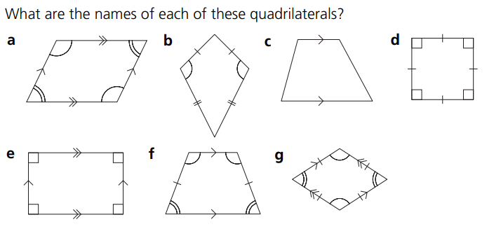
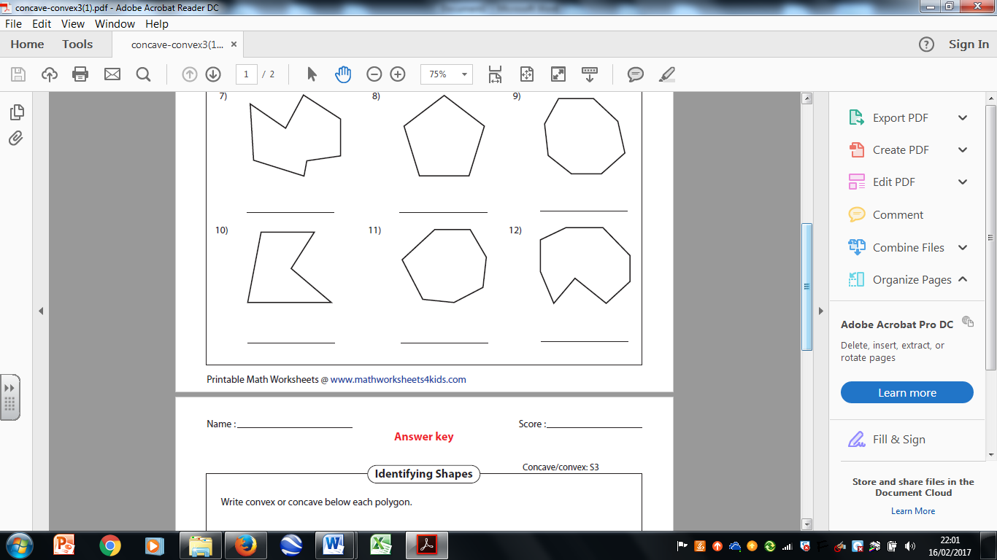
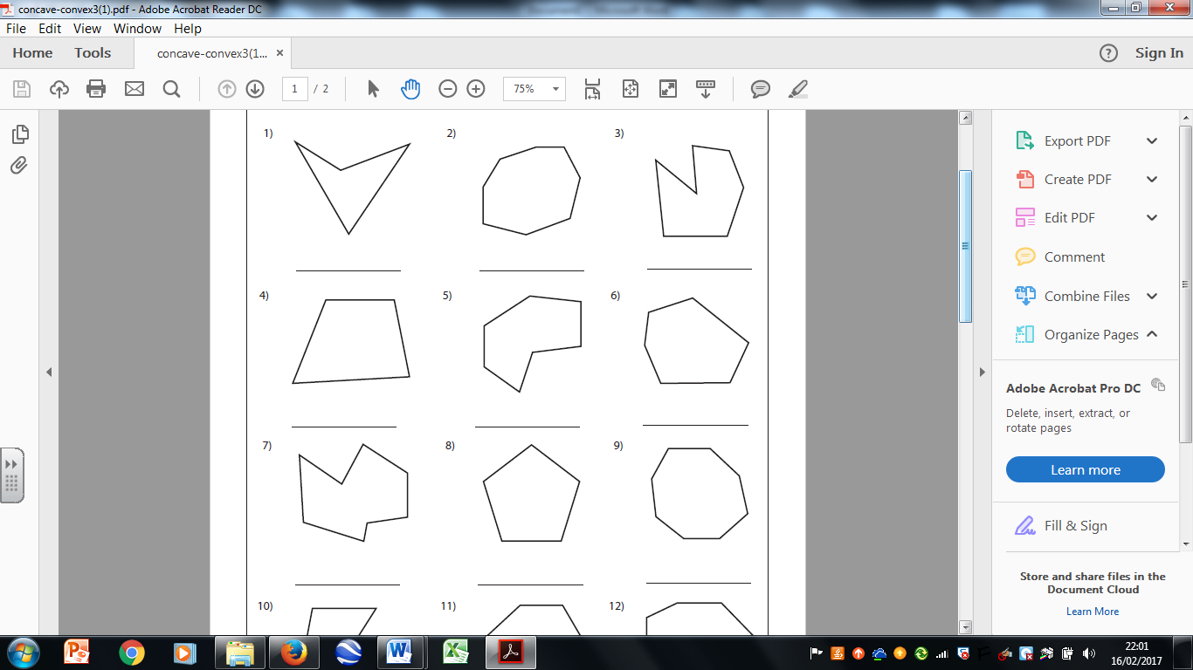
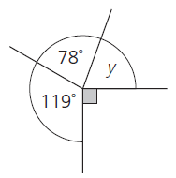
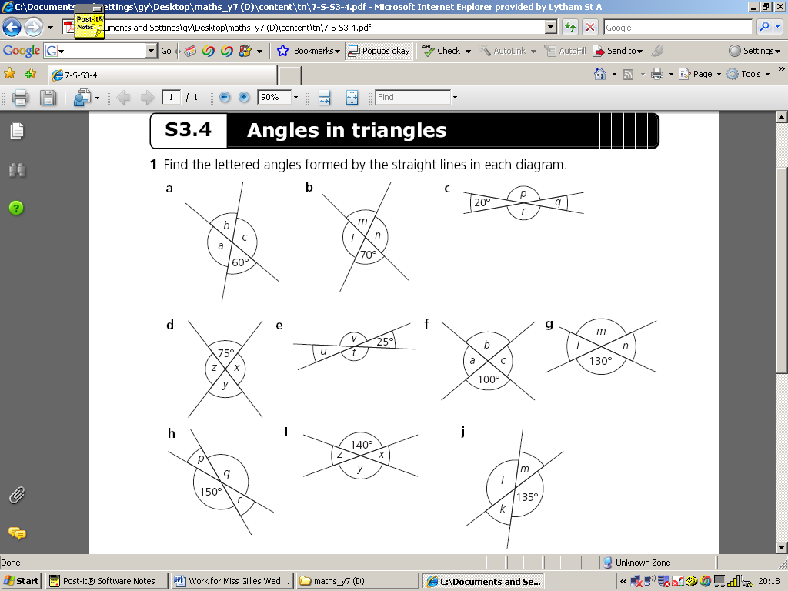
Geometry: Angles Topic 10 | What colour is: ∠ABC ∠DCE ∠CAB | Name the quadrilateral | Name the quadrilateral
 | Name the shape | Name the polygon | Name the polygon
 | Calculate the missing angles | Calculate the missing angles | Calculate the missing angle
B
D
C
A
E

Slide 5
Geometry: Angles Topic 10 | What colour is: ∠ABC ∠DCE ∠CAB | Name the quadrilateral parallelogram | Name the quadrilateral trapezium
 | Name the shape Isosceles triangle | Name the polygon Irregular Concave pentagon | Name the polygon Irregular convex hexagon
 | Calculate the missing angles a = 120° b = 60° c = 120° | Calculate the missing angles v = 155° u = 25° t = 155° | Calculate the missing angle y = 73°
B
D
C
A
E

Slide 6
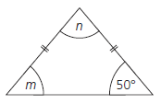
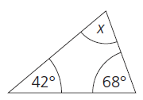
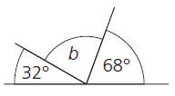
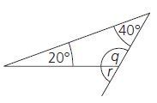
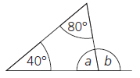

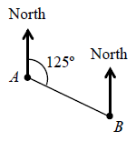
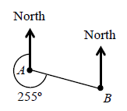
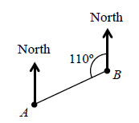
Geometry: Angles Topic 10 | Calculate the missing angle | Calculate the missing angle | Calculate the missing angles.
 | Calculate the missing angles | Calculate the missing angles | Calculate the missing angle
 | What is the bearing of B from A? | What is the bearing of B from A? | What is the bearing of A from B?

Slide 7
Geometry: Angles Topic 10 | Calculate the missing angle x = 78° | Calculate the missing angle b = 80° | Calculate the missing angles. m = 50° n = 80°
 | Calculate the missing angles m = 75° n = 75° l = 150° | Calculate the missing angles a = 120° b = 60° | Calculate the missing angle q = 120° r = 60°
 | What is the bearing of B from A? 125° | What is the bearing of B from A? 105° | What is the bearing of A from B? 250°

Slide 8
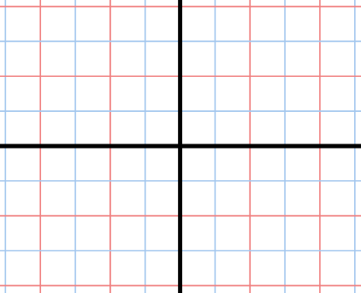
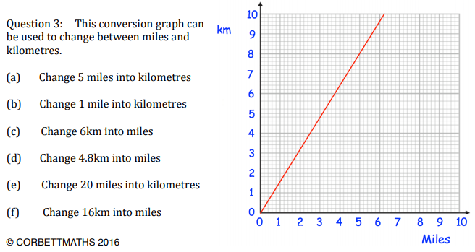
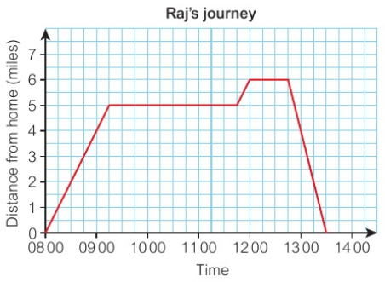
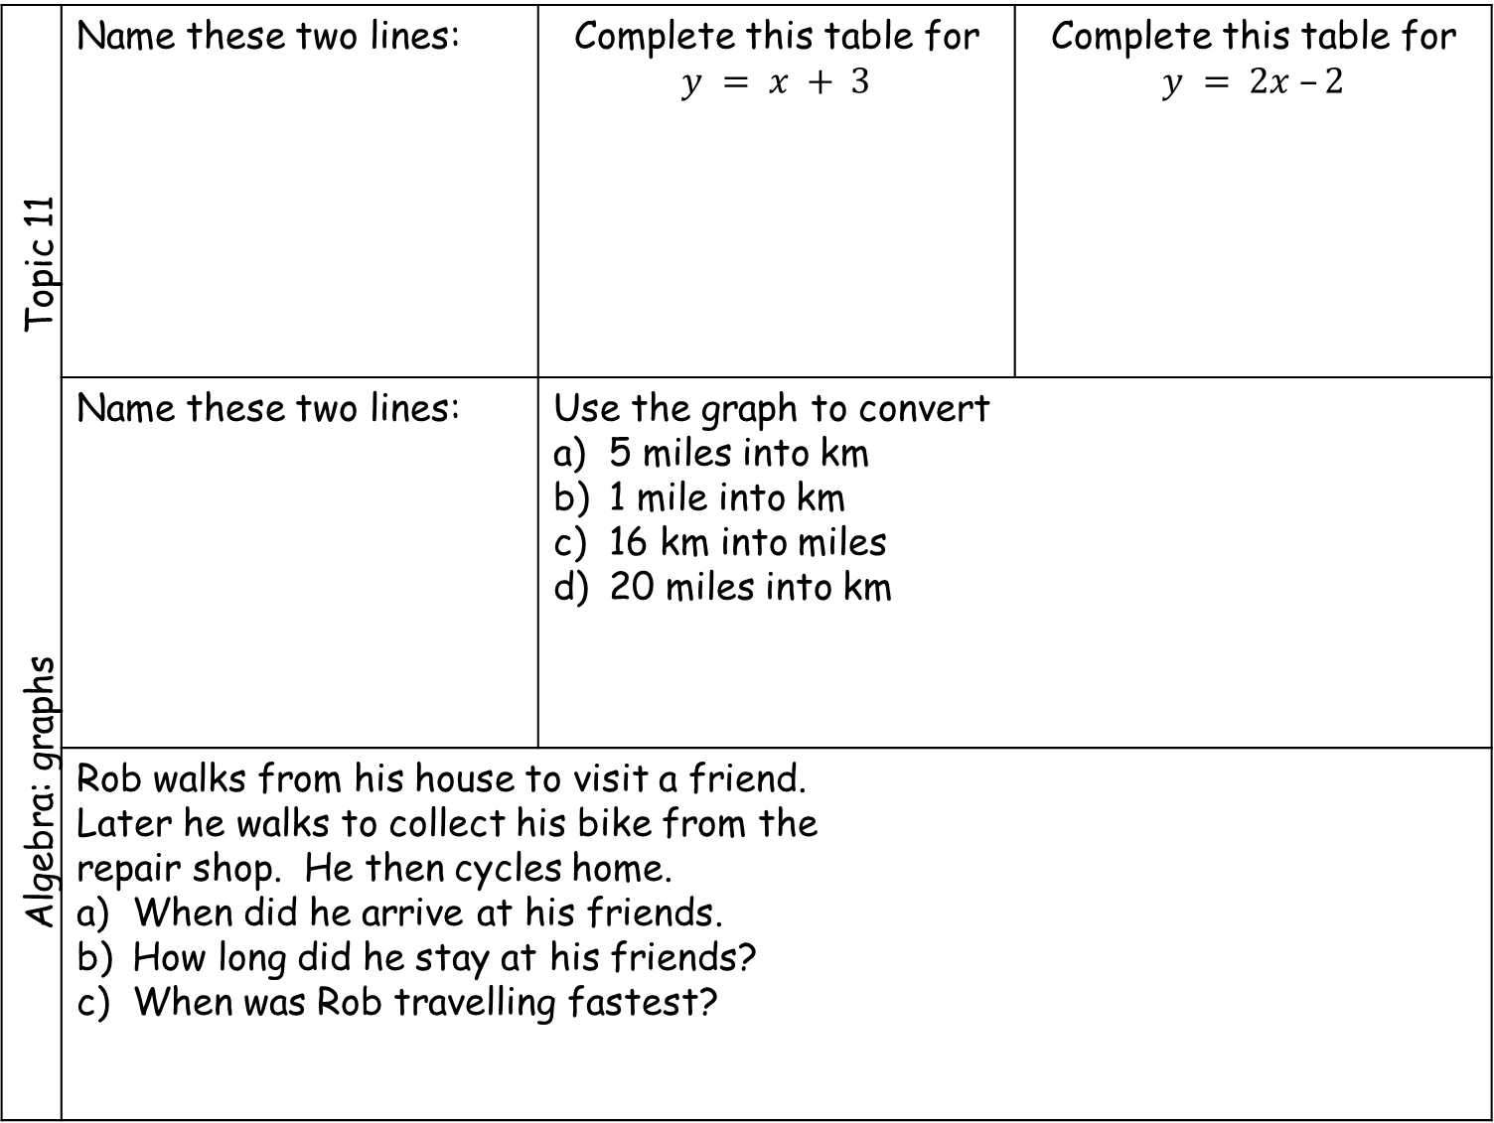
Algebra: graphs Topic 11 | Name these two lines: | Complete this table for $$y = x + 3$$ | Complete this table for $$y = 2x –2$$
 | Name these two lines: | Use the graph to convert 5 miles into km 1 mile into km 16 km into miles 20 miles into km
 | Rob walks from his house to visit a friend. Later he walks to collect his bike from the repair shop. He then cycles home. When did he arrive at his friends. How long did he stay at his friends? When was Rob travelling fastest?
a
x | 0 | 1 | 2 | 3 | 4
y | 3
x | 0 | 1 | 2 | 3 | 4
y | -2
b
a
b
km
miles

Slide 9
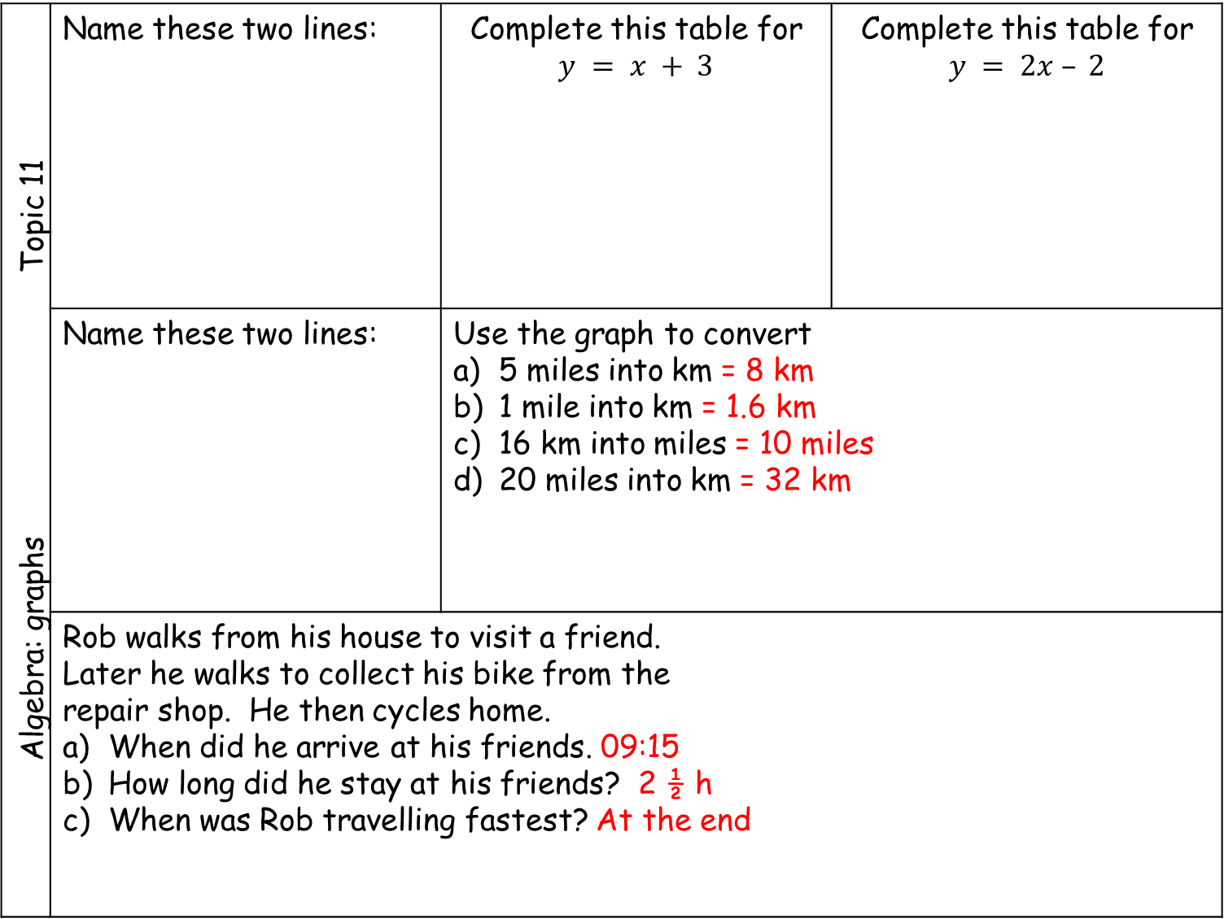
Algebra: graphs Topic 11 | Name these two lines: | Complete this table for $$y = x + 3$$ | Complete this table for $$y = 2x – 2$$
 | Name these two lines: | Use the graph to convert 5 miles into km = 8 km 1 mile into km = 1.6 km 16 km into miles = 10 miles 20 miles into km = 32 km
 | Rob walks from his house to visit a friend. Later he walks to collect his bike from the repair shop. He then cycles home. When did he arrive at his friends. 09:15 How long did he stay at his friends? 2 ½ h When was Rob travelling fastest? At the end
a
a: x = 2
b: y = -3
x | 0 | 1 | 2 | 3 | 4
y | 3 | 4 | 5 | 6 | 7
x | 0 | 1 | 2 | 3 | 4
y | -2 | 0 | 2 | 4 | 6
b
a
km
b
a: x = -2
b: y = 2
miles

Slide 10
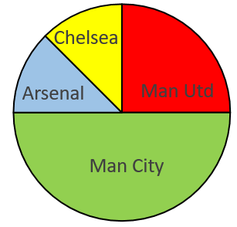
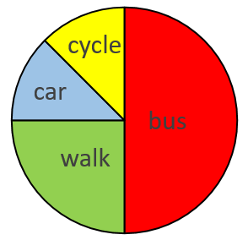
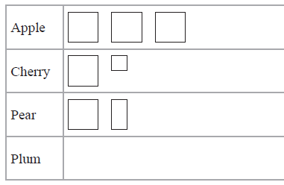
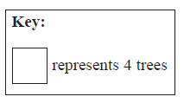
Statistics: Data display Topic 12 | What colour is the mode? | What is wrong with this bar chart? | What was the mode?
 | 80 people = Man Utd fans How many Fans did the Other teams have. | Total = 32 pupils How many came to school by each method. | Find the missing angles?
 | There is a total of 30 trees in the orchard. Complete the pictogram |  | Is the red line a frequency polygon?
10
8
6
4
2
0
10
8
6
4
2
0
frequency
frequency
7
8
9
10
A
B
C
age
 | Frequency | Angle
Red | 35
Blue | 10
Green | 15
Total | 60 | 360
10
8
6
4
2
0
10 20 30 40 50

Slide 11
Statistics: Data display Topic 12 | What colour is the mode? yellow | What is wrong with this bar chart? Bars different width | What was the mode?Age 8
 | 80 people = Man Utd fans How many Fans did the Other teams have. C = 40 A = 40 MC = 160 | Total = 32 pupils How many came to school by each method. Cy = 4 C = 4 W = 8 B = 16 | Find the missing angles?
 | There is a total of 30 trees in the orchard. Complete the pictogram. |  | Is the red line a frequency polygon? No - not in middle
10
8
6
4
2
0
10
8
6
4
2
0
frequency
frequency
7
8
9
10
A
B
C
age
 | Frequency | Angle
Red | 35 | 210
Blue | 10 | 60
Green | 15 | 90
Total | 60 | 360
10
8
6
4
2
0
10 20 30 40 50

