Slide 1
Test 3 Revision
Year 8 enhanced

Slide 2
Number : %/decimal/fraction Topic 9 | Convert these decimals in to fractions a) 0.2 1.05 c) Write $\frac{5 }{8}$as a decimal | Write the reciprocals of the following a) $\frac{2}{3}$ b) 0.7 c) $2\frac{2}{5}$
 | Calculate: a) $\frac{1}{5} of £30$ b) $\frac{3}{8} of £32$ c) $\frac{5}{7}of a number is 45, what is the original number?$ | Calculate : a) $1\frac{1}{5}+2\frac{2}{3}$ b) $4\frac{3}{5} − 2\frac{1}{4}$ c) $2\frac{5}{6}$ - $1\frac{2}{3}$
 | Calculate: a) $\frac{2}{6} × \frac{1}{8}$ b) $\frac{1}{4} × 1\frac{2}{3}$ c) $3\frac{3}{4}× 2\frac{4}{9}$ | Calculate: a) $\frac{2}{5} ÷ \frac{1}{5}$ b) $\frac{5}{8} ÷ \frac{2}{4}$ c) $3\frac{3}{4}÷2\frac{3}{7}$

Slide 3
Number : %/decimal/fraction Topic 9 | Convert these decimals in to fractions a) 0.2 $\frac{2}{10}$ = $\frac{1}{5}$ 1.05 1 $\frac{5}{100}$ = 1 $\frac{1}{20}$ c) Write $\frac{5 }{8}$as a decimal 0.625 | Write the reciprocals of the following a) $\frac{2}{3}$ reciprocal $=\frac{3}{2}$ b) 0.7 = $\frac{7}{10}$ reciprocal = $\frac{10}{7}$ c) $2\frac{2}{5}$ = $\frac{12}{5}$ reciprocal = $\frac{5}{12}$
 | Calculate: a) $\frac{1}{5} of £30$ = £6 b) $\frac{3}{8} of £32$ = £12 $$\frac{5}{7}of a number is 45, what is the original number?$$ $\frac{1}{7}$ = £9 7x9 = £63 | Calculate : a) $1\frac{1}{5}+2\frac{2}{3} =3\frac{3}{15}\text{+}\frac{10}{15}\text{= }3\frac{18}{15} \text{ = }4\frac{13}{15}$ b) $4\frac{3}{5} −2\frac{1}{4}$ $=2\frac{12}{20}\text{ - }\frac{5}{20}\text{= }2\frac{7}{20}$ c) $2\frac{5}{6} − 1\frac{2}{3}$ $=1\frac{5}{6}\text{ − }\frac{4}{6}\text{= }1\frac{1}{6}$
 | Calculate: a) $\frac{2}{6} × \frac{1}{8}$ $=\frac{2}{48}$ $=\frac{1}{24}$ b) $\frac{1}{4} × 1\frac{2}{3}$ $=\frac{1}{4} ×\frac{5}{3}=\frac{5}{12}$ c) $3\frac{3}{4}× 2\frac{4}{9}$ $= \frac{15}{4}×\frac{22}{9}$ = $\frac{5}{2}×\frac{11}{3}$ =$\frac{55}{6}=9\frac{1}{6}$ | Calculate: a) $\frac{2}{5} ÷ \frac{1}{5}$ $=\frac{2}{5}×\frac{5}{1}$ = $\frac{10}{5}$ = 2 b) $\frac{5}{8} ÷ \frac{2}{4}$ $= \frac{5}{8}×\frac{4}{2}$ = $\frac{20}{16}$ c) $3\frac{3}{4}÷2\frac{3}{7} = \frac{15}{4}÷ \frac{17}{7}$ = $\frac{15}{4}× \frac{7}{17}$ = $\frac{105}{68}$

Slide 4
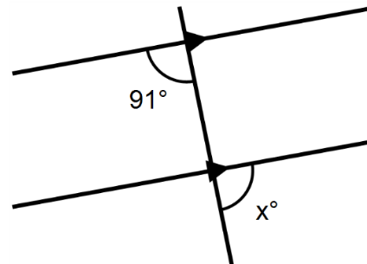
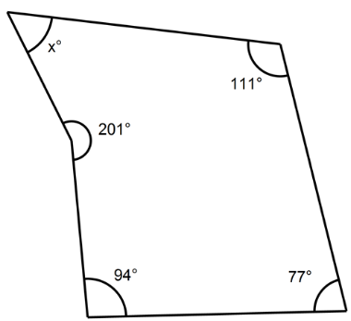
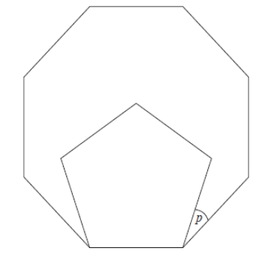
Geometry: Angles Topic 10 | What is the bearing of East | Calculate the size of an interior and exterior angle of a regular octagon.
 | a) Calculate the bearing of A from B b) Calculate the bearing of B from A | Calculate the size of angle x, give your reasons
 | The diagram shows a regular pentagon inside a regular octagon. Calculate the size of angle p | Find the size of the missing angle.

Slide 5
Geometry: Angles Topic 10 | What is the bearing of East 090 | Calculate the size of one interior and one exterior angle of a regular octagon. Exterior = 360 ÷ 8 = 45 Interior = 180-45 = 135
 | A from B 360 – 95 = 265 B from A 180 – 95 = 085 | Calculate the size of angle x, give your reasons
 | Octagon interior = 135 Pentagon interior = 108 p = 135 – 108 = 27 | 5 sides → 3 triangles Interior angle sum = 3 x 180 = 540 540 – 483 = 57º
180 – 91 =89
91
085

Slide 6
Algebra: graphs Topic 11 | State the gradient and y intercept of the following: y = 3x – 4 b) y - 2x = 5 c) 3y – 8x = -6 | Sketch a graph of the following: y = 2x – 1 b) y = 3 – x c) 2y = 6x + 1
 | State the equation of this straight line | Calculate the midpoint between the following coordinates: (1 , 3) (5 , 8) b) (-2, -3) (4, -7) c) (1.5, -7.5) (3.4, 2.5)
 | Calculate the gradient between these two coordinates . (-2, 4) (0, 8) b) (-3, -1) (1, 11) c) (-1, 3) (3, 9) | Find the equation of the straight line that goes through the following coordinates. (-2 , -1) ( 1, 8)

Slide 7
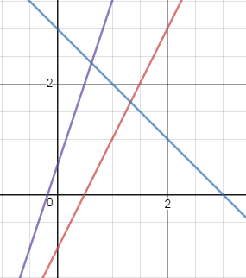
Algebra: graphs Topic 11 | State the gradient and y intercept of the following: y = 3x – 4 m = 3 c = (0, -4) b) y -2x = 5 m = 2 c = (0, 5) c) 3y – 8x = -6 y = $\frac{8}{3}$x – 2 m = $\frac{8}{3}$ c = (0, -2) | Sketch a graph of y = 2x – 1 b) y = 3 – x c) 2y = 6x + 1
 | State the equation of this straight line y= 2x + 1 | Calculate the midpoint between the following coordinates: (1 , 3) (5 , 8) (3, 5.5) b) (-2, -3) (4, -7) (1, -5) c) (1.5, -7.5) (3.4, 2.5) (2.45, -2.5)
 | Calculate the gradient between these two coordinates . (-2, 4) (0, 8) $\frac{8−4}{0−−2}$ = 2 b) (-3, -1) (1, 11) $\frac{11−−1}{1−−3}$ = 3 c) (-1, 3) (3, 9) $\frac{9−3}{3−−1}$ = $\frac{6}{4}$ = $\frac{3}{2}$ | Find the equation of the straight line that goes through the following coordinates. (-2 , -1) ( 1, 8) m = $\frac{8−−1}{1−−2}$ =3 y = 3x + c Sub in (1, 8) 8 = 3(1) + c c = 5 y =3x + 5

Slide 8
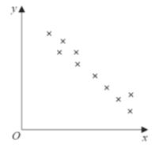
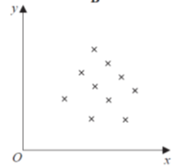
Scatter graphs and Venn diagrams Topic 12 | Draw a box plot to show the following data | = { pupils at LSA } A = { pupils who have a brother } B = {pupils who have a sister } Create some questions and answers using this Venn diagram
 | What could we put on the axes to show this type of correlation? | What could you put on the axes to show this type of correlation?
 | Put the numbers 1 - 20 into the Venn diagram below A {Factors of 30} B {prime} | Calculate: P (A ∩ B) = P ( A ∪ B) = P (A’ ) = P (A ∪ B)’ =
Minimum | 6
LQ | 9
Median | 12
IQR | 5
Range | 13
ε
A
B
230
600
220
450
ε
A
B

Slide 9
Scatter graphs and Venn diagrams Topic 12 |  | = { pupils at LSA } A = { pupils who have a brother } B = {pupils who have a sister } Create some questions and answers using this Venn diagram
 | Negative Correlation Temperature (x) Soup sales (y) | No correlation Height (x) IQ (y)
 |  | Calculate: P (A ∩ B) = $\frac{3}{20}$ P ( A ∪ B) = $\frac{12}{20}=\frac{3}{5}$ P (A’ ) = $\frac{13}{20}$ P (A ∪ B)’ = $\frac{8}{20}=\frac{2}{5}$
Minimum | 6
LQ | 9
Median | 12
UQ | 14
Max | 19
ε
A
B
230
600
220
450
4 8 9 12 14 16 18 20
11
1 6
10
15
2
3
5
13 19 17

