Slide 1
Test 3 Revision
Year 9 Foundation

Slide 2

Topic 8 | A dice is thrown. What is the probability of: getting a 6 getting an odd number getting a 7 getting a prime number getting a square number |  | A pupil is picked at random. What is the probability of picking: Someone with a pet cat and a pet dog. Someone with no pet cat or pet dog. Someone with only a dog. Someone with only a cat.
Topic 8 | The spinner is spun. Which letter represents: P(4) P(8) P(2) P(even) P(less than 7)
Topic 8 | What is the probability of picking: A girl from Newton? A boy from King? A person from Newton? A person from King? |  | A box of crisps has: 2 salt + vinegar 1 ready salted 5 cheese + onion What is the probability of picking salt + vinegar? Not picking ready salted?
Cat
Dog
8
3
5
4
A
B
C
D
E
F
G
2
4
2
2
1
0
1
4
6
2
 | Newton | King | Total
Boys | 6 | 4 | 10
Girls | 8 | 2 | 10
Total | 14 | 6 | 20

Slide 3
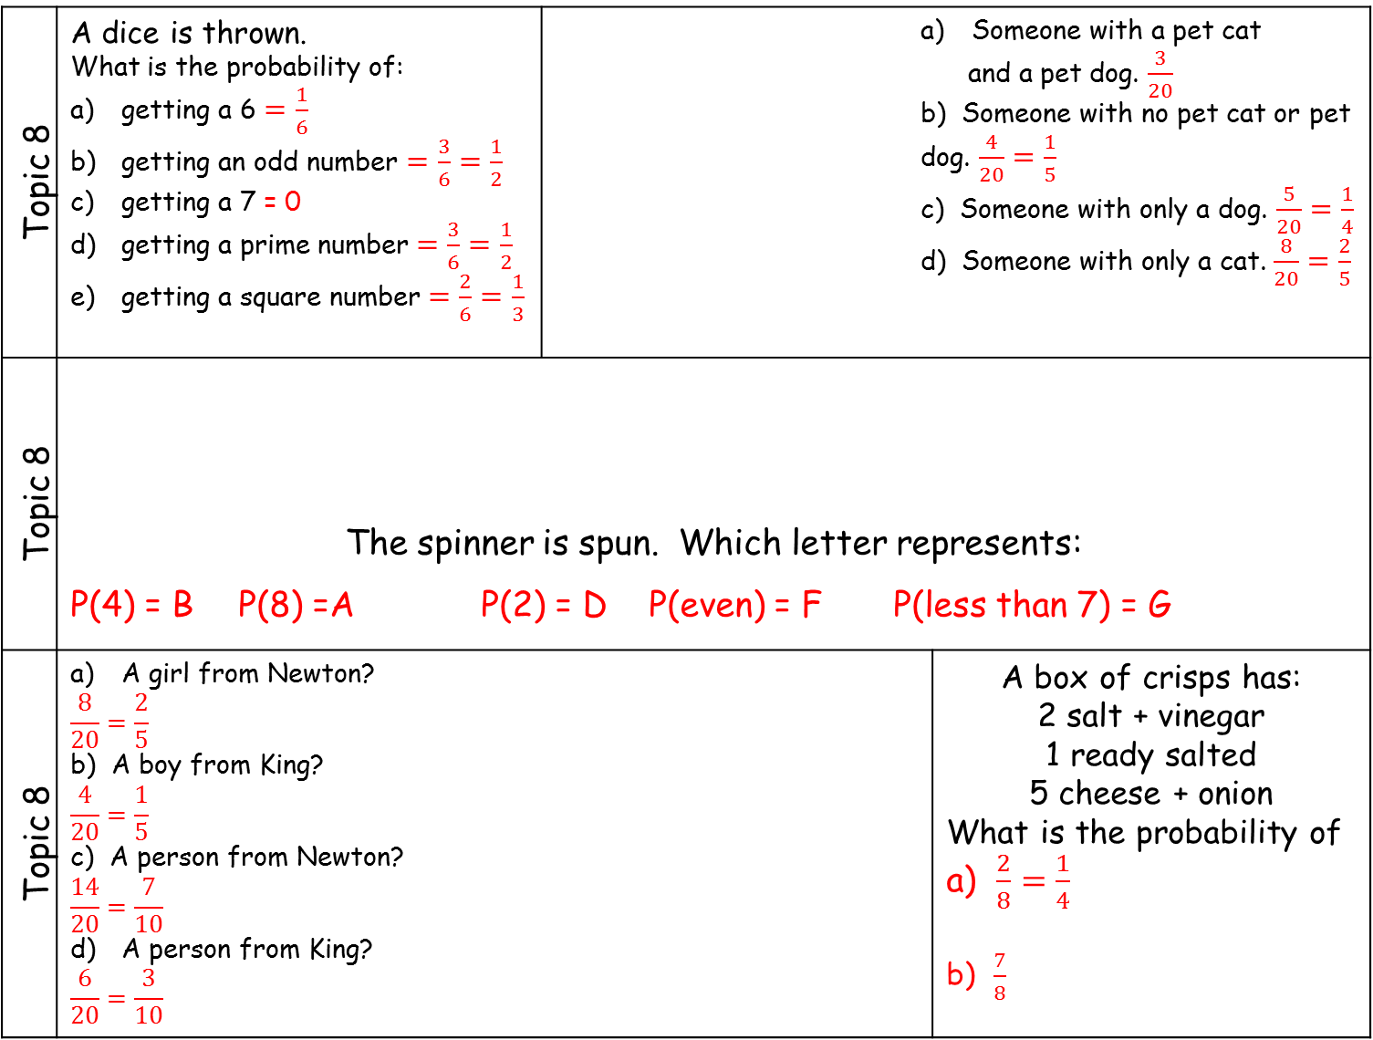
Topic 8 | A dice is thrown. What is the probability of: getting a 6 $=\frac{1}{6}$ getting an odd number $=\frac{3}{6}=\frac{1}{2}$ getting a 7 = 0 getting a prime number $=\frac{3}{6}=\frac{1}{2}$ getting a square number $=\frac{2}{6}=\frac{1}{3}$ |  | Someone with a pet cat and a pet dog. $\frac{3}{20}$ b) Someone with no pet cat or pet dog. $\frac{4}{20}=\frac{1}{5}$ c) Someone with only a dog. $\frac{5}{20}=\frac{1}{4}$ d) Someone with only a cat. $\frac{8}{20}=\frac{2}{5}$
Topic 8 | The spinner is spun. Which letter represents: P(4) = B P(8) =A P(2) = D P(even) = F P(less than 7) = G
Topic 8 | A girl from Newton? $$\frac{8}{20}=\frac{2}{5}$$ b) A boy from King? $$\frac{4}{20}=\frac{1}{5}$$ c) A person from Newton? $$\frac{14}{20}=\frac{7}{10}$$ A person from King? $$\frac{6}{20}=\frac{3}{10}$$ |  |  | A box of crisps has: 2 salt + vinegar 1 ready salted 5 cheese + onion What is the probability of a) $\frac{2}{8}=\frac{1}{4}$ b) $\frac{7}{8}$
Cat
Dog
8
3
5
4
A
B
C
D
E
F
G
2
4
2
2
1
0
1
4
6
2
 | Newton | King | Total
Boys | 6 | 4 | 10
Girls | 8 | 2 | 10
Total | 14 | 6 | 20

Slide 4
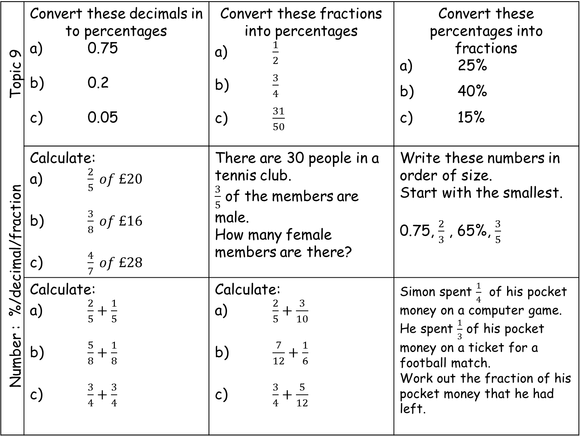
Number : %/decimal/fraction Topic 9 | Convert these decimals in to percentages a) 0.75 b) 0.2 c) 0.05 | Convert these fractions into percentages a) $\frac{1}{2}$ b) $\frac{3}{4}$ c) $\frac{31}{50}$ | Convert these percentages into fractions a) 25% b) 40% c) 15%
 | Calculate: a) $\frac{2}{5} of £20$ b) $\frac{3}{8} of £16$ c) $\frac{4}{7} of £28$ | There are 30 people in a tennis club. $\frac{3}{5}$ of the members are male. How many female members are there? | Write these numbers in order of size. Start with the smallest. 0.75, $\frac{2}{3}$ , 65%, $\frac{3}{5}$
 | Calculate: a) $\frac{2}{5}+\frac{1}{5}$ b) $\frac{5}{8}+\frac{1}{8}$ c) $\frac{3}{4}+\frac{3}{4}$ | Calculate: a) $\frac{2}{5}+\frac{3}{10}$ b) $\frac{7}{12}+\frac{1}{6}$ c) $\frac{3}{4}+\frac{5}{12}$ | Simon spent $\frac{1}{4}$ of his pocket money on a computer game. He spent $\frac{1}{3}$ of his pocket money on a ticket for a football match. Work out the fraction of his pocket money that he had left.

Slide 5
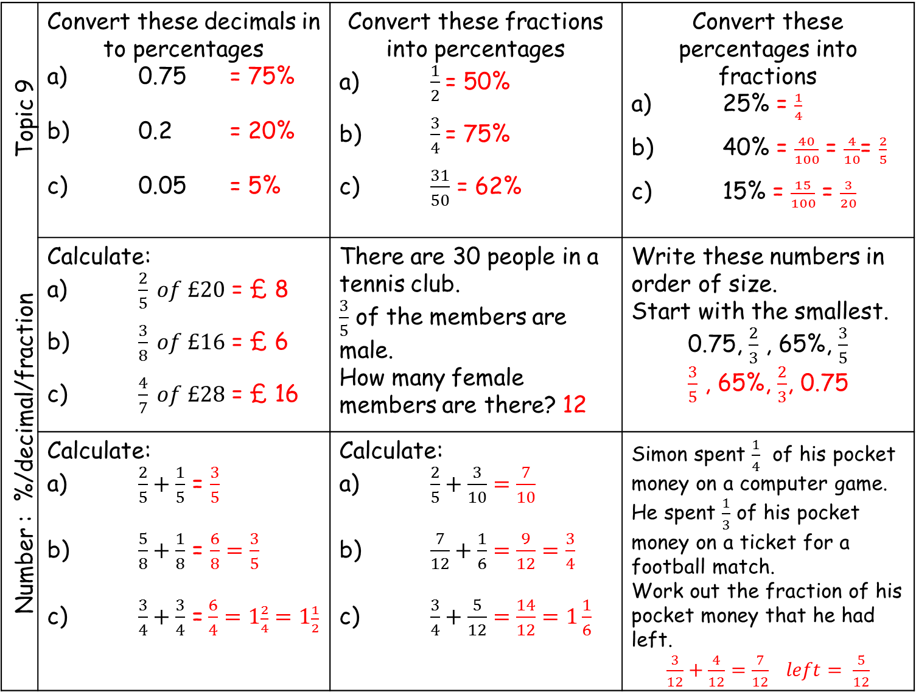
Number : %/decimal/fraction Topic 9 | Convert these decimals in to percentages a) 0.75 = 75% b) 0.2 = 20% c) 0.05 = 5% | Convert these fractions into percentages a) $\frac{1}{2}$= 50% b) $\frac{3}{4}$= 75% c) $\frac{31}{50}$ = 62% | Convert these percentages into fractions a) 25% = $\frac{1}{4}$ b) 40% = $\frac{40}{100}$ = $\frac{4}{10}$= $\frac{2}{5}$ c) 15% = $\frac{15}{100}$ = $\frac{3}{20}$
 | Calculate: a) $\frac{2}{5} of £20$ = £ 8 b) $\frac{3}{8} of £16$ = £ 6 c) $\frac{4}{7} of £28$ = £ 16 | There are 30 people in a tennis club. $\frac{3}{5}$ of the members are male. How many female members are there? 12 | Write these numbers in order of size. Start with the smallest. 0.75, $\frac{2}{3}$ , 65%, $\frac{3}{5}$ $\frac{3}{5}$ , 65%, $\frac{2}{3}$, 0.75
 | Calculate: a) $\frac{2}{5}+\frac{1}{5}$ = $\frac{3}{5}$ b) $\frac{5}{8}+\frac{1}{8}$ = $\frac{6}{8}=\frac{3}{5}$ c) $\frac{3}{4}+\frac{3}{4}$ =$\frac{6}{4}=1\frac{2}{4}=1\frac{1}{2}$ | Calculate: a) $\frac{2}{5}+\frac{3}{10}$ $=\frac{7}{10}$ b) $\frac{7}{12}+\frac{1}{6}$ $=\frac{9}{12}=\frac{3}{4}$ c) $\frac{3}{4}+\frac{5}{12}$ $=\frac{14}{12}=1\frac{1}{6}$ | Simon spent $\frac{1}{4}$ of his pocket money on a computer game. He spent $\frac{1}{3}$ of his pocket money on a ticket for a football match. Work out the fraction of his pocket money that he had left. $\frac{3}{12}+\frac{4}{12}$ $=\frac{7}{12} left= \frac{5}{12}$

Slide 6
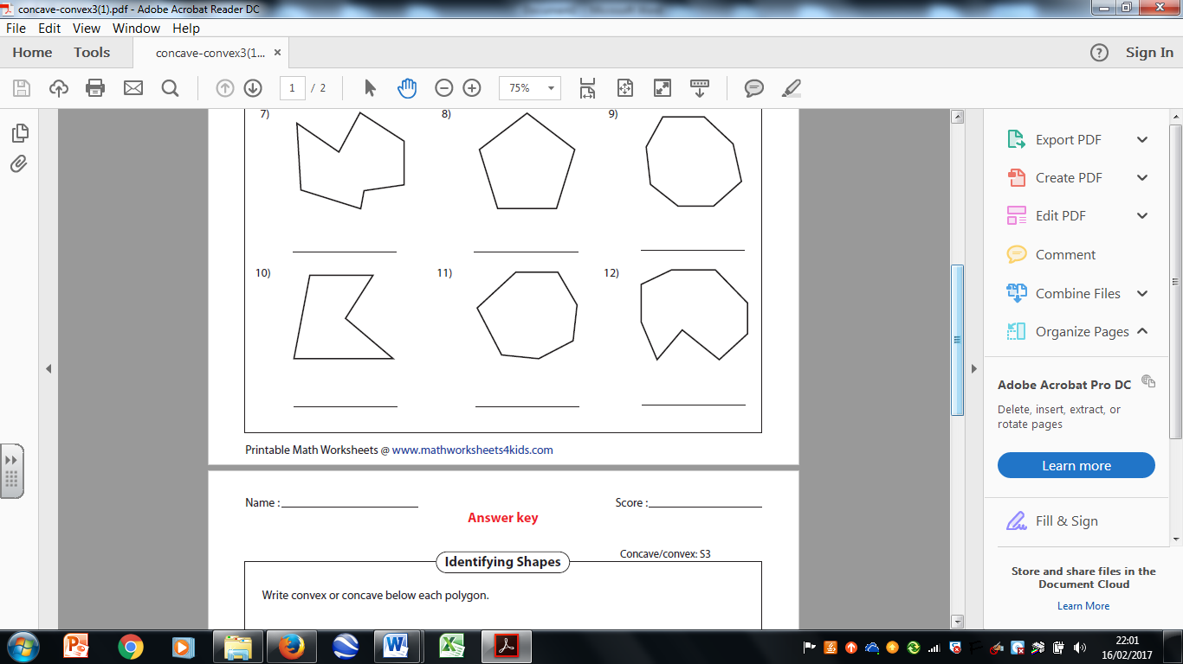
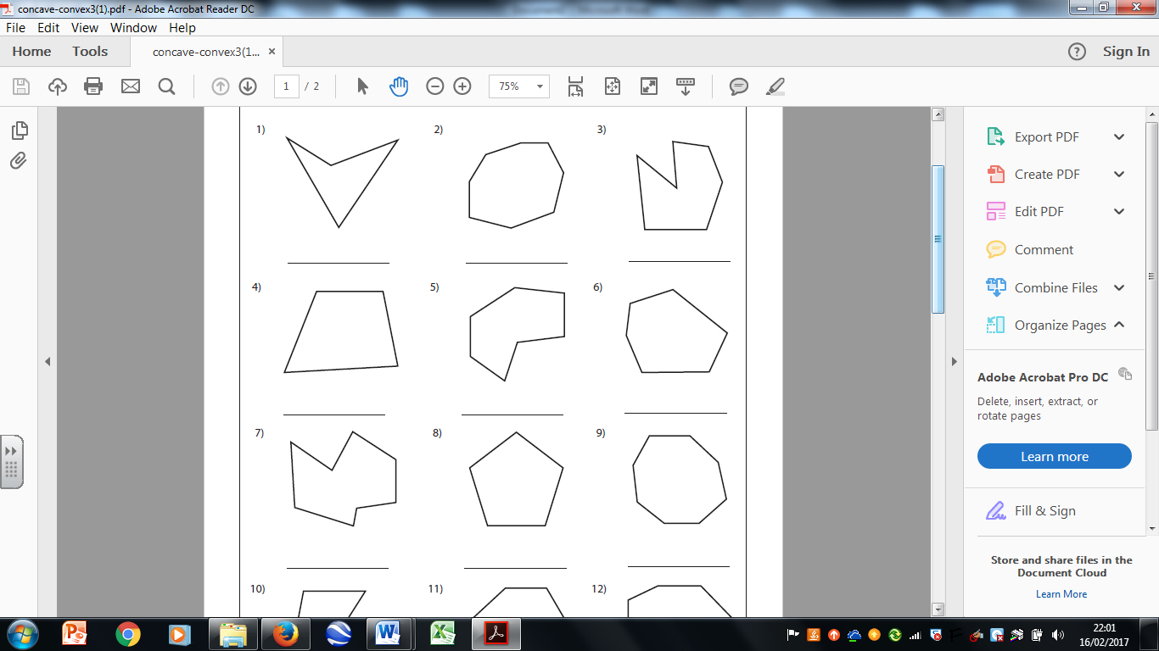
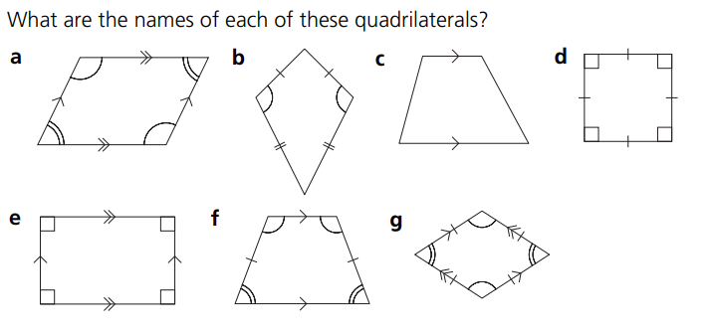
Geometry: Angles Topic 10 | Name the type of angle | Name the type of angle | Name the type of angle
 | Name the shape | Name the polygon | Name the polygon
 | Name the quadrilateral | Name the quadrilateral | Name the quadrilateral

Slide 7
Geometry: Angles Topic 10 | Name the type of angle reflex | Name the type of angle obtuse | Name the type of angle acute
 | Name the shape Isosceles triangle | Name the polygon Irregular Concave pentagon | Name the polygon Irregular convex hexagon
 | Name the quadrilateral parallelogram | Name the quadrilateral kite | Name the quadrilateral trapezium

Slide 8
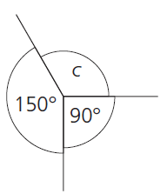
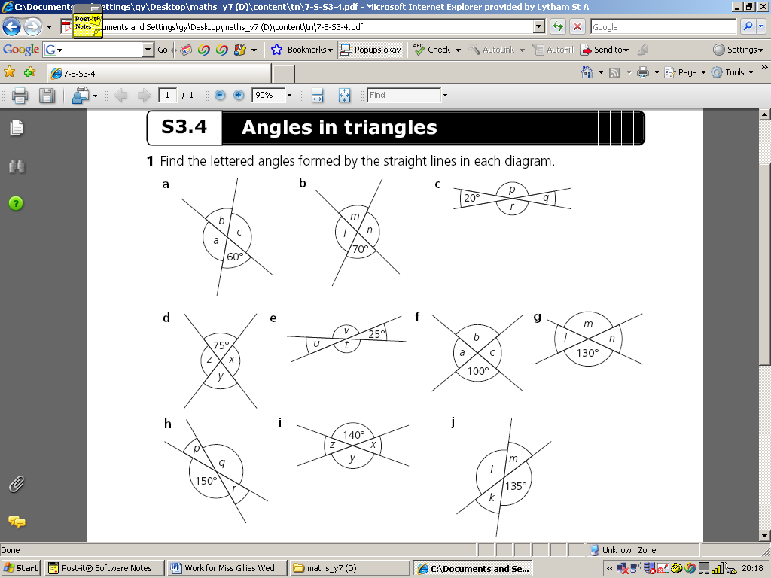
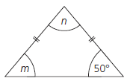


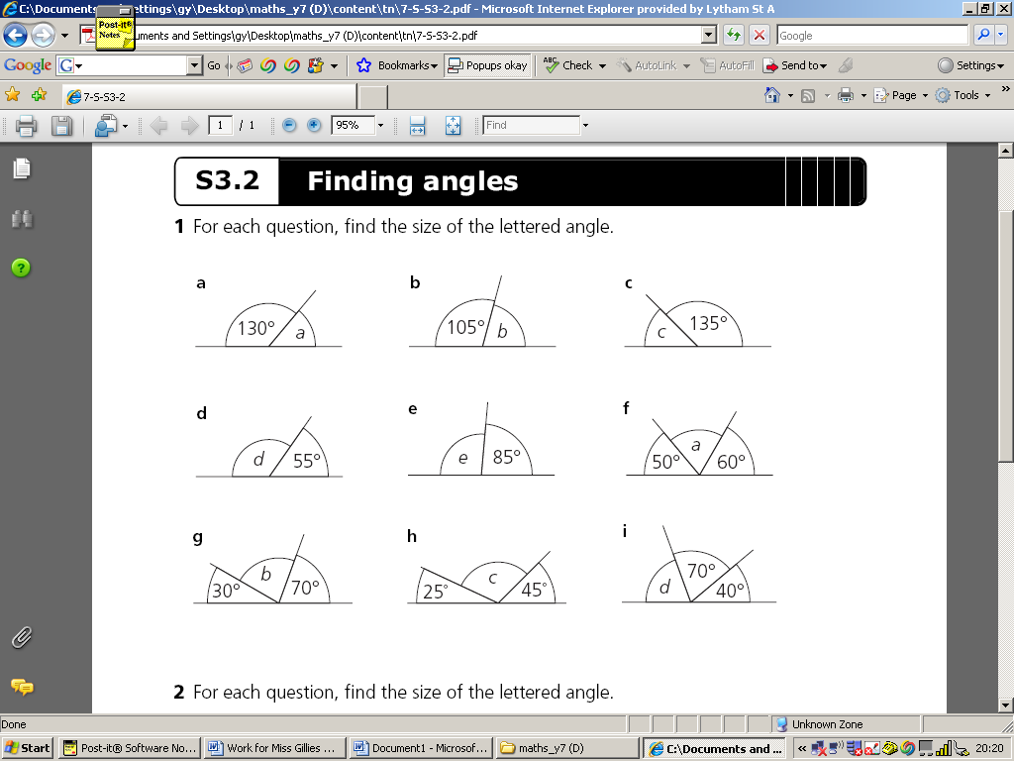
Geometry: Angles Topic 10 | Calculate the missing angles | Calculate the missing angles | Calculate the missing angle
 | Calculate the missing angle | Calculate the missing angle | Calculate the missing angle.
 | Calculate the missing angle | Calculate the missing angle | Calculate the missing angle

Slide 9
Geometry: Angles Topic 10 | Calculate the missing angles a = 120° b = 60° c = 120° | Calculate the missing angles v = 155° u = 25° t = 155° | Calculate the missing angle c = 120°
 | Calculate the missing angle 90° | Calculate the missing angle 40° | Calculate the missing angle. m = 50° n = 80
 | Calculate the missing angle 50° | Calculate the missing angle 75° | Calculate the missing angle 145°

Slide 10
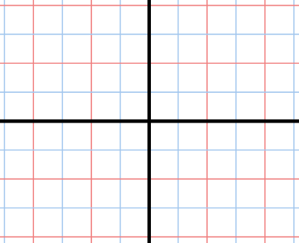
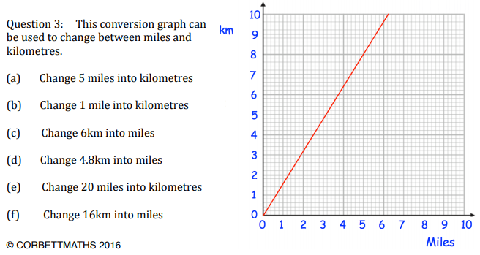
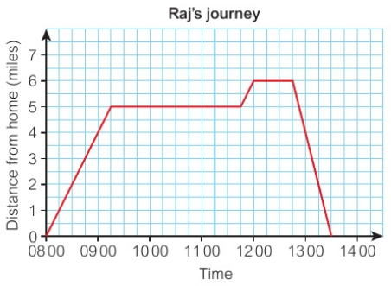
Algebra: graphs Topic 11 | Name these two lines: | Complete this table for y = x + 3 | Complete this table for y = 2x – 2
 | Name these two lines: | Use the graph to convert 5 miles into km 1 mile into km 16 km into miles 20 miles into km
 | Rob walks from his house to visit a friend. Later he walks to collect his bike from the repair shop. He then cycles home. When did he arrive at his friends. How long did he stay at his friends? When was Rob travelling fastest?
a
x | 0 | 1 | 2 | 3 | 4
y | 3
x | 0 | 1 | 2 | 3 | 4
y | -2
b
a
b
km
miles

Slide 11
Algebra: graphs Topic 11 | Name these two lines: | Complete this table for y = x + 3 | Complete this table for y = 2x – 2
 | Name these two lines: | Use the graph to convert 5 miles into km = 8 km 1 mile into km = 1.6 km 16 km into miles = 10 miles 20 miles into km = 32 km
 | Rob walks from his house to visit a friend. Later he walks to collect his bike from the repair shop. He then cycles home. When did he arrive at his friends. 09:15 How long did he stay at his friends? 2 ½ h When was Rob travelling fastest? At the end
a
a: x = 2
b: y = -3
x | 0 | 1 | 2 | 3 | 4
y | 3 | 4 | 5 | 6 | 7
x | 0 | 1 | 2 | 3 | 4
y | -2 | 0 | 2 | 4 | 6
b
a
km
b
a: x = -2
b: y = 2
miles

