Slide 1
The importance of human rights

Slide 2
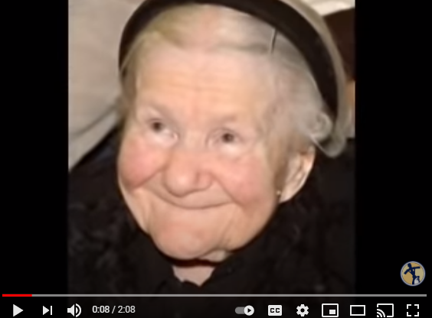
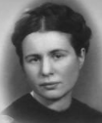
Rescuer: Irene Sendler

Slide 3
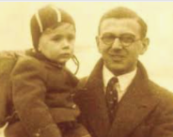
Rescuer: Nicholas Winton

Slide 4
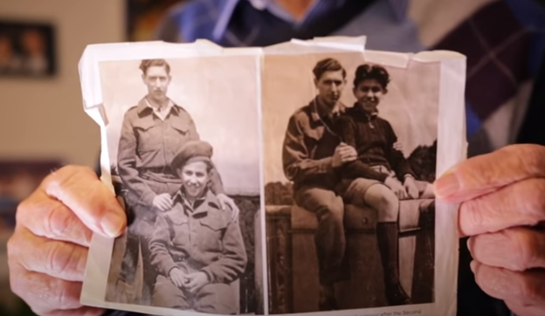
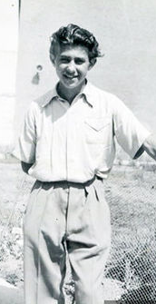
Holocaust survivor: The Testimony of Zigi Shipper
Notes:
https://www.hmd.org.uk/wp-content/uploads/old-images/zigi_shipper_easy_to_read_life_story_hmd.pdf

Slide 5
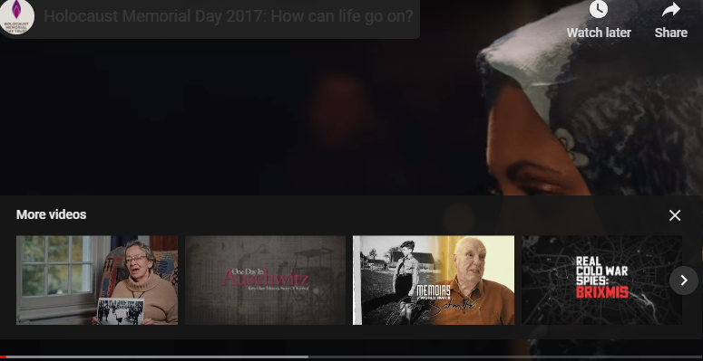
Do not be a bystander
Notes:
https://www.hmd.org.uk/wp-content/uploads/old-images/zigi_shipper_easy_to_read_life_story_hmd.pdf

