Slide 1
Body, Mind and Spirit.

Slide 2
How can you show your support to the LGBT+ community in our school and the country?

Slide 3
Design the official badge for 2022.
This is a national competition that LSA have signed up to.
With your permission, we will send the ‘best’ design from KS3 and KS4.

Slide 4
The theme is Art and Politics.
‘The Arc is Long’.
This quote is taken from Martin Luther King
(adapted from Theodore Parker).
‘The arc is long but it bends towards justice’.
Notes:
Launch of LGBT+ History Month 2022 in October/November 2021. There they will meet the members of the charity’s steering committee. Schools OUT UK, the charity that created history month is among the longest-running LGBT+ advocacy organisations in Britain

Slide 5
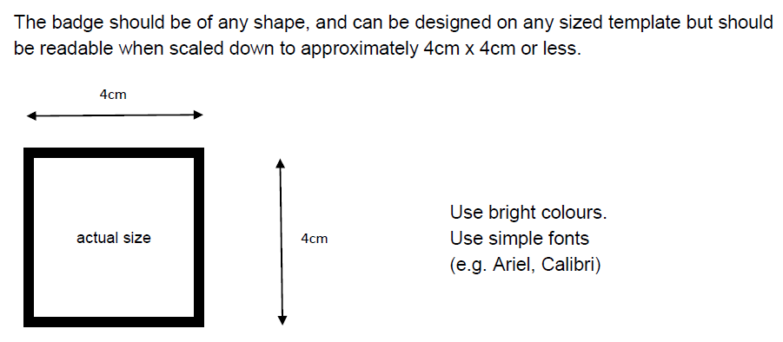
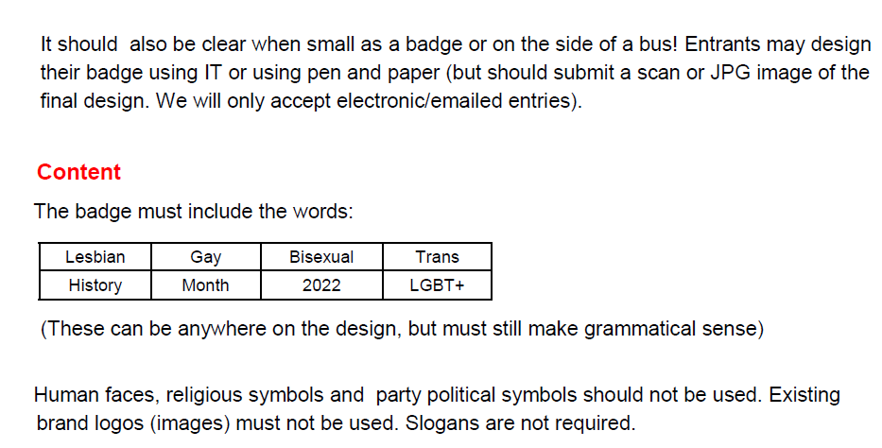
Eight words that must be on the badge.

Slide 6
Successful designs from previous years:-

Slide 7
There will also be a
Love to Shop
voucher prize for the ‘best’ designs.

