Slide 1
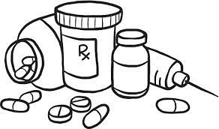
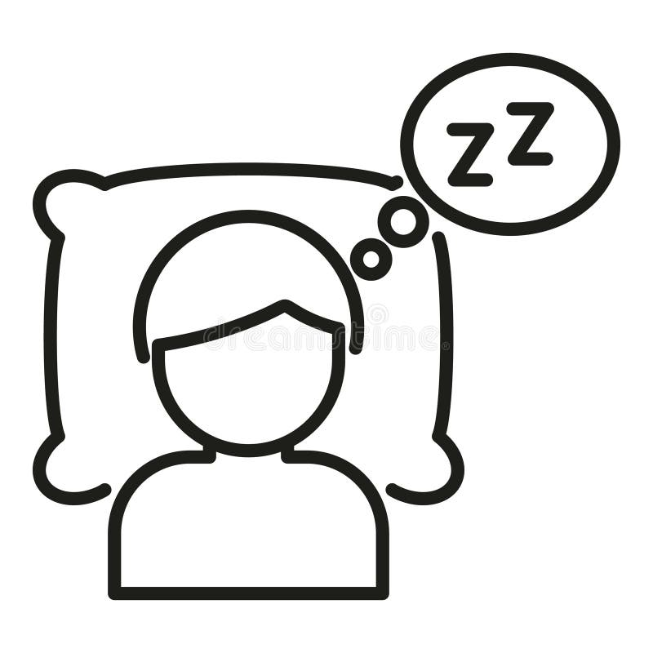
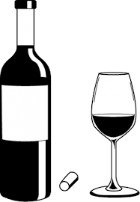
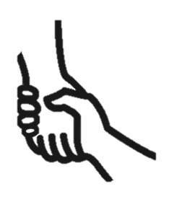
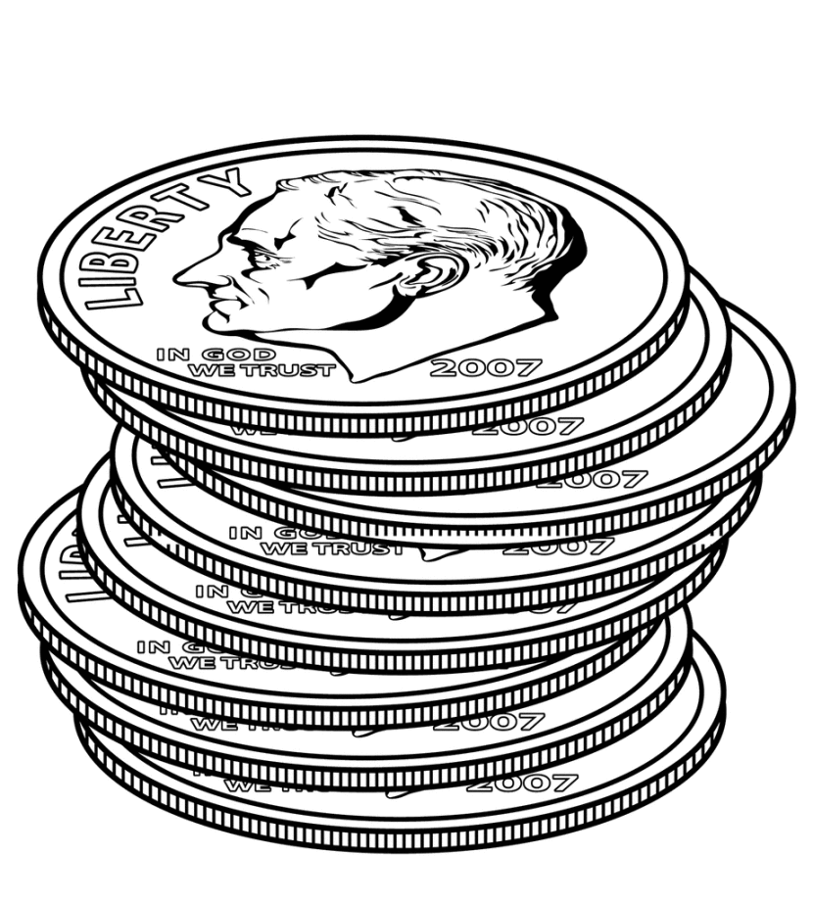
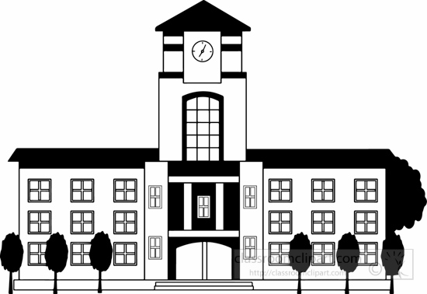
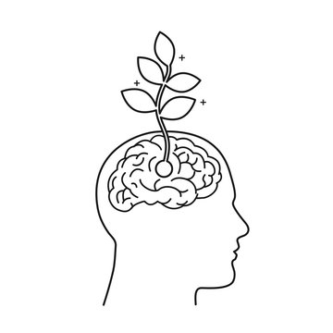
Where are areas of surplus and deficit located globally?
Ready for
KS4
KS3 Personal Development Learning Journey
Dangers of vaping
Drugs and effects
Exploring Attitudes
The workplace
What are employers looking for
Summer term- Living in the Wider world
Spring Term- Living in the wider world
Serious and organised crime
Managing Influences
Drugs and the Law
Habits and strategies to support progress
Employment and Pathways
Active Citizenship
Importance of sleep
Mental Health
Romantic relationships
Avoiding Assumptions
YEAR
Autumn Term 1: Health and wellbeing
Autumn Term 2: Relationships
9
Introduction to Yr 9 PSHE
Reframing negative thinking
Healthy and Unhealthy relationships
Marriage
Diversity LGBTQ+
Smoking risk and influences
How to manage risk taking behaviours
Precious liberties
First Aid- basic injuries
Being safe online
Summer Term : Health and wellbeing
Spring Term: Living in the widerworld
Blood, organ and stem cell donation
Alcohol awareness
Laws & Risks- Drugs
How to recognise biased or misleading information
Justice system
Attitudes to mental health
Digital Resilience
Negative relationships
Grooming
Autumn Term 1: Health and Wellbeing
Autumn Term 2: Relationships
Introduction to Yr 8 PSHE
Promoting emotional wellbeing and resilience
Respectful relationships
Online Relationships
Equality and stereotypes
YEAR
Loss and bereavement
Relationships and family
Growth mindset, self esteem and resilience
8
Summer Term: Relationships
Bullying
Friendships
Positive mental health
Making safe financial choices
Neurodiversity
Digital footprint
Operation of Parliament
Spring Term : Living in the Wider world
Saving, spending and budgeting
Being safe online & Social media
Political System in UK
Introduction to Consent
Hygiene
Introduction to LSA & School Values
Menstruation
YEAR
Autumn Term: Health and Wellbeing
7
Keeping safe FGM
Puberty
Healthy Bodies

