Slide 1



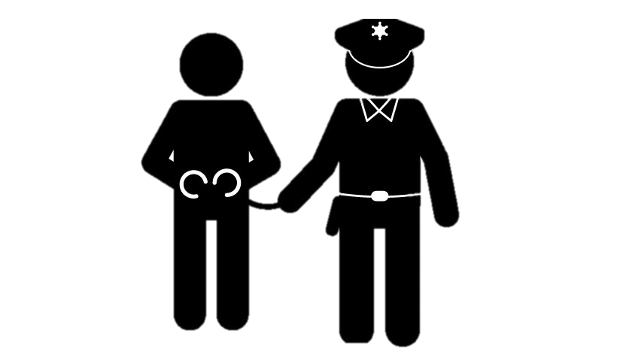




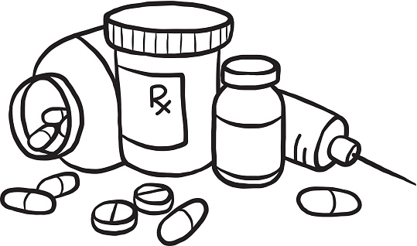



Where are areas of surplus and deficit located globally?
KS4 Personal Development Learning Journey
Ready for
KS5
Autumn Term 2: Relationships
Credit, debt, loans and mortgages
Muslim beliefs- Capital punishment
Pay slips, tax and NI
Community and responsibility
Cosmetic procedures
Sexual assault
Managing break-ups
Assessment
Capital Punishment
Radicalisation
RSHE Summer Term: Relationships and Health
Spring Term: RS Crime
Preventing extremism
CPR & First aid
Vaccinations
Recognising unwanted attention
Building trust in a relationship
Humanist beliefs- Capital Punishment
Christian beliefs- Capital punishment
College applications
How do I write a cover letter
Mock interview prep
Types and causes of Crime
Punishment
Autumn Term: Careers
Autumn Term 2: Citizenship- Law
YEAR
CV writing
L1 and 2
Mock interview reflection
11
College
Courses
Cover letter writing
UK Legal system
Hate crime
Social attitudes to sending nude images
Adoption and Fostering
Pregnancy and choices
Sexual Relationships
Relationships L1
Alcohol and Risks
RSHE Summer term- Relationships & Health
Dangers of vaping
Self-examination
Miscarriage
Readiness for parenthood
Relationships L2
Consent
Fertility treatments
Christian Beliefs about fertility treatments
Humanists Beliefs about fertility treatments
Humanist beliefs about Euthanasia
Volunteering
Apprenticeships
Muslim Beliefs about Euthanasia
Autumn Term 2- Religious studies
PSHE Spring term- Living in the wider world
Christian beliefs about Euthanasia
Muslim beliefs about fertility treatments
Assessment
Exam Stress and revision preparation
Employment and pathways
What do humanist believe about Abortion?
What do Christians believe about abortion?
What is medical ethics
Political Participation
Introduction to Politics
Role of an MP
YEAR
What is Euthanasia?
Autumn Term 2- Religious studies
Autumn Term 1: Citizenship- Law & Politics
10
What do Muslims believe about Abortion?
What is abortion?
Assessment
How are Laws made in the UK
What is democracy

