Slide 1
Teacher Information
All resources in booklets.
Please read the PSHE teacher handbook before teaching this unit.
Remember to log any safeguarding concerns on CPOMS.
Keep your class booklets safe as there will be a new booklet each half term.
Read the notes section for each slide and make sure you are familiar with the lesson content.
Always have 5 minutes left at the end to share the further support slide.

Slide 2

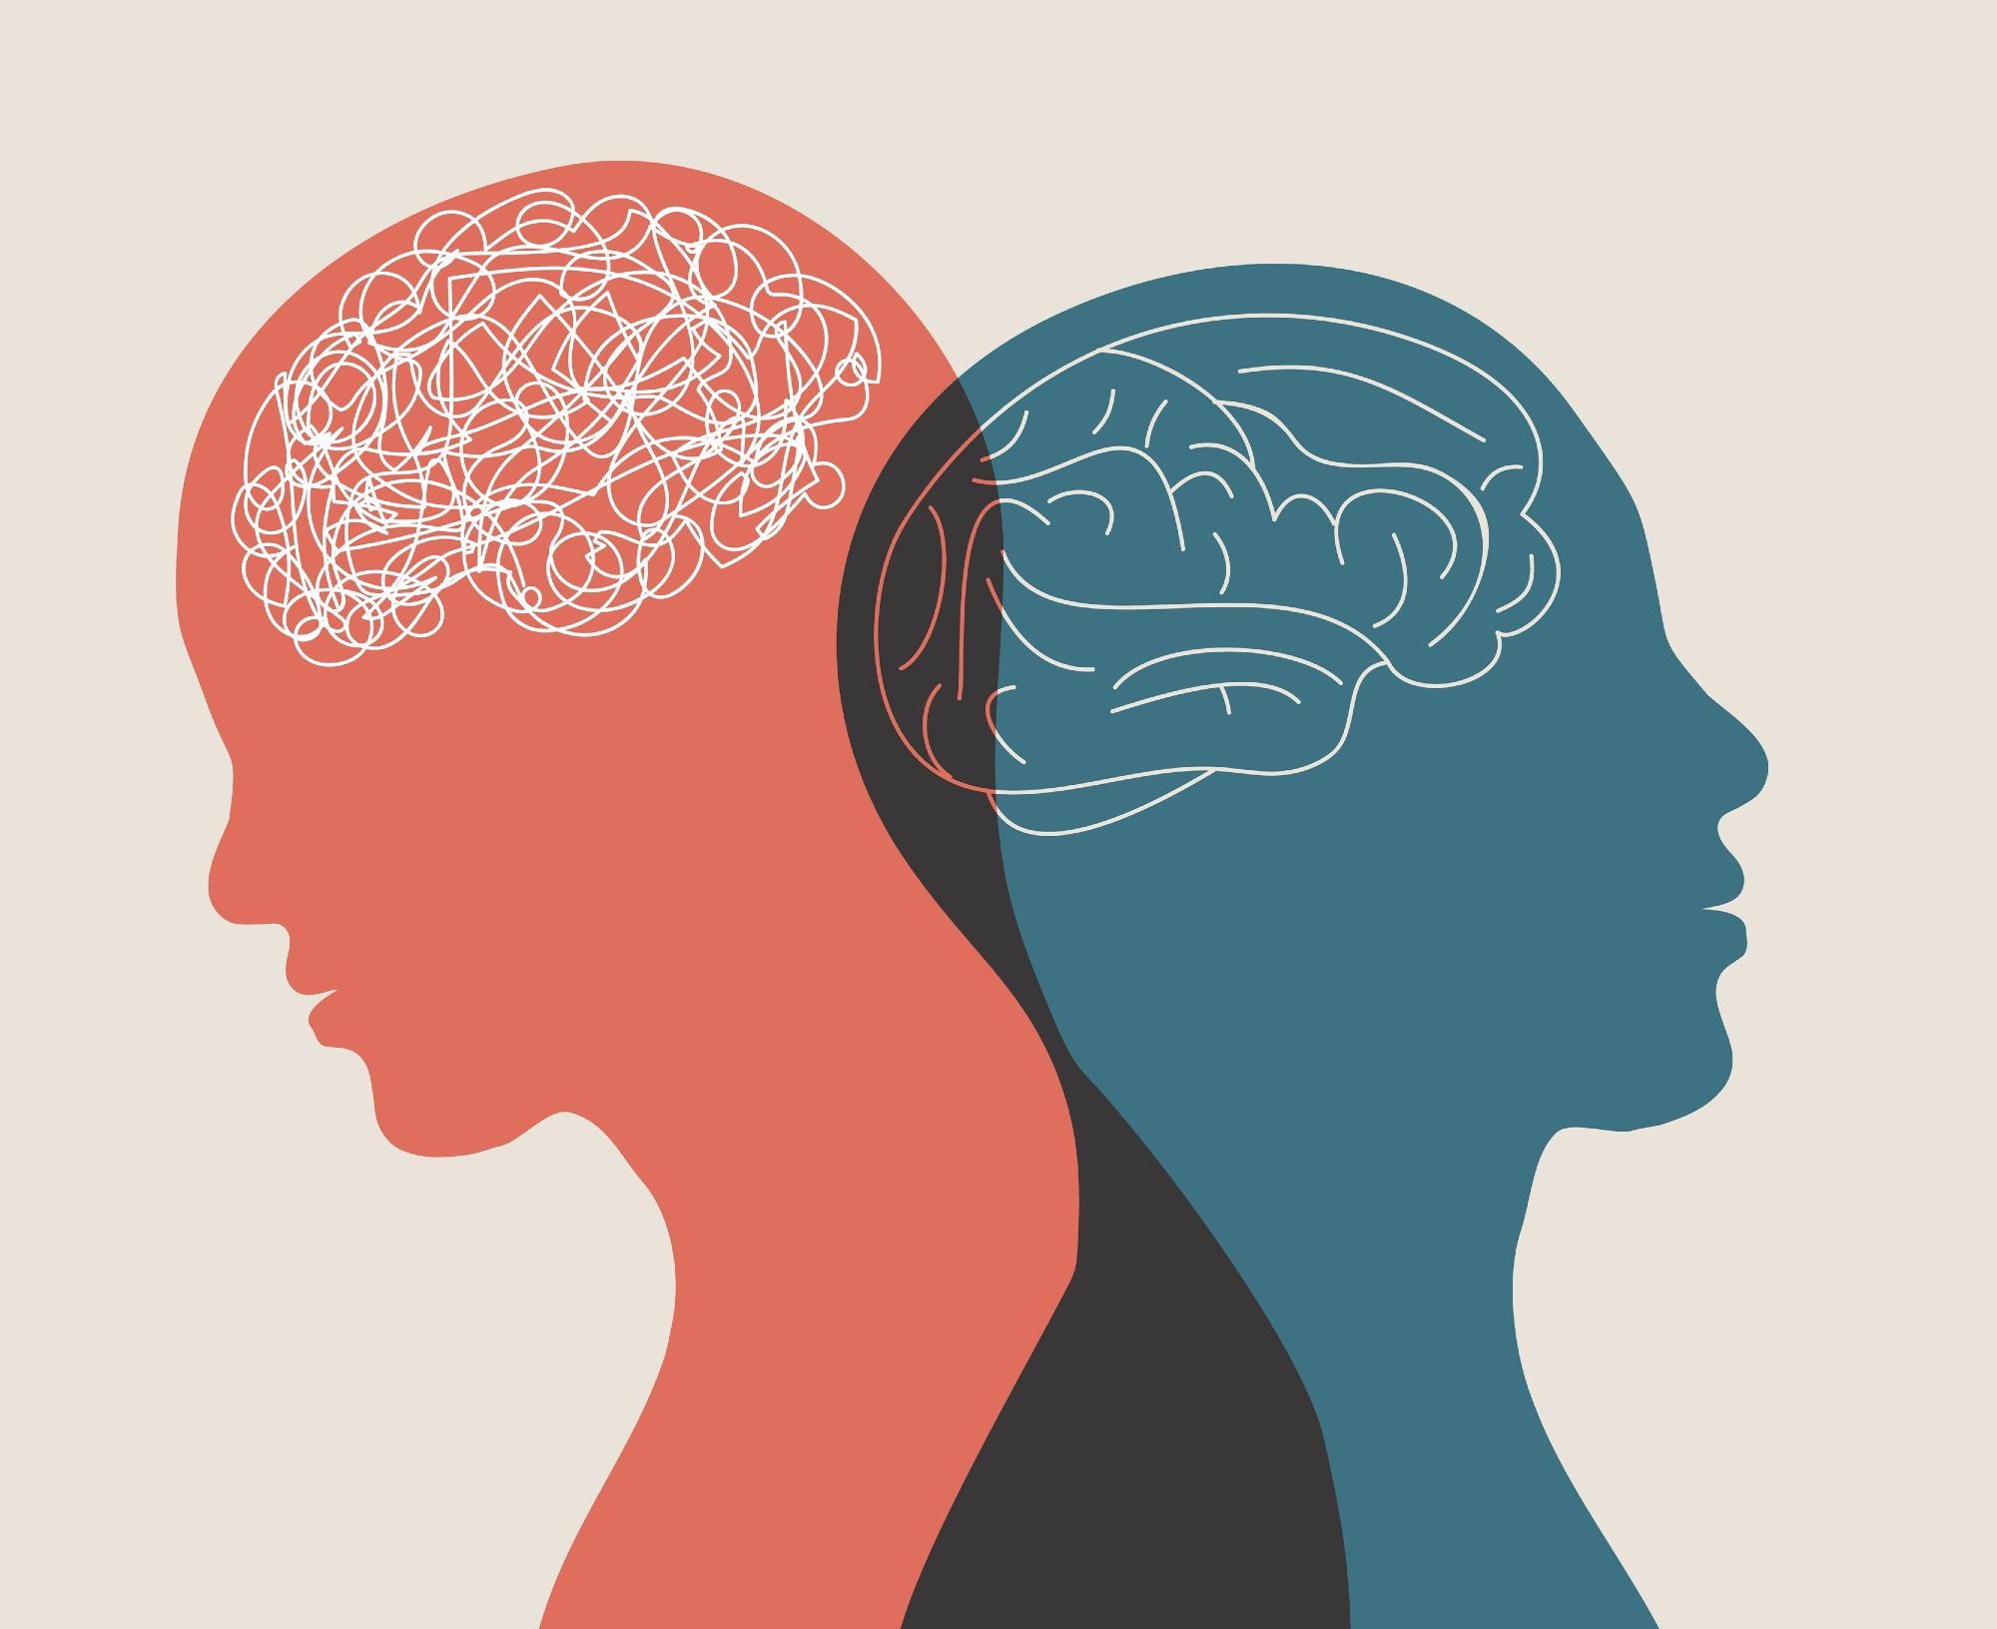

Lesson 2-Mental ill health conditions and getting help
Starter- ‘Do now’ Recap
What is meant by 'wellbeing'?
Name two hormones that affect emotions and explain one of their roles.
Give two strategies that can help someone manage strong emotions.
What is the difference between a helpful distraction and an unhelpful distraction?
Give two ways someone can reduce distractions from social media.
Challenge- How can looking after your physical health help you manage your emotions?
ASPIRATION - ENDEAVOUR - INTEGRITY - RESPECT

Slide 3
PSHE Ground Rules
Let other people talk and listen without interrupting
Be respectful
Do not use bad language and try to use language that won’t offend or upset anyone
Use the correct terms – if you don’t know them ask for help
Comment on what was said, not who said it
Never share your friends’ personal experiences
Don’t ask personal questions
Try not to judge others.
Notes:
Discuss the following ground rules with the class and explain these need to be followed every PD lesson.

Slide 4


Learning objectives
  Learning Objective: To learn how to recognise common mental ill health conditions, understand that everyone can experience worry and low mood at different times, and identify ways to access help and support.
Learning Outcomes
Recognise the characteristics of common mental ill health conditions.
Explain that everyone can experience worry and low mood at different times and understand when these feelings may require support.
Identify a range of sources of help and support for mental health, including how and when to access them.

Slide 5

Task 1- Knowledge check quiz
Mental health is...
  A. Something only adults have
  B. Something everyone has
  C. Only about mental illness
  D. The same as physical health
Which of these is a healthy coping strategy?
  A. Keeping worries secret forever
  B. Talking to a trusted adult
  C. Ignoring problems completely
  D. Staying awake all night
True or False:
Everyone experiences difficult emotions at some point.
Notes:
Knowledge Check (Multiple Choice) (2 mins)
Explain that today's lesson focuses on recognising when emotions are part of everyday life and when someone may need extra support.
Mental health is...
A. Something only adults have
B. Something everyone has ✅
C. Only about mental illness
D. The same as physical health
Which of these is a healthy coping strategy?
A. Keeping worries secret forever
B. Talking to a trusted adult ✅
C. Ignoring problems completely
D. Staying awake all night
True or False:
Everyone experiences difficult emotions at some point.
True ✅

Slide 6
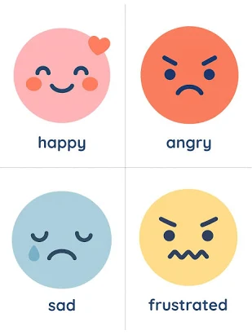
Task 2- Emotion continuum
Happy
Calm
Worried
Nervous Which emotions have you experienced before?
Sad
Angry
Overwhelmed
Notes:
5 mins Emotion continuum- display the emotions on the board and ask students which emotions have you experienced before.
Give an example of each emotion
Emphasise:
All emotions are normal.
Mental health exists on a spectrum.
Experiencing emotions does not automatically mean someone has a mental illness.

Slide 7
Task 3- Mental health vs Ill mental health
Common Mental Ill Health Conditions
Condition | Possible Characteristics
Anxiety | Excessive worry, panic, racing thoughts, avoiding situations
Depression | Persistent sadness, loss of interest, tiredness, hopelessness
Eating disorders | Unhealthy relationship with food or body image
OCD | Unwanted intrusive thoughts and repetitive behaviours
Notes:
5 mins
Explain
Mental health is everyone's emotional, psychological and social wellbeing.
Mental ill health refers to difficulties that significantly affect thoughts, feelings or behaviour over time.
Key Message
Having a bad day is normal.
If difficult feelings:
last several weeks,
become overwhelming,
affect school, friendships or sleep,
it may be time to seek support.

Slide 8
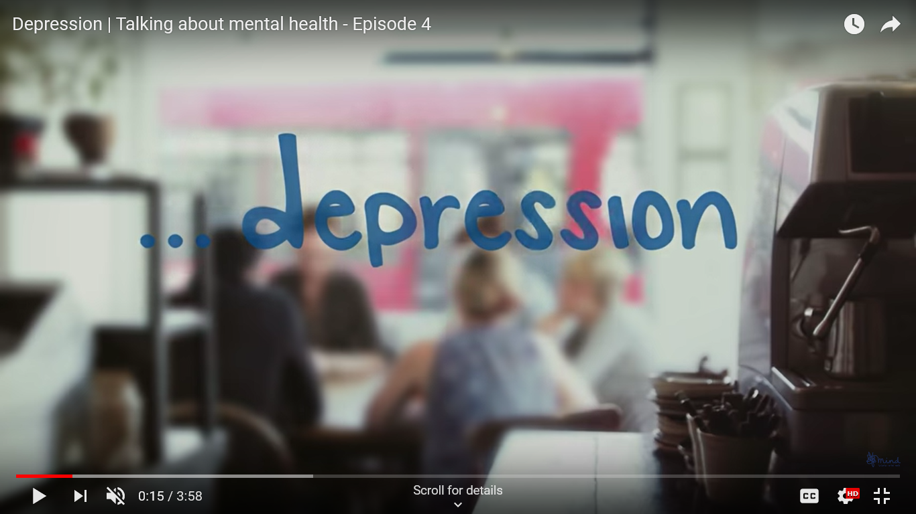
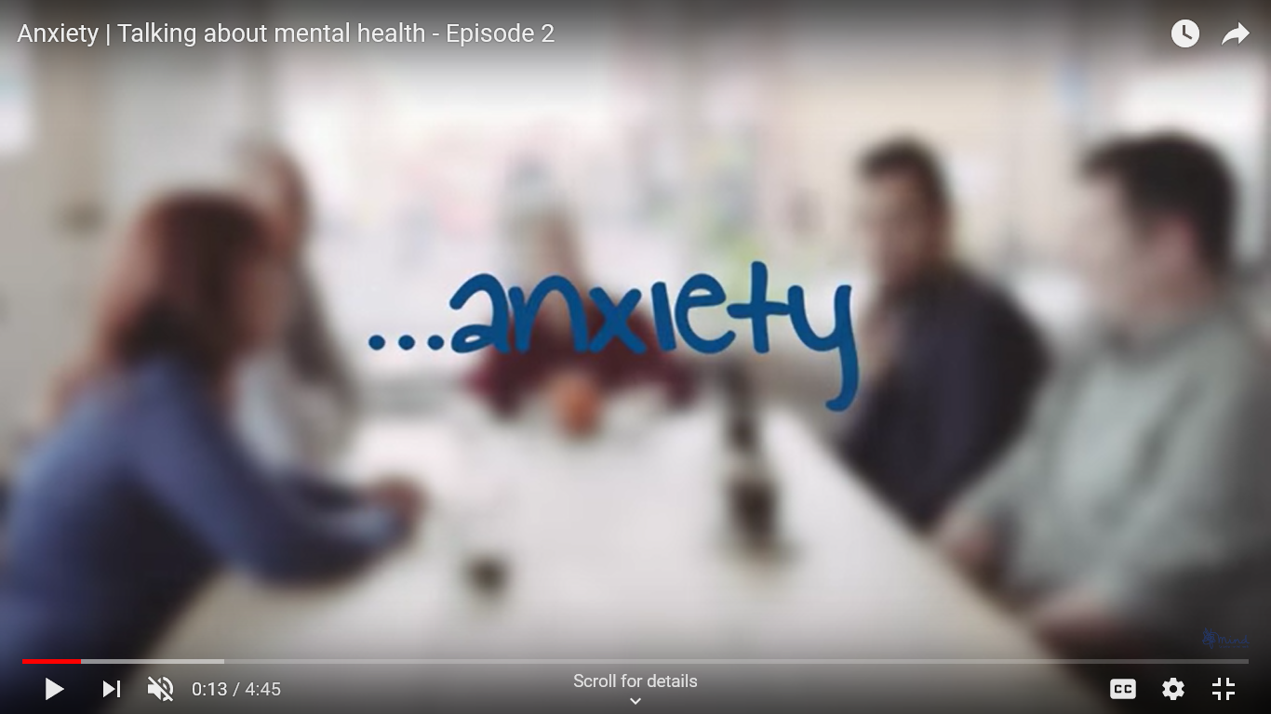
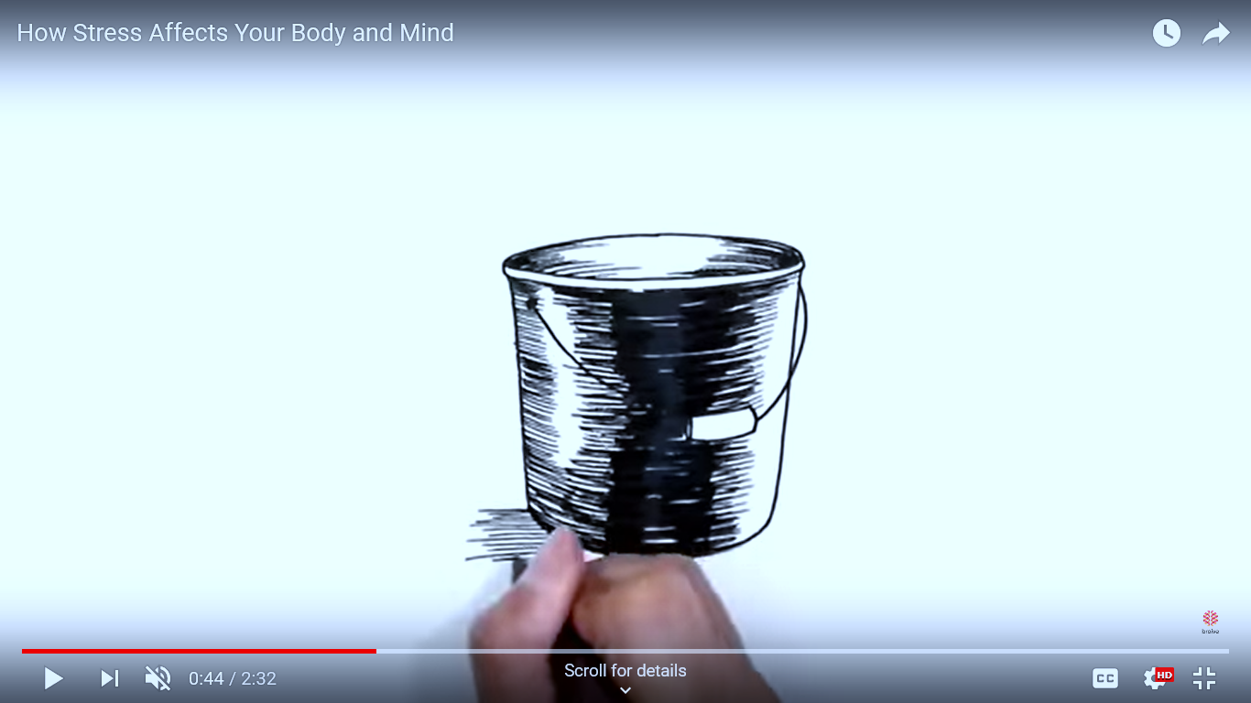
Task 4- Common conditions, challenges and strategies
Watch the videos and complete the table in your booklets, focusing on:
Signs that might mean someone has this mental health issue
Strategies and treatments
Ways others can help
…stress
Notes:
Teacher Notes (15 MIN)
Ask students to watch the clips on common mental health conditions and challenges. As they watch, students complete the questions in their booklets: Common Mental Health Conditions and challenges. Answers on next slide.
Watch the clip on depression here: https://www.youtube.com/watch?v=m82jEQXRurg (image hyperlinked)
Watch the clip on anxiety here: https://www.youtube.com/watch?v=lKWoIwgiLRk (image hyperlinked)
Watch the clip on stress here: https://www.youtube.com/watch?v=CZTc8_FwHGM (image hyperlinked)
Ask the class:
Was there anything that surprised them?
Is there anything else they want to know more about?
Raise points of interest from the videos to check understanding. Teacher notes are available in Resource 1a.
Support: Q&A
Some students might prefer to discuss what they have seen/heard rather than noting the content in their worksheet
Challenge: Key concepts
Ask students to suggest three key points they think it is important young people know about each different mental health condition/challenge.

Slide 9
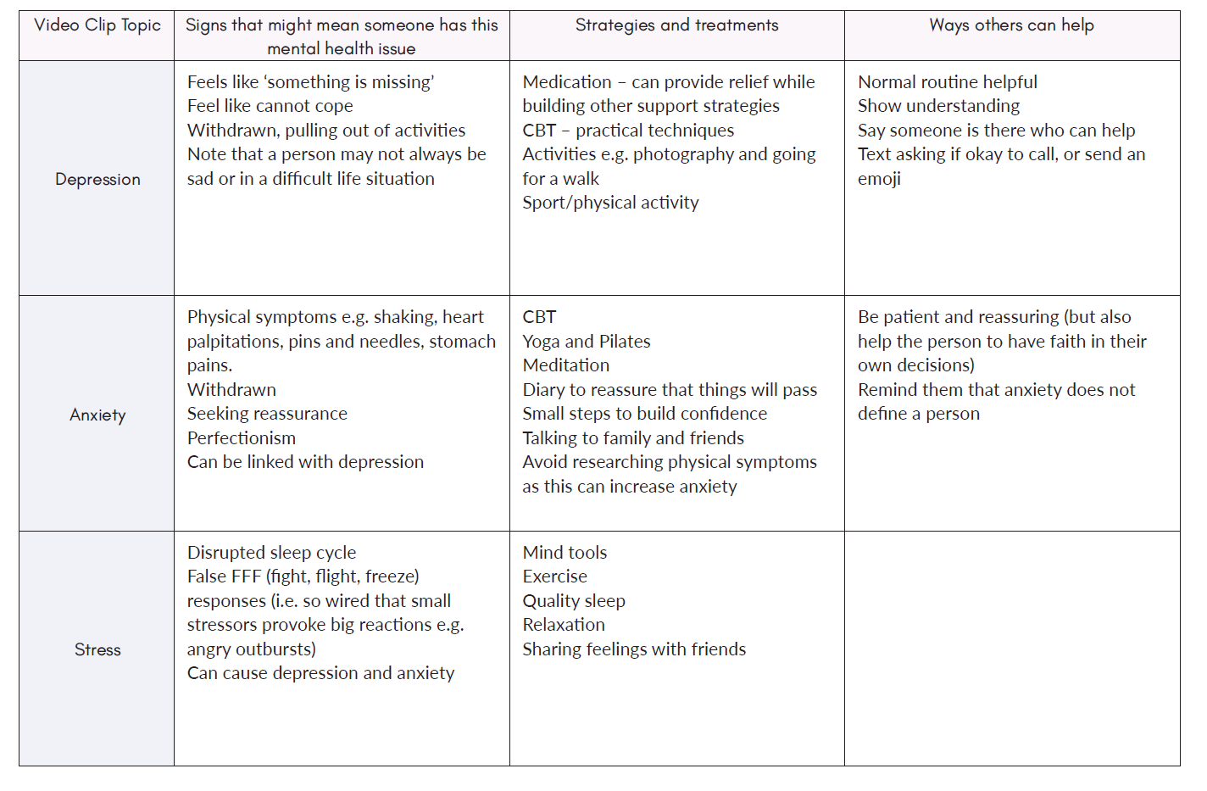

Slide 10

Task 5- Is it normal or needs support?
Students work in pairs.
Read the scenarios in your booklets and decide if it is normal or needs support
Discuss as a class:
What helped you decide?
Notes:
5 minutes
Scenarios
A
Sam feels nervous before every maths test.
➡ Normal worry
B
Luca has stopped seeing friends and hasn't enjoyed football for over a month.
➡ May need support
C
Ella feels upset after arguing with a friend.
➡ Normal emotion
D
Ben worries constantly, struggles to sleep and feels anxious every day.
➡ May need support
Discuss as a class:
What helped you decide?

Slide 11

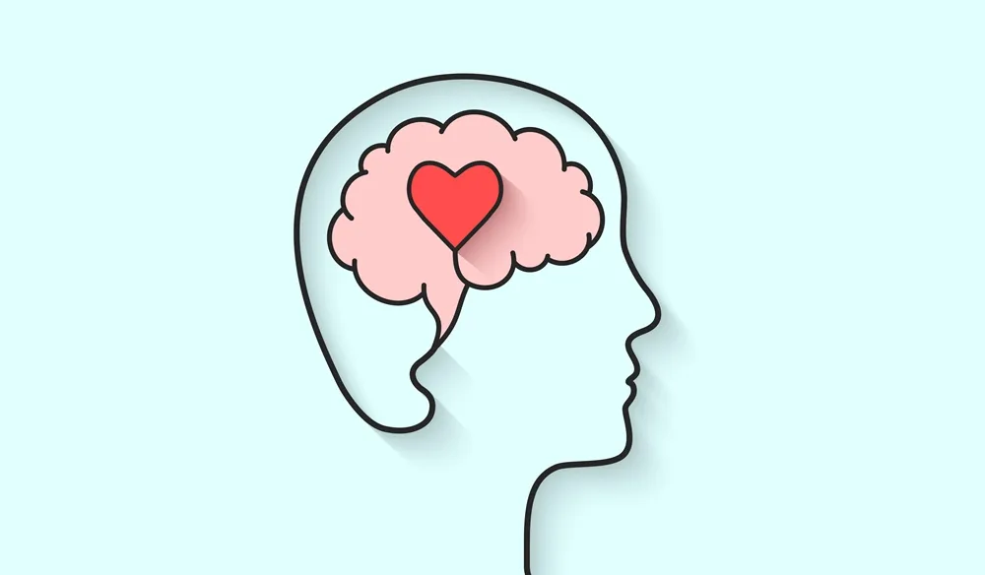
Task 6- Myth or fact?
Listen to the statements and Stand up for "Fact" or remain seated for "Myth".
Notes:
5 minutes
Students stand up for "Fact" or remain seated for "Myth".
Examples:
"Only adults experience mental health problems."
❌ Myth
"Talking to someone can help."
✅ Fact
"Mental illnesses are a sign of weakness."
❌ Myth
"Everyone experiences worry sometimes."
✅ Fact
"Getting help early is important."
✅ Fact
Discuss each answer briefly.

Slide 12

Task 7- Support network
Create a support network map with you in the middle and around the outside identify people or organisations you could speak to for support
Me
Notes:
5 minutes
Students complete a support network map.
Centre circle:
ME
Around the outside, students identify people or organisations they could speak to.
Examples:
Parent/carer
Trusted family member
Teacher
Form tutor
Head of Year
School counsellor
School nurse
GP
Friend
Childline
Kooth
Youngminds
Barnardo’s
Emergency services (999 if someone is in immediate danger)
Discuss:
Which adults are easiest to approach?
Why can asking for help feel difficult?

Slide 13

What have I learnt?
Complete the following questions in your booklets:
Name one common mental ill health condition.
What is the difference between everyday worry and needing support?
What can you do to support positive mental health?
Name two trusted people or organisations someone could contact if they were struggling.
Notes:
5 minutes

Slide 14
Signposting Support
If you have any concerns or questions regarding your own mental health, you can always speak to your parent or carer, or a teacher in school for more advice and support.
ChildLine:
www.childline.org.uk Phone: 0800 1111
Young Minds:
www.youngminds.org.uk
Samaritans:
www.samaritans.org Phone: 116 123

