Slide 1
Teacher Information
All resources in booklets.
Please read the PSHE teacher handbook before teaching this unit.
Remember to log any safeguarding concerns on CPOMS.
Keep your class booklets safe as there will be a new booklet each half term.
Read the notes section for each slide and make sure you are familiar with the lesson content.
Always have 5 minutes left at the end to share the further support slide.

Slide 2

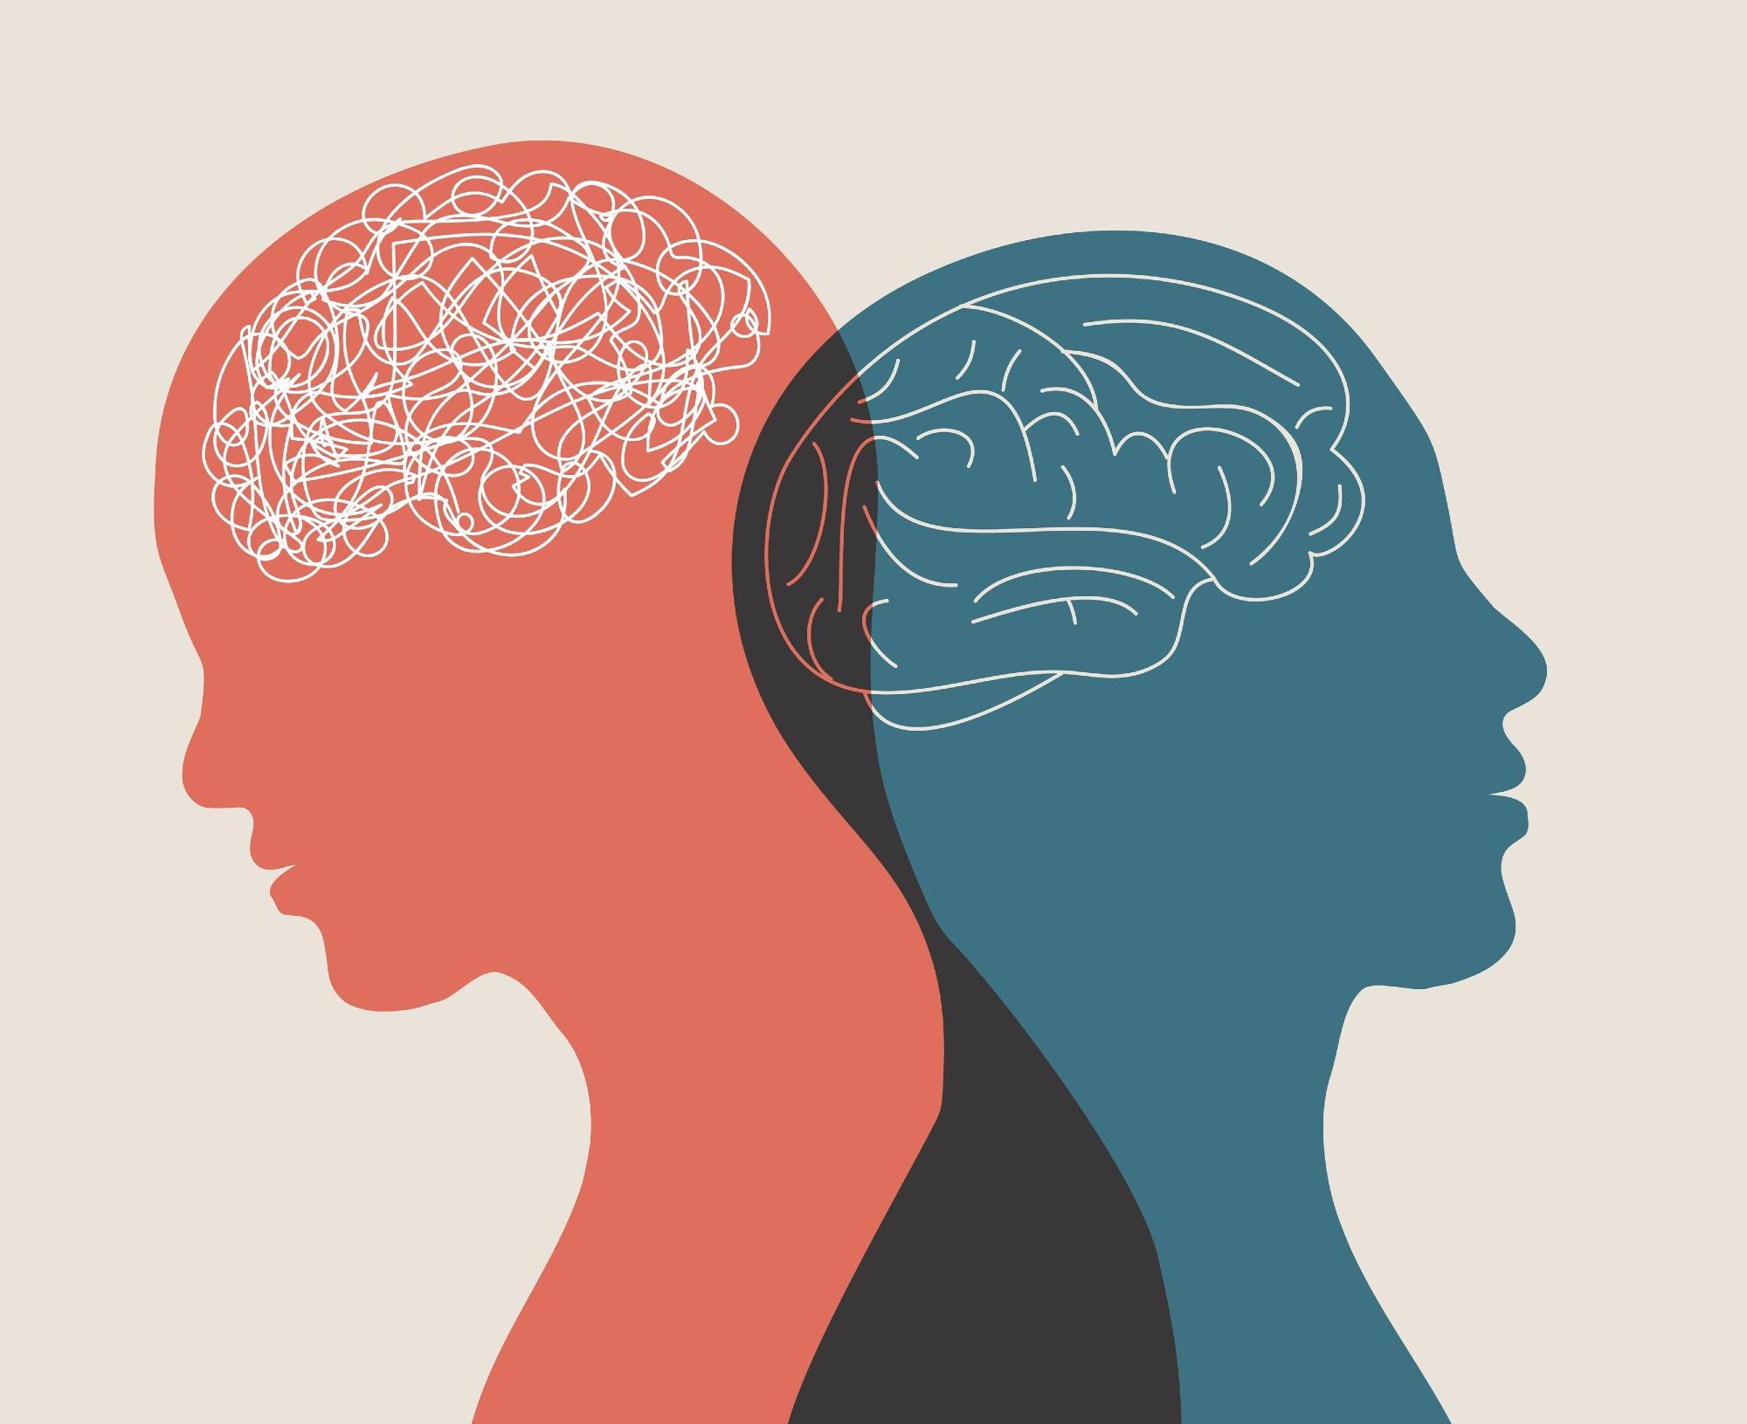

Lesson 3- Healthy coping strategies
Starter- ‘Do now’ Recap
1) Name two common mental ill health conditions.
2) What is the difference between everyday worry and a mental health condition that may need support?
3) Give two signs that someone might need extra support with their mental health.
4) Who are two trusted people or organisations that someone could speak to if they were struggling with their mental health?
5) True or False: Talking to someone about your mental health is a sign of weakness
Challenge- Why is it important to ask for help early if someone is struggling with their mental health, and how could this make a positive difference to their wellbeing?
ASPIRATION - ENDEAVOUR - INTEGRITY - RESPECT
Notes:
Name two common mental ill health conditions.
What is the difference between everyday worry and a mental health condition that may need support?
Give two signs that someone might need extra support with their mental health.
Who are two trusted people or organisations that someone could speak to if they were struggling with their mental health?
True or False: Talking to someone about your mental health is a sign of weakness.
Answer: False.
Challenge Question
Why is it important to ask for help early if someone is struggling with their mental health, and how could this make a positive difference to their wellbeing?

Slide 3
PSHE Ground Rules
Let other people talk and listen without interrupting
Be respectful
Do not use bad language and try to use language that won’t offend or upset anyone
Use the correct terms – if you don’t know them ask for help
Comment on what was said, not who said it
Never share your friends’ personal experiences
Don’t ask personal questions
Try not to judge others.
Notes:
Discuss the following ground rules with the class and explain these need to be followed every PD lesson.

Slide 4


Learning objectives
  Learning Objective: To learn about healthy coping strategies and how to seek support.
Learning Outcomes
Identify signs that someone is feeling worried, tense or stressed
Evaluate a range of healthy coping strategies
Explain how someone can seek help for themselves or others when feeling worried, tense or stressed

Slide 5
Key terms
Coping strategies
Worry
Rumination
Feeling concerned or troubled about something that might happen, for example, thinking about what might go wrong.
Worrying about or dwelling on something that has already happened.
Strategies that people use to manage difficult or challenging situations and thoughts, and unpleasant or strong emotions.
Tension
Stress
A feeling of being nervous, ‘wound up’
or unable to relax.
A reaction to feeling under pressure or threatened. When something stressful happens, the amygdala is activated and responds by sending ‘stress hormones’, such as adrenaline, through the body.
Notes:
Teacher notes – Introduction (5 mins)
Remind students what is meant by ‘coping strategies’ and explain that today’s lesson will explore how someone might feel when they are worried, ruminating, tense or stressed, strategies they can use to help them to manage their thoughts and feelings, and who they can speak to for help.
Click through the slide to also share definitions of worry, rumination, tension and stress.

Slide 6



Task 1- What’s our starting point?
1) Draw a picture of a young person using a healthy coping strategy which helps them when they feel worried, tense, or stressed.
2) Annotate your drawing by responding to the following:
What is the young person doing?
What signs might there be that the young person is feeling worried, tense or stressed?
How might they feel when they use the healthy coping strategy?
What other healthy coping strategies might they use if they feel worried, tense or stressed?
Who could they talk to about how they feel?
Notes:
Teacher notes – Baseline assessment activity (10 mins)
Working on their own, ask students to draw an image of a young person using a healthy coping strategy which helps them when they are feeling stressed or worried. Then, ask them to annotate their drawing by responding to the following questions:
What is the young person doing?
What signs might there be that the young person is feeling worried, tense or stressed?
How might they feel when they use the healthy coping strategy?
What other healthy coping strategies might they use if they feel worried, tense or stressed?
Who could they talk to about how they feel?
Circulate while students complete the activity to identify any gaps or misconceptions that might need to be addressed during the lesson. For example, if students find it hard to describe signs that can suggest someone is experiencing worry, (including rumination), tension or stress, you may want to spend longer on the first activity to help students explore how these emotions might affect someone. Once they have finished, ask students to put their drawings to the side, and explain that they will return to these later in the lesson.

Slide 7



Task 2- A gut feeling?
  How might feeling worried, tense, or stressed affect someone’s thoughts?
If someone is feeling worried, tense, or stressed, what might this feel like in their body?
If someone is feeling worried, tense, or stressed, how might they behave?
Notes:
Teacher notes – A gut feeling? (10 mins, slides 7-9)
In small groups, ask students to respond to the questions on the slide, writing their answers in three columns In their booklets. Encourage them to reflect on what they have already learnt about managing thoughts, feelings and emotions, and how someone might respond to difficult experiences, as they complete their answers. They should spend one minute answering each question:
How might feeling worried, tense, or stressed affect someone’s thoughts?
If someone is feeling worried, tense, or stressed, what might this feel like in their body?
If someone is feeling worried, tense, or stressed, how might they behave?
When students have written their answers, ask a volunteer from each group to bring forward their answers from one of their booklets. Briefly summarise responses for the class and draw out key learning:
If someone is feeling worried, tense or stressed, they might: have lots of thoughts in their mind at once, which might be difficult to sort between; they might feel like they have a ‘fuzzy’ brain, which makes it hard for them to concentrate; they might find it difficult to focus on anything apart from the cause of their worry or stress; they might feel that their thoughts are hard to control – for example, ruminating on something that has happened, or thinking lots about a ‘worst case scenario’. When someone experiences these thoughts and feelings, their amygdala – which controls the ‘fight, flight or freeze’ response - is likely to be active and on high alert. When this happens, it can be more difficult for the brain to focus and think clearly.
If someone feels worried, tense or stressed, they might experience bodily sensations such as: ‘butterflies’ in the stomach; feeling ill, lightheaded, dizzy or nauseous; feeling as though they suddenly need to use the toilet; feeling ‘stuck’ in one spot. They might have tingling sensations in their arms and legs, or feel they have ‘the shakes’ as their heart rate and breathing rate increase. These feelings can happen when the amygdala signals for the body to release hormones including adrenaline, to help the body to respond quickly to a stressful situation.
Someone experiencing these thoughts and feelings might respond by: ‘freezing’ if they feel overwhelmed; withdrawing from other people or becoming quieter than usual; quickly trying to find a solution to stop from feeling this way; expressing their feelings through their words or actions towards others (the ‘fight’ response); or trying to exit or ignore the situation (the ‘flight’ response).
Support: Give students Resource 1: Identifying feelings, and ask them to sort the signs of stress, worry and tension into the three categories on the sheet by colouring them in, or using a key.
Challenge: Ask students to consider what signs might help someone to identify when someone else is feeling worried, tense or stressed. Students might suggest: they might notice a sudden change in someone’s behaviour, such as not moving or speaking much, or moving and speaking very quickly; they might see physical signs such someone sweating more or looking more flushed; they might notice that someone finds it hard to communicate their thoughts clearly.

Slide 8




Task 2- A gut feeling?
‘Think, pair, share’
Why might someone find it hard to tell that they are feeling worried, tense, or stressed?
What can help them to recognise these feelings?
Pair
Think
Share
Notes:
Teacher notes – A gut feeling? (10 mins, slides 7-9)
Then, ask students to ‘think-pair-share’:
Why might someone find it hard to tell that they are feeling worried, tense, or stressed?
What can help them to recognise these feelings?
Challenge: Ask students to consider what signs might help someone to identify when someone else is feeling worried, tense or stressed. Students might suggest: they might notice a sudden change in someone’s behaviour, such as not moving or speaking much, or moving and speaking very quickly; they might see physical signs such someone sweating more or looking more flushed; they might notice that someone finds it hard to communicate their thoughts clearly.

Slide 9
Task 2- A gut feeling?
Sometimes, these emotions can lead to similar sensations as when someone feels very excited, or fearful.
Being very busy or focused for a long time, without breaks, might make it difficult to notice these feelings.
To help, they could:
Reflect on their day to think about if anything outside of their ‘normal’ routine has happened that makes them feel unpleasant emotions
take regular breaks to pause and identify how they are feeling
make sure their basic needs have been met
Notes:
Teacher notes – A gut feeling? (10 mins, slides 7-9)
Share the information on the slide.
Challenge: Ask students to consider what signs might help someone to identify when someone else is feeling worried, tense or stressed. Students might suggest: they might notice a sudden change in someone’s behaviour, such as not moving or speaking much, or moving and speaking very quickly; they might see physical signs such someone sweating more or looking more flushed; they might notice that someone finds it hard to communicate their thoughts clearly.

Slide 10

Task 3- Using healthy coping strategies
What healthy coping strategies might someone use when they experience feelings such as tension, worry or stress?
Notes:
Teacher notes – Using healthy coping strategies (15 mins, slides 10-17)
Explain that once someone recognises that they are feeling tension, worry or stress, they can then think about the best ways to manage these feelings. Drawing from the baseline assessment activity, ask students to ‘think-pair-share’ any healthy coping strategies they can think of, that someone might use when they experience these emotions.

Slide 11
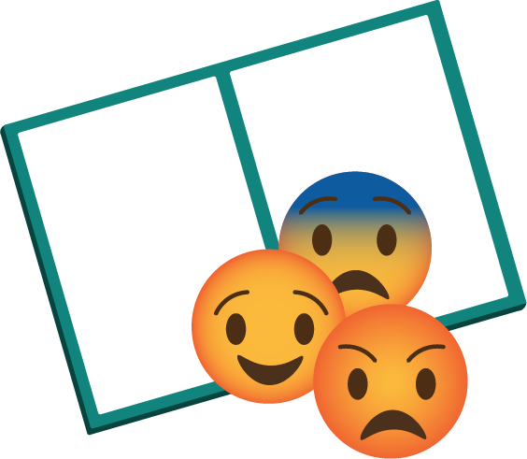
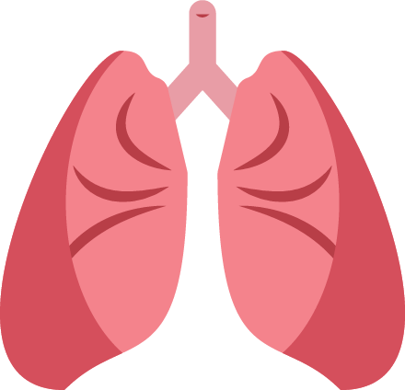

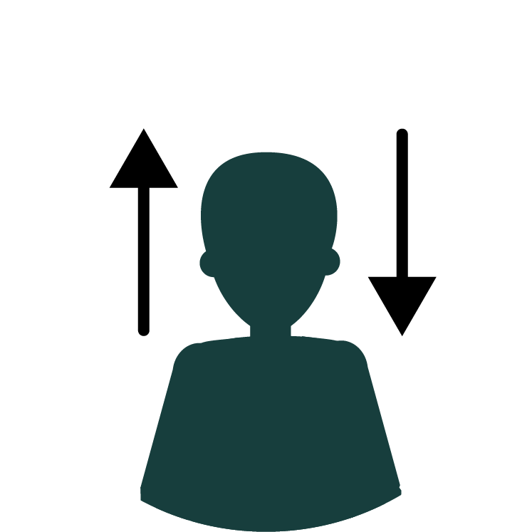

Task 3- Healthy coping strategies
Noticing and
naming feelings
and emotions
Pausing/taking a step back when feeling strong emotions such as anger, before acting
Slow-paced
breathing (inhaling for 4 counts and exhaling for 6 counts)
Progressive muscle
relaxation
Doing an absorbing
activity (e.g. playing a game/sport or crafting)
Notes:
Teacher notes – Using healthy coping strategies (15 mins, slides 10-17)
Take feedback, using this slide and the next to guide discussion and introduce any strategies students had not thought of. For example, noticing and naming strong, unpleasant or uncomfortable emotions can reduce their intensity and make it easier for us to choose the best ways of managing them. It is like finding our place on a map - the first step is to know where we are, and then we can decide where to go or what to do next.

Slide 12

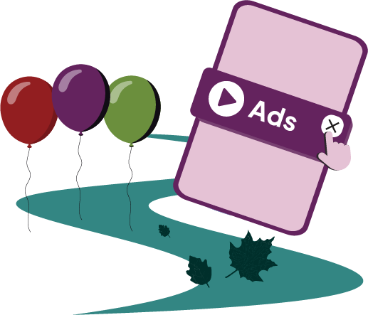

Task 3- Healthy coping strategies
Thinking about something they enjoy or a happy memory
Practicing ‘reappraisal’
– reframing negative thoughts by considering them from another angle, e.g. by thinking about what they can learn from the experience
‘Watching thoughts’, imagining unhelpful thoughts or worries as pop-ups on a computer that they can briefly notice and then ‘close’, or as leaves on a stream/balloons that they watch float away
Telling someone how they feel/asking someone for help
Notes:
Teacher notes – Using healthy coping strategies (15 mins, slides 10-17)
Take feedback, using this and the previous slide to guide discussion and introduce any strategies students had not thought of.

Slide 13
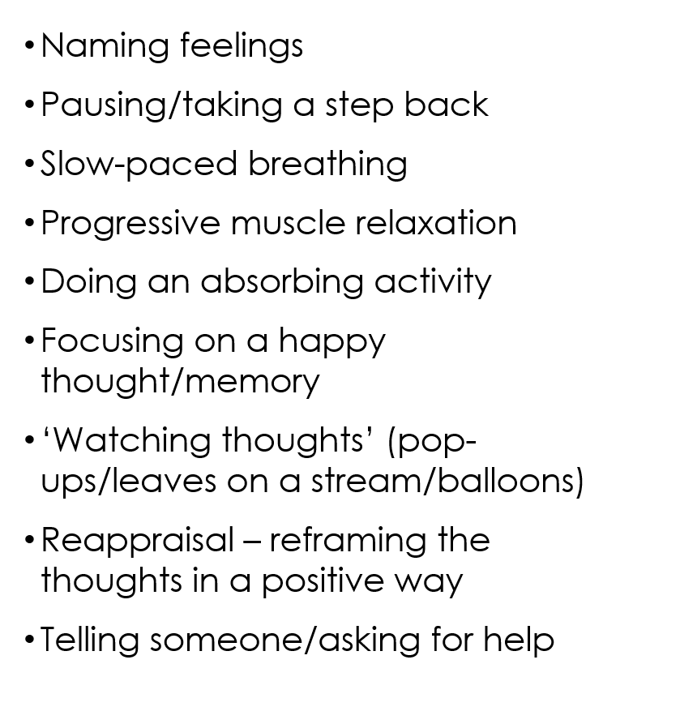
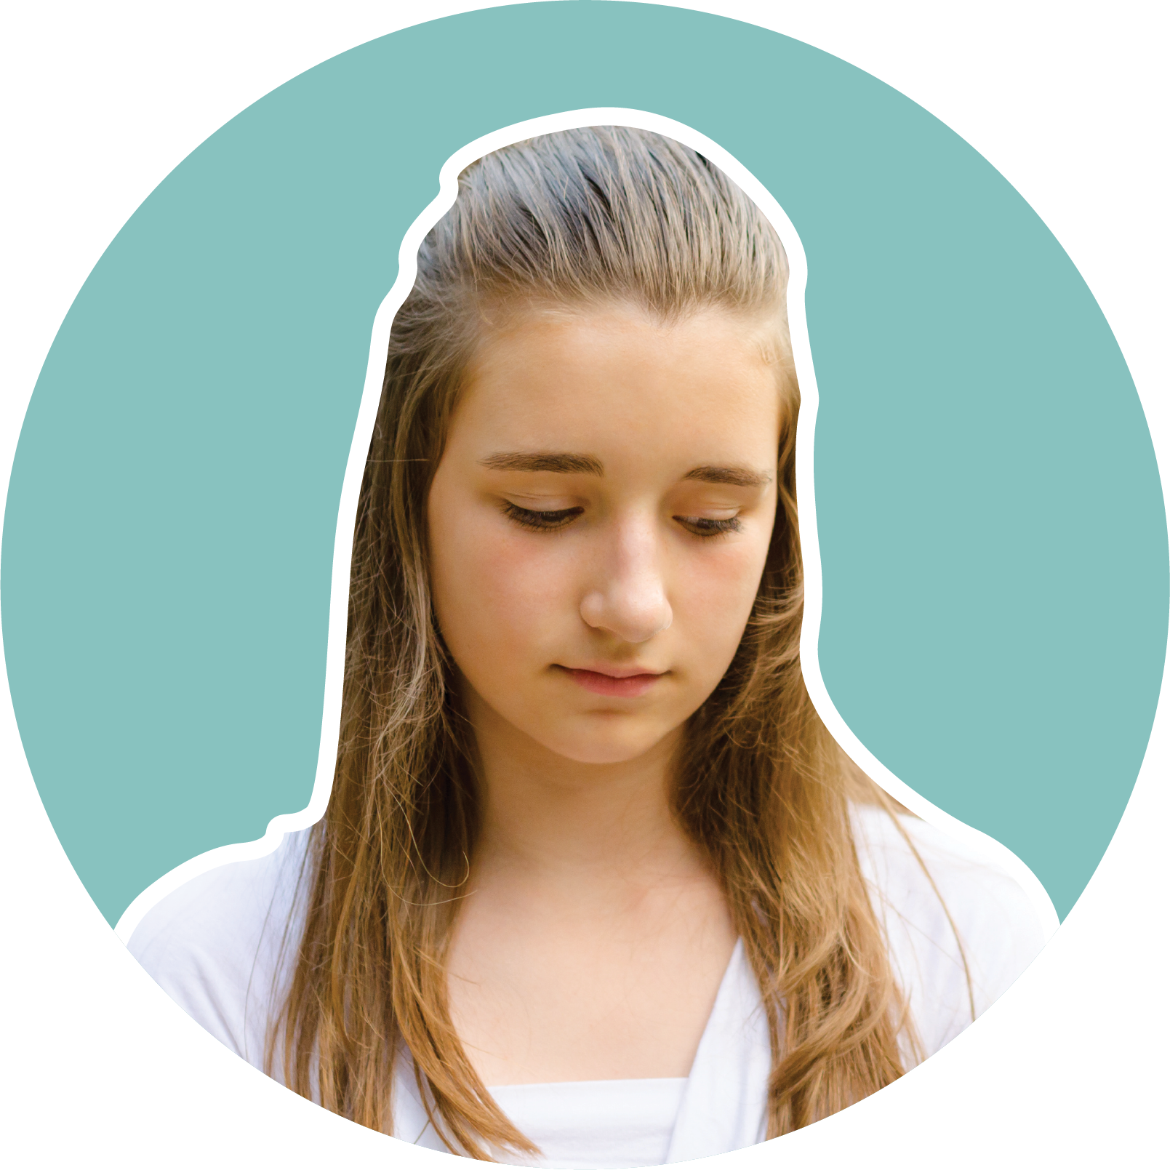
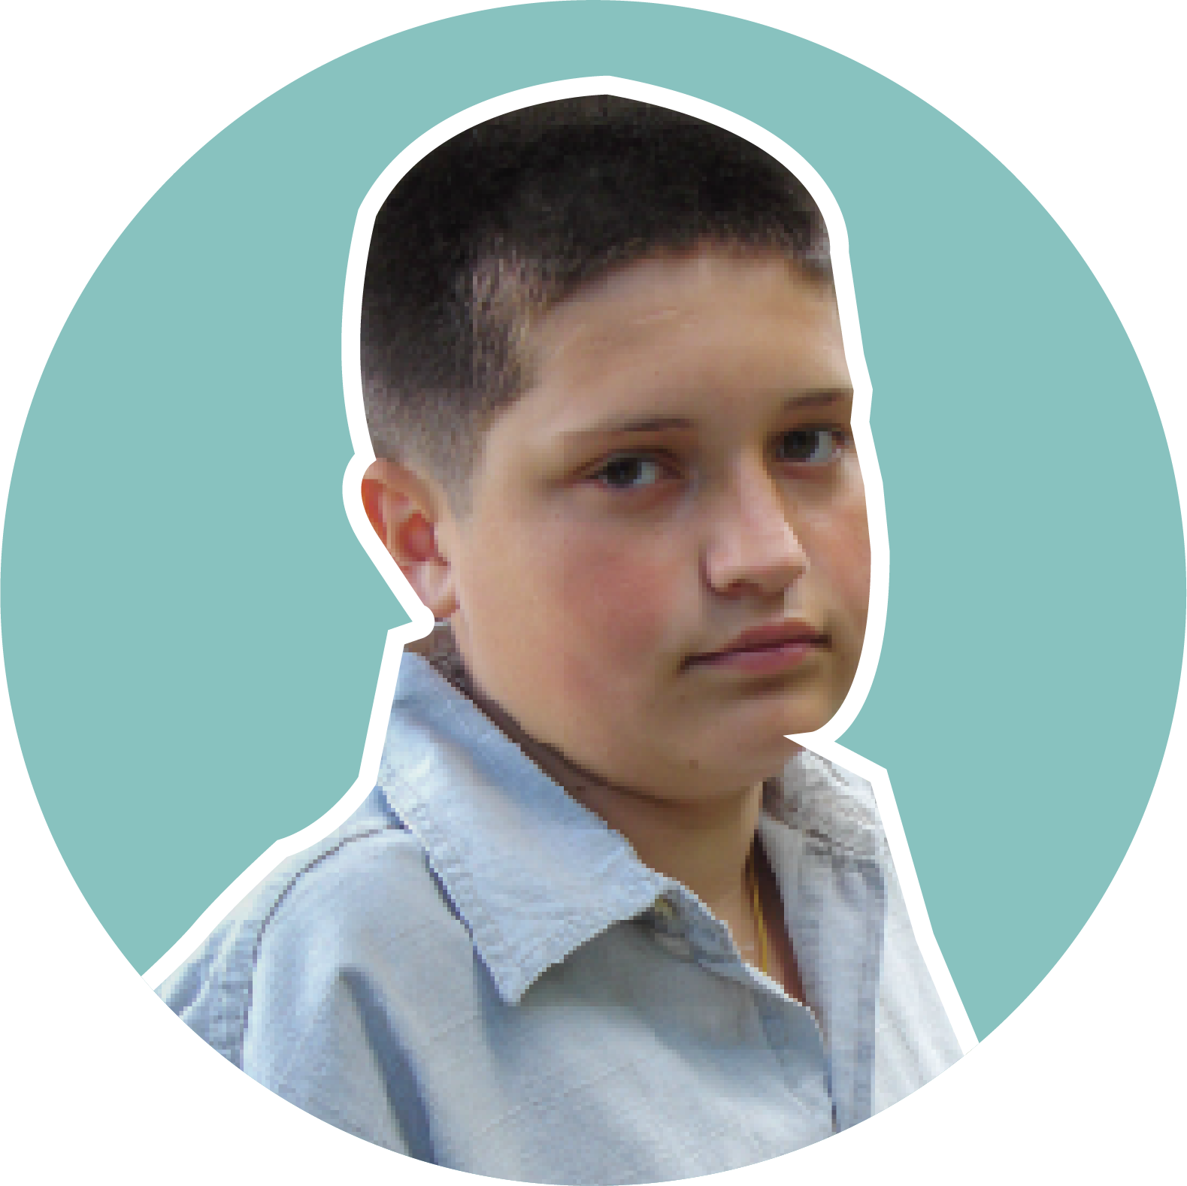
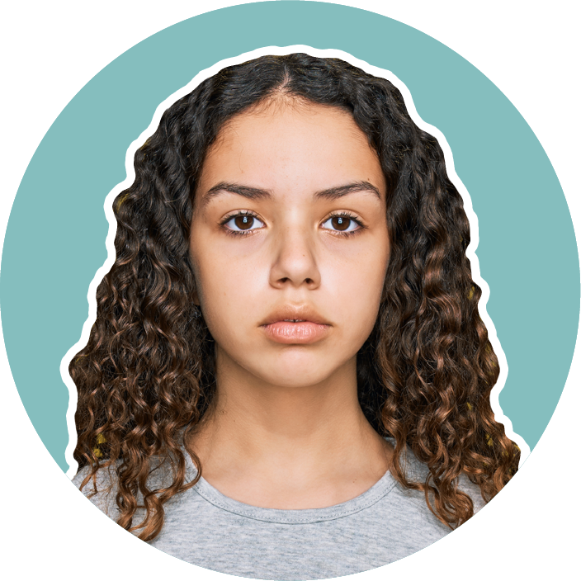
Task 4- Using healthy coping strategies
In groups- read the scenario you have been given. Answer the following:
What three healthy coping strategies
would be most helpful for your
character to use?
How would these strategies help them
to manage their feelings and emotions?
Taylor
Benny
Yasmin
Notes:
Teacher notes – Using healthy coping strategies (15 mins, slides 13-17)
Then, explain that you are going to revisit some characters from previous lessons and think about what healthy coping strategies they might use when they find it difficult to manage their emotions, and want to support their wellbeing and mental health.
In small groups, give students one of the three characters- Taylor, Benny or Yasmin (each are In their booklets)
Ask them to choose three healthy coping strategies from those you have just discussed and explain why they would be most helpful for their character to use.

Slide 14
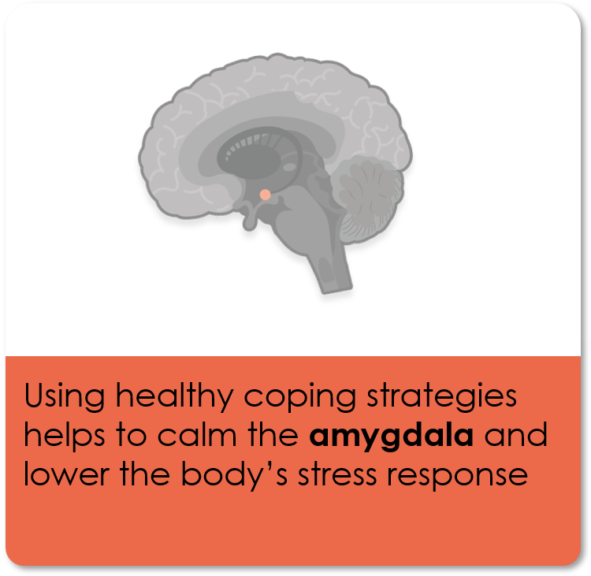
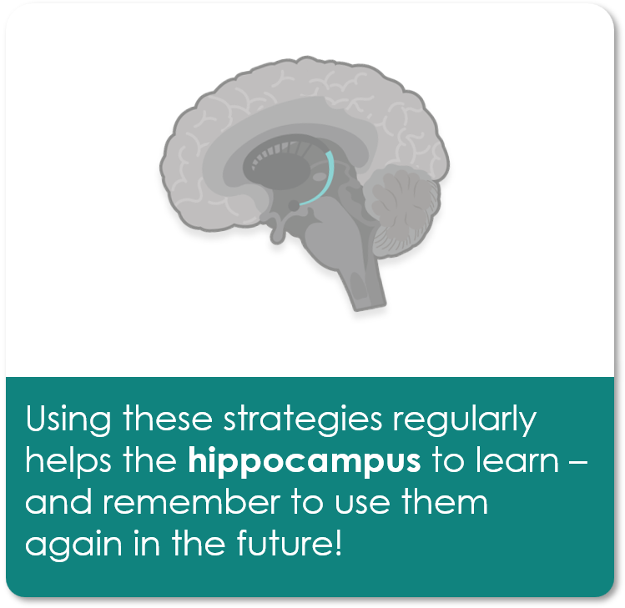
Task 4- Using healthy coping strategies
Notes:
Teacher notes – Using healthy coping strategies (15 mins, slides 15-17)
When groups have finished exploring strategies for their character, ask a volunteer from each group to feedback their answers. Use slides 15-17 to help guide discussion.
Draw out the key learning:
When someone regularly uses healthy coping strategies to manage tension, worry, stress, or other unpleasant or uncomfortable emotions, this can help the brain and body to feel calmer and more at ease. This is partly because using these strategies can help to send signals to the brain that the person is safe, calming the amygdala.
Using the strategies repeatedly and consistently over time can help people to become better at identifying and managing stress. The more they practise using healthy coping strategies, the easier it will become because the hippocampus will help them to learn and remember to use them next time.
It can sometimes be helpful for someone to recognise the ‘root cause’ of any unpleasant or uncomfortable emotions they might be feeling, in case there is anything they can do to address this directly, or to prevent a similar situation in future. For example, if someone feels worried or stressed before taking a test because they have not prepared for it, it may be helpful to use a healthy coping strategy to help manage their feelings in the moment, but they could also consider if there is anything they can do to prepare more for tests in future. This might help to decrease the likelihood or strength of any unpleasant emotions in the future.

Slide 15
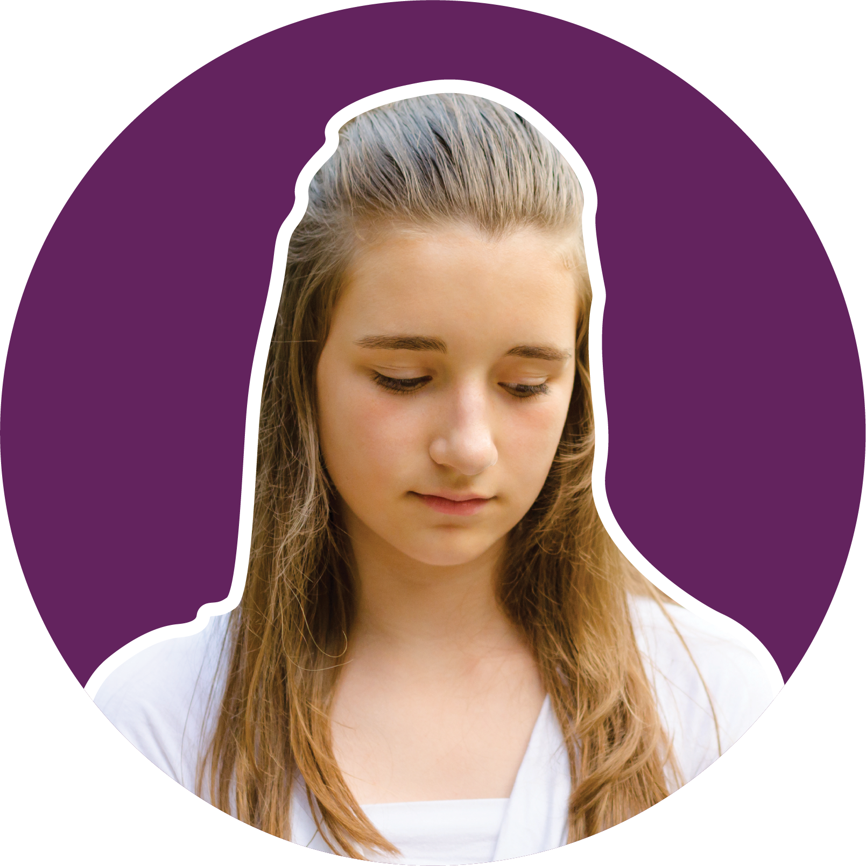
Taylor could…….
practise naming her feelings
and emotions, to help her
recognise when she is feeling overwhelmed and decide how to manage her feelings
practise ‘watching thoughts’, e.g. imagining her worries as pop-ups
on a computer, that she can notice briefly and then ‘close’, so she can refocus, and asking for help if she needs it
take regular breaks to pause and take a step back from her work and come back when she feels ready.
These strategies could help Taylor to feel more in control of her thoughts and feelings. They will be especially helpful for her to use when it is becoming hard to focus.
They could help to keep her calm and feel more able to do her revision and homework, without feeling overwhelmed.
Notes:
Teacher notes – Using healthy coping strategies (15 mins, slides 13-15)
When groups have finished exploring strategies for their character, ask a volunteer from each group to feedback their answers.

Slide 16
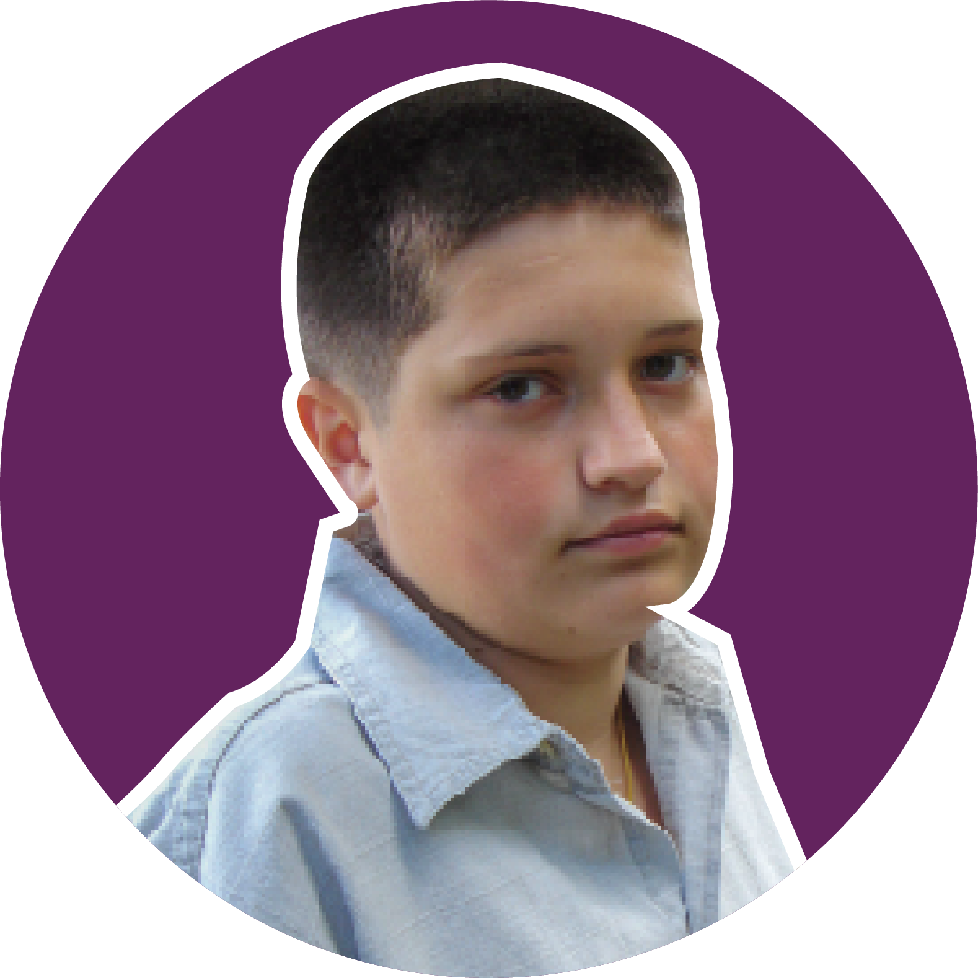
Benny could…….
practise slow-paced breathing to regulate his heart rate and lessen the impact of the ‘fight, flight or freeze’ response
try progressive muscle relaxation to relieve stress and tension in his body
do an absorbing activity for a short while, when he feels really worried about the speech
practise reframing his thoughts, for example by seeing the speech as an opportunity to share what he has learnt with his friends and celebrate his team’s win; and reminding himself that it doesn’t need to be perfect.
These strategies could help Benny to feel calmer and temporarily distract himself from thoughts that make him feel more worried or scared about public speaking. If he feels ill, practising slow-paced breathing before the speech or progressive muscle relaxation, might help him to lower his body’s stress response and slowly feel better.
Notes:
Teacher notes – Using healthy coping strategies (15 mins, slides 13-15)
When groups have finished exploring strategies for their character, ask a volunteer from each group to feedback their answers.

Slide 17

Yasmin could…….
pause and take a step back (e.g. counting to 5) before responding, when she feels stressed or irritable
practise naming her feelings
and emotions
try ‘watching thoughts’ strategies, e.g. imagining her feelings of frustration as leaves on a stream, floating away.
try activities that absorb her attention and take her focus
away from less pleasant thoughts and emotions.
These strategies could help Yasmin to feel calmer and
more in control. They will help her identify what she is feeling and why. Then she can plan her next steps, for example, taking more regular breaks to distract her mind or give it some rest.
When she thinks about or does an activity that makes her feel happy, and calmer, this boosts her ‘feel-good hormones’.
Doing this can help her to feel less stressed over time and more able to use her time well.
Notes:
Teacher notes – Using healthy coping strategies (15 mins, slides 13-15)
When groups have finished exploring strategies for their character, ask a volunteer from each group to feedback their answers.

Slide 18
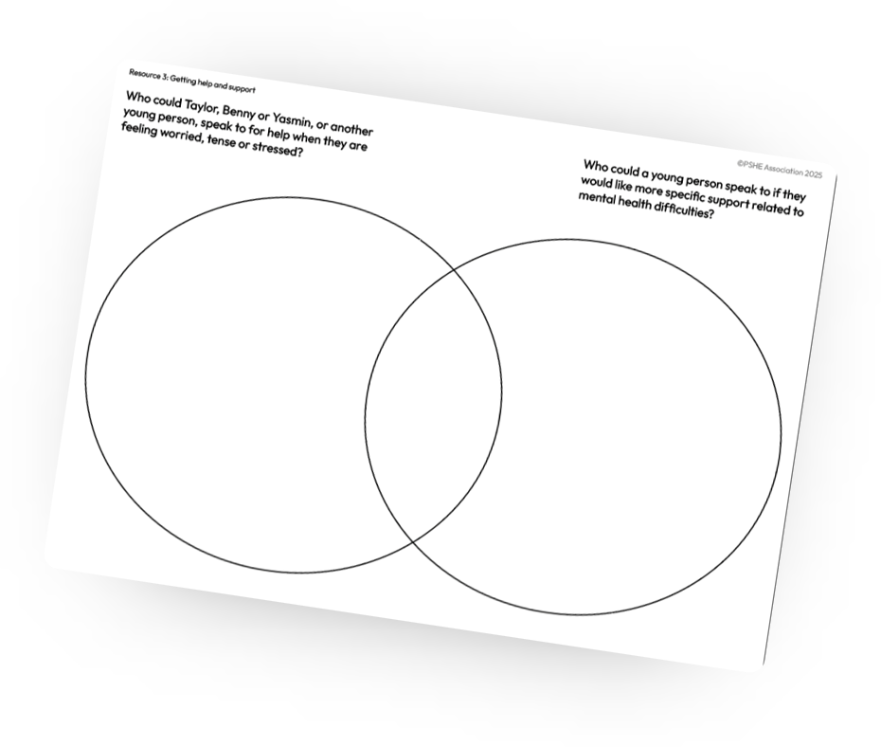
Task 5- Getting help and support?
Who could Taylor, Benny, Yasmin, or another young person, speak to for help when they are feeling worried, tense or stressed?
Who could a young person speak to, if they would like more specific support related to mental health difficulties?
Notes:
Teacher notes – Getting help and support (10 mins, slides 24-25)
Students to complete the Venn diagram
Take feedback, using the slide to guide discussion.
Explain that it is important for any young person who has questions or concerns about their wellbeing and mental health, to seek support no matter how ‘big’ or ‘small’ they think the problem might be. Friends of someone who might be having difficulties with mental health or wellbeing can also speak to a trusted adult for guidance and support.
Support: Give students Resource 3a: Who can help? and ask them to sort the sources of help and support into the categories into the categories by ticking the boxes.
Challenge: Ask students to describe what the friend of a young person such as Taylor, Benny, or Yasmin, could do to help them look after their wellbeing and mental health. Students might suggest: they could remind and encourage them to use healthy coping strategies if they notice they are feeling stressed, worried, or overwhelmed; they could ask what they are feeling, or give them time and space to practise using their healthy coping strategies before asking them to join back in an activity with others; they could join in using these healthy coping strategies with them so they don’t feel alone; they could ask an adult for help or support if they are worried about their friend.

Slide 19
Task 6- Getting help and support?
Support for managing emotions and wellbeing
More specific support for mental health difficulties
Parent or carer
GP or mental health nurse
Friends
Teacher
Childline or YoungMinds
NHS 111
Peer mentor
School counsellor
Local mental health support services
Notes:
Teacher notes – Getting help and support (5 mins)
Take feedback, using the slide to guide discussion.
Explain that it is important for any young person who has questions or concerns about their wellbeing and mental health, to seek support no matter how ‘big’ or ‘small’ they think the problem might be. Friends of someone who might be having difficulties with mental health or wellbeing can also speak to a trusted adult for guidance and support.
Support: Give students Resource 3a: Who can help? and ask them to sort the sources of help and support into the categories into the categories by ticking the boxes.
Challenge: Ask students to describe what the friend of a young person such as Taylor, Benny, or Yasmin, could do to help them look after their wellbeing and mental health. Students might suggest: they could remind and encourage them to use healthy coping strategies if they notice they are feeling stressed, worried, or overwhelmed; they could ask what they are feeling, or give them time and space to practise using their healthy coping strategies before asking them to join back in an activity with others; they could join in using these healthy coping strategies with them so they don’t feel alone; they could ask an adult for help or support if they are worried about their friend.

Slide 20
Task 7- What have we learnt?
Have you met the learning outcomes?
Add your new learning to your drawing from the beginning of the of the lesson, in a different colour.
We will be able to:
identify signs that someone is feeling worried, tense or stressed
evaluate a range of healthy coping strategies
explain how someone can seek help for themselves or others when feeling worried, tense or stressed
Notes:
Teacher notes –Endpoint assessment (5 mins)
Ask students to return to their drawing from the beginning of the lesson. Remind them of the learning outcomes for the lesson and, reflecting on these, ask them to add any new learning that they can, using a different coloured pen, to demonstrate they have met the outcomes. If, at the start of the lesson, they had not been able to identify any other healthy coping strategies someone might use, ask them to now focus on this and add this to their original answers.

Slide 21


Task 8- Reflection
Answer the following in your booklets:
Where have you used a healthy coping strategy to manage a difficult feeling or challenging situation? How has this helped
you since?
What is a healthy coping strategy that you would like to use to support your wellbeing and mental health?
Who can you talk to for help managing difficult thoughts, feelings or emotions?
Notes:
Teacher notes – Reflection (5 mins)
Answer the following in your booklets:
Where have you used a healthy coping strategy to manage a difficult feeling or challenging situation? How has this helped
you since?
What is a healthy coping strategy that you would like to use to support your wellbeing and mental health?
Who can you talk to for help managing difficult thoughts, feelings or emotions?

Slide 22
Signposting Support
If you have any concerns or questions regarding your own mental health, you can always speak to your parent or carer, or a teacher in school for more advice and support.
ChildLine:
www.childline.org.uk Phone: 0800 1111
Young Minds:
www.youngminds.org.uk
Samaritans:
www.samaritans.org Phone: 116 123

