Slide 1
Teacher Information
All resources in booklets.
Please read the PSHE teacher handbook before teaching this unit.
Remember to log any safeguarding concerns on CPOMS.
Keep your class booklets safe as there will be a new booklet each half term.
Read the notes section for each slide and make sure you are familiar with the lesson content.
Always have 5 minutes left at the end to share the further support slide.

Slide 2

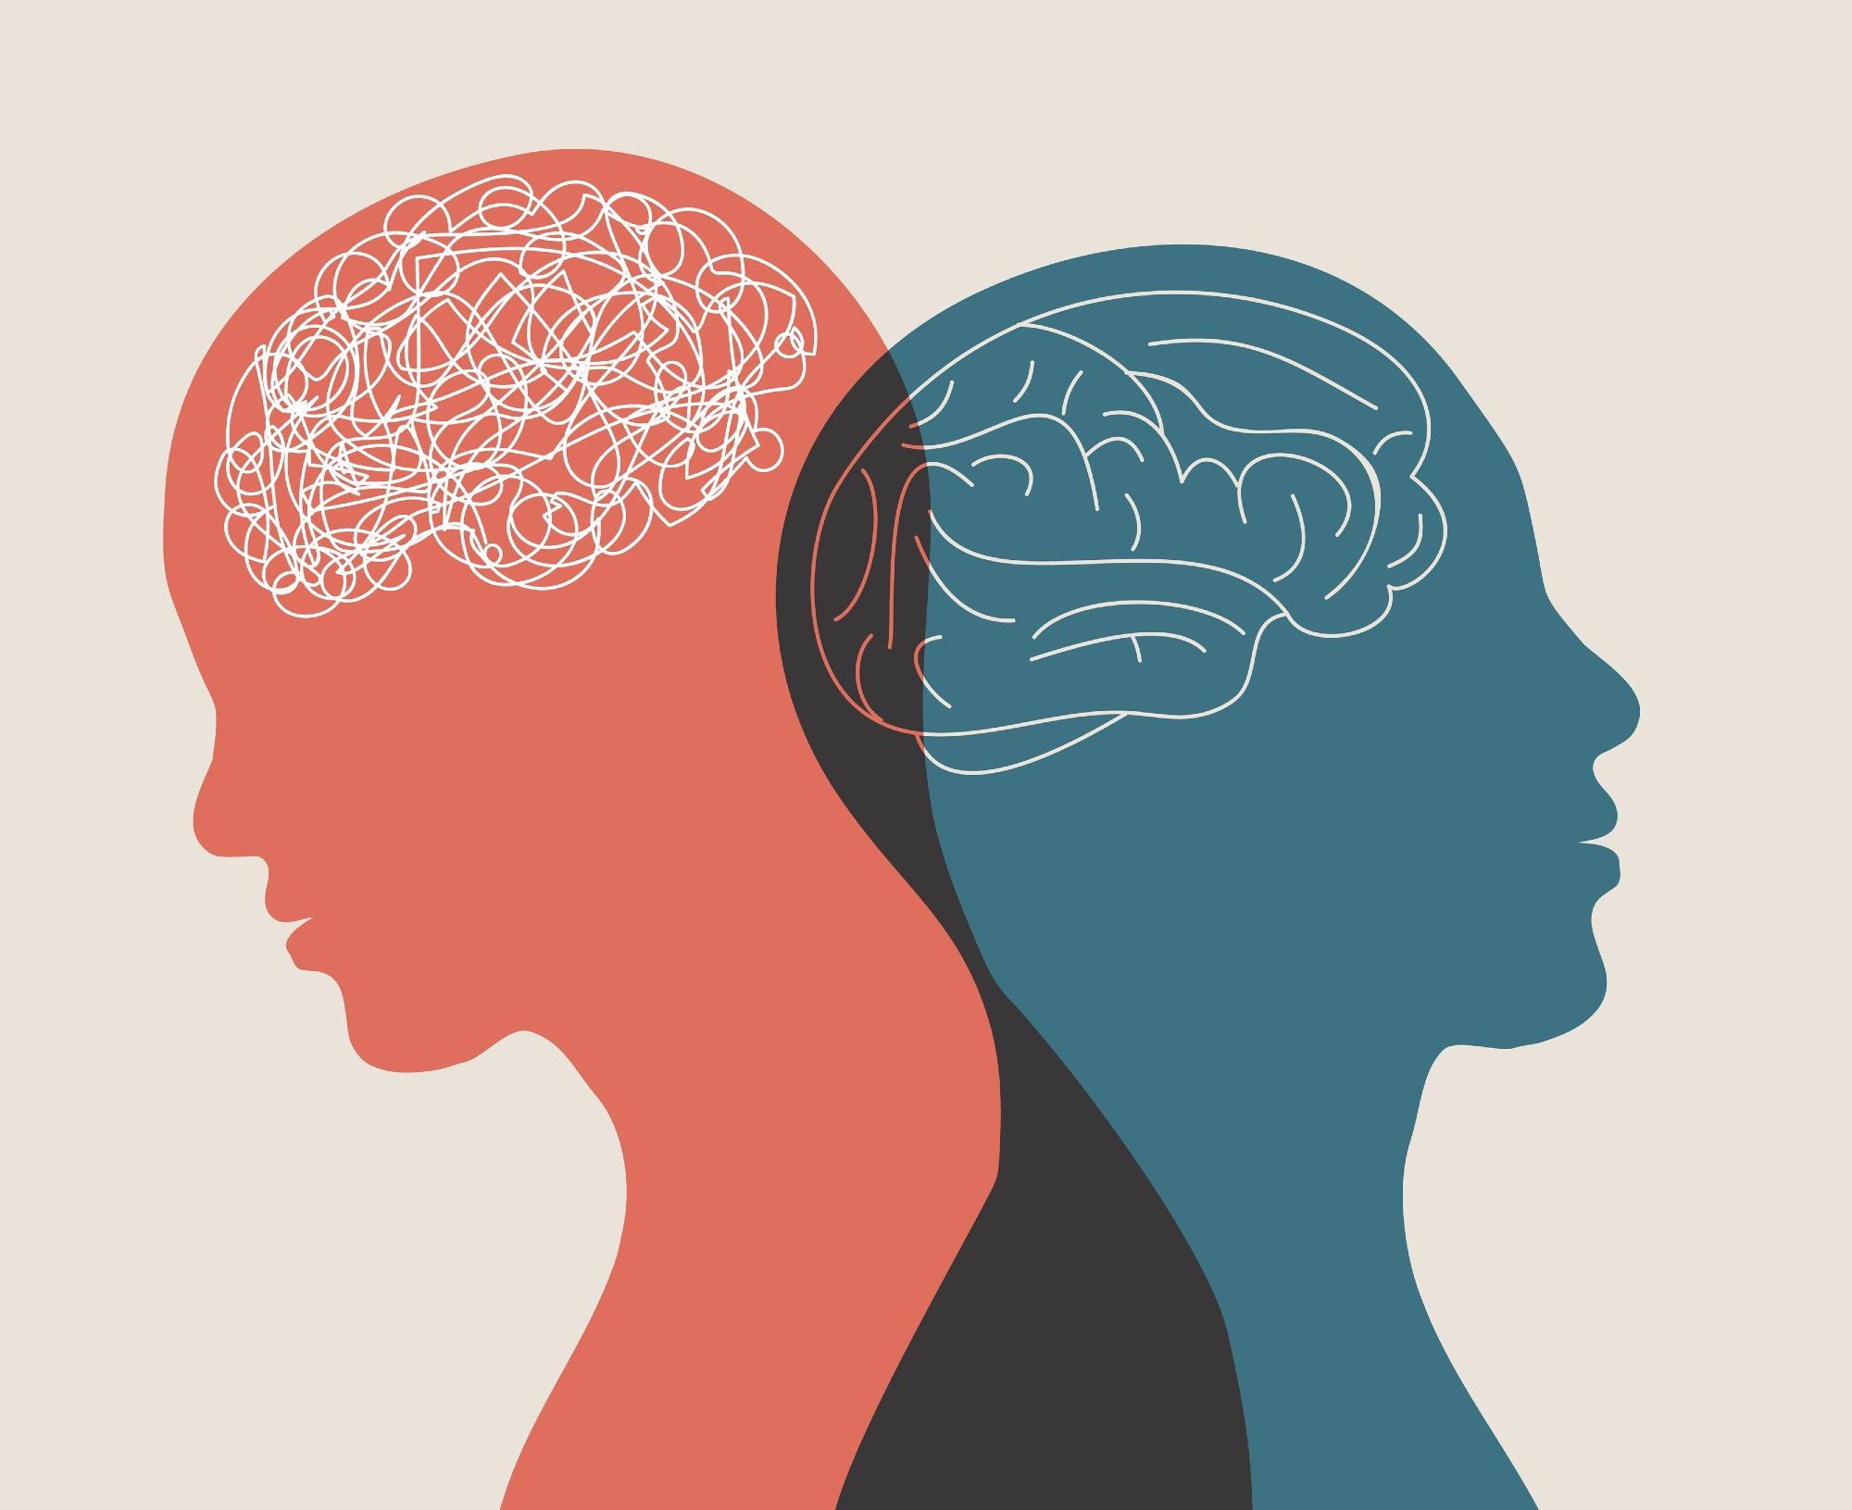

Lesson 4- Changing thinking habits
Starter- ‘Do now’ Recap
What is a coping strategy?
Name two signs that someone might be feeling worried, tense or stressed.
Give two examples of healthy coping strategies
Who could a young person talk to if they are worried or stressed?
Why is it important to practise healthy coping strategies
Challenge- A friend says they feel overwhelmed before an important test. Which three healthy coping strategies would you recommend, and explain why each one could help them manage their stress?
ASPIRATION - ENDEAVOUR - INTEGRITY - RESPECT
Notes:
What is a coping strategy? A coping strategy is a way of managing difficult situations, thoughts, or strong emotions.
2. Name two signs that someone might be feeling worried, tense or stressed.Possible answers: racing thoughts, difficulty concentrating, butterflies in the stomach, increased heart rate, sweating, withdrawing from others, feeling shaky.
3. Give two examples of healthy coping strategies.Any two from: slow-paced breathing, progressive muscle relaxation, naming feelings, taking a break, doing an absorbing activity, talking to someone, reframing negative thoughts, watching thoughts.
4. Who could a young person talk to if they are worried or stressed?A trusted adult, parent or carer, teacher, school counsellor, friend, GP, Childline, YoungMinds, NHS 111 or a peer mentor.
5. Why is it important to practise healthy coping strategies regularly?They help the brain and body feel calmer, make it easier to manage stress, and become more effective with practice.
🌟 Challenge Question
A friend says they feel overwhelmed before an important test. Which three healthy coping strategies would you recommend, and explain why each one could help them manage their stress?

Slide 3
PSHE Ground Rules
Let other people talk and listen without interrupting
Be respectful
Do not use bad language and try to use language that won’t offend or upset anyone
Use the correct terms – if you don’t know them ask for help
Comment on what was said, not who said it
Never share your friends’ personal experiences
Don’t ask personal questions
Try not to judge others.
Notes:
Discuss the following ground rules with the class and explain these need to be followed every PD lesson.

Slide 4


Learning objectives
  Learning Objective: To learn how to change thinking patterns to support wellbeing.
Learning Outcomes
Describe negative thinking patterns and assess their potential impact on wellbeing
Evaluate strategies to help reframe negative thinking
Identify ways to learn from disappointments and setbacks

Slide 5
Task 1- What’s our starting point?
Draw a circle on the line to show how much you agree or disagree with each statement.
Then, with a partner, discuss the quote about managing disappointments
Everything always goes wrong when I plan something!
I don’t know what to do, I find it really frustrating.
What can I do to manage disappointments?
Agree
Disagree
Notes:
Teacher notes – Baseline assessment activity (10 mins)
Give students Resource 1: Attitude Continuum and ask them to draw a circle on the line to show how much they agree or disagree with each statement. This will help gauge their starting points on how they view challenges, mistakes, and effort.
Then, ask students to think about the quote on the slide and discuss their thoughts with a partner. Ask volunteers to share their ideas with the class.
Use students’ suggestions and your observations to assess their starting points and consider how the lesson may need adapting. For example, if responses suggest that students believe skills and learning can’t improve with practice, spend more time exploring the first activity (Identifying negative thinking patterns); if they struggle to suggest strategies for managing disappointments, allow more time for the third activity (Setback ‘head, heart, hands’) to help them explore ways to learn from and reframe setbacks.

Slide 6

Task 2- Identifying negative thinking patterns
Match each thinking pattern to its definition and an example.
How might these thinking patterns affect someone’s wellbeing?
Why might it be important to recognise and challenge these thinking patterns?
Notes:
Teacher notes – Identifying negative thinking patterns (10 mins, slides 6-8)
In pairs, match each thinking pattern to its definition and an example. Ask them to match each type of thinking pattern to its definition and an example. Once they have completed the matching activity, ask students to discuss what the impact of these thinking patterns might be on someone’s wellbeing.
Take feedback, using Resource 2b: Negative thinking patterns teacher sheet to support discussions. Then, ask volunteers to share a brief summary of what they think ‘negative thinking patterns’ are and the effect they might have on someone.
Support: Give students Resource 2a: Negative thinking patterns examples where the thinking pattern and its definition are already matched. Ask them to match each thinking pattern to an example.
Challenge: Ask students to come up with an additional example for each thinking pattern.

Slide 7
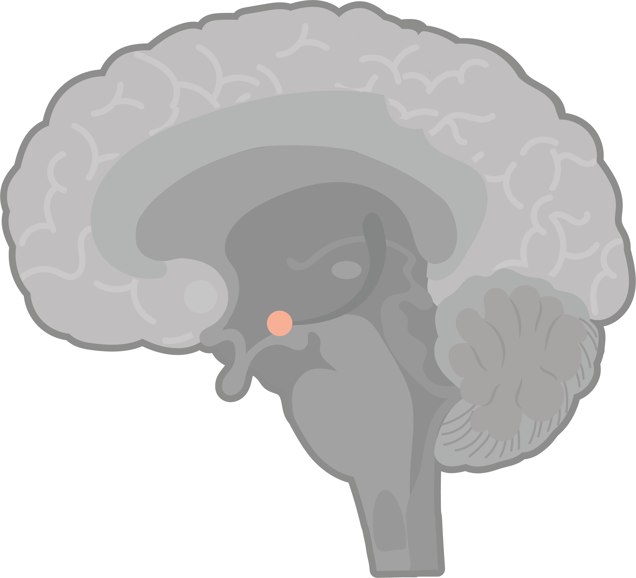


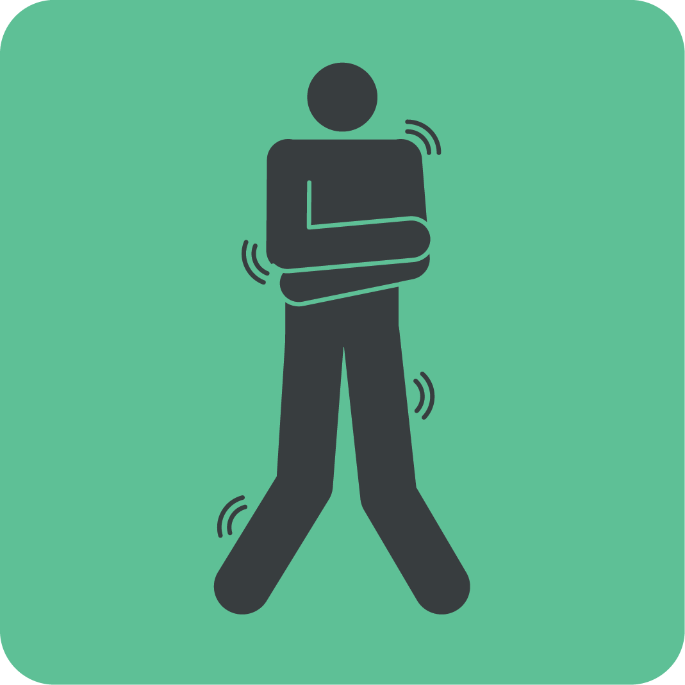

Identifying negative thinking patterns
Today, the “fight, flight or freeze” response can be less helpful.
The brain is still wired to focus on negative thoughts, especially during stress or strong emotions.
Repeated negative thoughts can make the amygdala more sensitive and make feelings about negative thoughts feel more intense.
Flight
Freeze
Fight
Notes:
Teacher notes – Identifying negative thinking patterns (10 mins, slides 6-8)
Use this slide and the next to draw out key learning:
Negative thinking patterns are unhelpful ways of thinking where someone focusses on more negative aspects of situations and, sometimes, makes situations seem worse than they are.
The brain naturally focusses on potential dangers - a survival mechanism from a time when being alert to danger was more important than being alert to rewards, as survival depended on it. So, when feeling an unpleasant or uncomfortable emotion in response to a challenging situation, the amygdala would often become active and set off the ‘fight, flight or freeze’ response, making the body ready to respond to danger or threat. While the ‘fight, flight, freeze’ response is less helpful today, the brain is still wired to focus more on negative thoughts.

Slide 8




Identifying negative thinking patterns
Some uncomfortable emotions like frustration or feeling left out can be useful signals someone that something is important to them. These feelings can help us reflect, prepare, or make positive changes.
But sometimes, unhelpful thinking patterns can take over. Like focusing only on problems, assuming the worst, or ignoring the evidence.
This can make challenges feel bigger than they are. They might lower someone’s confidence or cause them to feel worry, anxiety or tension.
Notes:
Teacher notes – Identifying negative thinking patterns (10 mins, slides 6-8)
Negative thoughts or feelings can signal to someone that something is important them. For example, feeling left out when friends make plans might draw attention to how much those friendships matter. Feeling frustrated after a test could show that doing well at school is something the person cares about. These feelings can be useful if they help us reflect, prepare, or make positive changes.
However, when unhelpful thinking patterns take over they can make challenges feel bigger or more overwhelming than they are, as someone may focus on problems, make assumptions without evidence, or struggle to see solutions. These thinking patterns are often unrealistic or unhelpful, reinforcing themselves over time.
This can cause someone to feel worry, anxiety, or tension, and can lower confidence, having a negative impact on wellbeing.
Reassure students that they don’t need to worry if they can’t remember the role of the fight, flight or freeze response, or the names of parts of the brain. What’s important is understanding that the brain is wired to focus on the negative. While this was helpful in the past, it can now lead to unhelpful thinking patterns that lower confidence and increase unpleasant or uncomfortable emotions.

Slide 9

Task 3-Alternatives to negative thinking patterns
Re-read the examples of negative thinking patterns and discuss the questions below:
What emotion might someone be feeling when they have this thought?
What strategies might someone use if they feel this way?
My friend didn’t text me back, they must be upset with me.
Notes:
Teacher notes – Alternatives to negative thinking patterns (10 mins, slides 9-12)
Ask students to look back at the examples of negative thinking patterns from the previous activity. For each example, in pairs, ask students to discuss the questions on the slide.
Take feedback from students, drawing out the key learning below:
Someone having catastrophising thoughts might feel stress, panic, or feel tearful; someone having personalising thoughts might feel embarrassment, guilt, or anger; someone having mind reading thoughts might feel insecurity, suspicion, or anxiousness; someone having overgeneralising thoughts might feel hopelessness, frustration, or a sense of overwhelm.
Self-regulation strategies, such as pausing, breathing, or doing absorbing activities that engage the senses can help someone feel calmer, or feel more pleasant or neutral emotions, before deciding what to do next. This can make it easier to challenge negative thinking patterns.

Slide 10

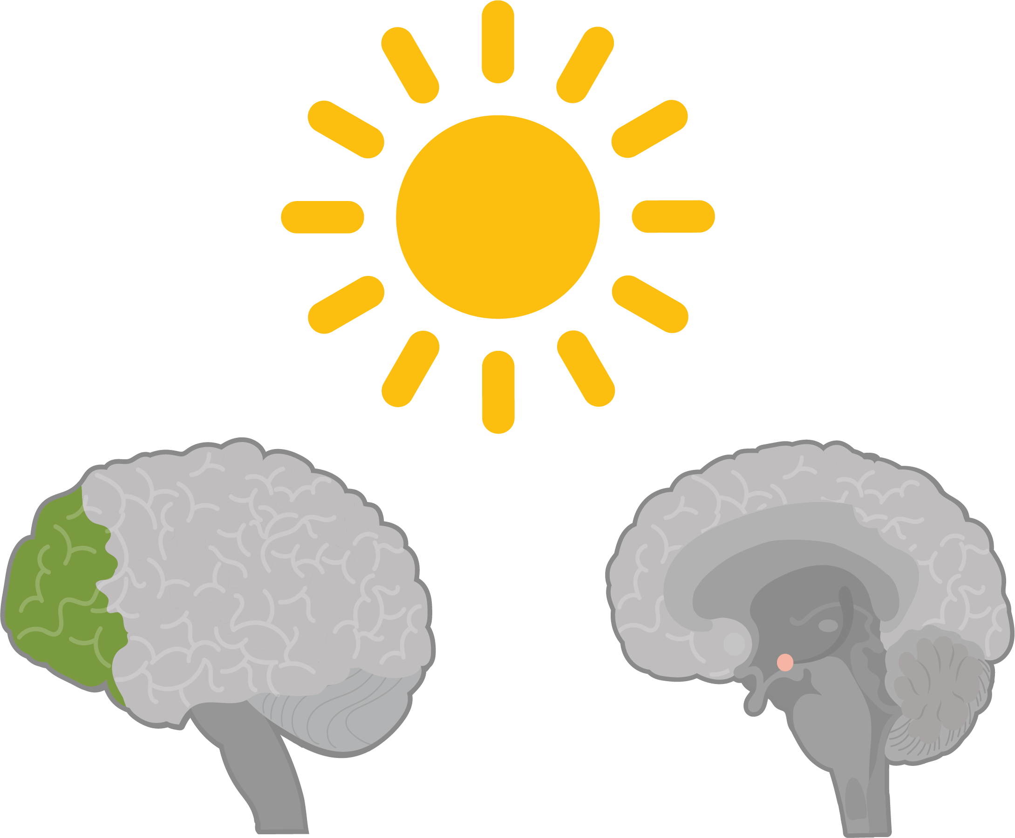

Task 3- Alternatives to negative thinking patterns
My friend didn’t text me back, they must be upset with me.
My friend might be busy or dealing with something. I’ll wait and check in later.
Task 3- Rescript the other examples of negative ‘self-talk’.
Why or when might someone find it more challenging to reframe their thoughts?
Notes:
Teacher notes – Alternatives to negative thinking patterns (10 mins, slides 9-12)
Explain that after using strategies to manage unpleasant emotions, someone might try to reframe their thoughts in a more helpful way. This can support them to develop a more balanced perspective when experiencing setbacks and can help them to make decisions on what to do next to support their wellbeing and achieve their goals.
Share the rescripted self-talk example on the slide to model how someone might reframe negative ‘self-talk’. Ask students to rescript each of the examples of ‘self-talk’ for the other thinking patterns in Resource 2, rewriting each example in a way that helps the person having the thought to learn from their experience.
Take feedback for each of the types of negative thinking pattern, before sharing the rescripted examples on the next slide.
Students to read the Reframing thoughts which models more of the examples of rescripted ‘self-talk’. Ask them to use the sentence starters to rescript the remaining examples.
Support 2: Give students Resource 3a: Self-talk cards. Ask them to match each rescripted thought process to an example and explain how it might help the person experiencing this thought. Explain to students that some of the rescripted options may work with more than one of the thinking patterns.
Note that these are the same rescripted options as on slide 17, so students can take part in feedback by identifying if they have matched the same cards and examples as on the slide, or if they have gone for different options. Which rescripted option do they think is most helpful?

Slide 11

Click cards to view
My friend might be busy or dealing with something. I’ll wait and check in later.
Nobody gets everything right all the time. I tried my best, and mistakes help me improve.
I didn’t do as well
as I wanted, but I can focus on what went well and work on what didn’t.
My friend didn’t text me back, they must be upset with me.
Everyone must think I’m really stupid for getting that question wrong.
I failed that test. I’m useless at everything.
I had a great time overall. One small thing doesn’t change the fact that I enjoyed myself.
I can focus on preparing. I know I feel scared, but I’ll do what I can to improve.
One test doesn’t decide everything. I can practice and strengthen the areas I found difficult.
I had fun at the party, but that one person didn’t talk to me so it was a disaster. 🌧️
I’ll never pass my exams, so there’s no point in trying.
I did badly on one test, I’m going to fail all my GCSEs.
Rejection happens to everyone sometimes. It doesn’t mean I’ll always be rejected.
Missing one day doesn’t mean I’ve failed. I can get back on track tomorrow.
Nobody is perfect. Effort and growth
are what matter most, not just getting everything right.
If they say no,
I’ll never find anyone who likes me, and I’ll be alone forever.
I missed one day of my revision plan, so it’s not working.
I should always get everything right, or people won’t respect me.
Notes:
Teacher notes – Alternatives to negative thinking patterns (10 mins, slides 9-12)
Click each negative thought to animate.
Draw out key learning using the animated slide to show how these thoughts might be reframed. Ask:
What impact might practising reframing thoughts have on someone’s wellbeing?
Why or when might someone find it more challenging to reframe their thoughts?
While taking feedback, draw out key learning on the impact of reframing thoughts:
Reframing thoughts and looking at situations from a different, more balanced perspective can help someone learn from challenges instead of feeling discouraged.
Then use the next slide and to further support discussion of key learning.

Slide 12
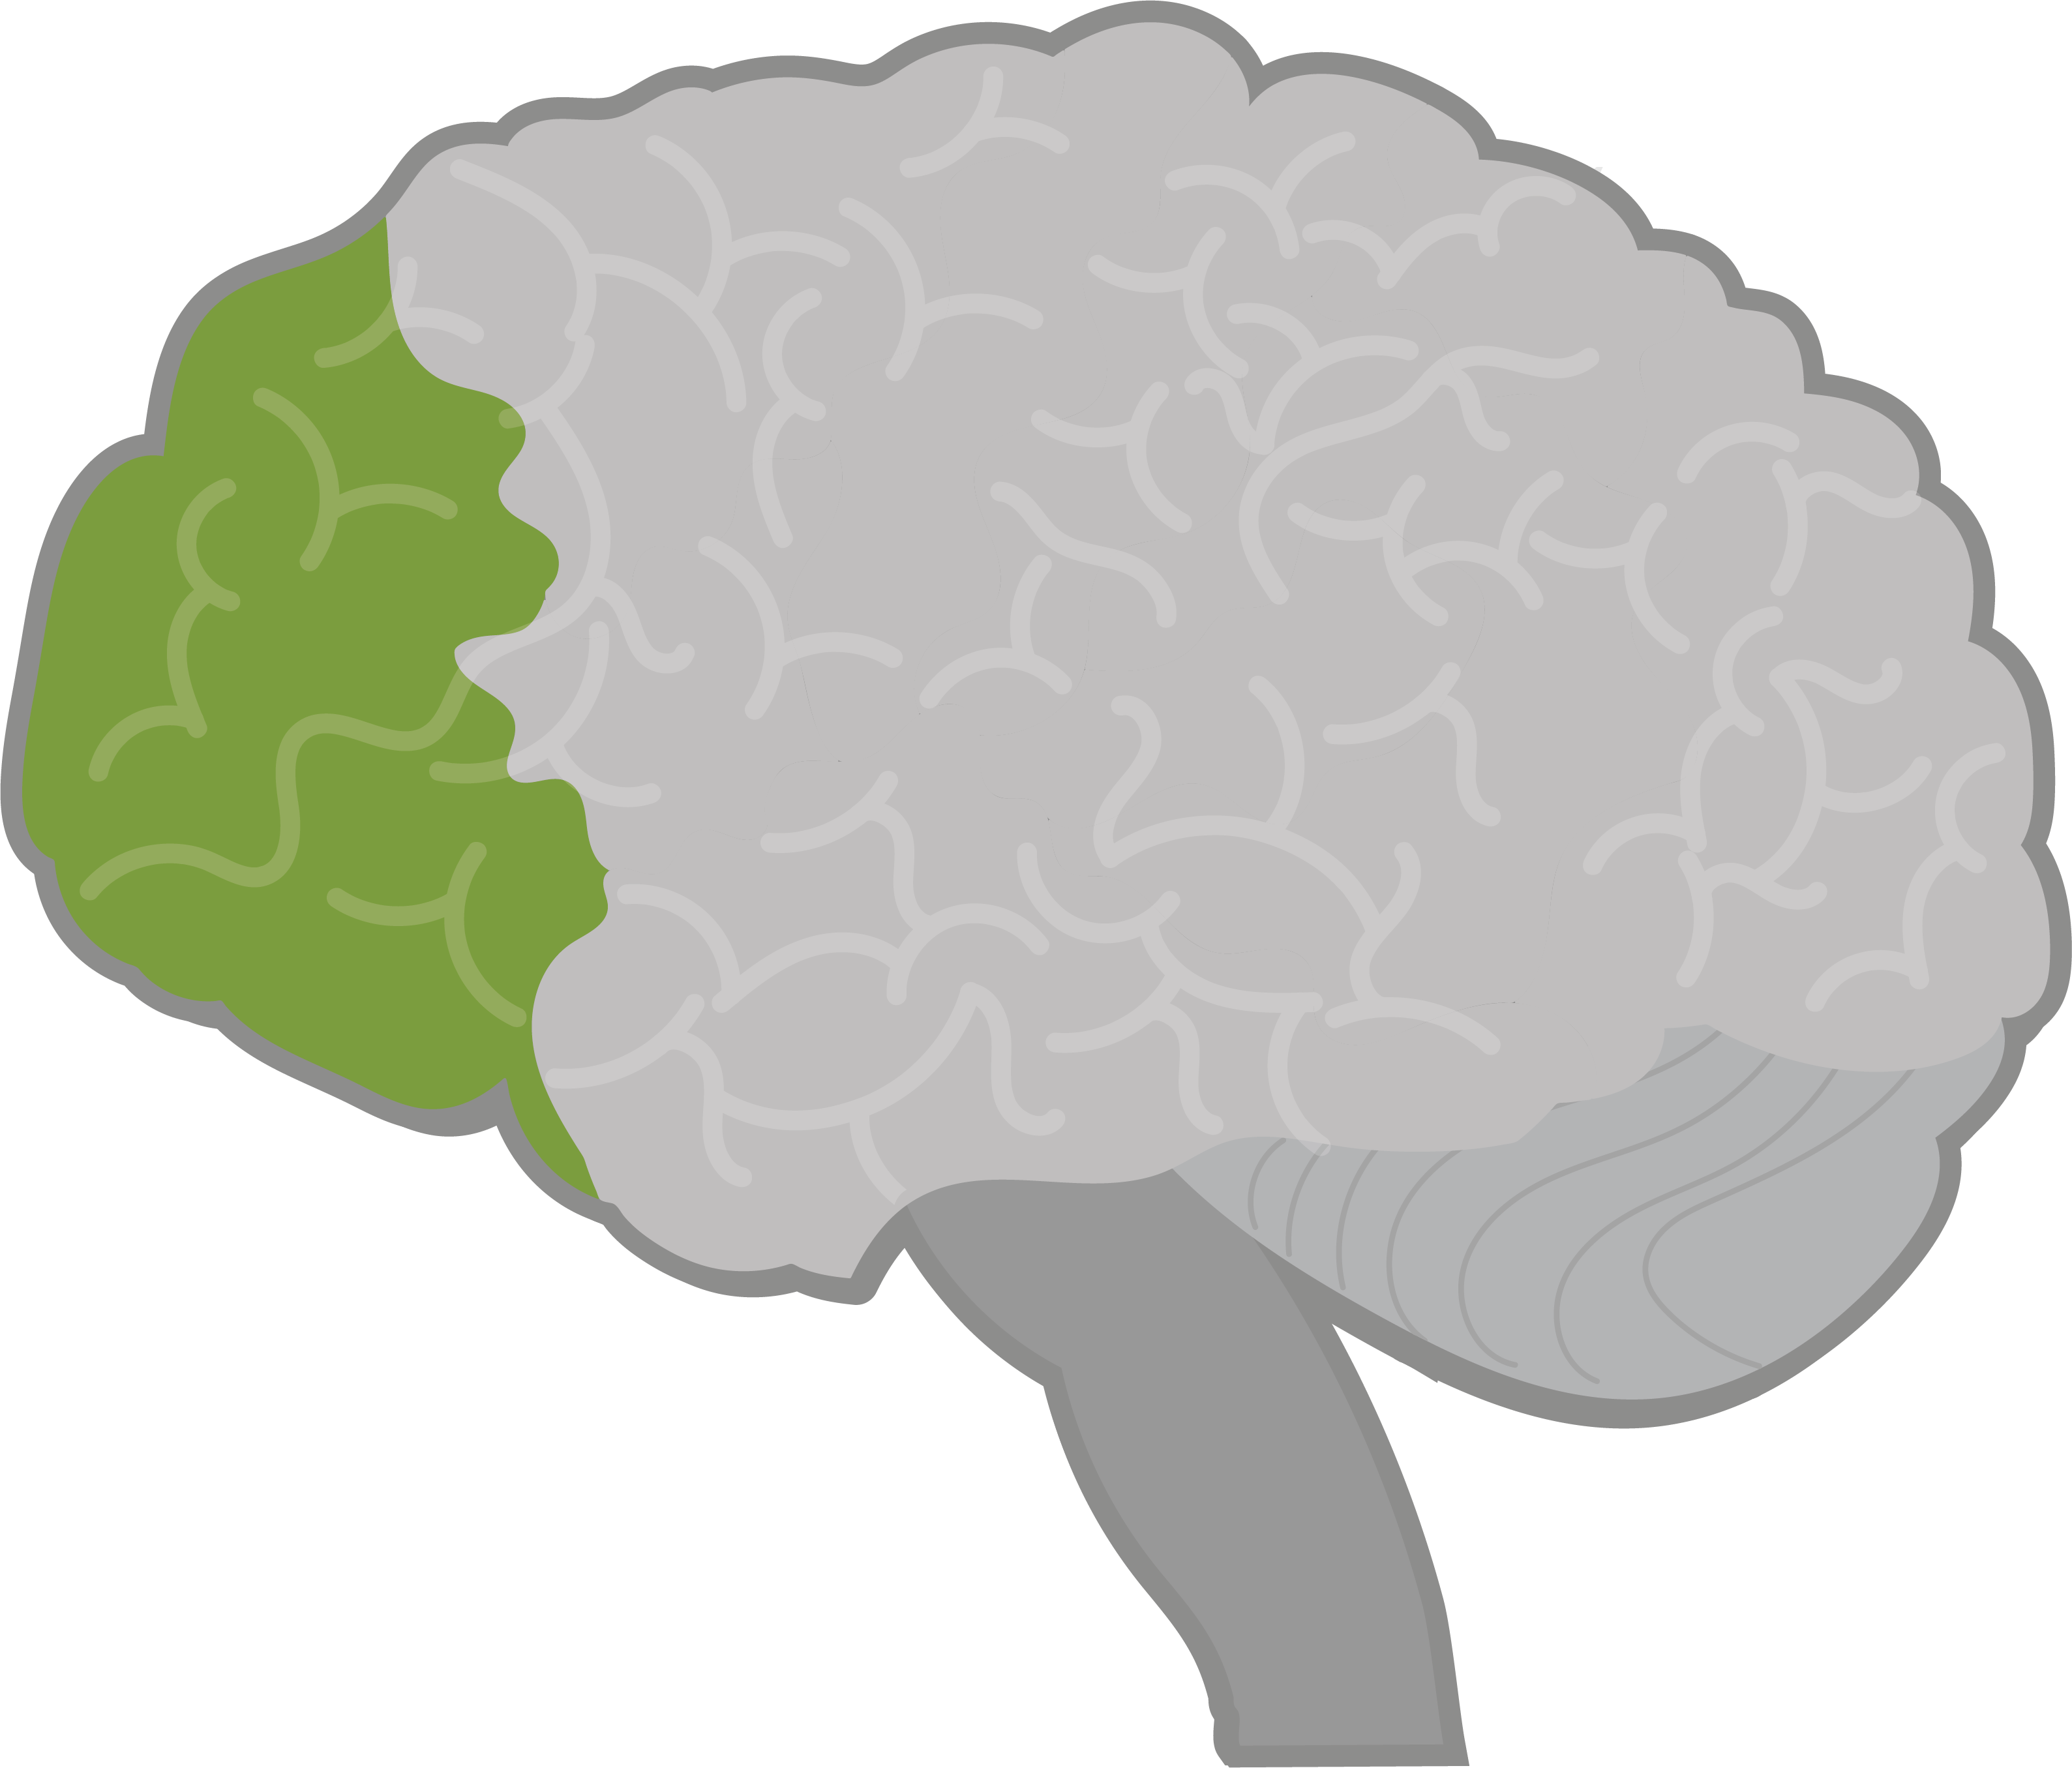
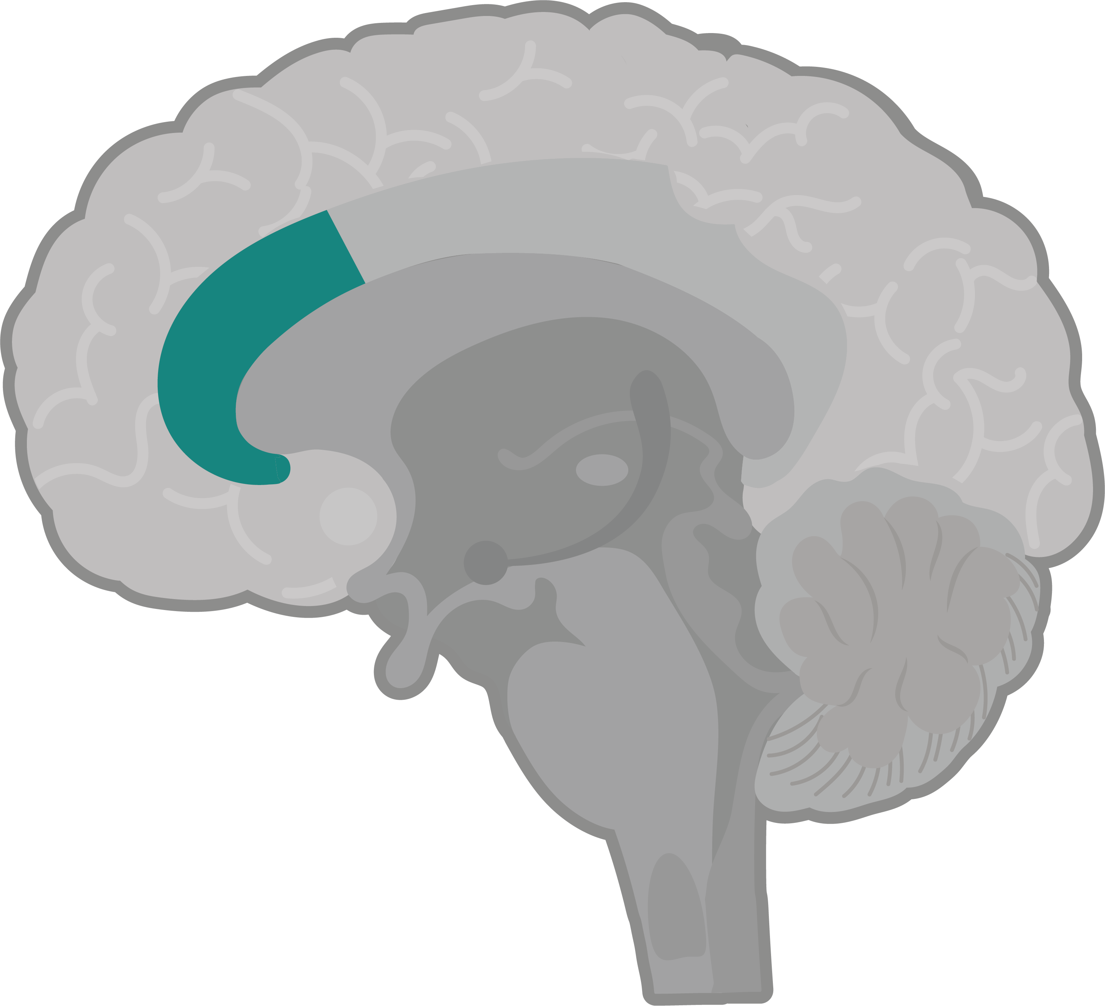
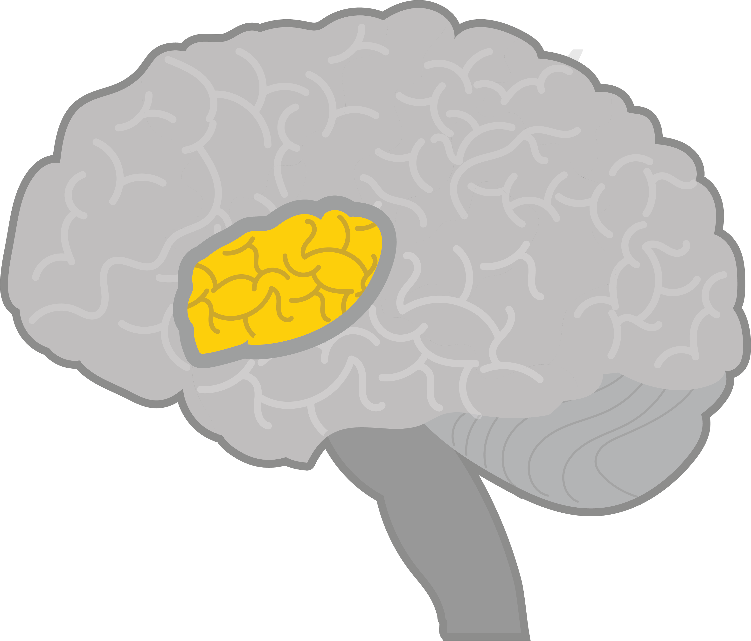
Task 4- Is it the right time to reframe thoughts?
The prefrontal cortex (PFC) helps with rational thinking, but stress, tiredness, or strong emotions can make reframing thoughts harder. Calming the nervous system first can make it easier to shift perspective.
Reframing thoughts strengthens brain connections and make it easier to move from automatic negative thoughts to more balanced perspectives, this also includes:
anterior cingulate cortex ACC
(attention and emotion regulation)
Insula
(emotional-awareness).
PFC
Notes:
Teacher notes – Alternatives to negative thinking patterns (10 mins, slides 9-12)
Click to animate
Use this slide to explain:
The process of reframing thoughts is supported by the PFC, which helps with rational thinking and perspective-taking, and by brain regions like the anterior cingulate cortex (ACC) and insula, which support attention-shifting, emotion regulation, and self-awareness.
When someone is tired, upset, or stressed, these areas of the brain become less effective, making it harder to reframe thoughts. That’s why it can help to calm strong emotions first using healthy coping strategies.
Over time, practising reframing helps strengthen the brain pathways involved, making it easier to challenge unhelpful thoughts, avoid automatic negative thinking, and build more flexible, balanced perspectives.
If students are concerned about remembering the role of areas of the brain, remind them that the most important learning here is that using healthy coping strategies can help manage strong emotions. This can sometimes make it easier to reframe negative thoughts, especially if someone is tired or upset.
And due to brain plasticity, the more we practise healthy coping strategies and reframing thoughts, the better we get at using them.

Slide 13

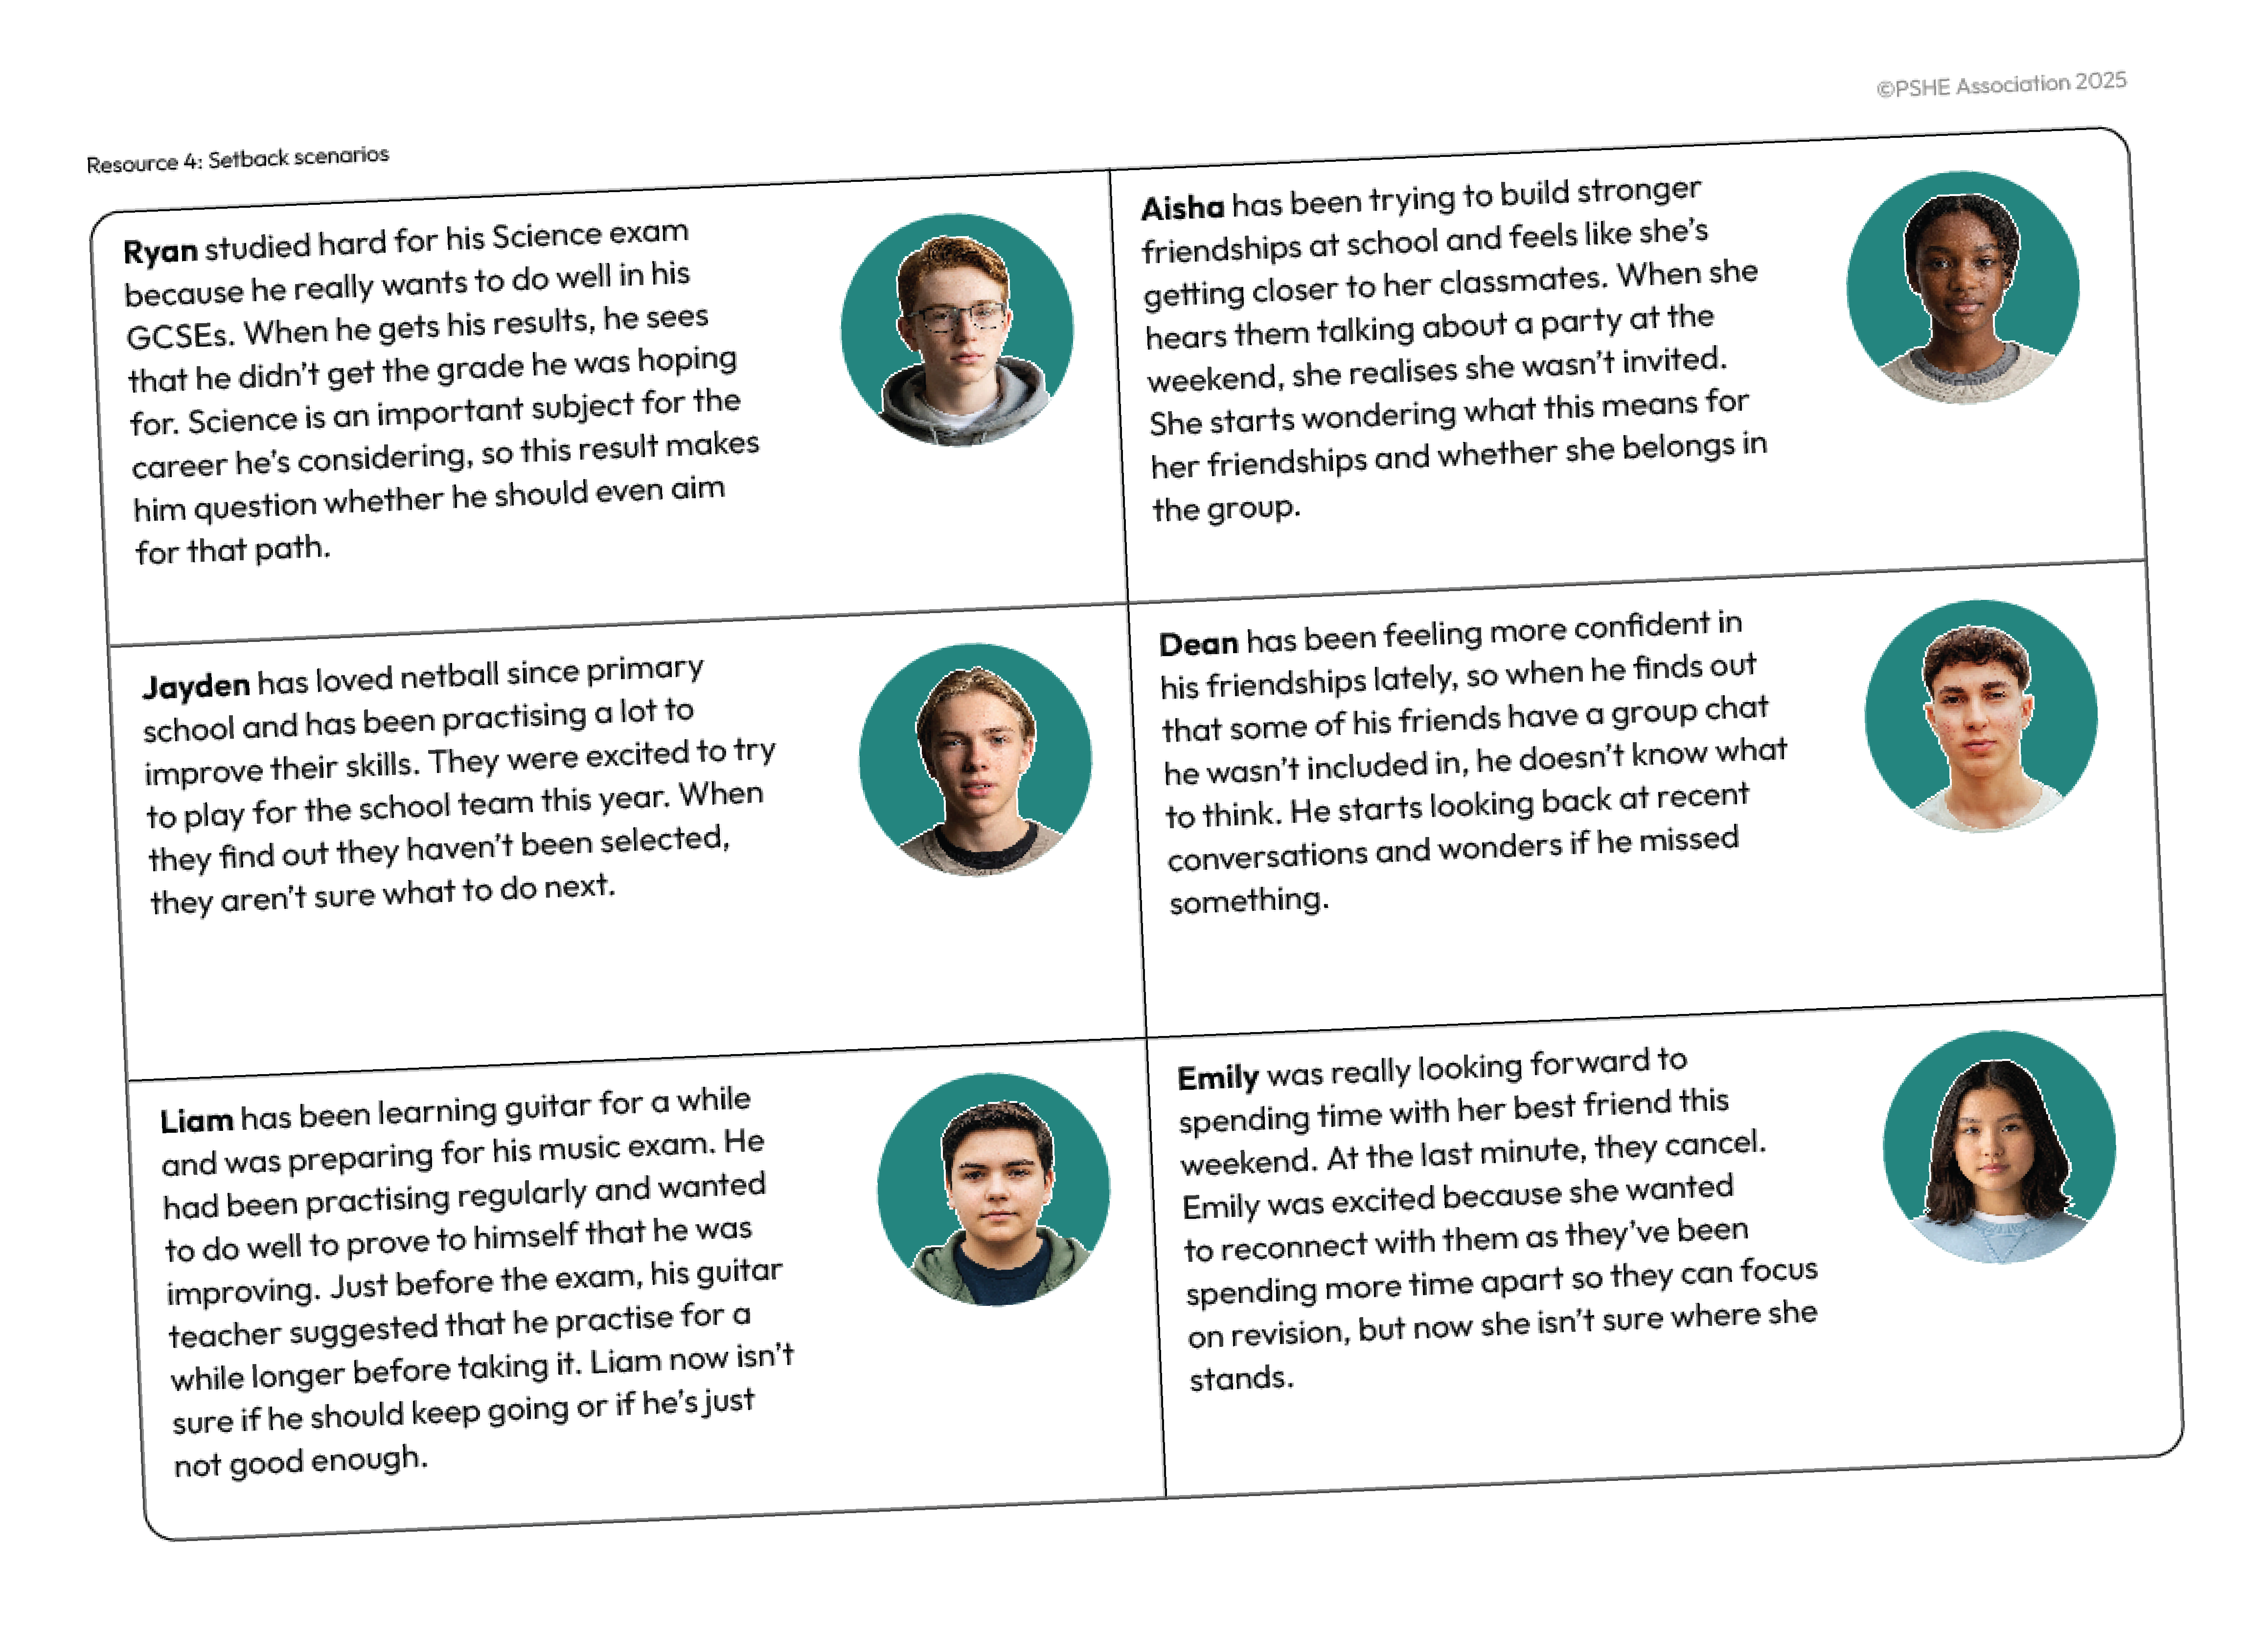


Task 5- Setback heads, hearts, hands
What might the character
be thinking?
How might the character
be feeling?
What could the character do to:
manage their feelings,
learn from the experience,
or reframe the setback?
Notes:
Teacher notes – Setback heads, hearts, hands (10 mins, slides 13-15)
Give small groups one of the six different scenarios from Resource 4: Setback scenarios. In their groups, ask students to answer the questions on the slide.
Support: Print slide 25 for students, which shows a range of emotions someone might experience. Ask students to refer back to their challenge strategies table from Lesson 1 to decide what their character might do.
Challenge: Ask students to suggest multiple strategies their character could use to manage the setback, and rank these from most to least likely to be effective.

Slide 14






Setback heads, hearts, hands
Ryan
Aisha
Jayden
Dean
Liam
Emily
Notes:
Teacher notes – Setback heads, hearts, hands (10 mins, slides 19-21)
Take feedback from each group, ensuring all scenarios are discussed. When discussing specific scenarios it might help to consider:
Ryan (exam setback): Ryan might think his effort wasn’t enough and doubt his ability in Science. He may feel disappointed or frustrated.
Naming emotions and taking a short break can help him manage his feelings, making it easier to think clearly. Reframing his thoughts to focus on progress rather than one result may rebuild confidence and mean that moving forward he is able to identify more specific points for improvement.
Aisha (friendship concerns): Aisha may believe not being invited means her classmates don’t like her. She might feel excluded and upset.
After realising that running the concern over and over in her head is unhelpful, ‘watching’ her thoughts by briefly noticing them and watching them float away (for example, imagining them as passing clouds, or leaves on a stream) can help her let go of unhelpful assumptions and avoid patterns of negative thinking. She can then shift her attention to something else. She might do this by engaging in an enjoyable activity to help her manage emotions, or seeking support from a trusted classmate or teacher may provide reassurance.
Jayden (team disappointment): Jayden might think not making the team means they aren’t good enough, leaving them feeling discouraged or disappointed.
Taking part in other enjoyable activities could help them step back and gain perspective. This space can allow time to reframe the situation, and for Jayden to consider ways they can improve for next year’s trials or try another sport to continue developing their skills.
Dean (group chat exclusion): Dean may wonder if his friends are leaving him out on purpose, making him feel confused, jealous or left out.
Reappraising the situation (e.g. considering the chat might have a specific purpose) can help him to avoid jumping to conclusions. Checking in with a friend could provide reassurance and clarity, helping him feel more secure in his friendships.
Liam (music exam doubts): Liam may feel annoyed or discouraged if his teacher suggests more practice, thinking it means he isn’t good enough. He may feel nervous about the idea of taking the music exam in the future.
Progressive muscle relaxation, or absorbing activities that engage the senses, may help him to regulate emotions and feel calmer. Or he might try enjoyable activities such as through playing an easier piece of music, or playing with a group, for fun. This can make it easier for him to see the extra practice as a way to build confidence rather than a failure.
Emily (friend cancelling plans): Emily might assume her friend cancelling means they don’t want to see her. She may feel annoyed, disappointed or uncertain.
Shifting focus to an alternative activity can help manage her emotions in the moment. If she still feels unsettled, having an open conversation with her friend may clarify the situation and provide reassurance.

Slide 15




Setback heads, hearts, hands
Recognising and reframing negative thinking patterns helps strengthen connections between the prefrontal cortex (PFC) and the amygdala.
This helps the PFC to calm the amygdala more effectively help manage strong emotions.
Over time, this can reduce negativity bias, so someone is less likely to automatically focus on the negative in future situations.
Notes:
Teacher notes – Setback heads, hearts, hands (10 mins, slides 13-15)
Click to animate
Remind students that setbacks are a normal part of life and happen to everyone, even when they try their best. The way someone thinks about a setback can affect how they feel and what they do next. Recognising emotions and using strategies like pausing, breathing, or engaging in an enjoyable activity can help manage difficult feelings before deciding what to do next. Many setbacks are temporary, and learning from them can help someone develop new skills or explore strategies they haven’t tried before.
Repeated negative thoughts can make the amygdala more sensitive over time, causing it to react more strongly to challenges and making it harder to stay calm or think clearly. But regularly using strategies to manage or work through setbacks helps strengthen the connection between the prefrontal cortex (PFC) and the amygdala. This makes it easier for the PFC to calm the amygdala and regulate emotions. Over time, this can reduce negativity bias, so someone is less likely to automatically focus on the negative in future situations.
Remind students that it’s okay if someone doesn’t remember the names or functions of brain areas. What matters is knowing that using healthy strategies to manage setbacks can help the brain respond in ways that support wellbeing and make it easier for someone to take part in activities that matter to them or move towards their goals. Over time, these strategies can help people to recognise and manage uncomfortable emotions, reframe negative thinking patterns that might otherwise hold them back, and see setbacks as opportunities to learn and grow.

Slide 16
What have we learnt?
Revisit your continuums from the start of the lesson
Draw a square on the line to show if your thoughts on each statement have changed or not.
If your answers have changed, explain what influenced this.
If they have stayed the same, explain why.
What one piece of advice would you give to this person?:
Everything always goes wrong when I plan something!
I don’t know what to do, I find it really frustrating.
What can I do to manage disappointments?
Agree
Disagree
Notes:
Teacher notes – Endpoint assessment (10 mins)
Ask students to revisit Attitude Continuum from the baseline assessment. On their own, ask them to draw a square on the line for each statement to show if their views have changed, considering what they have learned in the lesson.
For each statement ask them to respond to the prompts on the slide.
Returning to the quote from the start of the lesson on the slide, ask students to write one key piece of advice they would offer to the person. Encourage them to think about strategies discussed in the lesson and what they have learned about managing setbacks.
This is an opportunity to identify any continuing gaps in students’ understanding that you can plan to address in the following lessons, and assess the progress students have made in this lesson.

Slide 17
End of unit quiz and Personalised learning check
Complete the End of unit quiz on pages 51-53.
Check your score on your baseline and see how much you’ve improved.
Personalised learning check- PLC turn to Page 50 in your booklets and RAG rate the statements for end learning check (Red- I don’t understand this yet, Amber- I partly understand this/need more practice, Green- I can do this confidently) see your progress.
Notes:
Ask students to spend 5 minutes completing the end of unit quiz on pages 51-53 of their booklets and complete the PLC end learning check on page 50.

Slide 18
Signposting Support
If you have any concerns or questions regarding your own mental health, you can always speak to your parent or carer, or a teacher in school for more advice and support.
ChildLine:
www.childline.org.uk Phone: 0800 1111
Young Minds:
www.youngminds.org.uk
Samaritans:
www.samaritans.org Phone: 116 123

Slide 19


Thinking patterns information leaflet
Design a leaflet to help others understand negative thinking patterns and how to challenge them. The leaflet should:
explain what negative thinking patterns are
give examples to show how these thoughts can be reframed into more positive alternatives
highlight how changing thinking patterns can influence actions and wellbeing
Notes:
Teacher notes – Extension activity
Ask students to design a leaflet to help others understand negative thinking patterns and how to challenge them. The leaflet should:
explain what negative thinking patterns are
give examples to show how these thoughts can be reframed into more positive alternatives
highlight how changing thinking patterns can influence actions and wellbeing.

Slide 20












How might someone feel?
Angry
Scared or Worried
Sad
Happy
Disgusted
Surprised
Embarrassed
Loving
Bored
Confused
Overwhelmed
Curious
Excited
Amused
Something else
?
Notes:
Teacher notes – Support
Print or display this slide as a prompt for students requiring support during slide 19: Setback heads, hearts, hands.

