Slide 1
Test 6 Revision
Year 10 core

Slide 2
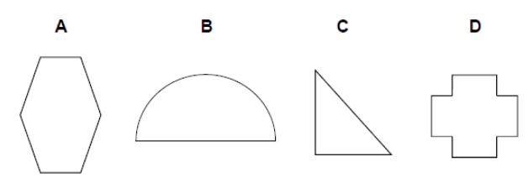
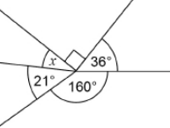
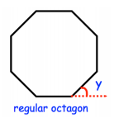
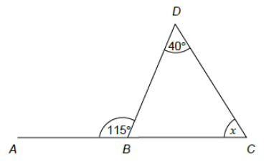
Properties of polygons and constructions Topic 21 | What is the sum of the exterior angles of any polygon? Circle your answer. | The exterior angle of a regular polygon is 30º .How many sides does it have? | Name the polygons
 | Work out the value of x and y. | Work out the value of x. | Calculate the size of each exterior and then each interior angle of a regular octagon.
 | The diagram shows 3 Regular polygons, find the Size of angle y |  | ABC is on a straight line, find the size of angle x
y
x
44

Slide 3
Properties of polygons and constructions Topic 21 | exterior angles sum to 360 | 360 ÷ 30 = 12 sides | A – hexagon B – semi circle C – triangle D - dodecagon
 | X = 44 Y = 92 | 360 – (90 + 36 + 160+ 21) 360 –307 = 53 | Exterior: 360/ 8 = 45 Interior : 180 – 45 = 135
 | Exterior pentagon = 72 Interior pentagon = 108 Y = 360 – (3 x108) Y= 360 – 324 Y= 36
y
x
44
108
108
108
65
X= 180 – (65 + 40)
X = 75

Slide 4
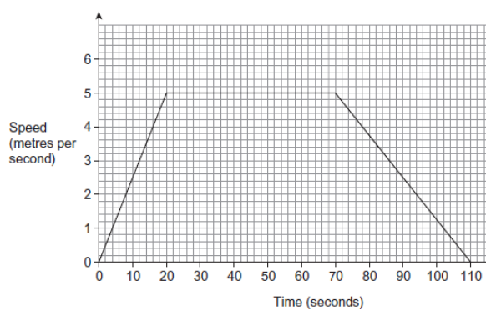
Algebra : Graphs Topic 22 | Complete the table of values for the following function y = $x^{2} −4x+1$ | Factorise and solve x2 - 2x - 8 = 0 Plot this graph and show where the graph crosses the x and y axis. | Complete the table of values for the following function y = 5 – x²
 | a) How fast was the cyclist travelling at 10 seconds. b) For how long did he cycle at 5 Metres per second? | c) Work out the total distance travelled by the cyclist | Sketch me what the graph of the following would look like: Y = x³ Y = $\frac{1}{x}$ Y = 5 – 2x Y = -x² + 2
X | -1 | 0 | 1 | 2 | 3
y |  | 1
X | -1 | 0 | 1 | 2 | 3
y |  |  | 4 |  | - 4

Slide 5
Algebra : Graphs Topic 22 | Complete the table of values for the following function y = $x^{2} −4x+1$ | Factorise and solve x2 - 2x - 8 = 0 (x – 4) (x + 2) = 0 Roots (4 , 0) ( -2, 0) Y intercept (0 , -8) | Complete the table of values for the following function y = 5 – x²
 | a) How fast at 10 seconds. 2.6 m/s b) He travelled at 5m/s for 50 seconds | c) 400m | Sketch me what the graph of the following would look like: Next slide
X | -1 | 0 | 1 | 2 | 3
y | 6 | 1 | -2 | -3 | -2
X | -1 | 0 | 1 | 2 | 3
y | 4 | 5 | 5 | 1 | - 4

Slide 6
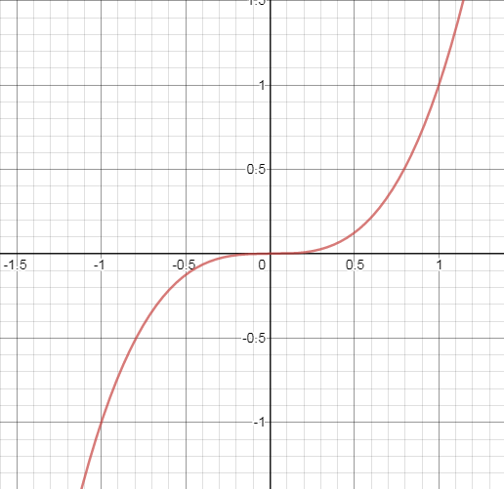
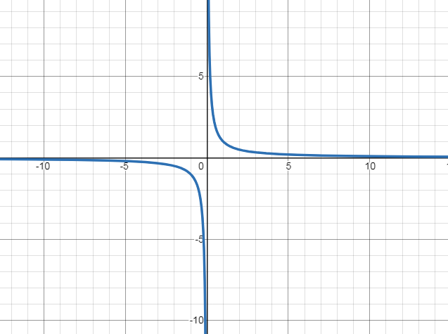
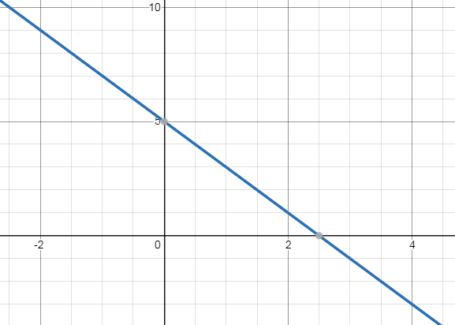
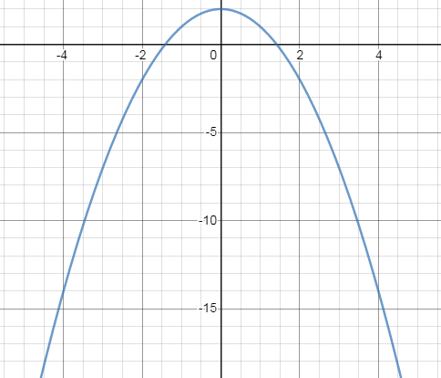
Algebra : Graphs Topic 22 | Y = x³ |  | Y = $\frac{1}{x}$
 | Y = 5 – 2x |  | Y = -x² + 2

Slide 7
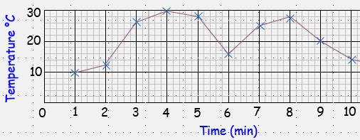
Sampling time series and pie charts Topic 23 | “Do you like crisps? “ What is wrong with this question on a questionnaire? Can you write a better question | John wants to know what people in his workplace think of the canteen, he asks 40 women. why might this not be a good reflection of what the whole workforce think.
 | Finish the table for a pie chart
 | How many minutes in the reaction was the temperature above 20 ºC ? Between which minutes saw the biggest fall in temperature?
Team | Freq | Angle
Liverpool | 10
Everton | 7
other | 6
Manchester city | 13
total
Flavour | Freq | Angle
Salt and V | 20
Cheese and O | 17
other | 23
Total | 72 | 360

Slide 8
Sampling time series and pie charts Topic 23 | “Do you like crisps? “ What is wrong with this question on a questionnaire? No time frame ,very vague Can you write a better question | John wants to know what people in his workplace think of the canteen, he asks 40 women. Only women picked
 | Finish the table for a pie chart
 | How many minutes in the reaction was the temperature above 20 ºC ? Between which minutes saw the biggest fall in temperature? 5minutes Between minutes 5 and 6
Team | Freq | Angle
Liverpool | 10 | 100
Everton | 7 | 70
other | 6 | 60
Manchester city | 13 | 130
total | 36 | 360
Flavour | Freq | Angle
Salt and V | 32 | 160
Cheese and O | 17 | 85
other | 23 | 115
Total | 72 | 360

Slide 9
Topic 24 – simultaneous equations | Think of two numbers that have a product of 12 and a sum of 7 Think of two numbers that have a sum of 19 and a difference of 5 | Solve the simultaneous equations 2x + y = 12 x + y = 7 | Solve the simultaneous equations 3a + b = 30 2a – b = 10
 | 4 cans of pop and 3 chocolate bars cost £5.00 3 cans of pop and 3 chocolate bars cost £4.20 Is £10 enough to buy 7 cans of pop and 7 chocolate bars? |  | Solve the simultaneous equations 3x + 6y = 24 2x + 4y = 16

Slide 10
Topic 24 – simultaneous equations | Think of two numbers that have a product of 12 and a sum of 7 3 and 4 Think of two numbers that have a sum of 19 and a difference of 5 12 and 7 | Solve the simultaneous equations 2x + y = 12 x + y = 7 X = 5 Y = 2 | Solve the simultaneous equations 3a + b = 30 2a – b = 10 A = 8 B = 6
 | 4 cans of pop and 3 chocolate bars cost £5.30 3 cans of pop and 3 chocolate bars cost £4.50 Is £10 enough to buy 7 cans of pop and 6 chocolate bars? Cans = 80p Chocolate bar = 70p 7 cans = 7 x 80p = £5.60 6 chocolate = 6 x 70p = £4.20 Total = £9.80 , yes 20p change |  | Solve the simultaneous equations 3x + 6y = 24 2x + 4y = 16 X = 2 Y= 3

