Slide 1
Test 6 Revision
Year 11 Higher

Slide 2
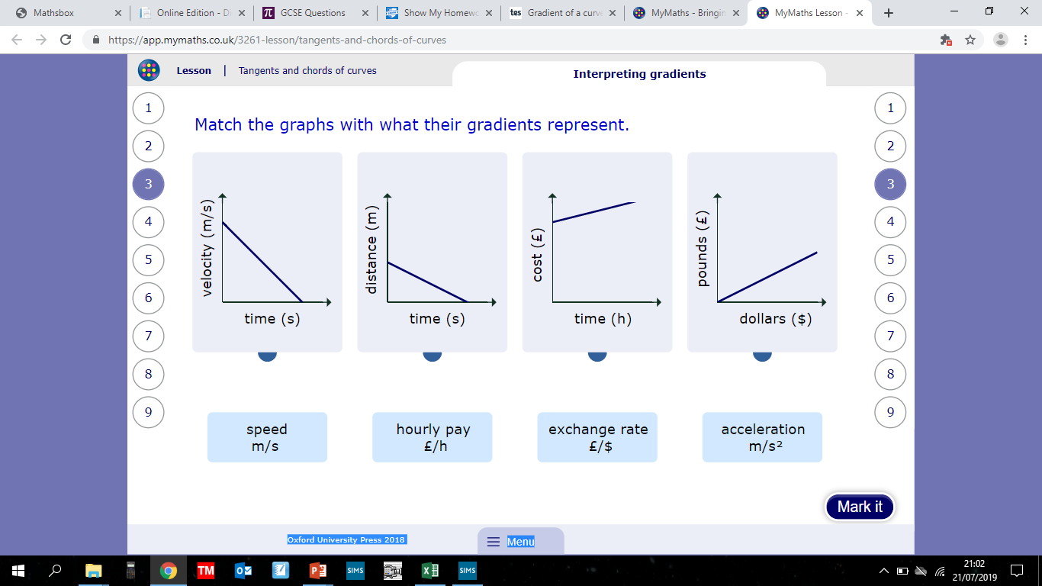
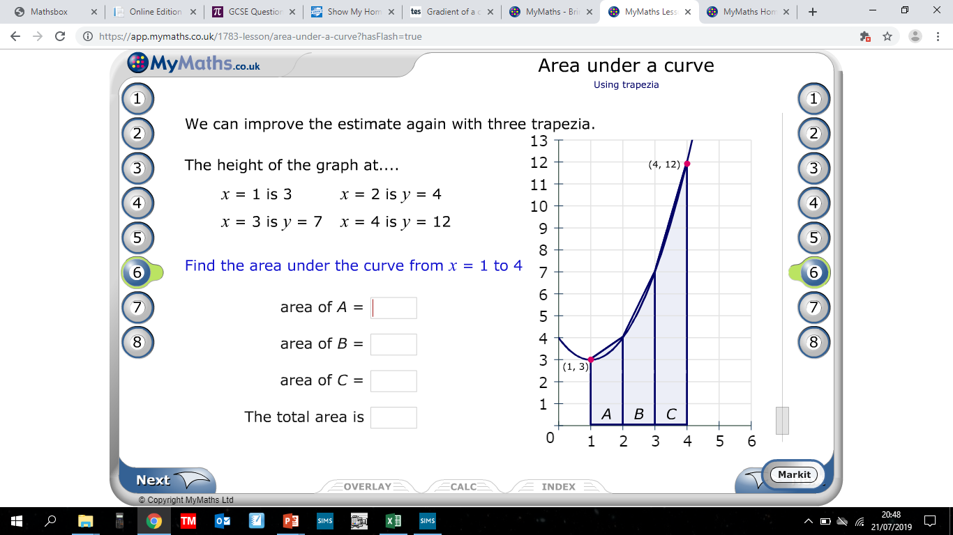
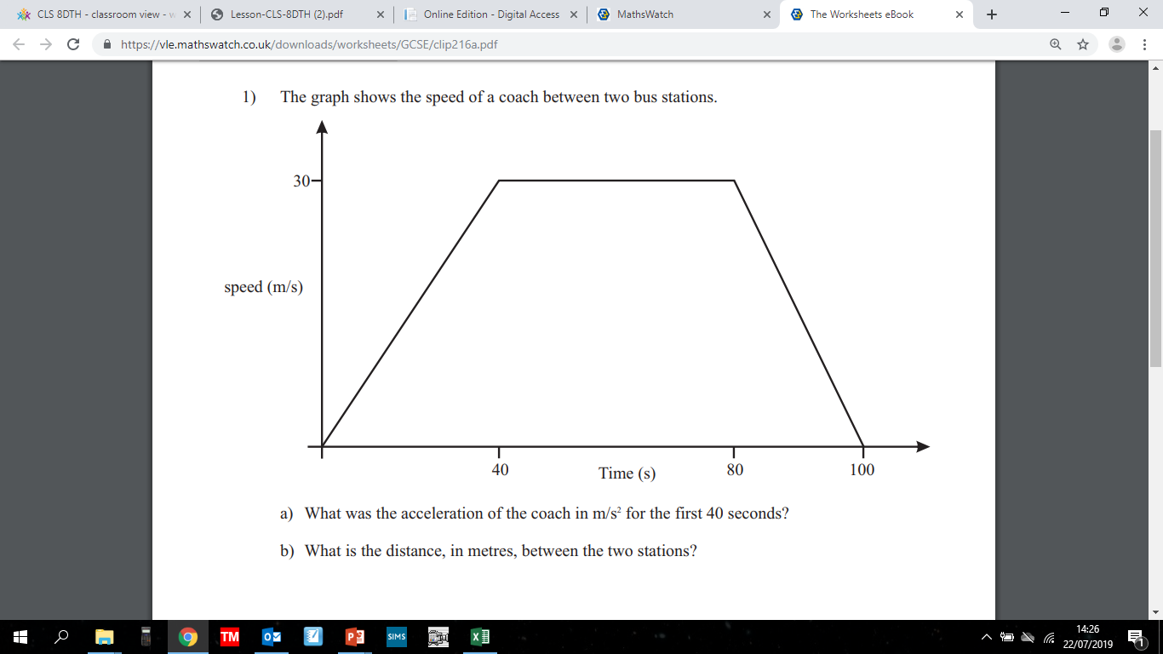
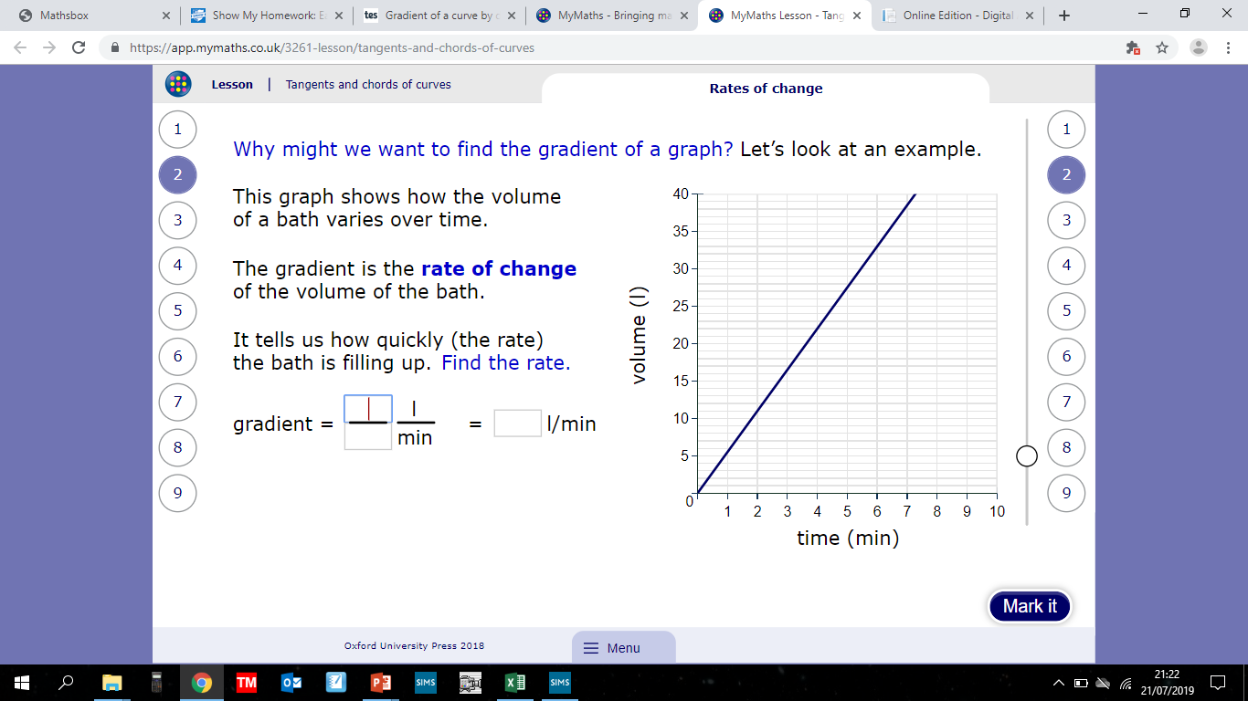
Algebra : Tangents and Area Topic 21
…….

Slide 3


Algebra : Tangents and Area Topic 21
Acceleration m/$s^{2}$
Speed m/s
Hourly pay £/h
Exchange rate £/$
3.5
5.5
9.5
18.5
….. rate of change of volume with time
$$\frac{3}{4}m/s^{2}$$
…….
2100m

Slide 4
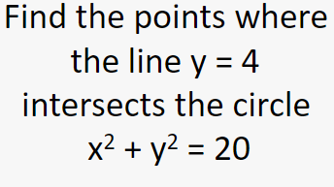
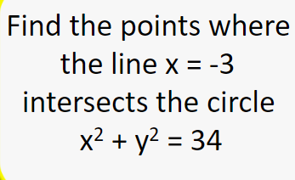

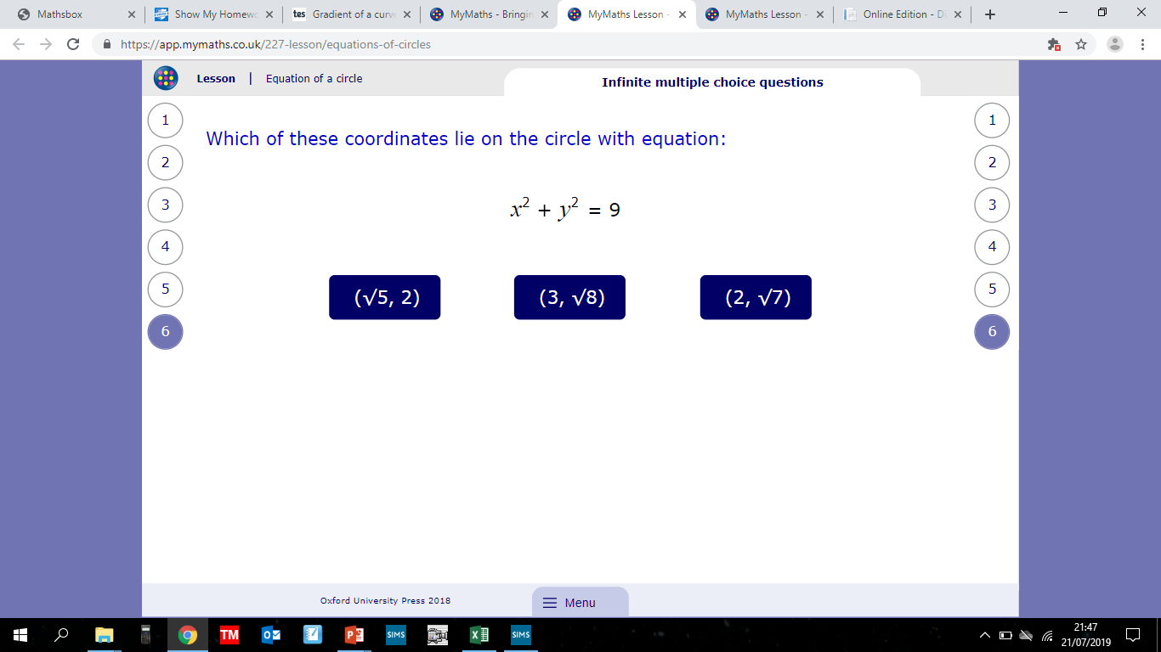
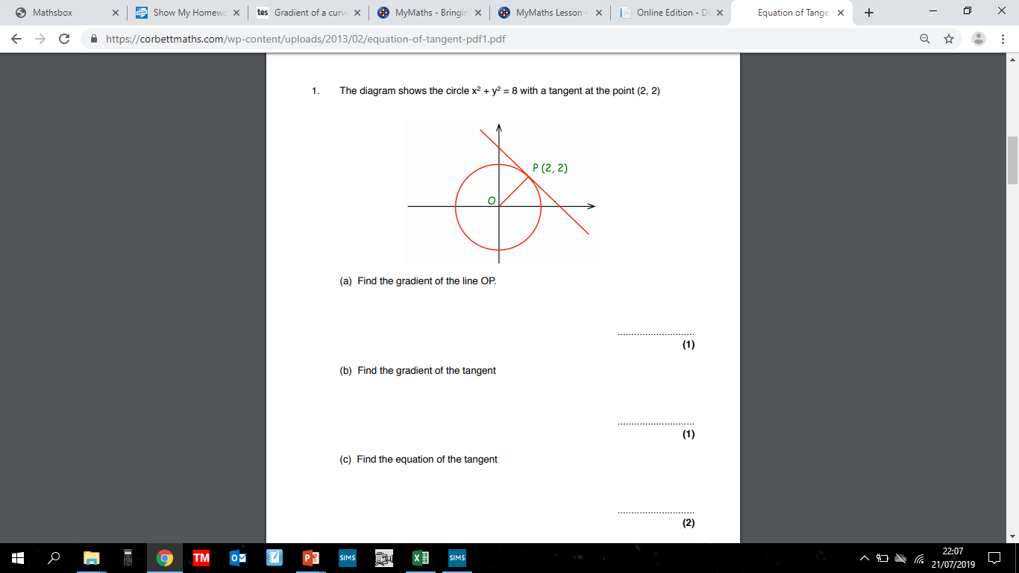
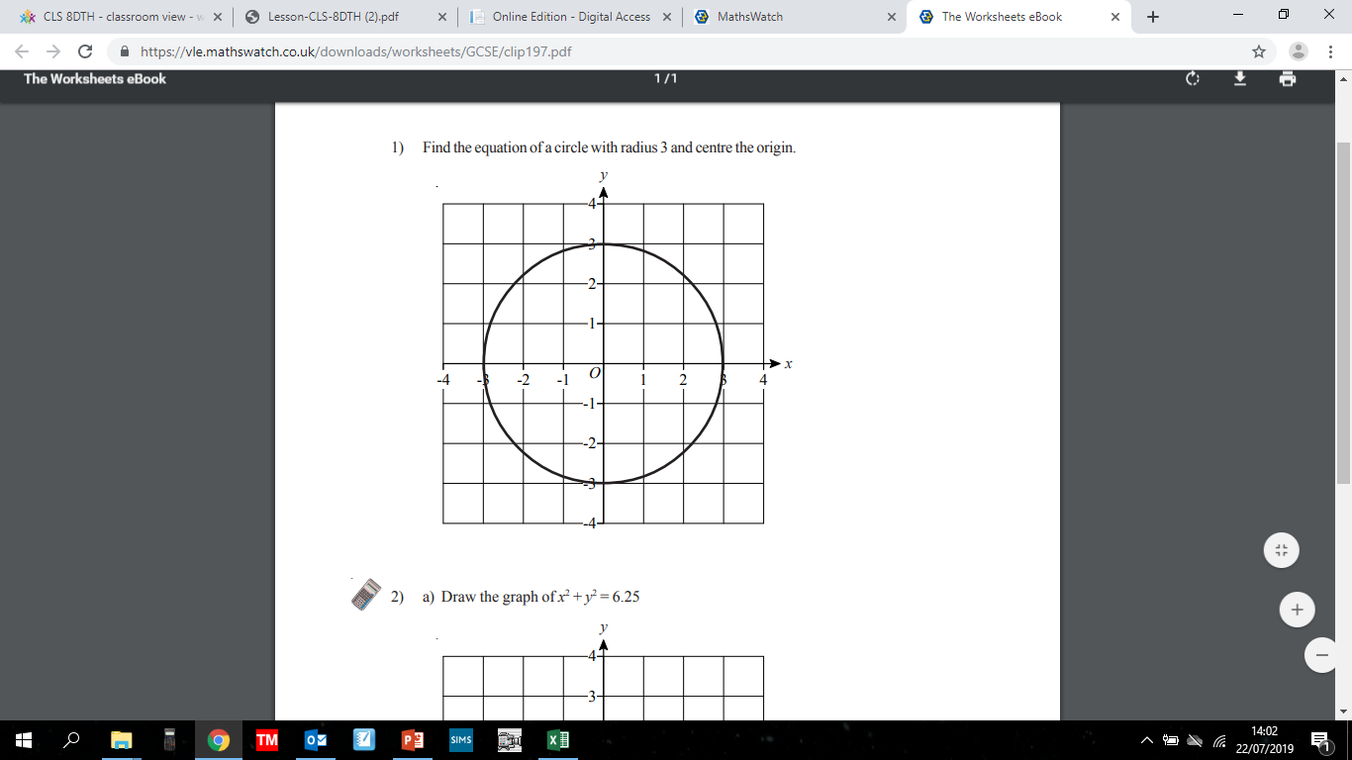
Algebra : Equation of a circle Topic 22

Slide 5


Algebra : Equation of a circle Topic 22
(2,4) and (-2,4)
(-3,5) and (-3,-5)
(-10,-5) and (5,10)
($\sqrt{5}, 2)$
1
-1
$x^{2}+y^{2}=9$
y = -x + 4

Slide 6
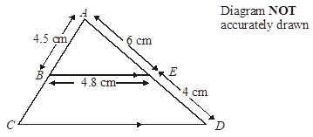
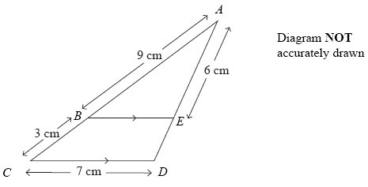
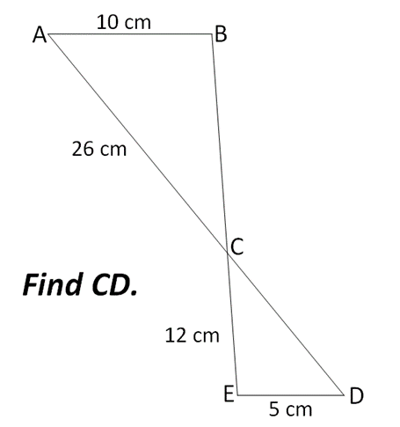
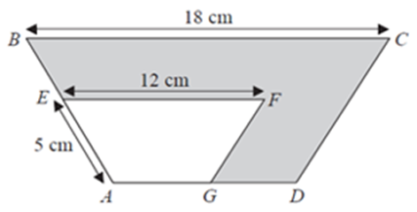
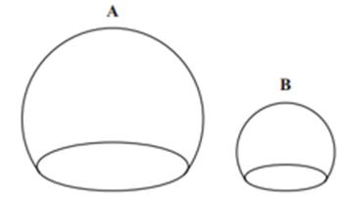
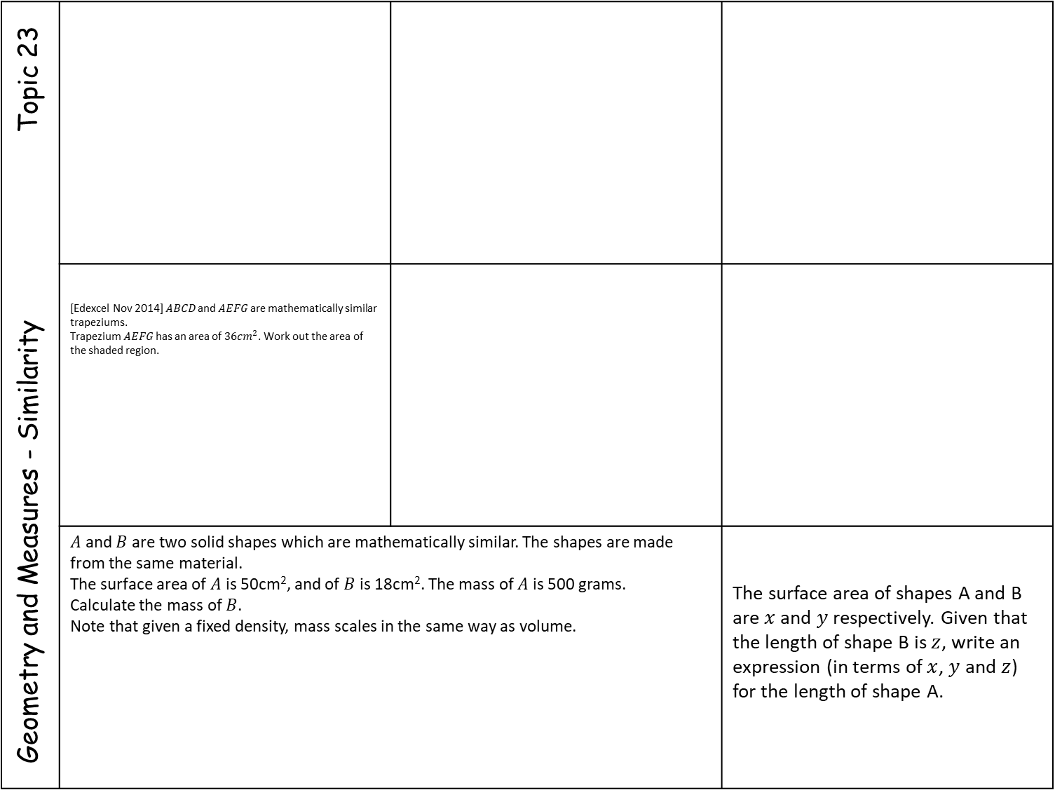
Geometry and Measures - Similarity Topic 23
 | [Edexcel Nov 2014] $ABCD$ and $AEFG$ are mathematically similar trapeziums. Trapezium $AEFG$ has an area of $36cm^{2}$. Work out the area of the shaded region.
 | $A$ and $B$ are two solid shapes which are mathematically similar. The shapes are made from the same material. The surface area of $A$ is 50cm², and of $B$ is 18cm². The mass of $A$ is 500 grams. Calculate the mass of $B$. Note that given a fixed density, mass scales in the same way as volume. |  | The surface area of shapes A and B are $x$ and $y$ respectively. Given that the length of shape B is $z$, write an expression (in terms of $x$, $y$ and $z$) for the length of shape A.
Two cones, P and Q, are mathematically similar.
The total surface area of cone P is 24cm².
The total surface area of cone Q is 96cm².
The height of cone P is 4 cm.
Work out the height of cone Q.
(b) The volume of cone P is 12 cm³. Work out the
volume of cone Q.
What is 42cm² in mm²?

Slide 7




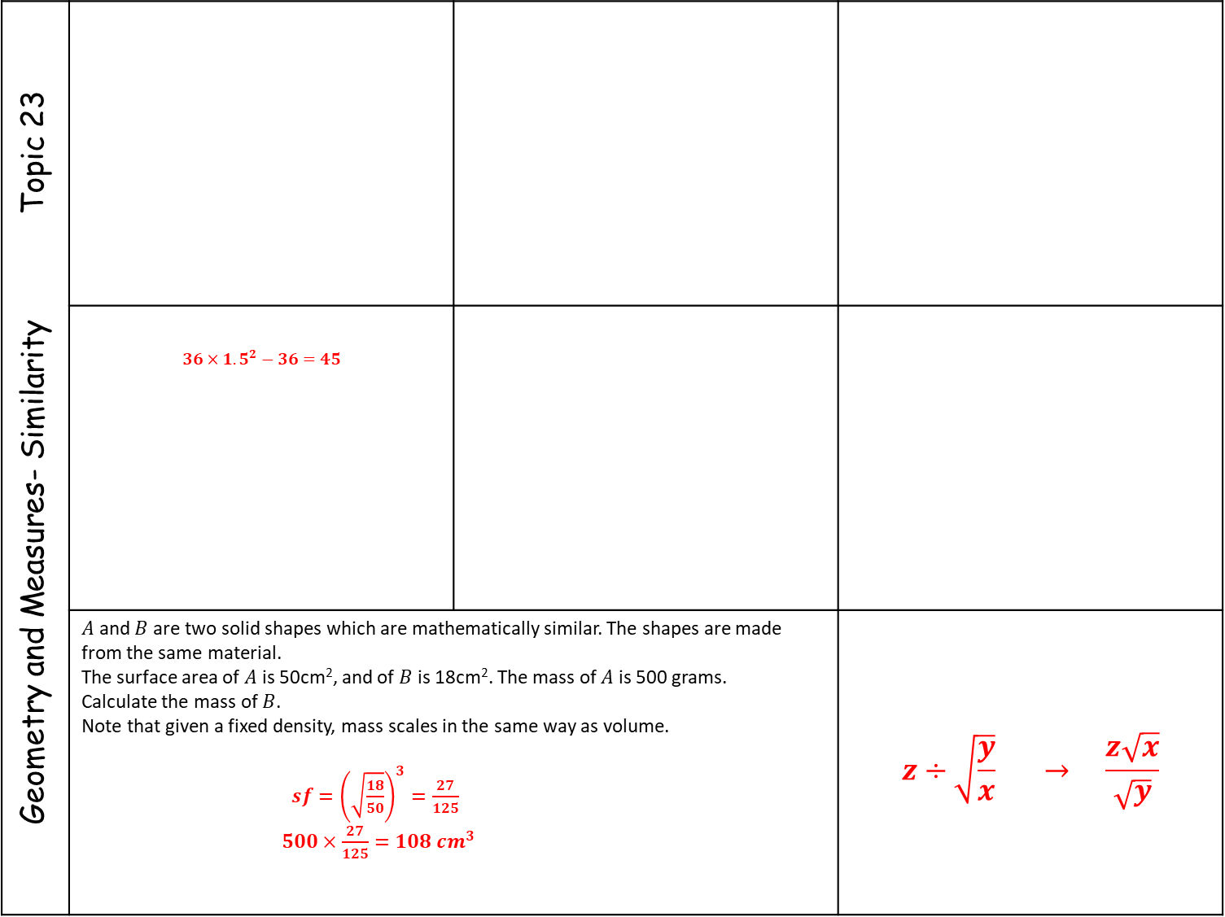


Geometry and Measures- Similarity Topic 23
 | $$36×{1.5}^{2}−36=45$$
 | $A$ and $B$ are two solid shapes which are mathematically similar. The shapes are made from the same material. The surface area of $A$ is 50cm², and of $B$ is 18cm². The mass of $A$ is 500 grams. Calculate the mass of $B$. Note that given a fixed density, mass scales in the same way as volume. $sf={\left(\sqrt{\frac{18}{50}}\right)}^{3}=\frac{27}{125}$ $500×\frac{27}{125}=108 cm^{3}$ |  | $$z÷\sqrt{\frac{y}{x}} → \frac{z\sqrt{x}}{\sqrt{y}}$$
CD = 13 cm
Two cones, P and Q, are mathematically similar.
The total surface area of cone P is 24cm².
The total surface area of cone Q is 96cm².
The height of cone P is 4 cm.
(a) Work out the height of cone Q.
$\sqrt{96÷24}=2$
$4×2=8cm$
(b) The volume of cone P is 12 cm³. Work out the
volume of cone Q.
$12×2^{3}=96cm3$
What is 42cm² in mm²?
$$42{cm}^{2} 4 200 mm^{2}$$

Slide 8
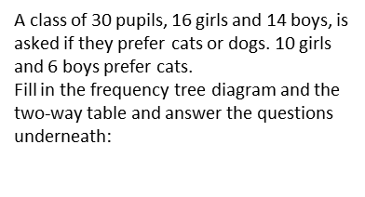
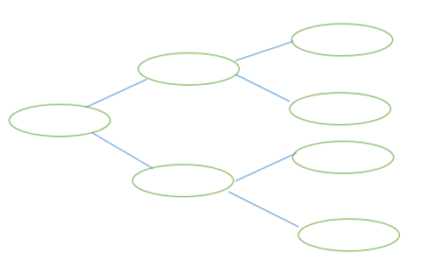
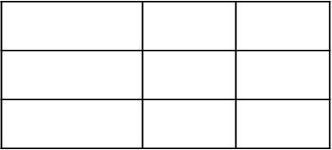
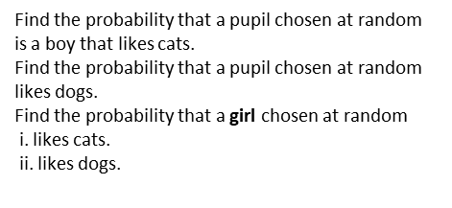
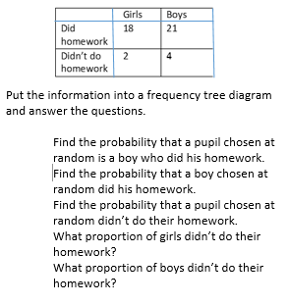
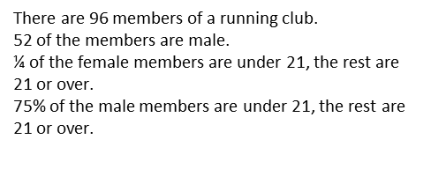
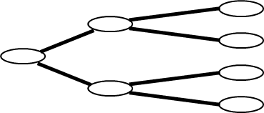
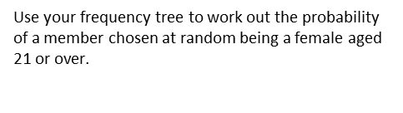
Data – Probability & Sampling Topic 24
 | . There was a population explosion at a rabbit sanctuary. 140 rabbits were caught, marked and returned to the sanctuary. A second sample of 80 rabbits were caught. 28 of these were marked. Estimate the number of rabbits in the sanctuary.

Slide 9
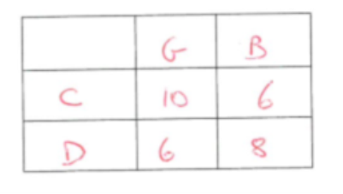

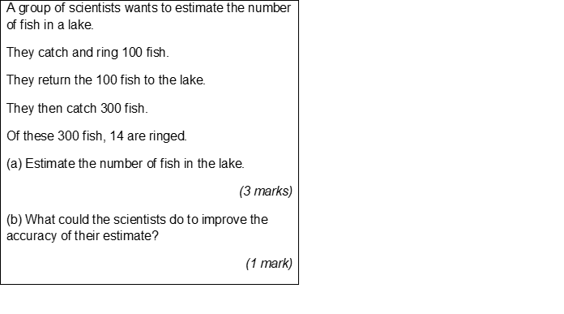
Data – Probability & Sampling Topic 24
 | . There was a population explosion at a rabbit sanctuary. 140 rabbits were caught, marked and returned to the sanctuary. A second sample of 80 rabbits were caught. 28 of these were marked. Estimate the number of rabbits in the sanctuary.
2143
400
Use a larger sample
20,10,20
(10,10),(6,4),(4,16)

