Slide 1




Student Bulletin – Year 11 – Monday 15th September
Please open your More Than Grades Logbooks, ready to fill them in.

Slide 2










10 Key Employability Skills

Slide 3










Science Revision Sessions
Monday - ADN, Science, room to be confirmed
Monday - MAM, Chemistry, C102
Monday 15th September

Slide 4


Tuesday 16th September

Slide 5




Science Revision
Wednesday - FSA, Physics, C007
Wellbeing Ambassadors
There will be a meeting on Wednesdays week A starting from
Wednesday 17th September in k002 3:10-4pm with Mrs Hoyle for year 8-11.
If students wish to continue with their role they must attend the meetings.
Wednesday 17th September

Slide 6

BTEC Creative Media
Catch-up in A130 from 3.15 till 4pm
GCSE RS Revision is on every week after school on Wednesday's from 15:10 - 16:10. The revision sessions will be run by Miss de Freitas (K001) and Mrs Hoyle (K002), alternating weekly.
Wednesday 17th September

Slide 7






Duke of Edinburgh Award
Drop in sessions every Thursday after school in the ACC
Thursday 18th September

Slide 8


Friday 19th September

Slide 9
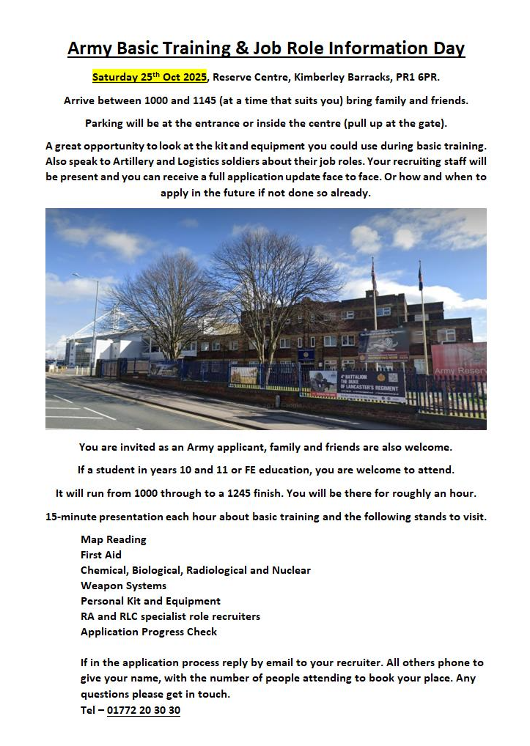
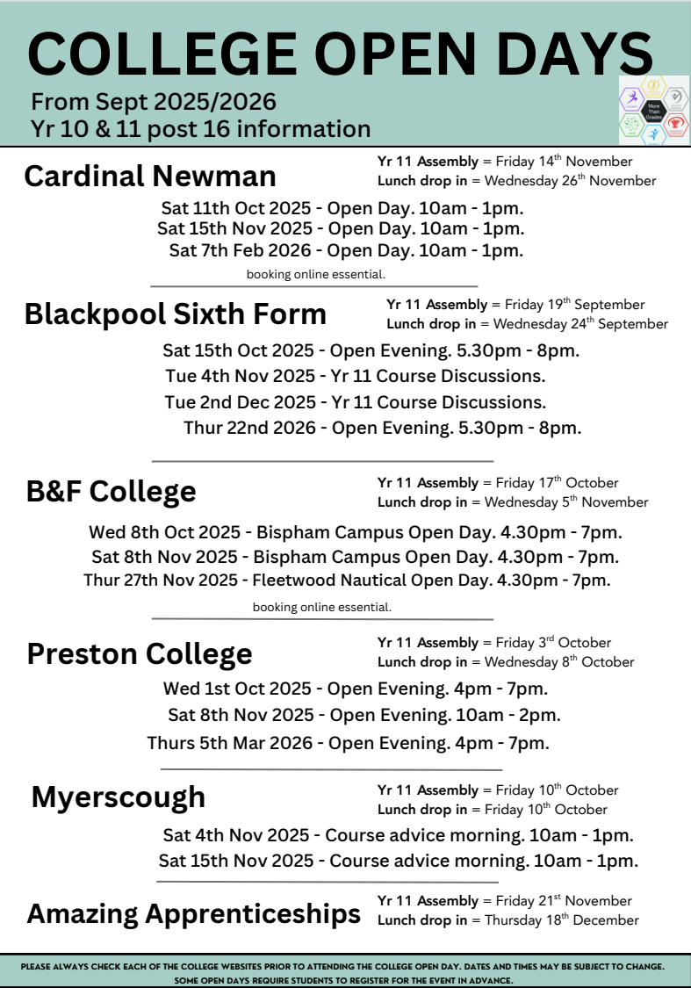

(Starting Wed 24th Sept)
COMING SOON / NOTICES

Slide 10

STEM Careers Support
Explore STEM opportunities at destinationstem.org.uk — mentoring, placements, experiences, and career advice for ages 13–19.
Virtual Careers Fairs: stem.org.uk/secondary/careers/virtual-careers-fairs – explore industry sectors and routes into STEM.
Green Careers: stem.org.uk/secondary/careers/green-careers – resources, videos, and case studies on climate and sustainability careers.
Year 11 NEA1 Catch-Up
Sessions available every Monday, Wednesday & Thursday in W002 until 4pm.
COMING SOON / NOTICES

