Slide 1




Student Bulletin – Year 7 – Monday 15th September
Please open your More Than Grades Logbooks, ready to fill them in.

Slide 2










10 Key Employability Skills

Slide 3










Monday 15th September

Slide 4


Tuesday 16th^{th} September

Slide 5





(Starting Wed 24th Sept)
Wednesday 10th September

Slide 6







Thursday 11th September

Slide 7


Friday 12th September

Slide 8
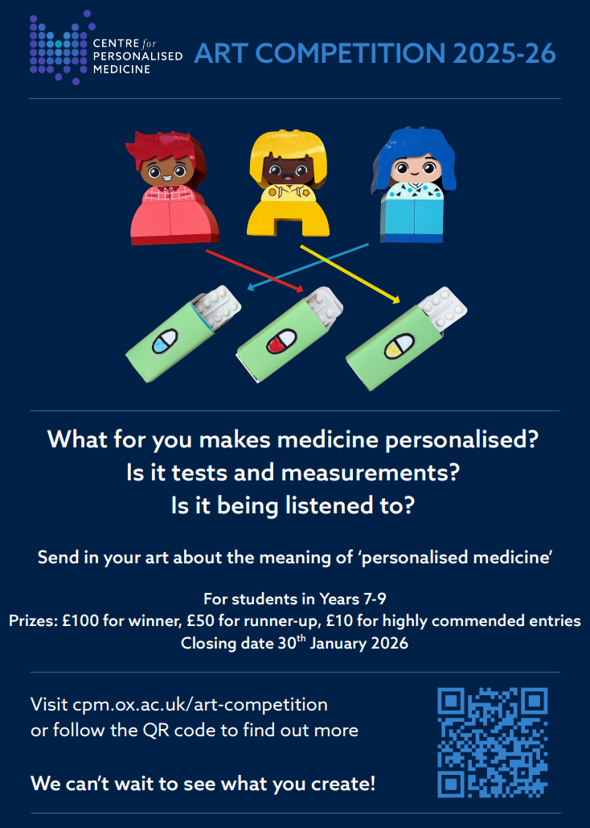
Wellbeing Ambassadors
Would you like to help support student wellbeing at LSA?
To apply, write a short letter to Mrs Hoyle (K002) explaining what you would bring to the team and how you would support others.
Deadline: Monday 22nd September
Successful applicants will join the first meeting on Wednesday 1st October (Week A, K002).
COMING SOON / NOTICES

