Slide 1




Student Bulletin – Year 8 – Monday 15th September
Please open your More Than Grades Logbooks, ready to fill them in.

Slide 2










10 Key Employability Skills

Slide 3










Monday 15th September

Slide 4


Tuesday 16th September

Slide 5





(Starting Wed 24th Sept)
Wednesday 17th September

Slide 6







Thursday 18th September

Slide 7


Friday 19th^{th} September

Slide 8
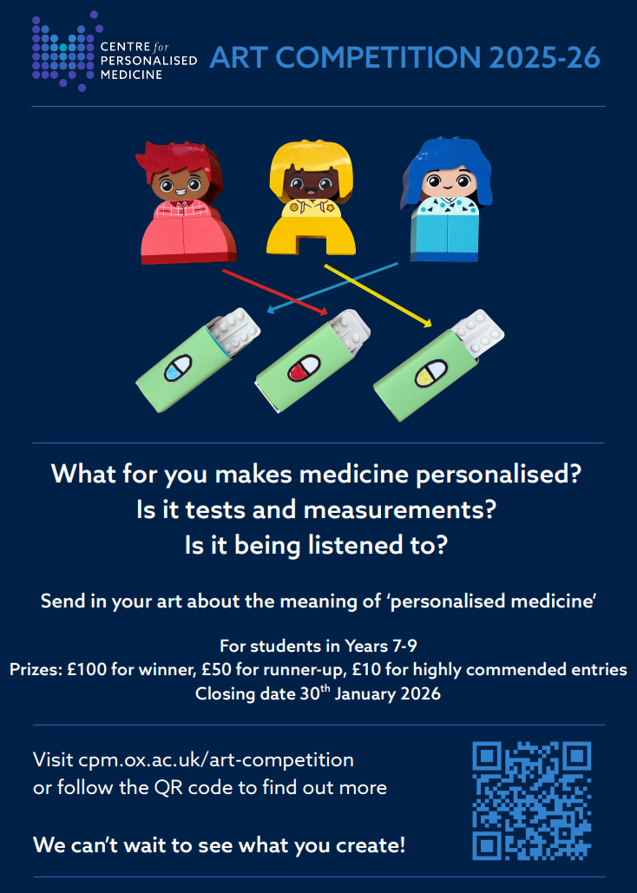
Wellbeing Ambassadors
There will be a meeting on Wednesdays week A starting from
Wednesday 17th September in k002 3:10-4pm with Mrs Hoyle for year 8-11.
If students wish to continue with their role they must attend the meetings.
STEM Careers Support
Explore STEM opportunities at destinationstem.org.uk — mentoring, placements, experiences, and career advice for ages 13–19.
Virtual Careers Fairs: stem.org.uk/secondary/careers/virtual-careers-fairs – explore industry sectors and routes into STEM.
Green Careers: stem.org.uk/secondary/careers/green-careers – resources, videos, and case studies on climate and sustainability careers.
COMING SOON / NOTICES

