Slide 1
Test 2 Revision
Year 8 Enhanced

Slide 2
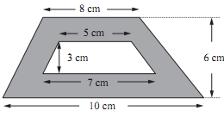

Topic 5 | Find the area: | Find the area: | Find the shaded area.
Topic 5 | Find the circumference Find the area | Find the circumference Find the area | Find the perimeter Find the area
Topic 5 | Find the area. | Find the shaded area. | Find the orange area.
8 cm
6 cm
3 cm
7 cm
6 cm
12 cm
4.5 cm
12 cm
12 cm
8 cm
4 cm
10 cm
7 cm
6 cm

Slide 3
Topic 5 | Find the area:60cm² | Find the area:30cm² | Find the shaded area. 36cm²
Topic 5 | Circumference 37.7 cm b) Find the area 113.1cm² | Circumference 28.3 cm Find the area 63.6cm² | a)Perimeter 38.8cm b)Find the area 56.5cm²
Topic 5 | Find the area. 53.1cm² | Shaded area. 15.7cm² | Orange area. 21.5cm²
8 cm
6 cm
3 cm
7 cm
6 cm
12 cm
4.5 cm
12 cm
12 cm
8 cm
4 cm
10 cm
7 cm
6 cm

Slide 4
Topic 6 | Share £12.50 in the ratio 3 : 2. Share £216 in the ratio 3 : 2 : 4 | Simplify the following ratios. £2.20 : 30p 4 kg : 500 g 1.2 m : 60 cm | Rewrite the following as unitary ratios. 2 : 3 4 : 5 5 : 8
Topic 6 | Map scale 1 : 50 000 How far does 1 cm on the map represent in km? How far would 2 km be in the map? | Soap powder is sold in two sizes: 300g boxes costing £2.40 1000g boxes costing £10.50 Which box gives the better value for money? | Fabric conditioner is in two sizes: 750 ml = £1.80 3 litres = £7.15 Which gives the best value?
Topic 6 | £1 = 1.07 Euros. Change £475 to Euros. Change 250 Euros to £. | A British family are on holiday in America. They order 3 hot dogs and 1 chicken salad. The exchange rate is £1 = $1.44 Work out their total bill in pounds (£).
Menu
Hot dog Chicken salad Hamburger Pizza | $5.10 $4.50 $3.80 $4.00

Slide 5
Topic 6 | Share £12.50 in the ratio 3 : 2. 7.50 : 5 Share £216 in the ratio 3 : 2 : 4 72 : 48 : 96 | Simplify the following ratios. £2.20 : 30p 22 : 3 4 kg : 500 g 8 : 1 1.2 m : 60 cm 2 : 1 | Rewrite the following as unitary ratios. 2 : 3 1 : 1.5 4 : 5 1 : 1.25 5 : 8 1 : 1.6
Topic 6 | Map scale 1 : 50 000 How far does 1 cm on the map represent? 0.5 km How far would 2 km be in the map? 4 cm | Soap powder is sold in two sizes: 300g boxes costing £2.40 100 g £ 80 p 1000g boxes costing £10.50 100g £ 1.05 Which box gives the better value for money? 300g box BEST BUY | Fabric conditioner is in two sizes: 750 ml = £1.80 1500 ml £3.60 3 litres = £7.15 1.5 l = £3.575 Which gives the best value? 3 L BEST BUY
Topic 6 | £1 = 1.07 Euros. Change £475 to Euros. 508.25 Change 250 Euros to £. £ 233.64 | A British family are on holiday in America. They order 3 hot dogs and 1 chicken salad. The exchange rate is £1 = $1.44 £13.75 Work out their total bill in pounds (£).
Menu
Hot dog Chicken salad Hamburger Pizza | $5.10 $4.50 $3.80 $4.00

Slide 6
Topic 7 | 9, 11, 13, 15, … a) Find the n^{th} term for this sequence. b) Find the 30th term for this sequence. c) Which term has a value of 89? | -2, 3, 8, 13, … a) Find the n^{th} term for this sequence. b) Find the 30th term for this sequence. c) Which term has a value of 258? | 40, 37, 34, 31, … a) Find the n^{th} term for this sequence. b) Find the 30th term for this sequence. c) Which term has a value of 8?
Topic 7 | Find the first 4 terms in the sequence using the rule T(n) = 2n + 2.5 2.5, 4.5,6.5,8.5 | Find the first 4 terms in the sequence using the rule T(n) = n² + 1 2,5,10,17 | Show that: (n + 1)(n – 1) + 1 = n²
Topic 7 | The n^{th} term of a sequence is n² + 50 Work out the first three terms of the sequence. | 5, 8, 13, 20, 29, …… Find the rule for the n^{th} term of this quadratic sequence | 5, 9, 15, 23, 33, …… Find the rule for the n^{th} term of this quadratic sequence

Slide 7
Topic 7 | 9, 11, 13, 15, … a) Find the n^{th} term for this sequence. 2n+ 7 b) Find the 30th term for this sequence. 67 c) Which term has a value of 89? 41 | -2, 3, 8, 13, … a) Find the n^{th} term for this sequence. 5n - 7 b) Find the 30th term for this sequence. 143 c) Which term has a value of 258? 53 | 40, 37, 34, 31, … Find the n^{th} term. -3n + 43 b) Find the 30th term for this sequence. -47 c) Which term has a value of 4? 13th
Topic 7 | Find the first 4 terms in the sequence using the rule T(n) = 2n + 2.5 | Find the first 4 terms in the sequence using the rule T(n) = n² + 1 | Show that: (n + 1)(n – 1) + 1 = n² n²+ n – n - 1 + 1 = n²
Topic 7 | The n^{th} term of a sequence is n² + 50 Work out the first three terms of the sequence. 51, 54, 59 | 5, 8, 13, 20, 29, …… Find the rule for the n^{th} term of this quadratic sequence n²+ 4 | 5, 9, 15, 23, 33, …… Find the rule for the n^{th} term of this quadratic sequence n² + n + 1

Slide 8
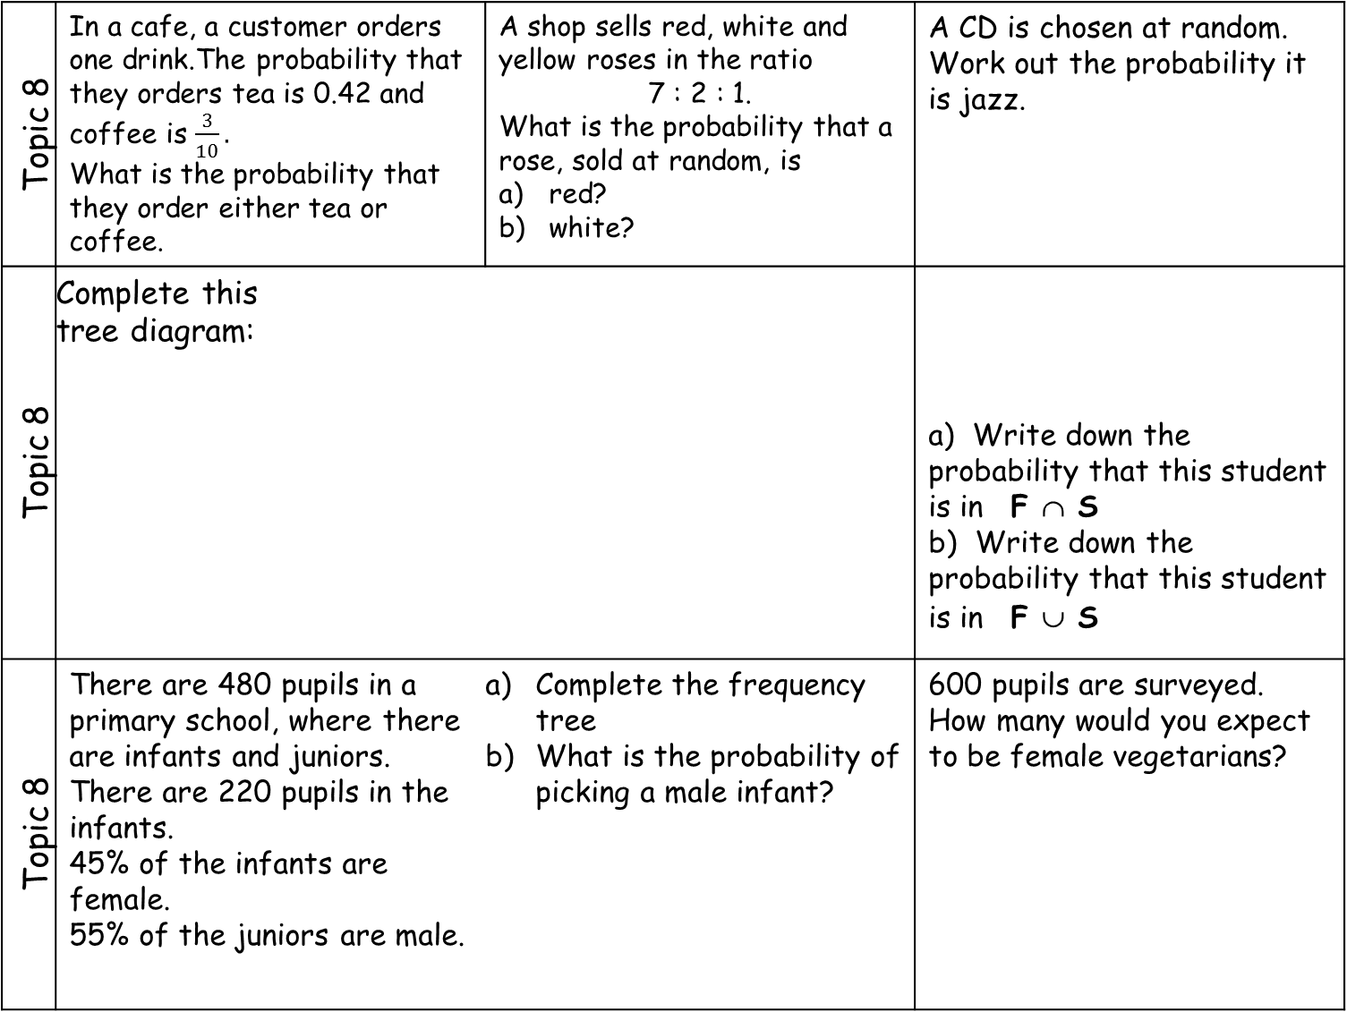
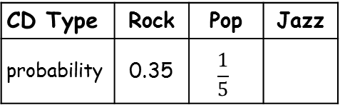
Topic 8 | In a cafe, a customer orders one drink.The probability that they orders tea is 0.42 and coffee is $\frac{3}{10}.$ What is the probability that they order either tea or coffee. | A shop sells red, white and yellow roses in the ratio 7 : 2 : 1. What is the probability that a rose, sold at random, is red? white? | A CD is chosen at random. Work out the probability it is jazz.
Topic 8 | Complete this tree diagram: |  | a) Write down the probability that this student is in F ∩ S b) Write down the probability that this student is in F ∪ S
Topic 8 | There are 480 pupils in a primary school, where there are infants and juniors. There are 220 pupils in the infants. 45% of the infants are female. 55% of the juniors are male. | Complete the frequency tree What is the probability of picking a male infant? | 600 pupils are surveyed. How many would you expect to be female vegetarians?
CD Type | Rock | Pop | Jazz
probability | 0.35 | $$\frac{1}{5}$$
F
S
8
3
5
4
 | Boys | Girls
Vegetarian | 0.05 | 0.2
Non-vegetarian | 0.4 | 0.35

Slide 9

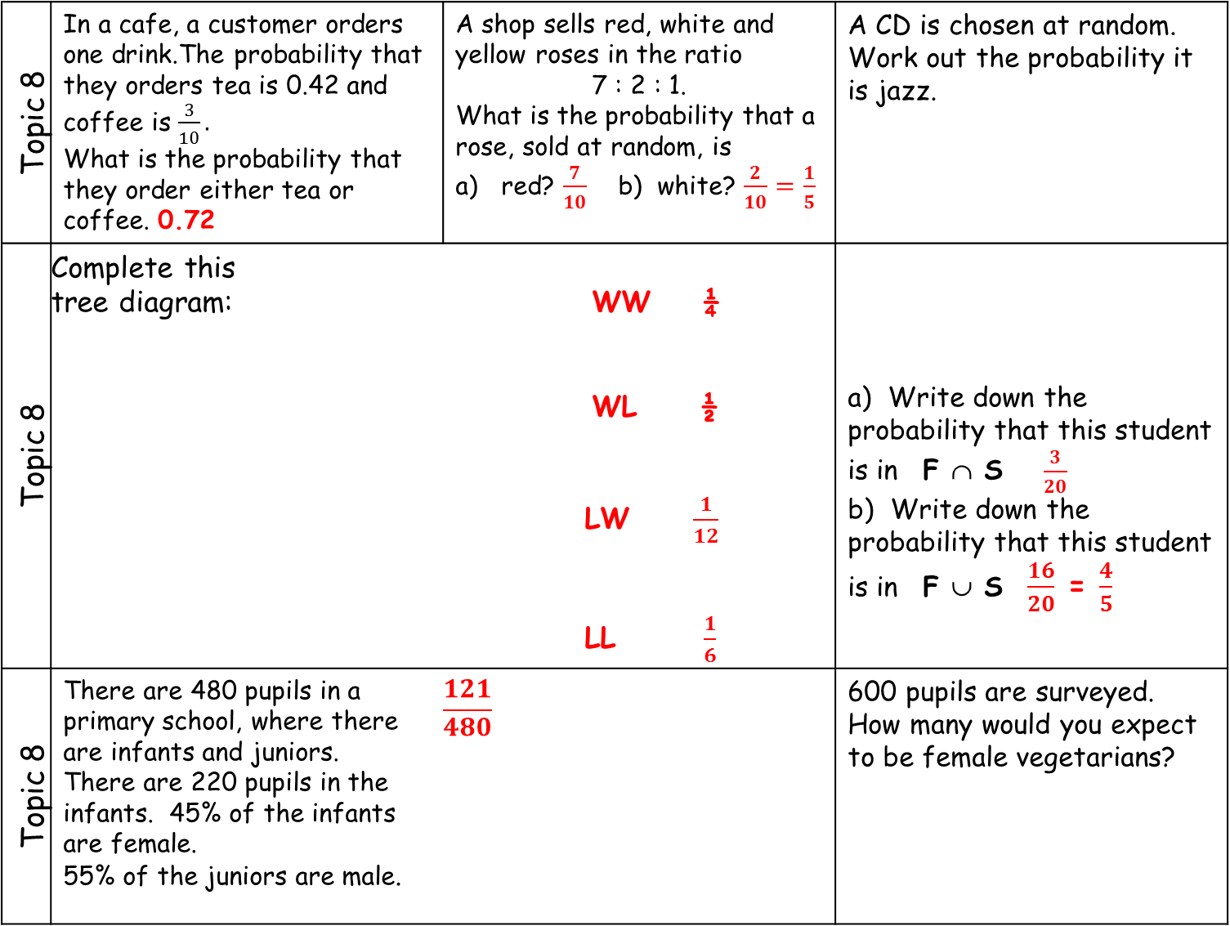


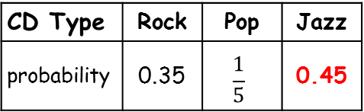

Topic 8 | In a cafe, a customer orders one drink.The probability that they orders tea is 0.42 and coffee is $\frac{3}{10}.$ What is the probability that they order either tea or coffee. 0.72 | A shop sells red, white and yellow roses in the ratio 7 : 2 : 1. What is the probability that a rose, sold at random, is red? $\frac{7}{10}$ b) white? $\frac{2}{10}=\frac{1}{5}$ | A CD is chosen at random. Work out the probability it is jazz.
Topic 8 | Complete this tree diagram: WW ¼ WL ½ LW $\frac{1}{12}$ LL $\frac{1}{6}$ |  | a) Write down the probability that this student is in F ∩ S $\frac{3}{20}$ b) Write down the probability that this student is in F ∪ S $\frac{16}{20}$ = $\frac{4}{5}$
Topic 8 | There are 480 pupils in a primary school, where there are infants and juniors. There are 220 pupils in the infants. 45% of the infants are female. 55% of the juniors are male. | $$\frac{121}{480}$$ | 600 pupils are surveyed. How many would you expect to be female vegetarians?
CD Type | Rock | Pop | Jazz
probability | 0.35 | $$\frac{1}{5}$$ | 0.45
F
S
8
3
5
4
$$\frac{2}{3}$$
$$\frac{1}{3}$$
$$\frac{1}{4}$$
$$\frac{2}{3}$$
female
99
220
infants
male
121
480
120 | Boys | Girls
Vegetarian | 0.05 | 0.2
Non-vegetarian | 0.4 | 0.35
juniors
female
117
260
male
143

