Slide 1
Test 1 Revision
Year 8 Foundation

Slide 2
Topic 1 | Use the correct sign < > 5.8 6.3 -3 0.45 0.41 | Complete the addition pyramid | Work out: 5 – 7 -3 + 4 -2 + 6 -9 - 3 2 - 10
Topic 1 | Put the following numbers into ascending order: 0.5 , 1.6, 0.8, 0.2, 0.6 b) 0.21 , 0.2, 0.35, 0.27 | Put the following numbers into ascending order: 2, -7, -1 , 5, -4 -8, 0, 3, -10, -2 | Write the correct sign
Topic 1 |  | What is the difference in temperatures? | The temperature in Moscow falls by 11 degrees. What is the new temperature?
-8 |  |  |  | 5 |  | -2
-7 + 5 |  | 4 - 5
9 - 4 |  | -3 + 8
-8 - 2 |  | 5 - 9
 |  | +4 |  |  | +4 |  |  | +4
 |  |  |  |  |  | 1
Town | Temperature
Blackpool | 2°C
Moscow | -9°C

Slide 3
Topic 1 | Use the correct sign < > 5.8 < 6.3 2 > -3 0.45 > 0.41 | Complete the addition pyramid | Work out: 5 – 7 = -2 -3 + 4 = 1 -2 + 6 = 4 -9 – 3 = -12 2 – 10 = -8
Topic 1 | Put the following numbers into ascending order: 0.5 , 1.6, 0.8, 0.2, 0.6 0.2 0.5 0.6 0.8 1.6 b) 0.21 , 0.2, 0.35, 0.27 0.2 0.21 0.27 0.35 | Put the following numbers into ascending order: 2, -7, -1 , 5, -4 -7 -4 -1 2 5 -8, 0, 3, -10, -2 -10 -8 -2 0 3 | Write the correct sign
Topic 1 |  | What is the difference in temperatures? 11° | The temperature in Moscow falls by 11 degrees. What is the new temperature? -20°
0
-8 |  |  |  | 5 |  | -2
-3
3
-7 + 5 | < | 4 - 5
9 - 4 | = | -3 + 8
-8 - 2 | < | 5 - 9
 |  | +4 |  |  | +4 |  |  | +4
-7 |  |  | -3 |  |  | 1 |  |  | 5
Town | Temperature
Blackpool | 2°C
Moscow | -9°C

Slide 4
Topic 2 | Simplify r + r + r 2t + 4t + 8t 5d - 7d | Simplify 2 x a 3b x 6 c x c | Simplify 3r + 2r - r 5t - 2t + 4t 2d - 4d + d
Topic 2 | Write expressions for: 4 more than x 3 less than x 5 lots of x x multiplied by itself | a = 3 b = 5 Find: a + b 4a 2a + b | a = 6 b = -2 Find: b + a 4b a²
Topic 2 | George has g sweets. Alfie has 8 more sweets than George. Jess has four times as many sweets as George. | George has g sweets. Bobby has 2 less sweets than George. Chloe has half as many sweets than George. | George has g sweets. Jacob has twice as many sweets as George. Grace has 5 less sweets than George

Slide 5
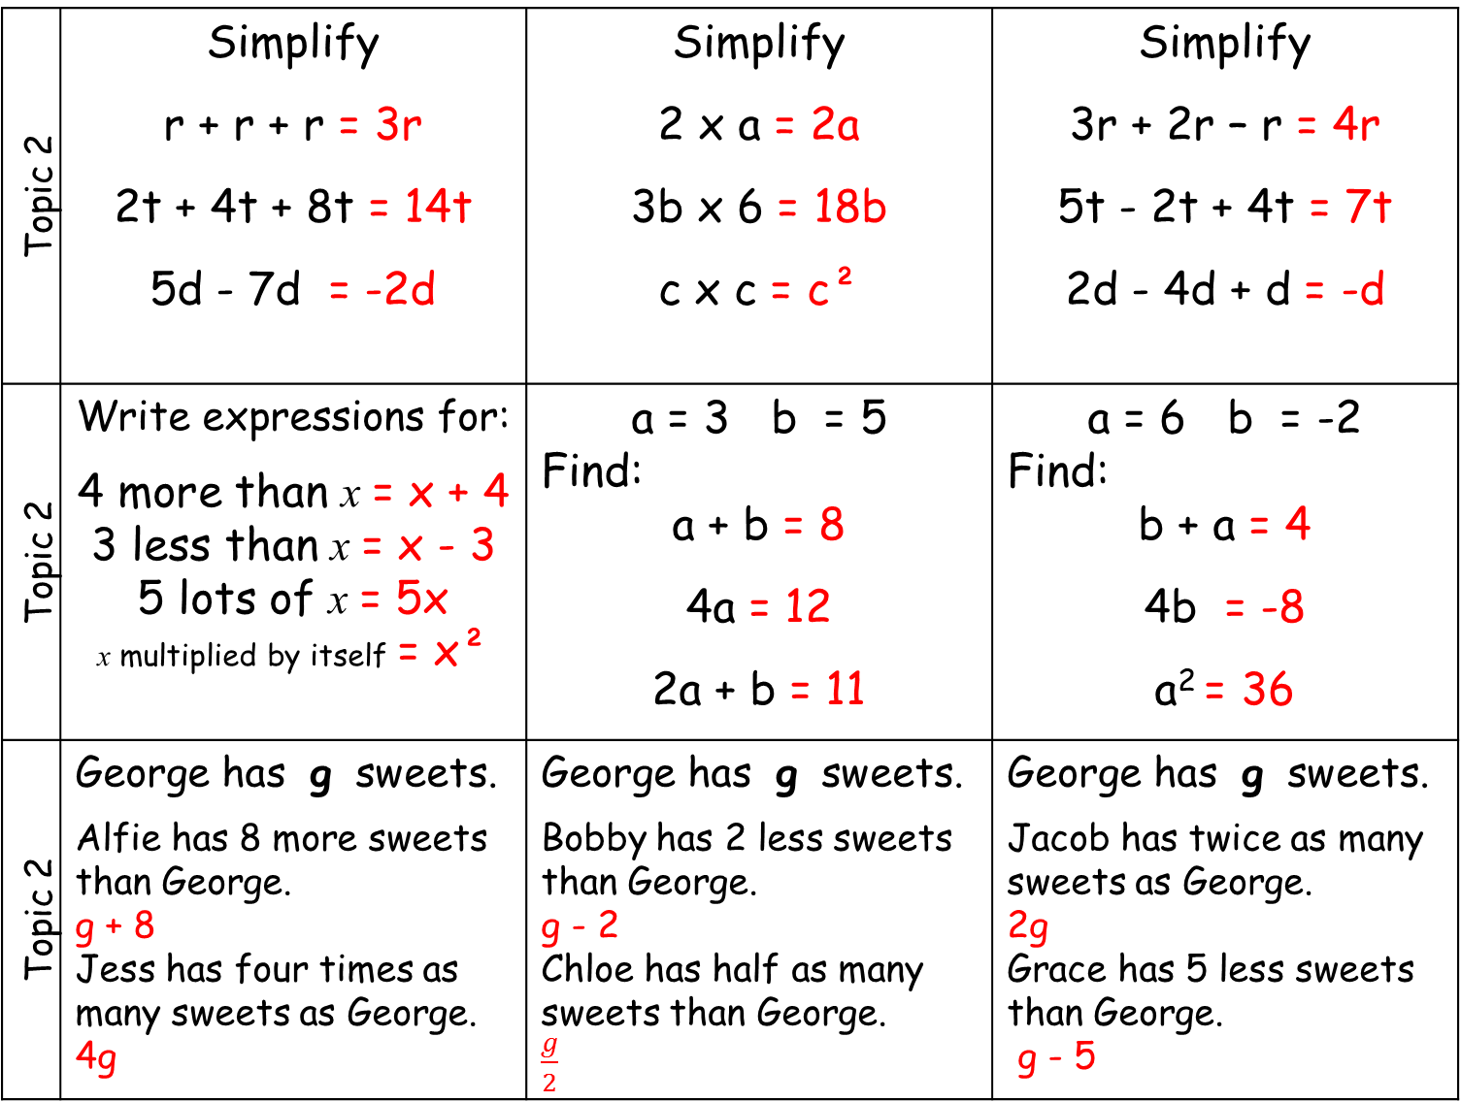
Topic 2 | Simplify r + r + r = 3r 2t + 4t + 8t = 14t 5d - 7d = -2d | Simplify 2 x a = 2a 3b x 6 = 18b c x c = c² | Simplify 3r + 2r – r = 4r 5t - 2t + 4t = 7t 2d - 4d + d = -d
Topic 2 | Write expressions for: 4 more than x = x + 4 3 less than x = x - 3 5 lots of x = 5x x multiplied by itself = x² | a = 3 b = 5 Find: a + b = 8 4a = 12 2a + b = 11 | a = 6 b = -2 Find: b + a = 4 4b = -8 a² = 36
Topic 2 | George has g sweets. Alfie has 8 more sweets than George. g + 8 Jess has four times as many sweets as George. 4g | George has g sweets. Bobby has 2 less sweets than George. g - 2 Chloe has half as many sweets than George. $\frac{g}{2}$ | George has g sweets. Jacob has twice as many sweets as George. 2g Grace has 5 less sweets than George. g - 5

Slide 6
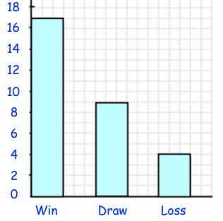
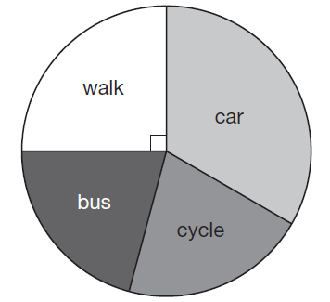
Topic 3 | Find the mode of these numbers: 4, 7, 8, 3, 8, 6, 7, 5 | Find the median of these numbers: 4, 6, 6, 3, 4, 9, 2 | Find the mean of: 4, 6, 11, 5, 9
Topic 3 | What is the mode? | What is the mode? | Find the mode.
Topic 3 | The range of two numbers is 6. What could the two numbers be? ……… ……… | Three number have a range of 6 and a median of 5. What could the numbers be? ……… ……… ……… | Find three numbers with a mean of 5. ……… ……… ………
Age | Frequency
4 | 8
5 | 6
6 | 6
7 | 5

Slide 7
Topic 3 | Find the mode of these numbers: 4, 7, 8, 3, 8, 6, 7, 5 Mode = 7 and 8 | Find the median of these numbers: 4, 6, 6, 3, 4, 9, 2 2, 3, 4, 4, 6, 6, 9 Median = 4 | Find the mean of: 4, 6, 11, 5, 9 Total = 35 Mean = 35 ÷ 5 = 7
Topic 3 | What is the mode? | What is the mode? | Find the mode.
Topic 3 | The range of two numbers is 6. What could the two numbers be? ……… → + 6 → ……… | Three number have a range of 6 and a median of 5. What could the numbers be? ……… 5 ……… + 6 | Find three numbers with a mean of 5. Total = 5 + 5 + 5 = 15 ……… ……… ………
Mode = win
Mode = car
Age | Frequency
4 | 8
5 | 6
6 | 6
7 | 5
Mode = 4

Slide 8
Topic 4 | List the first 5 multiples of 3. | List the first 5 multiples of 6. List the first 5 multiples of 9. What is the LCM of 6 and 9. | Calculate 3 + 4 x 5 18 - 12 ÷ 3
Topic 4 | List all of the factors of 20. | List all the factors of 12. List all the factors of 16. What is the HCF of 12 and 16. | Calculate (4 + 2)² 15 ÷ 5 + 2 x 8
Topic 4 | 1, 2, 3, 4, 5, 6, 7, 8 Which of these numbers are: Even Prime Square | Write 28 as a product of its prime factors. | Write 100 as a product of its prime factors.

Slide 9
Topic 4 | List the first 5 multiples of 3. 3 6 9 12 15 | List the first 5 multiples of 6. 6 12 18 24 30 List the first 5 multiples of 9. 9 18 27 36 45 What is the LCM of 6 and 9. 18 | Calculate 3 + 4 x 5 = 3 + 20 = 23 18 - 12 ÷ 3 = 18 - 4 = 14
Topic 4 | List all of the factors of 20. 1, 20, 2, 10, 4, 5 | a) List all the factors of 12. 1, 12, 2 6, 3, 4 List all the factors of 16. 1, 16, 2, 8, 4 What is the HCF of 12 and 16. 4 | Calculate (4 + 2)² = 6² = 36 15 ÷ 5 + 2 x 8 = 5 + 16 = 21
Topic 4 | 1, 2, 3, 4, 5, 6, 7, 8 Which of these numbers are: Even: 2, 4, 6, 8 Prime 2, 3, 5, 7 Square 1, 4 | Write 28 as a product of its prime factors. 28 = 2 x 2 x 7 | Write 100 as a product of its prime factors. 100 = 2 x 2 x 5 x 5

