Slide 1
Test 2 Revision
Year 8 FOUNDATION

Slide 2
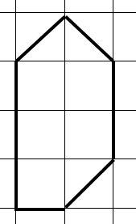
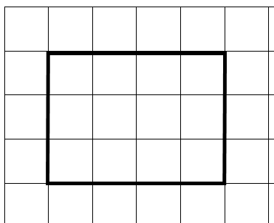
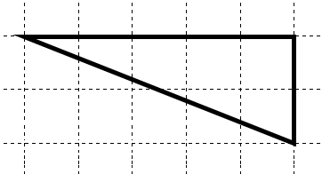
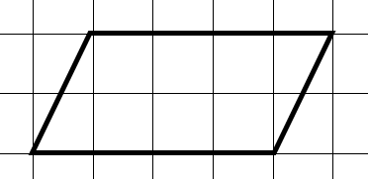
Topic 5 | Complete the following: 3 cm = ……… mm 4.15 m = ……… cm 2.5 km = ……… m | What is the perimeter? | What is the area?
Topic 5 | What is the area? | What is the area? | What is the area?
Topic 5 | What is the height? | What is the area? | What is the area?
Area = 24 cm²
6 cm
5 cm
9 cm
8 cm
8 cm
7 cm
10 cm

Slide 3
Topic 5 | Complete the following: 3 cm = 30 mm 4.15 m = 415 cm 2.5 km = 2500 m | What is the perimeter? 10 cm | What is the area? 6 ½ cm
Topic 5 | What is the area? 12 cm² | What is the area? 8 cm² | What is the area? 5 cm²
Topic 5 | What is the height? 3 cm | What is the area? 35 cm² | What is the area? 40 cm²
Area = 24 cm²
6 cm
9 cm
5 cm
8 cm
8 cm
7 cm
10 cm

Slide 4
Topic 6 | What is the ratio of triangles to squares? | What is the ratio of grey to white squares? | Simplify these ratios 6 : 10 25 : 10 9 : 12
Topic 6 | Miss Gilroy’s form has 12 girls and 8 boys. What is the ratio of girls : boys? | These ratios are equivalent. Find the missing values 2 : 3 10 : …… …… : 24 | There are 300 pupils in year 8. There are 130 boys. What is the ratio of boys : girls?
Topic 6 | 5 bars of chocolate cost £2.00. How much does 1 bar cost? | 3 footballs cost £24.00. How much will 4 footballs cost? | 6 text books cost £150. How much will 5 text books cost?

Slide 5
Topic 6 | What is the ratio of triangles to squares? 6 : 4 3 : 2 | What is the ratio of grey to white squares? 4 : 8 1 : 2 | Simplify these ratios 6 : 10 3 : 5 25 : 10 5 : 2 9 : 12 3 : 4
Topic 6 | Miss Gilroy’s form has 12 girls and 8 boys. What is the ratio of girls : boys? 12 : 8 3 : 2 | These ratios are equivalent. Find the missing values 2 : 3 10 : 15 16 : 24 | There are 300 pupils in year 8. There are 130 boys. What is the ratio of boys : girls? 130 : 170 13 : 17
Topic 6 | 5 bars of chocolate cost £2.00. How much does 1 bar cost? 40p | 3 footballs cost £24.00. How much will 4 footballs cost? £8 x 4 = £32 | 6 text books cost £150. How much will 5 text books cost? £25 x 5 = £125

Slide 6
Topic 7 | Complete the sequence What is the rule? 12, 15, 18, 21, …… , …… 27, 32, 37, 42, …… , …… | Complete the sequence What is the rule? 45, 41, 37, 33, …… , …… 51, 45, 39, 33, …… , …… | Complete the sequence What is the rule? 6.5, 8, 9.5, …… , …… 2.4, 2.8, 3.2, …… , ……
Topic 7 | Complete the sequence What is the rule? 2, 4, 8, 16, …… , …… 400, 200, 100, …… , …… | Complete the sequence What is the rule? 5, 50, 500, …… , …… 40, 4, 0.4, …… , …… | Complete the sequence What is the rule? …… , 19, ……, 25, ……, 31 …… , 10, ……, 6, ……, 2
Topic 7 | Find the next 3 numbers. 10, ………, ……… , ……… | Find the next 3 numbers. 5 , ………, ……… , ……… | Find the next 3 numbers. - 13, ………, ……… , ………
start | rule
10 | + 8
start | rule
5 | - 4
start | rule
-13 | + 3

Slide 7
Topic 7 | Complete the sequence What is the rule? 12, 15, 18, 21, 24 , 27 + 3 27, 32, 37, 42, 47 , 52 + 5 | Complete the sequence What is the rule? 45, 41, 37, 33, 29 , 25 - 4 51, 45, 39, 33, 27 , 21 - 6 | Complete the sequence What is the rule? 6.5, 8, 9.5, 11 , 12.5 + 1.5 2.4, 2.8, 3.2, 3.6 , 4.0 + 0.4
Topic 7 | Complete the sequence What is the rule? 2, 4, 8, 16, 32 , 64 X 2 400, 200, 100, 50 , 25 ÷ 2 | Complete the sequence What is the rule? 5, 50, 500, 5000 , 50000 X 10 40, 4, 0.4, 0.04 , 0.004 ÷ 10 | Complete the sequence What is the rule? 16 , 19, 22, 25, 28, 31 + 3 12 , 10, 8 , 6, 4, 2 - 2
Topic 7 | Find the next 3 numbers. 10, 18, 26 , 34 | Find the next 3 numbers. 5 , 1, -3 , -7 | Find the next 3 numbers. - 13, -10 , -7 , -4
start | rule
10 | + 8
start | rule
5 | - 4
start | rule
-13 | + 3

Slide 8
Topic 8 | A dice is thrown. What is the probability of: getting a 6 getting an odd number getting a 7 |  | A pupil is picked at random. What is the probability of picking: a) Someone with a pet cat and a pet dog. b) Someone with no pet cat or pet dog.
Topic 8 | Which letter represents: P(4) P(8) P(2) P(even)
Topic 8 | What is the probability of picking: A girl from Newton? A boy from King? A person from Newton? |  | A box of crisps has: 2 salt + vinegar 1 ready salted 5 cheese + onion What is the probability of picking a packet of salt + vinegar?
Cat
Dog
8
3
5
4
A
B
C
D
E
2
4
2
2
1
0
1
4
6
2
 | Newton | King | Total
Boys | 6 | 4 | 10
Girls | 8 | 2 | 10
Total | 14 | 6 | 20

Slide 9
Topic 8 | A dice is thrown. What is the probability of: getting a 6 $\frac{1}{6}$ getting an odd number $\frac{1}{2}$ getting a 7 0 |  | A pupil is picked at random. What is the probability of picking: Someone with a pet cat and a pet dog. $\frac{3}{20}$ b) Someone with no pet cat or pet dog. $\frac{4}{20}$
Topic 8 | Which letter represents: P(4) = B P(8) = A P(2) = C P(even) = E
Topic 8 | What is the probability of picking: A girl from Newton? $$\frac{8}{20}=\frac{2}{5}$$ b) A boy from King? $$\frac{4}{20}=\frac{1}{5}$$ A person from Newton? $$\frac{14}{20}=\frac{7}{10}$$ |  | A box of crisps has: 2 salt + vinegar 1 ready salted 5 cheese + onion What is the probability of picking a packet of salt + vinegar? $\frac{2}{8}=\frac{1}{4}$
Cat
Dog
8
3
5
4
A
B
C
D
E
2
4
2
2
1
0
1
4
6
2
 | Newton | King | Total
Boys | 6 | 4 | 10
Girls | 8 | 2 | 10
Total | 14 | 6 | 20

