Slide 1
Test 1 Revision
Year 7 ENHANCED

Slide 2
Topic 1 | Use the correct sign < > 5.8 6.3 -3 0.45 0.41 | Complete the addition pyramid | Work out: 5 - -7 -3 + - 4 -2 - + 6 -9 - - 3 2 + - 10
Topic 1 | The temperature in Moscow falls by 11 degrees. What is the new temperature? | What is the difference in temperatures? | Write the correct sign
-8 |  |  |  | 5 |  | -2
Town | Temperature
Blackpool | 2°C
Moscow | -9°C
-7 + 5 |  | 4 - 5
9 - 4 |  | -3 + 8
-8 - 2 |  | 5 - 9

Slide 3
Topic 1 | Use the correct sign < > 5.8 < 6.3 2 > -3 0.45 > 0.41 | Complete the addition pyramid | Work out: 5 - -7 = 12 -3 + - 4 =- 7 -2 - + 6 = -8 -9 - - 3 = -6 2 + - 10 = -8
Topic 1 | The temperature in Moscow falls by 11 degrees. What is the new temperature? -20° | What is the difference in temperatures? 11° | Write the correct sign
0
-8 |  |  |  | 5 |  | -2
-3
3
Town | Temperature
Blackpool | 2°C
Moscow | -9°C
-7 + 5 | < | 4 - 5
9 - 4 | = | -3 + 8
-8 - 2 | < | 5 - 9

Slide 4
Topic 2 | Simplify 2 x 9a 3b x 6 x b -4c x 5c x -3c | Simplify 3r + 2r - r 7t + 5g – 2g - 4t 5y - 2d - 4d – 6y | Write expressions for: 4 more than x 3 less than x 5 lots of x x multiplied by itself
Topic 2 | George has g sweets. Bobby has 2 less sweets than George. Chloe has half as many sweets than George. | a = 6 b = -2 Find: 5a - b 4b + 7 3a² | Expand 5x(2x + 7) 8y(4 – 3y) 7e(2e + 5 – 2f)
Topic 2 | Expand and simplify 4r + 5(r – 8) 6g(3g + 1) – 8g 3(4d + 2) + 6(8d – 3)

Slide 5
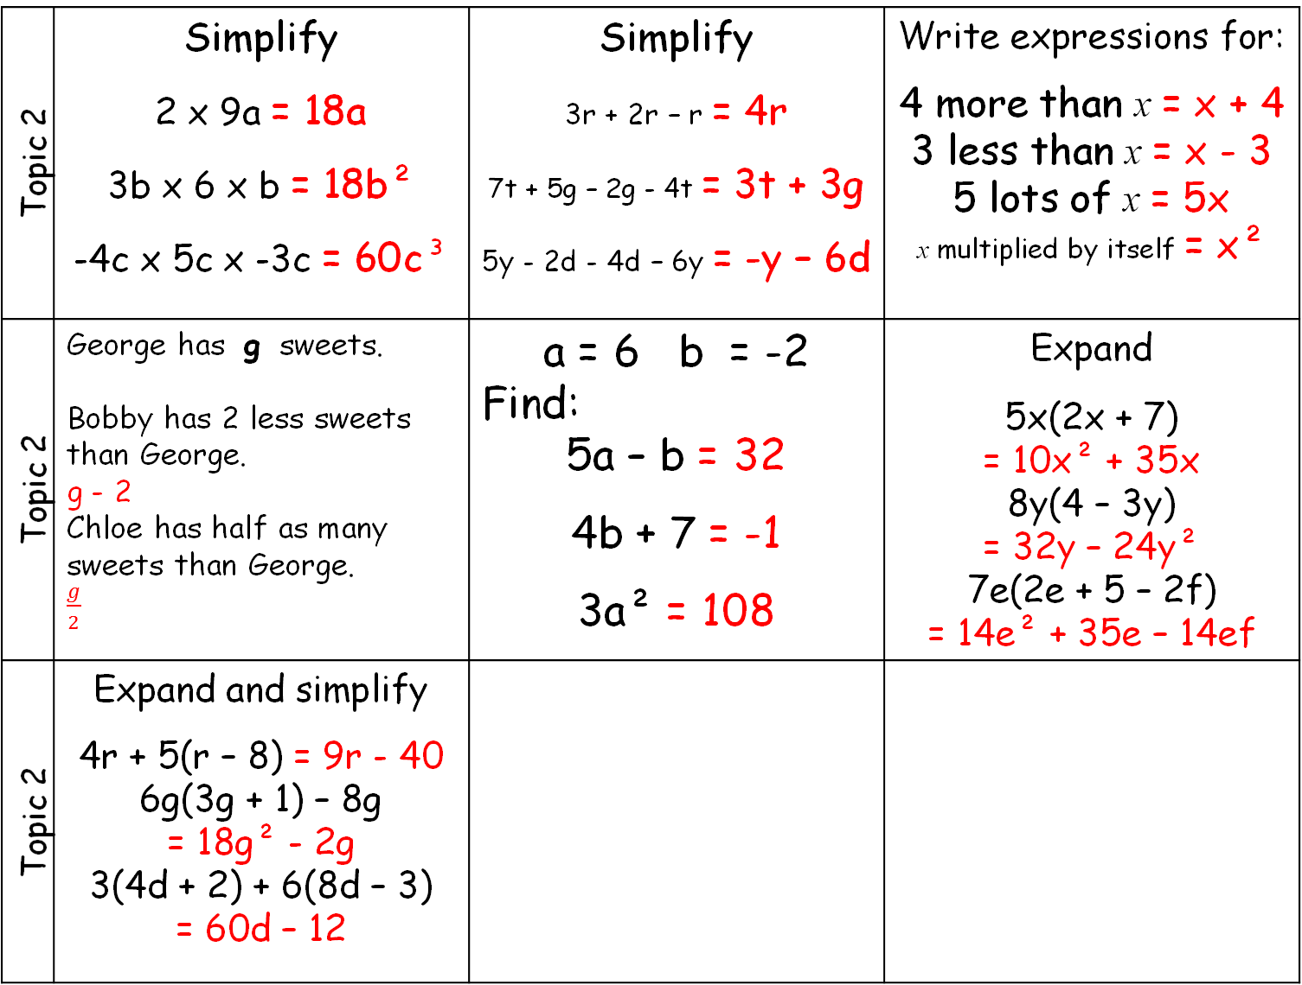
Topic 2 | Simplify 2 x 9a = 18a 3b x 6 x b = 18b² -4c x 5c x -3c = 60c³ | Simplify 3r + 2r – r = 4r 7t + 5g – 2g - 4t = 3t + 3g 5y - 2d - 4d – 6y = -y – 6d | Write expressions for: 4 more than x = x + 4 3 less than x = x - 3 5 lots of x = 5x x multiplied by itself = x²
Topic 2 | George has g sweets. Bobby has 2 less sweets than George. g - 2 Chloe has half as many sweets than George. $\frac{g}{2}$ | a = 6 b = -2 Find: 5a – b = 32 4b + 7 = -1 3a² = 108 | Expand 5x(2x + 7) = 10x² + 35x 8y(4 – 3y) = 32y – 24y² 7e(2e + 5 – 2f) = 14e² + 35e – 14ef
Topic 2 | Expand and simplify 4r + 5(r – 8) = 9r - 40 6g(3g + 1) – 8g = 18g² - 2g 3(4d + 2) + 6(8d – 3) = 60d – 12

Slide 6
Topic 3 | The mean of 4 numbers is 10. Find the missing number. 6, 12, 14, ? | A rugby team played 6 games. Here are the number of points scored: 24, 8, 18, 6, 12, 19 Work out the mean and median score | The rugby team played 1 more game. The mean score for all 7 games is now 16. How many points did they score in the 7th game?
Topic 3 | Find the mean number of goals scored | Find the mean and mode | Find the mean and mode Calculator allowed
Goals | Freq
0 | 8
1 | 6
2 | 3
3 | 3
Sweets | Freq
5 | 5
6 | 3
7 | 1
8 | 1
Plants | Freq
1 | 15
2 | 13
3 | 14
4 | 16

Slide 7
Topic 3 | The mean of 4 numbers is 40. Find the missing number. 6, 12, 14, 8 | A rugby team played 6 games. Here are the number of points scored: 24, 8, 18, 6, 12, 19 mean 14.5 (87/6) median 15 | The mean score for all 7 games is now 16. How many points did they score in the 7th game? 16 x 7 = 112 112 – 87 = 25 points
Topic 3 | 21/20 = 1.05 | Mean = 58/10 = 5.8 Mode = 5 | Mean = 147/58 = 2.5(1dp) Mode = 4
Goals | Freq
0 | 8
1 | 6
2 | 3
3 | 3
Sweets | Freq
5 | 5
6 | 3
7 | 1
8 | 1
Plants | Freq
1 | 15
2 | 13
3 | 14
4 | 16

Slide 8
Topic 4 | List the first 5 multiples of 3. | List the first 5 multiples of 6. List the first 5 multiples of 9. What is the LCM of 6 and 9. | Calculate 3 + 5 x 4 20 - 15 ÷ 3
Topic 4 | 1, 2, 3, 4, 5, 6, 7, 8 Which of these numbers are: Even Prime Square | List all the factors of 16. List all the factors of 24. What is the HCF of 16 and 24 | Calculate (6 + 2)² 15 ÷ 5 + 2 x 8
Topic 4 | Write 28 as a product of its prime factors. | Draw a Venn Diagram to show all the factors of 16 and 24 | Find the HCF and LCM of 16 and 24.

Slide 9
Topic 4 | List the first 5 multiples of 3. 3 6 9 12 15 | List the first 5 multiples of 6. 6 12 18 24 30 List the first 5 multiples of 9. 9 18 27 36 45 What is the LCM of 6 and 9. 18 | Calculate 3 + 4 x 5 = 3 + 20 = 23 18 - 12 ÷ 3 = 18 - 4 = 14
Topic 4 | 1, 2, 3, 4, 5, 6, 7, 8 Which of these numbers are: Even: 2, 4, 6, 8 Prime 2, 3, 5, 7 Square 1, 4 | a) List all the factors of 12. 1, 12, 2 6, 3, 4 List all the factors of 16. 1, 16, 2, 8, 4 What is the HCF of 12 and 16. 4 | Calculate (4 + 2)² = 6² = 36 15 ÷ 5 + 2 x 8 = 5 + 16 = 21
Topic 4 | Write 28 as a product of its prime factors. 28 = 2 x 2 x 7 | Draw a Venn Diagram to show all the factors of 16 and 24 | Find the HCF of 16 and 24. HCF = 8
16
24
16
1, 2, 4, 8
3, 6,
12, 24

