Slide 1
Test 5 Revision
YEAR 11 Core

Slide 2
Topic 17 | $$a=\left(\begin{aligned}2 \\ 3\end{aligned}\right) b= \left(\begin{aligned}3 \\ 4\end{aligned}\right)$$ Calculate: a + b a – b 2a | $$a=\left(\begin{aligned}5 \\ 1\end{aligned}\right) b= \left(\begin{aligned}−1 \\ −4\end{aligned}\right)$$ Draw: a b | $$a=\left(\begin{aligned}−1 \\ 2\end{aligned}\right) b= \left(\begin{aligned}4 \\ −2\end{aligned}\right)$$ Calculate: a + b a – b 3a
Topic 17 | Enlarge scale factor 2 | Describe these transformations that map the red triangle onto the blue triangle
Topic 17 | Reflect in the mirror line

Slide 3
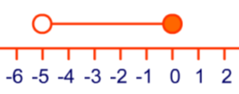
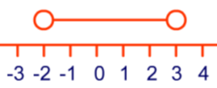
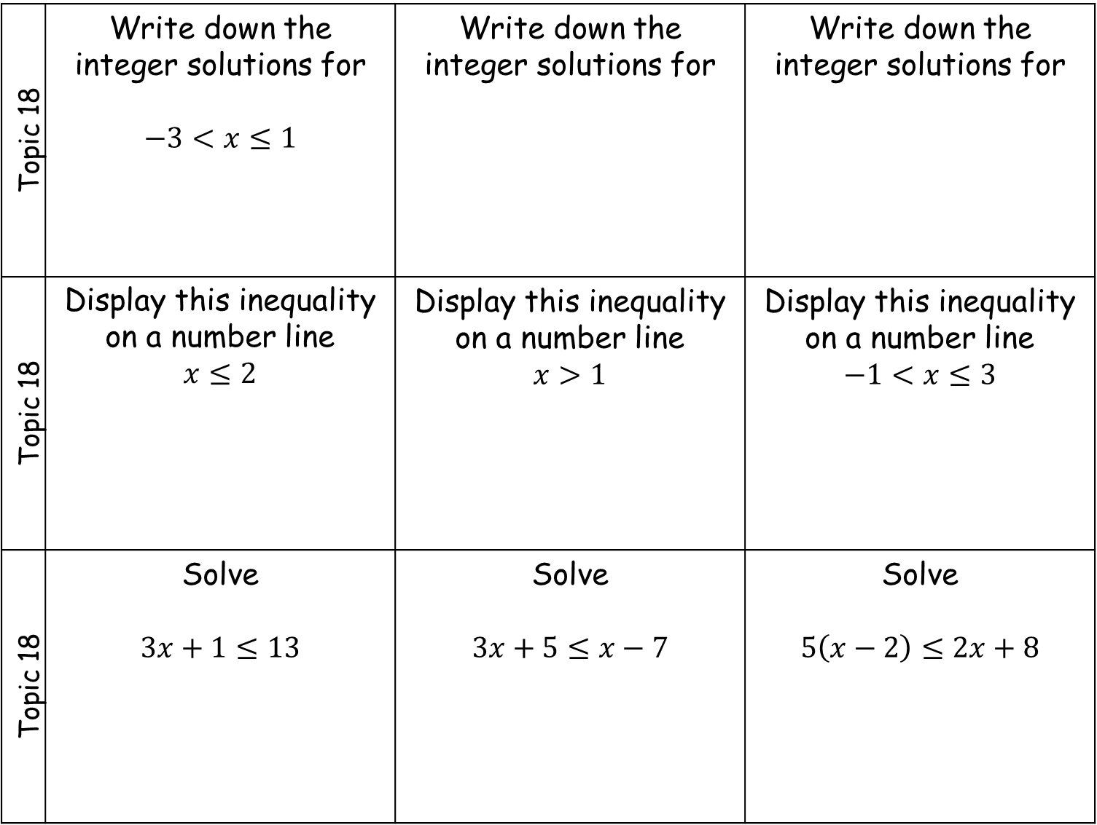
Topic 18 | Write down the integer solutions for $$−3<x≤1$$ | Write down the integer solutions for | Write down the integer solutions for
Topic 18 | Display this inequality on a number line $$x≤2$$ | Display this inequality on a number line $$x>1$$ | Display this inequality on a number line $$−1<x≤3$$
Topic 18 | Solve $$3x+1≤13$$ | Solve $$3x+5≤x−7$$ | Solve $$5\left(x−2\right)≤2x+8$$

Slide 4
Topic 19 | Construct this triangle | Construct this triangle | Construct this triangle
Topic 19 | Bisect an angle | Bisect a line | Construct an equilateral triangle of side 6 cm
Topic 19 | Construct the locus of the points 2 cm from the line. | Construct the locus of the points 2 cm from the point. | Construct the locus of the points the same distance from both points.
3 cm
4 cm
5 cm
40°
80°
30°
5 cm
6 cm
7 cm

Slide 5
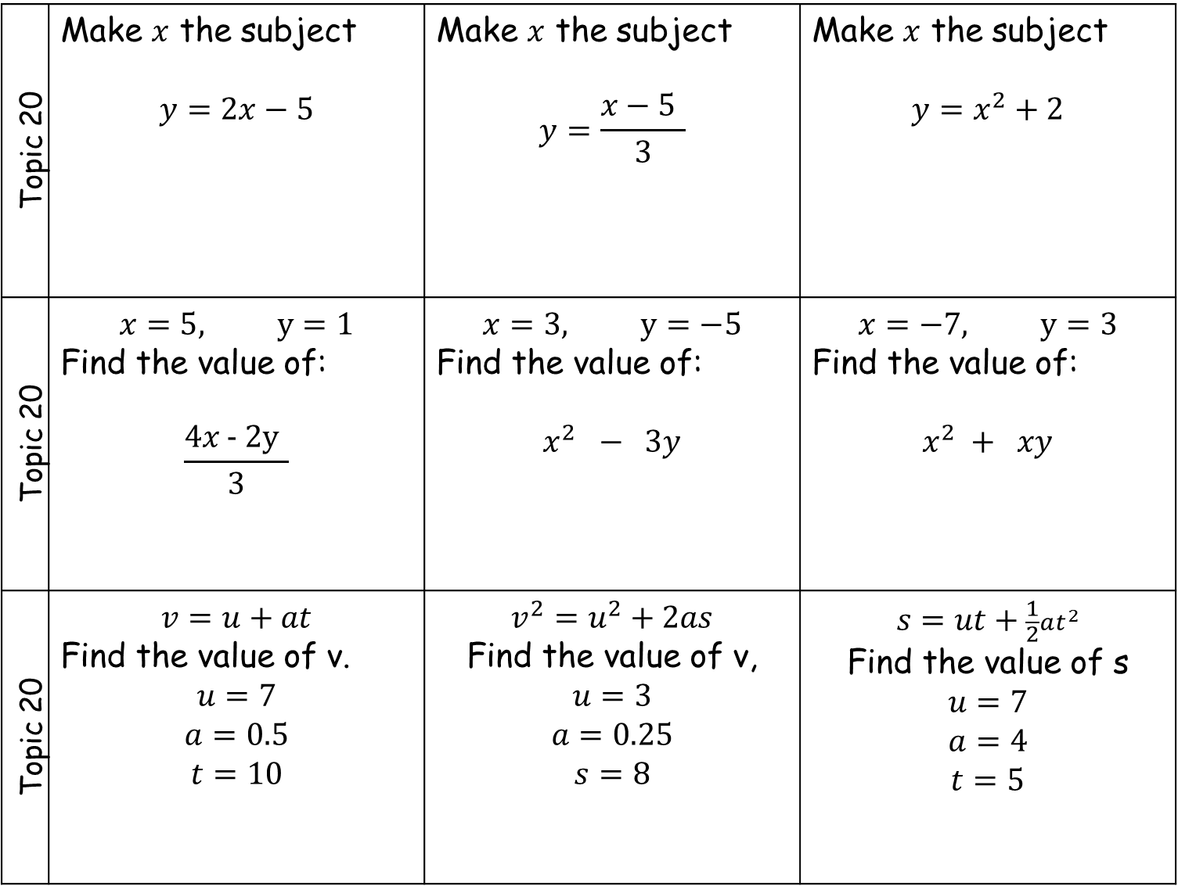
Topic 20 | Make $x$ the subject $$y=2x−5$$ | Make $x$ the subject $$y=\frac{x−5 }{3}$$ | Make $x$ the subject $$y=x^{2}+2$$
Topic 20 | $$x=5, y=1$$ Find the value of: $$\frac{4x\text{ - 2}\text{y} }{3}$$ | $$x=3, y=−5$$ Find the value of: $$x^{2} − 3y$$ | $$x=−7, y=3$$ Find the value of: $$x^{2} + xy$$
Topic 20 | $$v=u+at$$ Find the value of v. $$u=7$$ $$a=0.5$$ $$t=10$$ | $$v^{2}=u^{2}+2as$$ Find the value of v, $$u=3$$ $$a=0.25$$ $$s=8$$ | $$s=ut+\frac{1}{2}at^{2}$$ Find the value of s $$u=7$$ $$a=4$$ $$t=5$$

