Slide 1
Test 5 Revision
YEAR 11 Foundation

Slide 2
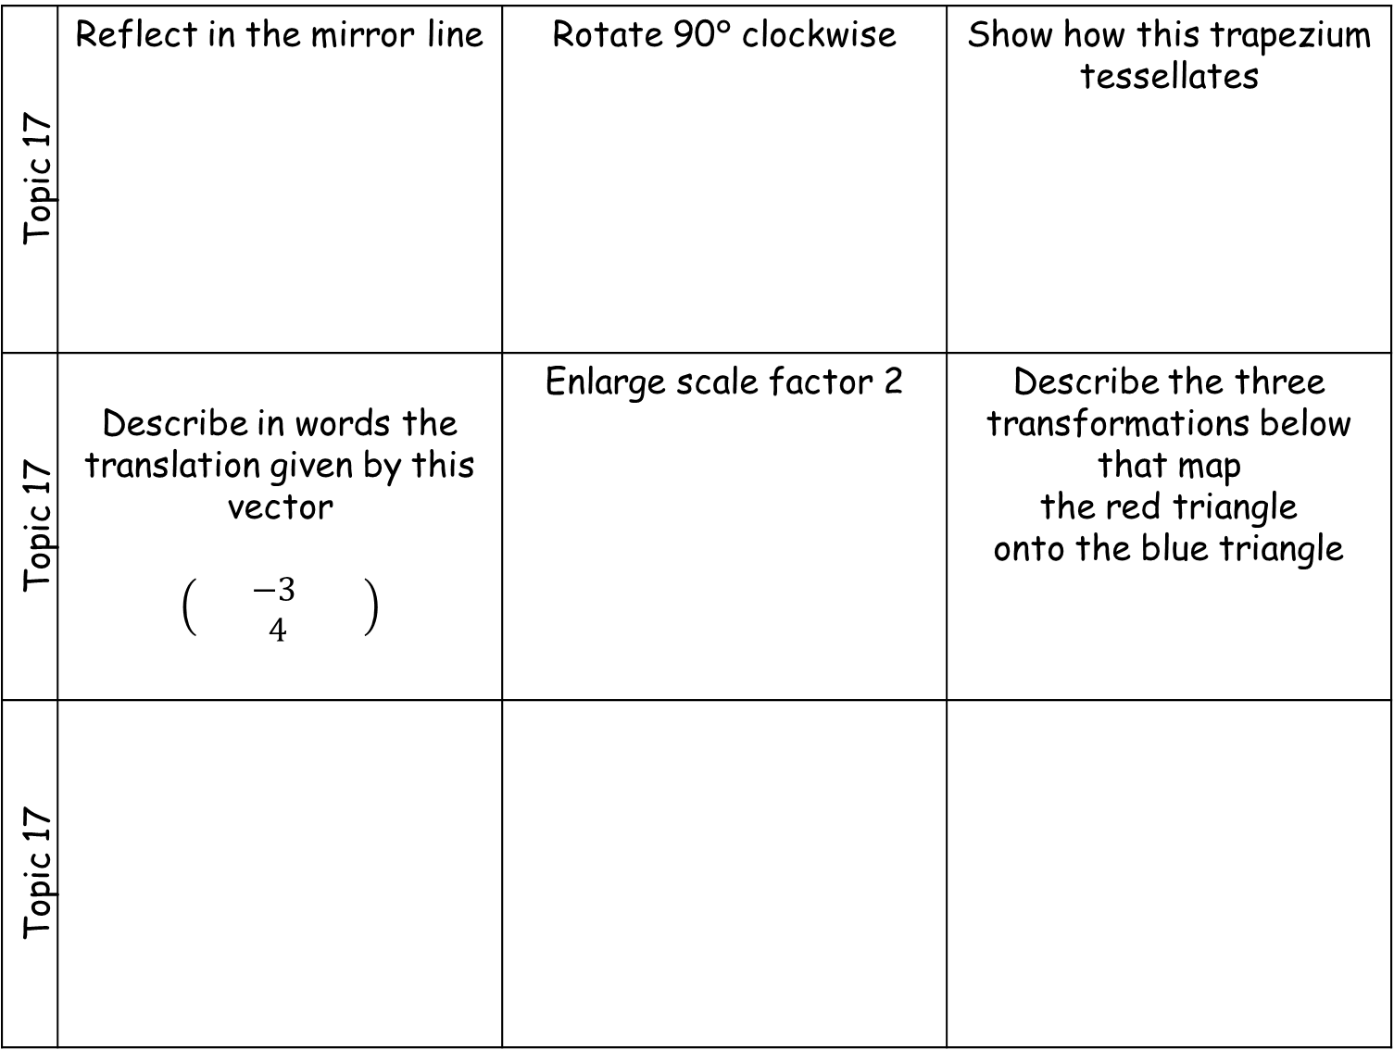
Topic 17 | Reflect in the mirror line | Rotate 90° clockwise | Show how this trapezium tessellates
Topic 17 | Describe in words the translation given by this vector $$\left(\begin{matrix} −3 & \\ 4 & \end{matrix}\right)$$ | Enlarge scale factor 2 | Describe the three transformations below that map the red triangle onto the blue triangle
Topic 17

Slide 3
Topic 18 | Calculate 23 x 34 | Calculate 5.47 x 6 | Given that 72 x 43 = 3096 Work out: (a) 7.2 x 4.3 (b) 0.72 x 430 (c) 3096 ÷ 430
Topic 18 | Calculate 596 ÷ 4 | Calculate 45 ÷ 4 | Calculate 45.6 ÷ 3
Topic 18 | Calculate 795 ÷ 15 | A school buys 34 books. Each book costs £5.21. Work out the total cost of the 34 books. | Debbie buys sweets for £1.89, a magazine for £1.65 and a drink for 87p. She pays with a £5 note. How much change will she get?

Slide 4
Topic 19 | Construct this triangle | Construct this triangle | Construct this triangle
Topic 19 | Bisect an angle | Bisect a line | Construct an equilateral triangle of side 6 cm
Topic 19 | Construct the locus of the points 2 cm from the line. | Construct the locus of the points 2 cm from the point. | Construct the locus of the points the same distance from both points.
3 cm
4 cm
5 cm
40°
80°
30°
5 cm
6 cm
7 cm

Slide 5
Topic 20 | Round 2748 to the nearest 10 | Round 4.781 to 1 d.p. | Round 81.365 to 2 d.p.
Topic 20 | Round 839 to 1 S.F | Round 0.0681 to 1 S.F | Round 8731 to 2 S.F
Topic 20 | Estimate $\frac{3.7 x 2.9}{6.45}$ | Calculate and write down all of the figures on your calculator display | The length of a line is 63cm to the nearest cm. What is the longest possible length of the line?

