Slide 1
Test 2 Revision
Year 7 FOUNDATION

Slide 2
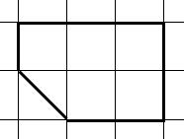
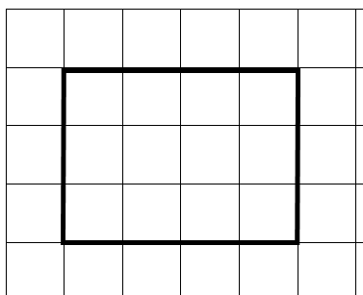
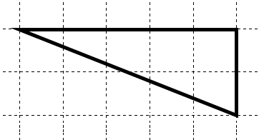
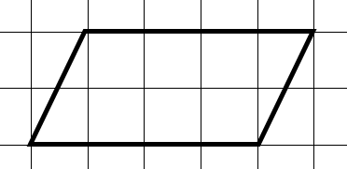
Topic 5 | Complete the following: 3 cm = ……… mm 4 m = ……… cm 2 km = ……… m | What is the perimeter? | What is the area?
Topic 5 | What is the area? | What is the area? | What is the area?
Topic 5 | What is the height? | What is the area? | What is the area?
Area = 10 cm²
3 cm
8 cm
5 cm
5 cm
10 cm

Slide 3
Topic 5 | Complete the following: 3 cm = 30 mm 4 m = 400 cm 2 km = 2000 m | What is the perimeter? 10 cm | What is the area? 5 ½ cm
Topic 5 | What is the area? 12 cm² | What is the area? 8 cm² | What is the area? 5 cm²
Topic 5 | What is the height? 2 cm | What is the area? 15 cm² | What is the area? 40 cm²
Area = 10 cm²
3 cm
8 cm
5 cm
5 cm
10 cm

Slide 4
Topic 6 | What is the ratio of triangles to squares? | What is the ratio of grey to white squares? | Simplify these ratios 6 : 10 25 : 10 9 : 12
Topic 6 | Miss Gilroy’s form has 12 girls and 8 boys. What is the ratio of girls : boys? | These ratios are equivalent. Find the missing values 2 : 3 4 : …… …… : 30 | There are 20 pupils in a form. There are 12 boys. What is the ratio of boys : girls?
Topic 6 | 3 bars of chocolate cost 90 pence. How much does 1 bar cost? | 3 footballs cost £15. How much will 1 football cost? | 6 text books cost £30. How much will 5 text books cost?

Slide 5
Topic 6 | What is the ratio of triangles to squares? 6 : 4 3 : 2 | What is the ratio of grey to white squares? 4 : 8 1 : 2 | Simplify these ratios 6 : 10 3 : 5 25 : 10 5 : 2 9 : 12 3 : 4
Topic 6 | Miss Gilroy’s form has 12 girls and 8 boys. What is the ratio of girls : boys? 12 : 8 3 : 2 | These ratios are equivalent. Find the missing values 2 : 3 4 : 6 20 : 30 | There are 20 pupils in a form. There are 12 boys. What is the ratio of boys : girls? 12 : 8 3 : 2
Topic 6 | 3 bars of chocolate cost 90 pence. How much does 1 bar cost? 30p | 3 footballs cost £15. How much will 1 football cost? £5 | 6 text books cost £30. How much will 5 text books cost? £5 x 5 = £25

Slide 6
Topic 7 | Complete the sequence What is the rule? 12, 15, 18, 21, …… , …… 16, 20, 24, 28, …… , …… | Complete the sequence What is the rule? 26, 24, 22, 20, …… , …… 29, 26, 23, 20, …… , …… | Complete the sequence What is the rule? 1, 6, 11, …… , …… 2.5, 3.5, 4.5, …… , ……
Topic 7 | Complete the sequence What is the rule? 2, 4, 8, 16, …… , …… 400, 200, 100, …… , …… | Complete the sequence What is the rule? 5, 50, 500, …… , …… 40000, 4000, 400, …… , …… | Complete the sequence What is the rule? …… , 6, ……, 10, ……, 14 …… , 30, ……, 20, ……, 10
Topic 7 | Find the next 3 numbers. 10, ………, ……… , ……… | Find the next 3 numbers. 18 , ………, ……… , ……… | Find the next 3 numbers. - 10, ………, ……… , ………
start | rule
10 | + 3
start | rule
18 | - 4
start | rule
-10 | + 2

Slide 7
Topic 7 | Complete the sequence What is the rule? 12, 15, 18, 21, 24 , 27 + 3 16, 20, 24, 28, 32 , 36 + 4 | Complete the sequence What is the rule? 26, 24, 22, 20, 18, 16 - 2 29, 26, 23, 20, 17, 14 - 3 | Complete the sequence What is the rule? 1, 6, 11, 16, 21 + 5 2.5, 3.5, 4.5, 5.5, 6.5 + 1
Topic 7 | Complete the sequence What is the rule? 2, 4, 8, 16, 32 , 64 x 2 400, 200, 100, 50 , 25 ÷ 2 | Complete the sequence What is the rule? 5, 50, 500, 5000 , 50000 x 10 40000, 4000, 400, 40, 4 ÷ 10 | Complete the sequence What is the rule? 4 , 6, 8, 10, 12, 14 + 2 35 , 30, 25 , 20, 15, 10 - 5
Topic 7 | Find the next 3 numbers. 10, 13, 16 ,19 | Find the next 3 numbers. 18, 14, 10, 6 | Find the next 3 numbers. - 10, -8 , -6 , -4
start | rule
10 | + 3
start | rule
18 | - 4
start | rule
-10 | + 2

Slide 8
Topic 8 | A dice is thrown. What is the probability of: getting a 1 getting an even number getting a 7 |  | A pupil is picked at random. What is the probability of picking: a) Someone with a pet cat and a pet dog. b) Someone with no pet cat or pet dog.
Topic 8 | Which letter represents: P(1) P(8) P(2) P(even)
Topic 8 | What is the probability of picking: A girl from Newton? A boy from King? A person from Newton? |  | A box of crisps has: 2 salt + vinegar 1 ready salted 5 cheese + onion What is the probability of picking a packet of salt + vinegar?
Cat
Dog
2
1
5
2
A
B
C
D
E
2
4
2
2
1
0
1
4
6
2
 | Newton | King | Total
Boys | 6 | 4 | 10
Girls | 8 | 2 | 10
Total | 14 | 6 | 20

Slide 9
Topic 8 | A dice is thrown. What is the probability of: getting a 1 $\frac{1}{6}$ getting an even number $\frac{1}{2}$ getting a 7 0 |  | A pupil is picked at random. What is the probability of picking: Someone with a pet cat and a pet dog. $\frac{1}{10}$ b) Someone with no pet cat or pet dog. $\frac{2}{10}$
Topic 8 | Which letter represents: P(1) = B P(8) = A P(2) = C P(even) = E
Topic 8 | What is the probability of picking: A girl from Newton? $$\frac{8}{20}=\frac{2}{5}$$ b) A boy from King? $$\frac{4}{20}=\frac{1}{5}$$ A person from Newton? $$\frac{14}{20}=\frac{7}{10}$$ |  | A box of crisps has: 2 salt + vinegar 1 ready salted 5 cheese + onion What is the probability of picking a packet of salt + vinegar? $\frac{2}{8}=\frac{1}{4}$
Cat
Dog
2
1
5
2
A
B
C
D
E
2
4
2
2
1
0
1
4
6
2
 | Newton | King | Total
Boys | 6 | 4 | 10
Girls | 8 | 2 | 10
Total | 14 | 6 | 20

