Slide 1
Test 2 Revision
Year 7 HIGHER

Slide 2
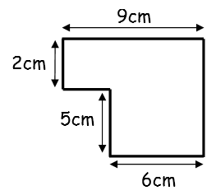
Topic 5 | Complete the following: 3 cm = ……… mm 4.15 m = ……… cm 2.5 km = ……… m | What is the perimeter? | What is the perimeter?
Topic 5 | What is the height? | What is the area? | What is the area?
Topic 5 | What is the height? | What is the area? | What is the area?
3 cm
8 cm
9 cm
6 cm
5 cm
Area = 24 cm²
8 cm
8 cm
10 cm
7 cm
12 cm
Area
18 cm²
10 cm
?
4.5 cm
5 cm
10 cm
5 cm
9 cm
8 cm

Slide 3
Topic 5 | Complete the following: 3 cm = 30mm 4.15 m = 415 cm 2.5 km = 2500 m | What is the perimeter? 3 + 8 + 3 + 8 = 22cm | P = 32cm
Topic 5 | 24 ÷8 = 3cm | (8 x 10) ÷2 = 40cm² | Area = 7 x 5 = 35cm²
Topic 5 | Height → x9 → ÷2 → 18 Height ← ÷9 ← x2 ←18 Height = 4cm | (8 x 4.5) ÷ 2 = 18cm² | Total area = 95cm²
3cm
7cm
3 cm
8 cm
9 cm
6 cm
Area = 24 cm²
8 cm
5 cm
10 cm
8 cm
7 cm
12 cm
10 cm
7x10
= 70
5x5
= 25
5 cm
4.5 cm
10 cm
5 cm
8 cm
7cm

Slide 4
Topic 6 | Miss Gilroy’s form has 12 girls and 8 boys. What is the ratio of girls : boys? What fraction of the class are girls? | What is the ratio of grey to white squares? | Simplify these ratios 6 : 10 25 : 10 9 : 12 32 : 40 12 : 30 : 18
Topic 6 | Complete these equivalent ratios 2 : 3 10 : …… …… : 24 1 : …… | There are 300 pupils in year 7. There are 130 boys. What is the ratio of boys : girls? | 5 bars of chocolate cost £2.40. How much do 3 bars cost?
Topic 6 | Pink paint is made by mixing red and white paint in the ratio 2 : 3. I need 20 litres of pink paint. How much white and red paint will I need? | Share £32 in the ratio 3 : 5. | Share £12.50 in the ratio 3 : 2.

Slide 5
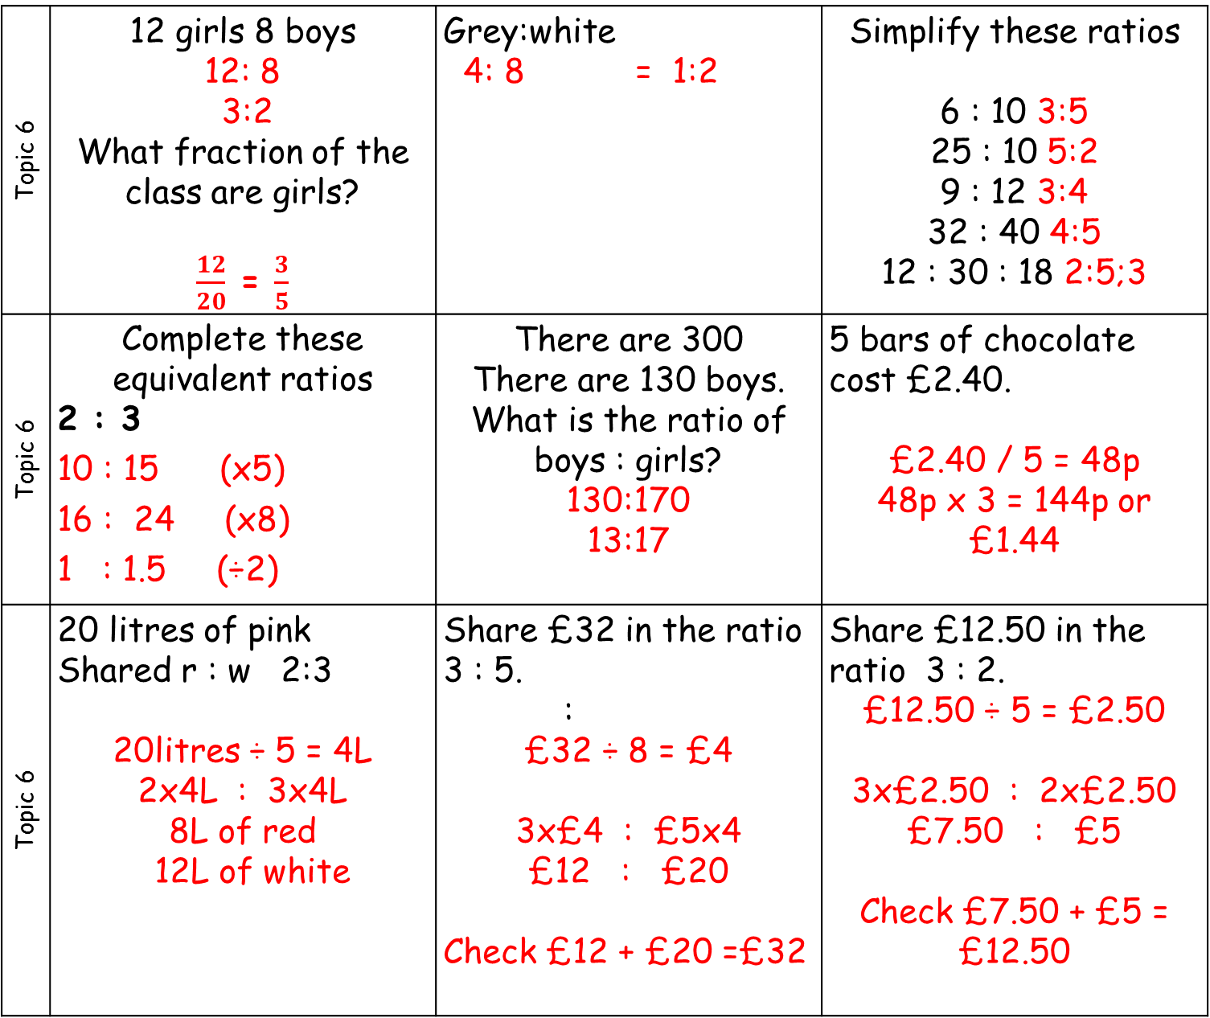
Topic 6 | 12 girls 8 boys 12: 8 3:2 What fraction of the class are girls? $\frac{12}{20}$ = $\frac{3}{5}$ | Grey:white 4: 8 = 1:2 | Simplify these ratios 6 : 10 3:5 25 : 10 5:2 9 : 12 3:4 32 : 40 4:5 12 : 30 : 18 2:5;3
Topic 6 | Complete these equivalent ratios 2 : 3 10 : 15 (x5) 16 : 24 (x8) 1 : 1.5 (÷2) | There are 300 There are 130 boys. What is the ratio of boys : girls? 130:170 13:17 | 5 bars of chocolate cost £2.40. £2.40 / 5 = 48p 48p x 3 = 144p or £1.44
Topic 6 | 20 litres of pink Shared r : w 2:3 20litres ÷ 5 = 4L 2x4L : 3x4L 8L of red 12L of white | Share £32 in the ratio 3 : 5. : £32 ÷ 8 = £4 3x£4 : £5x4 £12 : £20 Check £12 + £20 =£32 | Share £12.50 in the ratio 3 : 2. £12.50 ÷ 5 = £2.50 3x£2.50 : 2x£2.50 £7.50 : £5 Check £7.50 + £5 = £12.50

Slide 6
Topic 7 | Complete the sequence What is the rule? 12, 15, 18, 21, …… , …… 51, 45, 39, 33, …… , …… | Complete the sequence What is the rule? 6.5, 8, 9.5, …… , …… 2.4, 2.8, 3.2, …… , …… | Complete the sequence What is the rule? 5, 50, 500, …… , …… 40, 4, 0.4, …… , ……
Topic 7 | Complete the sequence What is the rule? 19 , …… , 25, …… , 31 …… , 10, …… , 6, …… , 2 | Find the first 4 terms in the sequence using the rule T(n) = 2n | Find the first 4 terms in the sequence using the rule T(n) = 5n + 1
Topic 7 | Find the n^{th} term: 5, 7, 9, 11, … Use your rule to find the 20th term in the sequence. | Find the n^{th} term: 1, 9, 17, 25, … Use your rule to find the 20th term in the sequence. | Find the n^{th} term: -9, -5, -1, 3, … Use your rule to find the 20th term in the sequence.

Slide 7
Topic 7 | Complete the sequence What is the rule? 12, 15, 18, 21, 24 , 27 (+3) 51, 45, 39, 33, 27, 21 (-6) | Complete the sequence What is the rule? 6.5, 8, 9.5, 11, 12.5 (+1.5) 2.4, 2.8, 3.2, 3.6,4.0 (+0.4) | Complete the sequence What is the rule? 5, 50, 500, 5000, 50 000 Rule: x10 40, 4, 0.4, 0.04, 0.004 Rule: ÷10
Topic 7 | Complete the sequence What is the rule? 19 , 22 , 25, 28 , 31(+3) 12 , 10, 8 , 6, 4, 2 | Find the first 4 terms in the sequence using the rule T(n) = 2n 2,4,6,8 | Find the first 4 terms in the sequence using the rule T(n) = 5n + 1 T₁ = 5 x 1 +1 = 6 6,11,16,21
Topic 7 | Find the n^{th} term: 5, 7, 9, 11, … T_{n} = 2n+3 T₂₀ = 2x20 +3 = 43 | Find the n^{th} term: 1, 9, 17, 25, … T_{n} = 8n – 7 T₂₀ = 8x20 -7 = 153 | Find the n^{th} term: -9, -5, -1, 3, … T_{n} = 4n - 13 T₂₀ = 4x20 -13 = 67 .

Slide 8
Topic 8 | A dice is thrown. What is the probability of: getting a 6 getting an odd number getting a 7 getting a prime number getting a square number |  | A pupil is picked at random. What is the probability of picking: Someone with a pet cat and a pet dog. Someone with no pet cat or pet dog. Someone with only a dog. Someone with only a cat.
Topic 8 | The spinner is spun. Which letter represents: P(4) P(8) P(2) P(even) P(less than 7)
Topic 8 | What is the probability of picking: A girl from Newton? A boy from King? A person from Newton? A person from King? |  | A box of crisps has: 2 salt + vinegar 1 ready salted 5 cheese + onion What is the probability of picking salt + vinegar? Not picking ready salted?
Cat
Dog
8
3
5
4
A
B
C
D
E
F
G
2
4
2
2
1
0
1
4
6
2
 | Newton | King | Total
Boys | 6 | 4 | 10
Girls | 8 | 2 | 10
Total | 14 | 6 | 20

Slide 9
Topic 8 | A dice is thrown. What is the probability of: a 6 1/6 an odd number 3/6 a 7 0 a prime number (2,3,5) 3/6 a square number (1 or 4) 2/6 |  | Someone with a pet cat and a pet dog. 3/20 Someone with no pet cat or pet dog.4/20 Someone with only a dog. 5/20 Someone with only a cat. 8/20
Topic 8 | The spinner is spun. Which letter represents: P(4) = B P(8) = A P(2) = D P(even) = F P(less than 7) = G
Topic 8 | What is the probability of picking: 8/20 4/20 14/20 6/20 |  | A box of crisps has: 2 salt + vinegar 1 ready salted 5 cheese + onion What is the probability of 2/8 7/8
Cat
Dog
8
3
5
4
A
B
C
D
E
F
G
2
4
2
2
1
0
1
4
6
2
 | Newton | King | Total
Boys | 6 | 4 | 10
Girls | 8 | 2 | 10
Total | 14 | 6 | 20

