Slide 1
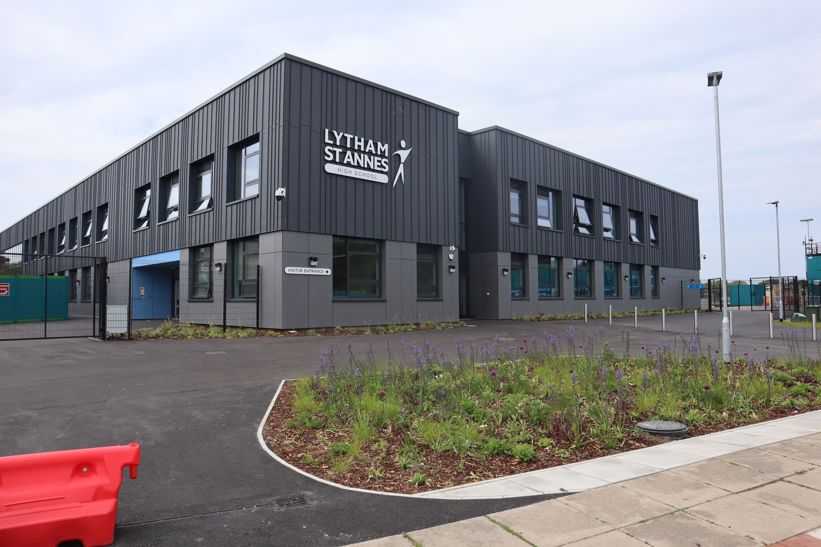

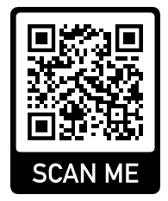
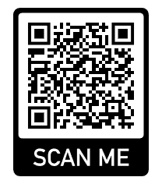
GCSE Preferences Process 2025
Contact us at GCSEpreferences2025@lsahigh.org
All information at https://www.lythamhigh.lancs.sch.uk/students/year-9-preferences
ASPIRATION ENDEAVOUR INTEGRITY RESPECT
Notes:
Insert paste 2 booklets

Slide 2
Content of this presentation
Mrs Clegg Head of School
General Principles and Advice
Excellence Programme
Mr Cubbon Deputy Head Curriculum
How does the Year 10 timetable compare to Year 9
The Curriculum
OCR and BTEC
Mr Howard
Timeline
Complete your preferences on the Microsoft Form
ASPIRATION ENDEAVOUR INTEGRITY RESPECT

Slide 3
General Principles
Broad and balanced
range of subjects
Meets
individual needs
and
aspirations
qualifications
careers experiences
21st century Employability Skills
Ready for
Further Ed or Apprenticeships
ASPIRATION ENDEAVOUR INTEGRITY RESPECT

Slide 4



GCSE Choices are just the first step
Remember individual GCSE subjects
Do not block or facilitate specific careers
ASPIRATION ENDEAVOUR INTEGRITY RESPECT

Slide 5
A Broad and Balanced Curriculum maximises future study and many careers
The structure ensures a broad and balanced curriculum.
You must choose between
French or German and History or Geography
Powerful body of knowledge - ‘cultural capital’
Key to success in later life whatever routes are taken
Support other subjects in post-16 study, university & careers
ASPIRATION ENDEAVOUR INTEGRITY RESPECT

Slide 6
Core Subjects French or German
There are many other benefits, including improvements in:
Understanding sentence construction, tenses, grammar and literacy
Your ‘marketability’ to colleges and universities
Communication skills greatly valued by employers
Insight into world communities, languages, and cultures
Business opportunities abroad and in the UK
Travel opportunities
……‘languages are hard!’ ……
ASPIRATION ENDEAVOUR INTEGRITY RESPECT

Slide 7
Some Advice
All GCSEs are challenging.
Computer Studies – Best suited for those students with a real aptitude for Maths and Science. (Complex coding)
History – Best suited for those with strong English Literature skills, ability to analyse sources and write at length.
Single Sciences (Previously known as Triple Science) – Best suited for those who plan to study medicine, dentistry, Veterinary Medicine or Research Science
Drama and Music – Best suited to those who are happy to perform in public. It is an essential part of the course.
ASPIRATION ENDEAVOUR INTEGRITY RESPECT

Slide 8
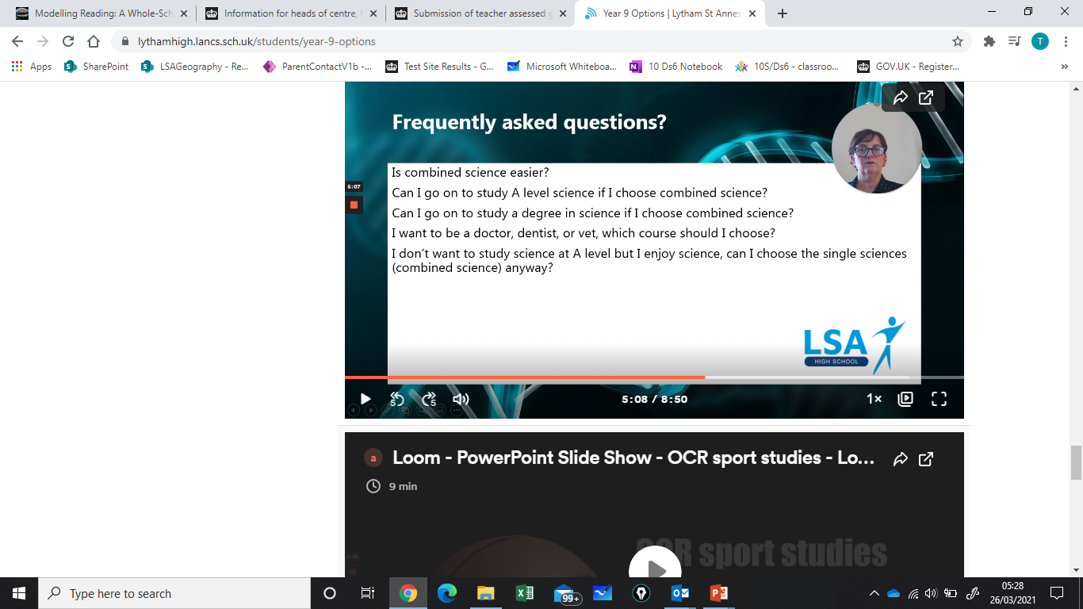
Combined Science or Single Sciences
GCSE Combined Science = 10 hours
GCSE Single Sciences = 15 hours
and takes up one of two open choices
Combined Science and Single Sciences are equally difficult
Both cover Biology, Chemistry and Physics equally
Single Sciences simply covers more topics
Y9 Reports contain a science recommendation
NOT direct advice
ASPIRATION ENDEAVOUR INTEGRITY RESPECT
Notes:
15 or 10 hours per fortnight
Very few choices guarantee you or block you from a career path, but Triple science is recommended for medical degrees ir science is your passion

Slide 9
What questions will help or hinder?
What further advice do I need?
What subjects are my friends taking?
Who is my favourite Y9 teacher?
Which subjects open many doors for later study or careers?
I don’t know what job I will do so how can I choose?
Which subjects am I best at?
Shall I choose my subjects based on my career plan?
How will I be assessed?
ASPIRATION ENDEAVOUR INTEGRITY RESPECT
Notes:
Take out? Or moidfy

Slide 10

The Wider Curriculum
More Than Grades
Available to all pupils
Pupils should experience something in each of 6 areas EVERY year of school
Increasingly important in Years 10 and 11
Logbook can be taken to college & apprenticeship interviews
See Mr Reid in the ACC
ASPIRATION ENDEAVOUR INTEGRITY RESPECT

Slide 11
Aspiration and Careers Excellence Programme
Takes place in year 10.
5 sessions over the year.
Each session from 3.10pm to 4.10pm.
3 Programmes
1. The STEM Excellence Programme - Science, Technology, Engineering and Maths including coding and cyber security.
2. The Creative & Digital Excellence Programme - Including the arts, graphic design, digital media, marketing, journalism and architecture
3. The Caring Professions Excellence Programme - Including the legal professions, law and order, medicine, teaching and social work.
Motivated Year 10 pupils can apply for one programme and
a reserve programme.
ASPIRATION ENDEAVOUR INTEGRITY RESPECT

Slide 12

Aspiration & Careers
Excellence Programme
This opportunity is designed to enrich the curriculum for highly motivated students with a thirst for knowledge and exceptional manners!
5 Session programme of practical hands / brains on workshops tackling activities alongside industry professionals.
Designed to broaden pupils’ horizons, consider a range of career paths and undoubtedly support their applications for competitive apprenticeships, college and university courses.
ASPIRATION ENDEAVOUR INTEGRITY RESPECT

Slide 13
How will my new timetable compare to Y9?
Subject | Y9 | Y10 & Y11 | Choice?
English | 8 hours | 8 hours | No
Maths | 8 hours | 8 hours | No
P.D. | 1 PD, 2 Rs | 2 hours | No
Core P.E | 4 hours | 2 hours | No
20
Subject | Y9 | Y10 & Y11 | Choice?
French or German | 4 hours | 5 hours | French OR German
Geography or History | 4 hours of both | 5 hours | Geography OR History
Science | 6 hours | 10 hours | Combined OR Single.
1
5
2
5
10
3
Three single sciences
Biology, Chemistry, Physics
5 hours per subject
15
Subject | Y9 | Y10 & Y11 | Choice?
Open choice | various | 5 hours | 11 + 4 open choice
Open choice | various | 5 hours | 11 + 4 open choice
4
5
5
5
ASPIRATION ENDEAVOUR INTEGRITY RESPECT

Slide 14
10 hours of Combined Science with 2 open choice subjects
15 hours of Three single sciences, with only 1 open subject
 | Combined Science | Three single Sciences | Y9
Qualifications | 2 GCSE, ‘7’ ‘6’ or ‘6’ ‘6’ | 3 GCSE, ‘9’ ‘6’ ‘4’ | -
Time studied | 10 hours | 15 hours | 6 hours
Other options | 2 open choice 5 hours x2 2 GCSEs | 1 open choice 5 hours x1 1 GCSE | -
Studying – always in equal amounts | Biology Chemistry Physics | Biology Chemistry Physics | Biology Chemistry Physics
Level of Difficulty | Grade 9 – 4 Higher tier Grade 5 – 1 Foundation | Grade 9 – 4 Higher tier Grade 5 – 1 Foundation | -
Teachers | Usually 2 teachers | Usual 3 teachers | Usually 1
ASPIRATION ENDEAVOUR INTEGRITY RESPECT

Slide 15
Three ‘Non-GCSE Subjects’
Creative Media production – BTEC Level 1 / 2 –Technical award
Health and Social Care – OCR Cambridge National Level 1 / 2
Sports Studies - OCR Cambridge National Level 1 / Level 2
OCR or BTEC
Have a wider range of learning and assessment styles,
assessment is throughout the course not just at the end.
Equivalent ‘points values’ to GCSE grades
Academically rigorous
Have an Exam PLUS NEA (coursework)
Equally valued by colleges, universities and employers
ASPIRATION ENDEAVOUR INTEGRITY RESPECT

Slide 16
Subject combinations not allowed
If you are interested in a sports / physical education course speak to your PE teacher or Miss Harrison or Mr Fenwick
They will advise which course best suits your skills and needs
You are not allowed to study both
GCSE Physical Education
and
Cambridge National Sports Studies
Do not choose both subjects in open or in reserve choices
ASPIRATION ENDEAVOUR INTEGRITY RESPECT

Slide 17
Can I take both History and Geography?
‘Yes’ if other subjects are broad and balanced
Single science and History AND geography is not broad!
Can I take both French and German?
‘Yes’ if other subjects are broad and balanced
Single science and French AND German is not broad!
‘Yes’ if you already study the second language
Simply select your top preference first e.g. History in the core
Then select e.g. Geography in your open (or reserve) choices
The same applies to French and German
ASPIRATION ENDEAVOUR INTEGRITY RESPECT

Slide 18
Timeline / Key Dates – Part 1
Thursday 6th February - 3.30pm-7pm - Subject Consultation
Likely English, Maths, Science and five other subjects
General preferences support appointments - Mr Howard
Friday 7th February
We send parents the preference form link ( also available on the website )
Mon 10th & Tues 11th February - 4pm-6pm
Support meetings with form tutor for some students and their families.
Mon 10th (JHW) & Tues 11th February (TCU) - 4pm-6pm
Online general preferences support appointments if needed.
Wednesday 12th February - deadline to submit online preference form
ASPIRATION ENDEAVOUR INTEGRITY RESPECT

Slide 19
Timeline / Key Dates – Part 1
February to June we:
- check every form individually
- consult as necessary
- build the timetable for Year 7 to Year 11
The key question is:
Will this broad and balanced set of subjects,
along with additional careers experiences,
prepare well for a wide range of possible careers?
Early July (or sooner) - confirmation of Y10 subjects
Warning! No guarantee of all preferences
Please chose reserves subjects wisely
ASPIRATION ENDEAVOUR INTEGRITY RESPECT
Notes:
Make this timeline part 2

Slide 20
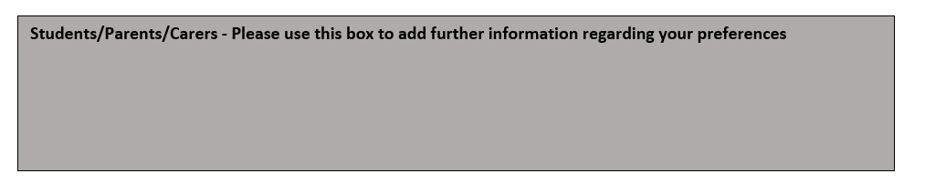
For additional support please:
1. Speak to senior teacher later this evening.
2. Email GCSEpreferences2025@lsahigh.org
3. Book a general preferences online support appointment through school cloud on 6th, 10th or 11th February.
4. Complete the ‘further information’ box on the form

Slide 21
Sources of advice and guidance
All information will be emailed to parents and posted at https://www.lythamhigh.lancs.sch.uk/students/year-9-preferences
Students - during the day - who can I speak to
- Subject teachers
- Form tutors
Mrs Grierson in the student hub
Miss Gibbons and Ms Sharrock - Aspiration & Careers Centre – Ansdell block
Mr Howard – Office located in Ansdell block
ASPIRATION ENDEAVOUR INTEGRITY RESPECT

Slide 22
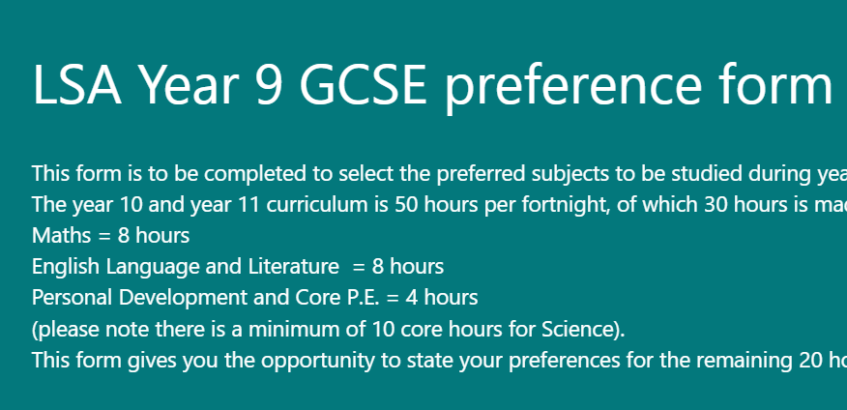
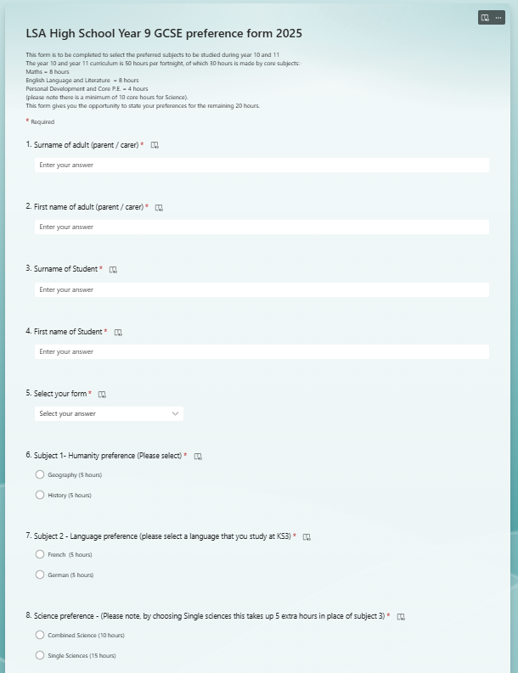



Completing the GCSE Preference Form
The Microsoft Forms link will be live on the
website from Friday 7th February.
Complete on a phone, tablet, laptop or PC.
Deadline Wednesday 12th February.
https://forms.office.com/Pages/ResponsePage.aspx?id=hmpYW-bEmU2DF5CfHJ74qhexkb6dPY9Im2iMwi3dX1ZUQlpWMzNUUlpONkYzM1FWTllSNFNHQjY4Ty4u

Slide 23
What happens right now?
Go to the subject marketplace in the Dining Room
- speak to Heads of subjects for around 30 minutes
- SEND team and Colleges.
- after which you are free to leave
When you leave your seats, please:
-Take care descending the stairs
-Exit this hall to your left to access the dining room
ASPIRATION ENDEAVOUR INTEGRITY RESPECT

Slide 25
Discarded slides

Slide 26
Three Key Principles for students
1. Plan for multiple careers, don’t ‘rule out’ any subjects yet!
Experts say you will have five careers over your working life
Subject choice rarely defines a career path (science)
Broad and balanced range rather than a narrower range
ASPIRATION ENDEAVOUR INTEGRITY RESPECT
Notes:
Simplify these principle or make the third – you don’t need to take _____ to be an _____ business, engineer, ?? ??

Slide 27
Three Key Principles for students
2. You don’t need a specific subject for most careers
You don’t necessarily need to study:
Engineering to be an Engineer or
Business Studies to work in Business or
Single Sciences to work in Science
We provide subjects you need for many future paths
Careers experiences supplement the qualifications gained
ASPIRATION ENDEAVOUR INTEGRITY RESPECT

Slide 28
Three Key Principles for students
3. ‘50 hour fortnightly curriculum’
30 core hours - English, Maths, Science, Core PE and PD
10 further core hours with two ‘either or’ preferences
Geography or History
French or German
10 hours of open choice – 2 subjects of 5 hours each
Science preference affects one open choice – see later
ASPIRATION ENDEAVOUR INTEGRITY RESPECT

Slide 29
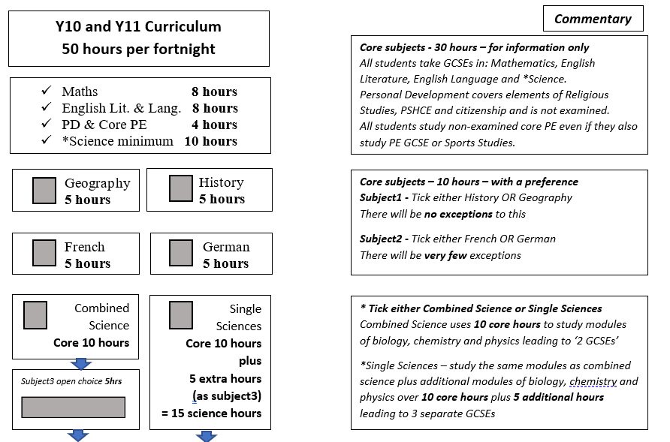
ASPIRATION ENDEAVOUR INTEGRITY RESPECT

Slide 30
ASPIRATION ENDEAVOUR INTEGRITY RESPECT

Slide 31
ASPIRATION ENDEAVOUR INTEGRITY RESPECT

Slide 32
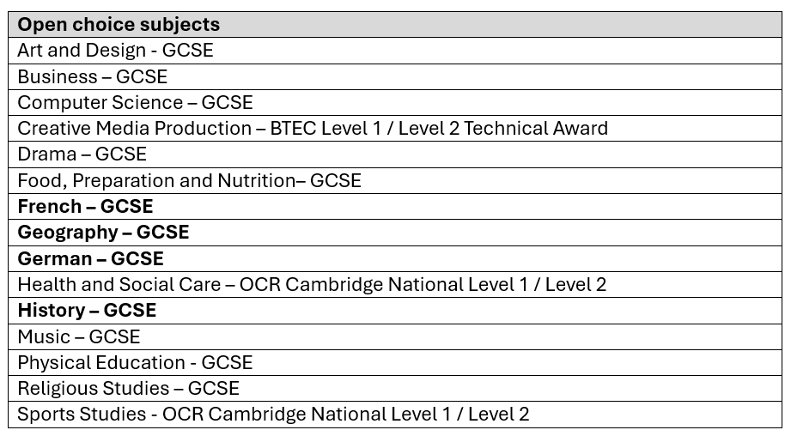
ASPIRATION ENDEAVOUR INTEGRITY RESPECT

Slide 33
ASPIRATION ENDEAVOUR INTEGRITY RESPECT

Slide 35
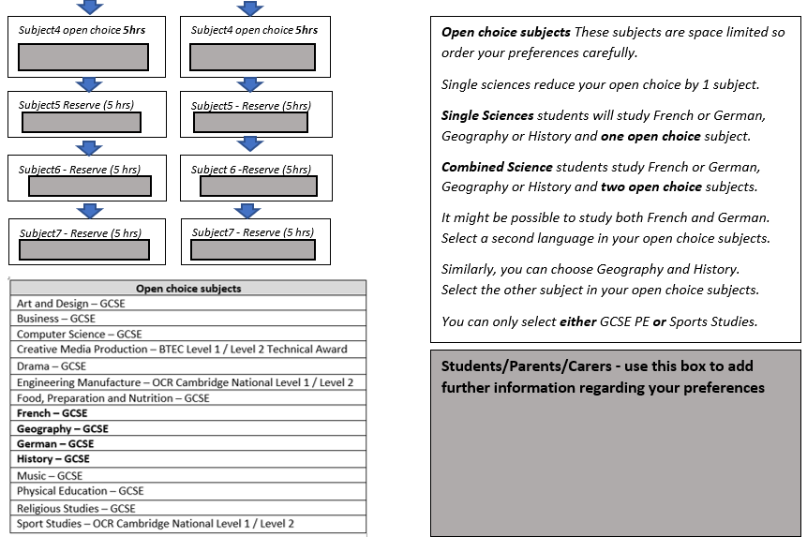
ASPIRATION ENDEAVOUR INTEGRITY RESPECT

Slide 36
ASPIRATION ENDEAVOUR INTEGRITY RESPECT

