Slide 1


Design and Technology
Curriculum Folder
2023

Slide 2

Contents
Core Curriculum intent
Subject specific intent, implementation, impact
The golden strands
The subject progression (long term plan)
Curriculum offer
Information on how the subject is monitored and evaluated
Assessment data
Action plan
Information on CPD (what courses are available for people to access. Any training you have completed or a plan for training.)
A budget – if appropriate
Link governor information – name and a note of any meetings held
Any subject specific risk assessments
Examples of pupils work which is considered to be of a high standard with annotated notes explaining why it is of a high standard
Details of extra-curricular activities (trips/clubs)

Slide 3
Core Curriculum intent
At Lugwardine Primary Academy we develop children as resilient learners who have the knowledge, understanding and skills to be responsible and effective members of their community.
The curriculum we teach will enable our learners to be confident members of both their local community and the wider world. The children will leave Lugwardine Primary passionate about their beliefs and equipped with the knowledge and skills they need to achieve their full potential.
Our curriculum is designed to inspire, support and include. We believe that by developing the whole child, pupils will learn to transfer the skills and knowledge across different settings and circumstances. We believe all children benefit from a range of learning opportunities and seek to develop their experiences both inside and outside the classroom.

Slide 4
Subject Intent
At Lugwardine Primary Academy At Lugwardine Primary Academy it is our intent to deliver a design and technology curriculum which inspires children to be creative and critical thinkers. We teach skills progressively to ensure that all children are able to practice and build on their previous learning and develop their skill set as they progress through the school. The children are taught to combine their designing and making skills with knowledge and understanding in order to design and make a product. They will also have the chance to evaluate products, allowing them to improve their product, as they would in the real world.
We intend for the children to develop problem solving skills that last them a life time and support them in their chosen careers.

Slide 5
Subject Implementation
At Lugwardine Primary Academy We have devised a scheme of work in correspondence with the national curriculum. Our curriculum ensures a progression of skills starting from EYFS until Year 6, allowing the children to leave our school with a good array of skills needed for the rest of their lives. For example, solving problems, becoming resilient learners and working as a team collaboratively to achieve a goal.
In our year groups we teach design and technology relating to our class topics and ensure that we build upon the skills taught in the previous year group. We ensure to cover the range of different design and technology areas outlined in the national curriculum: sewing and textiles, cooking and nutrition, electrical and mechanical components and using materials. We believe that Design and Technology is not a subject that can be solely taught within the classroom. We will ensure that each year group has access to our forest school area and has time to be ‘’hands-on’’, developing life skills and working collaboratively on projects. We also provide each year group with their own garden area (a raised bed) in for which they will take responsibility for preparing, planting and growing their own fruit and vegetables before harvesting them. We will also provide a farm trip for the younger children to explain why each process is so important.
For each construction project that each year group does, we ensure to undertake the following structure:
To research the project
To design the project
Make the project
Evaluate the project.

Slide 6
We also ensure that technical knowledge is taught and that children understand the technical knowledge surrounding the subject. Children will also be provided with opportunities to showcase their work through ‘stay and share’ sessions where work is displayed.
Where possible, design and technology will have cross-curricular links to other subjects, such as art, maths and science. Design and technology will follow a similar assessment pathway as art: We ensure that the children are aware of the skills they are developing and what the objectives are. The children are also given the chance to look back on previous design and technology work that they have produced. They are also provided with opportunities to evaluate their own and peer work, suggesting what they think went well and how they may change it if they were to do the project again. Teachers may also make suggestions to improve children’s work or use questioning affectively in order to support children to think of their own improvements. This is all done in a positive light, making it clear to the children that mistakes are ok as we wish for our children to be able to be creative without fear or worry. Giving children feedback allows the children to think critically about their work, in a safe environment, and helps the children to be resilient learners.
Health and safety will be taught effectively to ensure that all children are aware of the risks that may be involved in a given task. In the first instance the children will be asked to discuss or consider what safety rules will need to be abided by and teachers will fill in any extra rules the children may not have considered.

Slide 7
Subject Impact
At Lugwardine Primary Academy our curriculum impact shall be a clear enjoyment by children of design and technology and an increase in confidence and ‘have a go’ attitude. We wish for our children to be willing to improvise, adapt and over-come barriers. Children will feel proud displaying their work around school for all to see. They will also be able to demonstrate key skills and transferable skills learnt in design and technology applying the knowledge to other subjects (particularly in Maths, Art and Science) but also throughout their lives. Children will improve their skill set surrounding the design and technology curriculum and learn to be more resilient individuals.

Slide 8
Golden threads
Developing our own ideas.
Using tools and equipment to see our ideas into fruition.
Evaluating our ideas to see what we would change next time.

Slide 9
Long term plan
 | Autumn 1 | Autumn 2 | Spring 1 | Spring 2 | Summer 1 | Summer 2
Year 1 |  | Moving Parts (sliders) Moving Pictures |  | Creating Paper Toys |  | Cooking and Nutrition
Year 2 |  | Nutrition pizza topping |  | To make a light house |  | Sewing buttons onto fish
Year 3 |  | Photograph frames Structures |  | Moving Easter Bunny |  | Make a Healthy Sandwich
Year 4 |  | Mechanical moving parts |  | Nutrition - scones |  | Castles – draw bridges
Year 5 |  | Structures links to Victorians |  | Textiles with Tudor focus |  | Victorian sweets/cakes
Year 6 |  | Bread rolls |  | Controllable vehicles |  | Day of the Dead sewing/masks

Slide 10
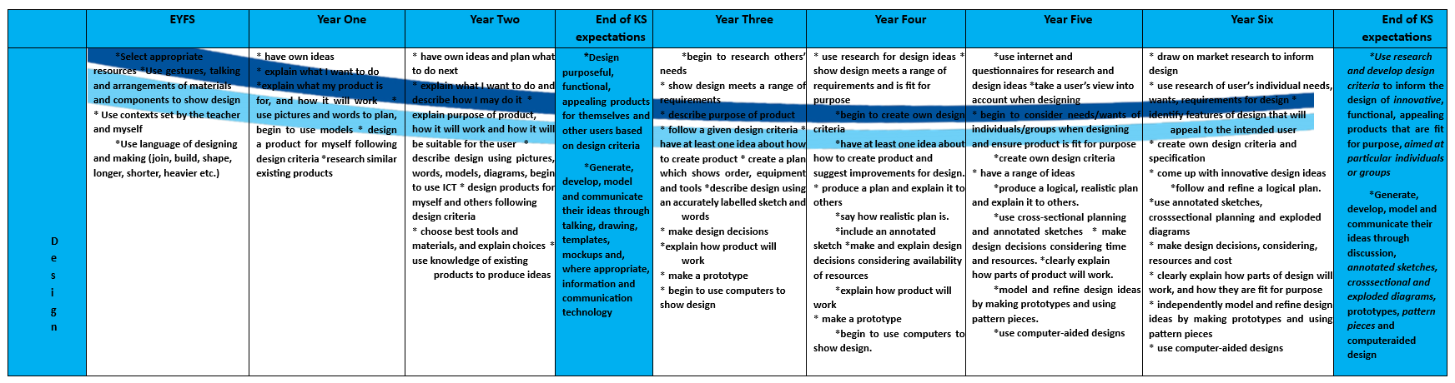
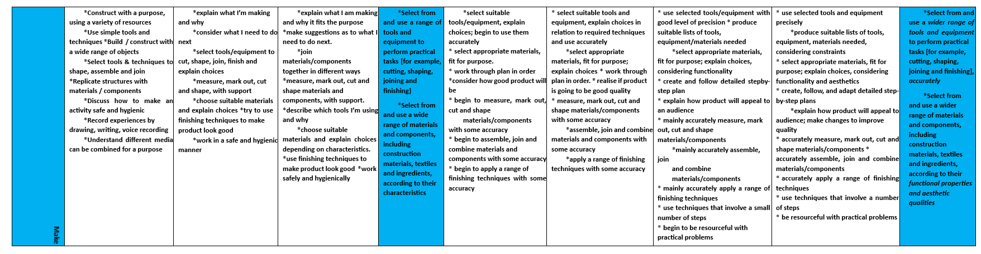
Curriculum offer

Slide 11
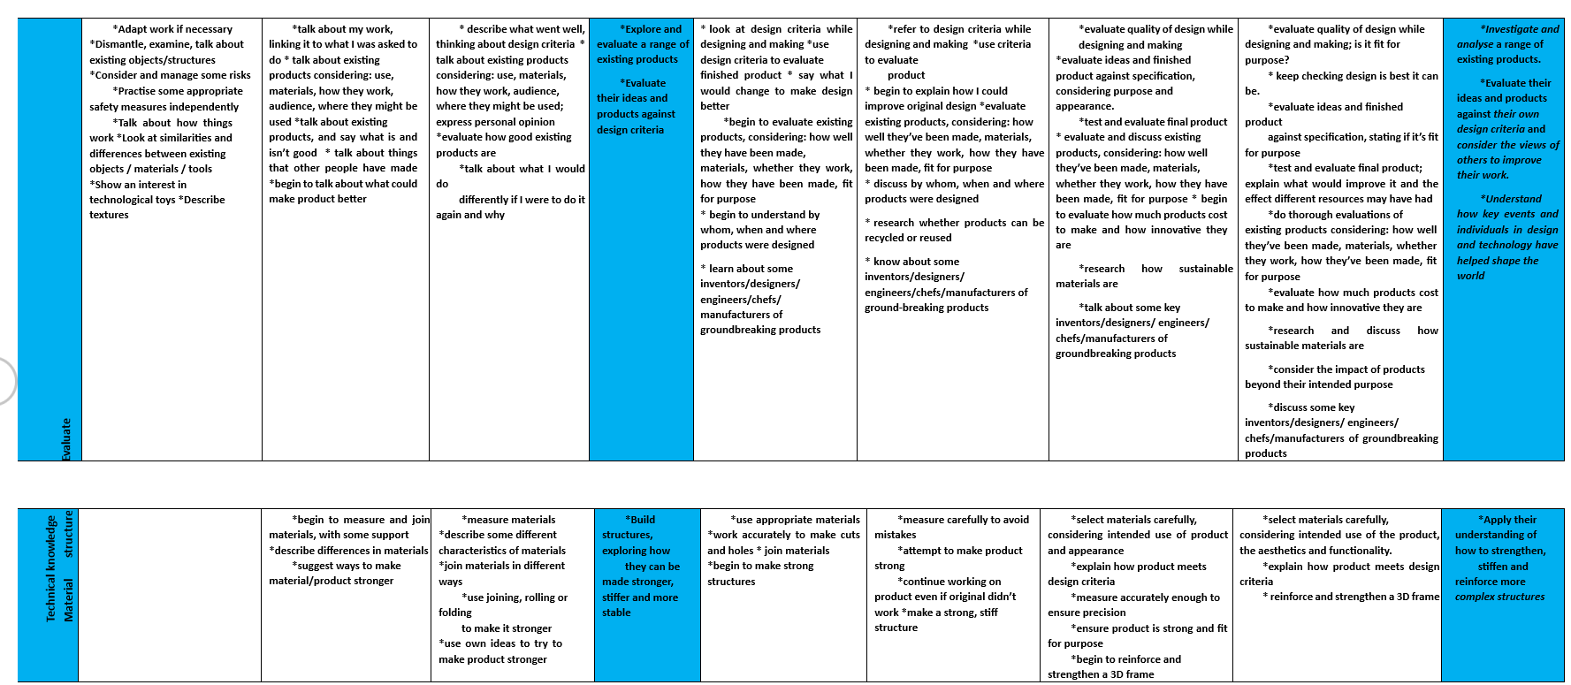

Slide 12
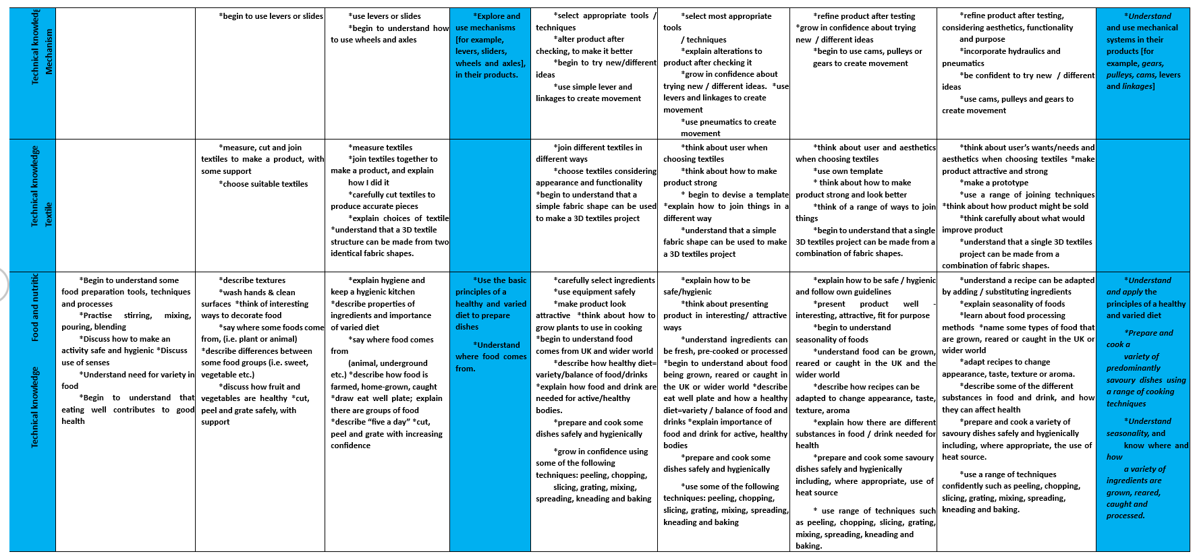
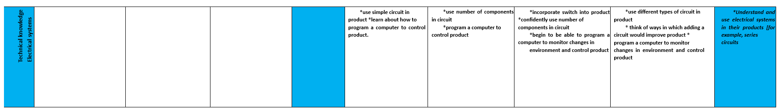

Slide 13
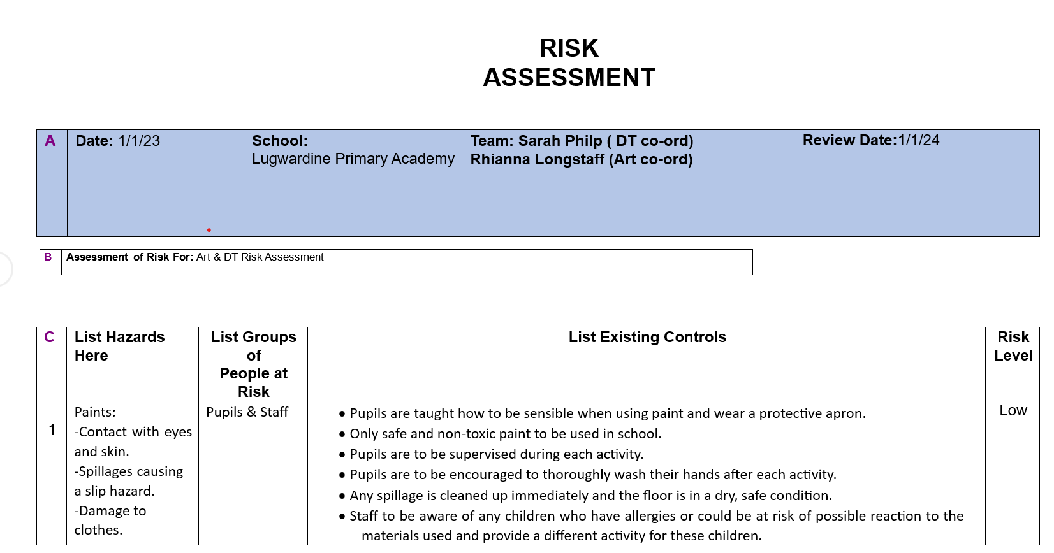
RISK ASSESSMENT
Subject specific risk assessments

Slide 14
